Slide 1
Hartle-Hawking
wave function and
large-scale power suppression of CMB
Dong-han Yeom
LeCosPA, National Taiwan University
2017. 7. 7.
Based on Chen, Lin and DY, 1707.01471

Slide 2
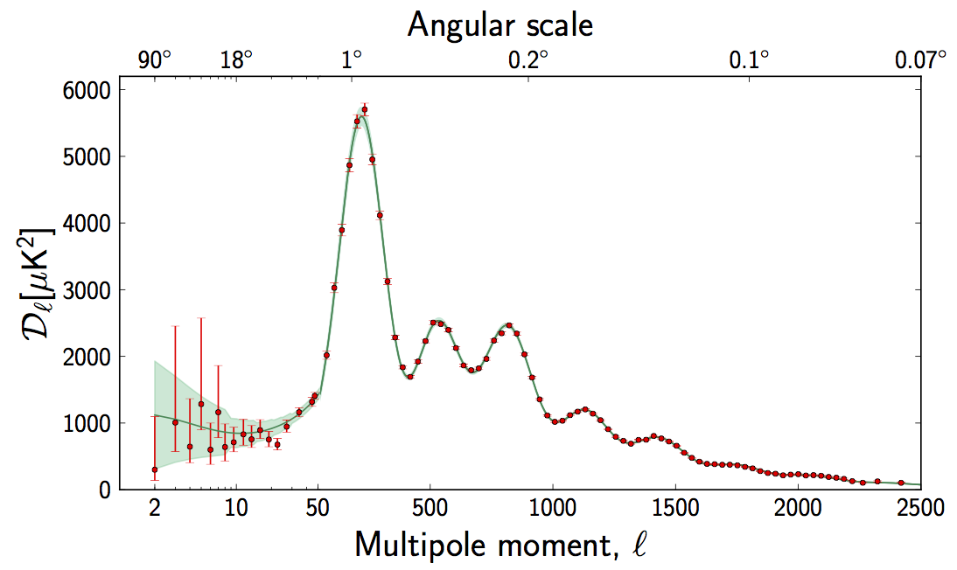
Success of inflation
Inflation + ΛCDM model is very successful!

Slide 3
Two problems
Initial singularity problem
Large-scale power suppression?

Slide 4
Two problems
Initial singularity problem
Large-scale power suppression?

Slide 5
Two ways for power suppression
: within GR + single field inflation
Chen and Lin, 1505.05980
Phantom matter (w < -1)
  → Where it comes?
Kinetic energy dominate era (w > 0)
  → Why such a quantum state?
... Both ideas look not satisfactory.

Slide 6
Two problems
Initial singularity problem
Large-scale power suppression?
Maybe, problems of quantum gravity?
e.g., Ashtekar and Barrau, 1504.07559

Slide 7
Can there be a connection?
Initial Singularity Problem
Large-scale Power Suppression Problem
Euclidean Quantum Gravity
?

Slide 8
CONTENTS
HH wave function and
large-scale power
suppression of CMB
I
Hartle-Hawking wave function
II
Halliwell-Hawking revisited
III
Large-scale power suppression

Slide 9
I
Hartle-Hawking wave function
Hartle and Hawking, 1983

Slide 10
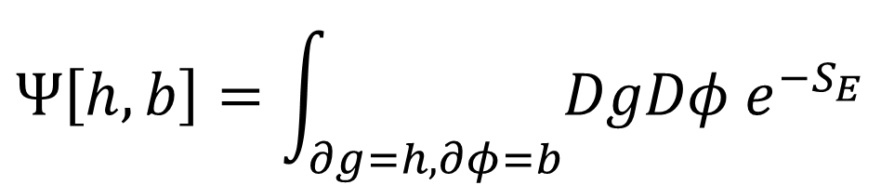
I
Hartle-Hawking wave function
Hartle and Hawking, 1983
$$Ψ\left[h,b\right]=\int_{∂g=h,∂φ=b}{DgDφ e^{−S_{E}}}$$

Slide 11
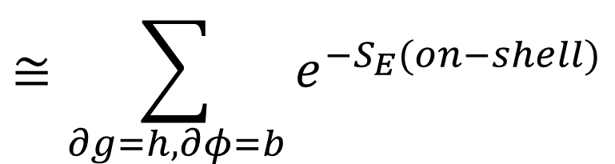
I
Hartle-Hawking wave function
Hartle and Hawking, 1983
$$Ψ\left[h,b\right]=\int_{∂g=h,∂φ=b}{DgDφ e^{−S_{E}}}$$
$$≅\sum_{∂g=h,∂φ=b}{e^{−S_{E}(on−shell)}}$$
L
E

Slide 12
Euclidean path integral approach
Action
Metric ansatz

Slide 13
Euclidean path integral approach
L
E
Euclidean on-shell solution

Slide 14
Euclidean path integral approach
L
Wick-rotation
E
Euclidean on-shell solution

Slide 15
Euclidean path integral approach
Lorentzian dS
L
Wick-rotation
E
Euclidean on-shell solution

Slide 16
II
Halliwell-Hawking revisited
Halliwell and Hawking, 1985
Laflamme, 1987

Slide 17
Halliwell-Hawking formalism
Perturbations

Slide 18
Halliwell-Hawking formalism
Evolution equations of mode functions

Slide 19
Halliwell-Hawking formalism
Wave function for each perturbation modes
Using this wave function, one can calculate the power spectrum

Slide 20
Choice of Euclidean vacuum
Laflamme’s Euclidean vacuum
Closed form of the power spectrum
(evaluated at the horizon crossing time)

Slide 21
dS instanton / Wick-rotated
L
E

Slide 22
Turn on perturbations
L
E
Must impose regularity
+
Laflamme’s Euclidean vacuum

Slide 23
Turn on perturbations + evolution
L
E

Slide 24
Turn on perturbations + evolution
+ Wick-rotation
Perturbations frozen
after horizon crossing
L
E

Slide 25
III
Large-scale power suppression
Chen, Lin and DY, 1707.01471

Slide 26
Scale-invariance for small scales
Scale invariance for small scales:
Bunch-Davies vacuum

Slide 27
Scale-invariance for small scales
Power enhanced for
large scales
e.g., Starobinsky, astro-ph/9603075
Scale invariance for small scales:
Bunch-Davies vacuum

Slide 28
Varying mass!

Slide 29
What does this mean?
The Euclidean path integral can explain the power suppression without ad hoc assumptions.
There would be several cautious problems.
  If our universe experienced more than 50 e-foldings, then the effects of instantons has nothing to do with power-suppression.
  The power-suppression requires a specific shape of the inflaton potential.

Slide 30
Future aspects
What about the Starobinsky model?
What about Euclidean wormholes?
Chen, Hu and DY, 1611.08468
Kang and DY, 1703.07746
Chen and DY, 1706.07784

Slide 31
Thank you

