Slide 1
Matter Equation of State in General Relativity
Hyeong-Chan Kim
(KNUT)
ICGAC-XIII & IK15 ,
Ewha Womans University, Seoul, Korea
July 03, 2017.
Based on Phys. Rev. D 95 (2017), H.K., Chueng Ji (NCSU).

Slide 2
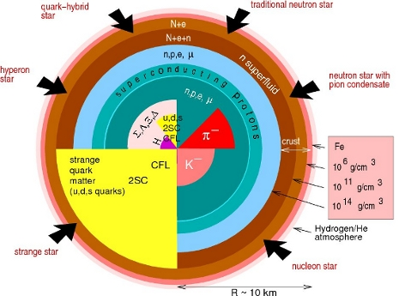

Equation of states obtained
in a flat spacetime are used!
Tiny volume→ Locality
Large enough number of particles
→ Statistical description in terms of density and pressure.

Slide 3
Equation of State in General Relativity
General Covariance:
Freely falling frame = locally flat
EoS in freely falling frame = EoS in flat ST
Scalar quantity
Density and pressure are scalar quantities.
Therefore, their values in other frame can be determined from
those in the locally orthonormal reference frame.
Then, why do we consider the gravity effect on EOS?

Slide 4

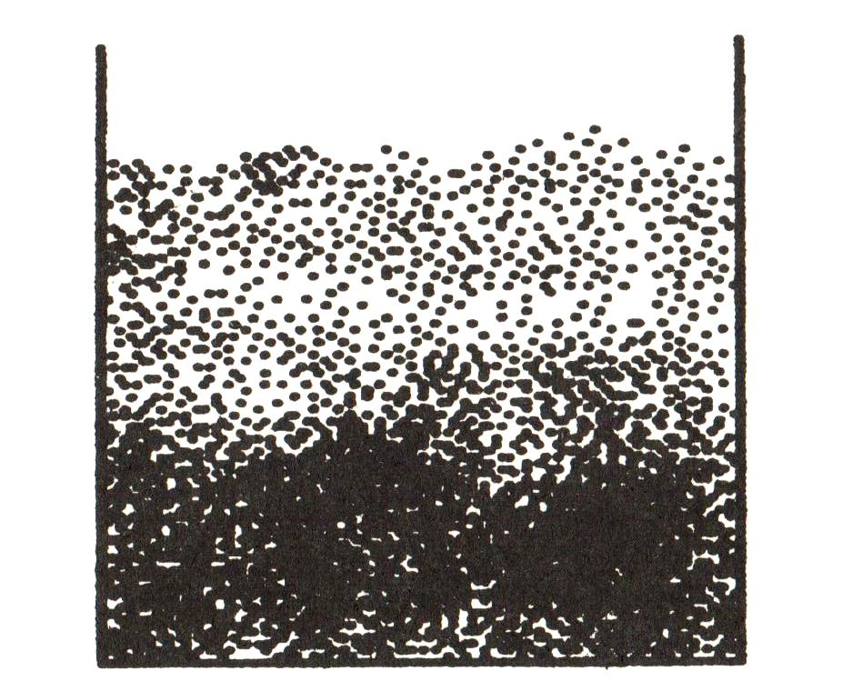
Statistics of a gas in a strong gravity
Statistical description requires :
g
g
g
Local description is allowed only when many enough particles are included in a box much smaller than its limiting value, L~ c²/g
is possible??
Effective local (statistical) description is inappropriate.
A strong gravity restricts the region of space where the statistical
description is possible.

Slide 5
Q: It appears genuine that strong gravity affects
on the distributions of matters.
Then, how about the Equation of State?

Slide 6
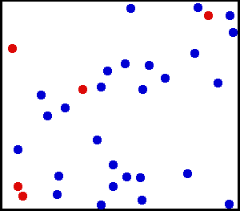
Two Equation of States for an ideal gas
EoS 1:
(Ideal gas law)
Adiabaticity dS = 0 :
EoS 2:
(Polytropic EoS)

Slide 7







Statistics in a Canonical Ensemble (Summary)
Basic principle:
The number of particles in unit phase volume is proportional to
Partition function:
Total energy and entropy:
Heat Capacity:
Number of ptls (normalized):

Slide 8





Ideal Gas in a Constant Gravity
z
A
Rindler spacetime:
g
Lagrangian for a particle:
Rindler horizon
Conjugate momentum:
Assume the gas does not gravitating, i.e., we ignore the self gravity.

Slide 9







One particle partition function
One particle Hamiltonian:
Four vector:
For a given energy, Momentum
space increases at z= - g⁻¹.
Separate volume from
gravity dependence
One particle partition function:
Thermal bath at a temperature

Slide 10

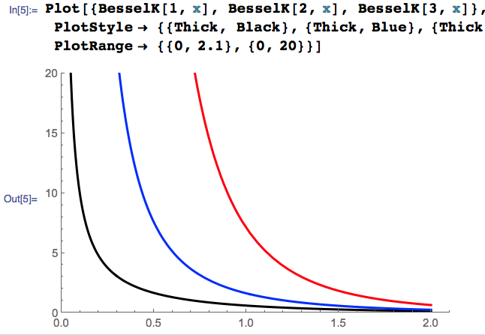
The gravity dependence of the partition function
Gravity dependence:

Slide 11





N-particle partition function
Partition function:
Number density in a unit phase volume:
Number density/Volume:
For
Most of particles will be gathered around the bottom of the box
In this case, the particles moves in an effective 2-dimensional space.

Slide 12
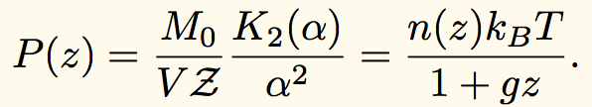

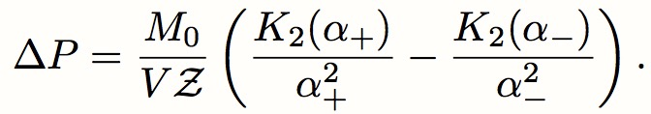

Energy density and pressure
Energy density:
Pressure:
Ideal gas law is satisfied locally
(not globally) by local temperature
Pressure difference:
Average Pressure:

Slide 13
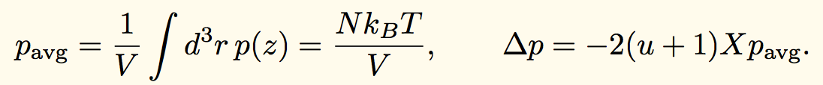
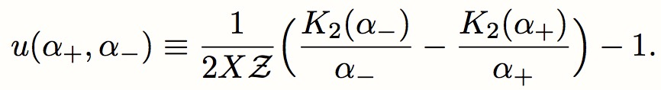
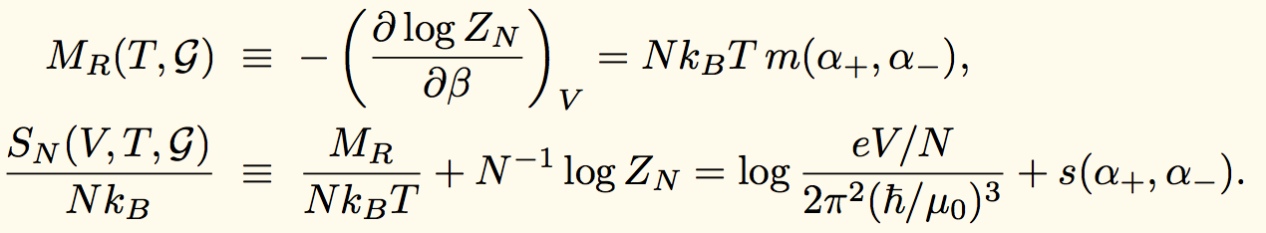
Total energy and Entropy:
Define pressure in Rindler frame:
Ideal gas law is satisfied on the whole system if one
define an average pressure for a Rindler spacetime.
The total energy and entropy in Rindler frame:

Slide 14

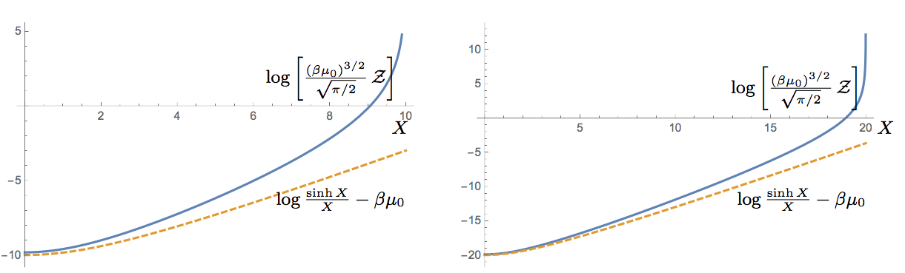

Newtonian regime:
Gravity should be small:
Rest mass term
Gravity correction
Exact
Exact
Newtonian
Newtonian
Special relativistic correction

Slide 15

Newtonian gravity limit, energy and entropy
U_{N} /Nk_{B}T
Internal energy:
X
✗
Entropy:
(X dep part of S_{N})/Nk_{B}
Entropy takes
negative values
for large gravity.
Mathematical artifact
of the canonical
ensemble.
Ordering effect of gravity
X

Slide 16

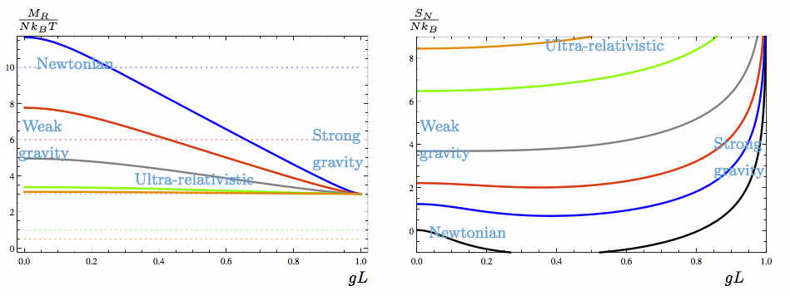

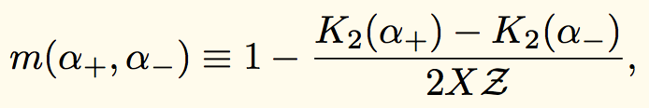

Total energy and Entropy in Rindler Spacetime
In the strong gravity region, physical quantities appear to have some
universality.
The energy is larger than 3Nk_{B}T always.

Slide 17
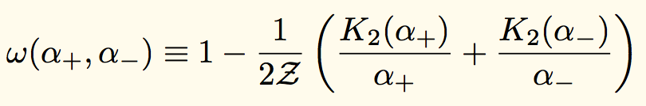
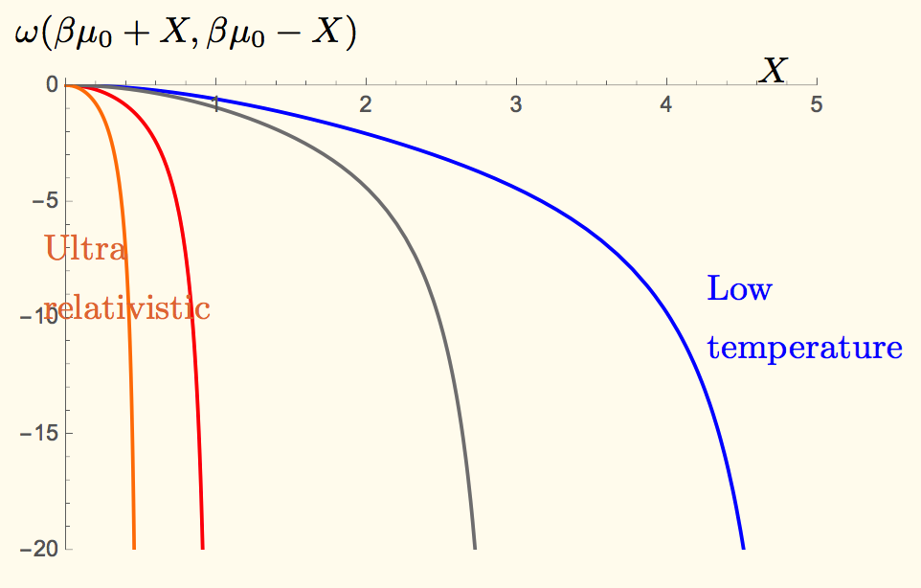
Gravitational potential:
Gravitational potential Energy:

Slide 18
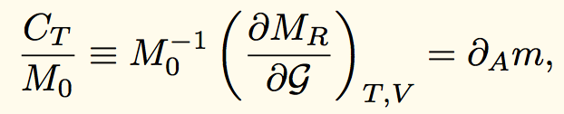
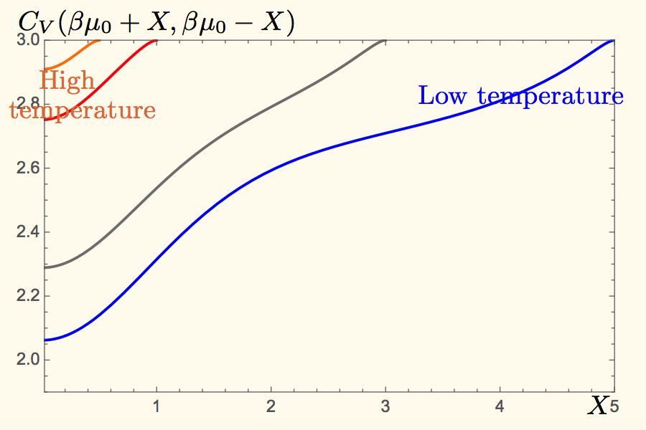
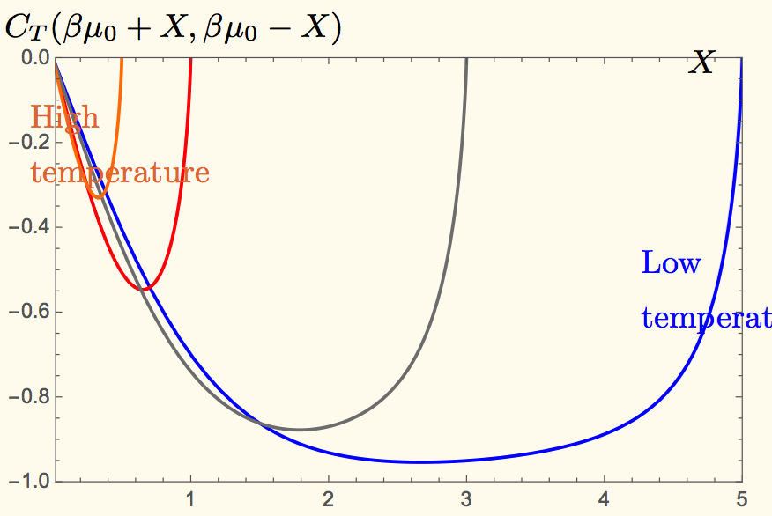
Two Energy Capacities:
Heat Capacity wrt temperature change and
Energy Capacity wrt gravity change:

Slide 19

Strong gravity regime:
Parameterize the distance from the event horizon as
Radiation?
Area
proportionality

Slide 20



Thermodynamic first law
Differentiating the definition of entropy:
Differentiating the partition function:
Combining the two, we get the first law:
Gravitational
potential energy

Slide 21




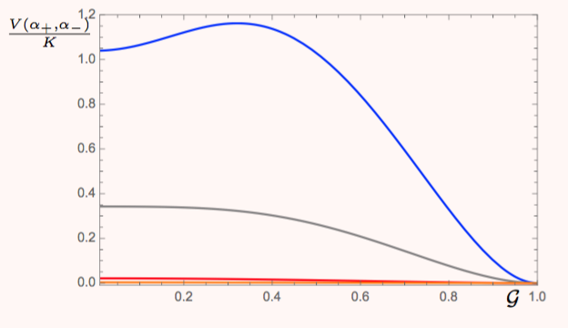

Equation of state for an adiabatic system
From the first law with dS=0,
From the definition of Heat capacities:
Combining the two, we get:
Integrating:
Universal feature?
5
3
1
1/2

Slide 22






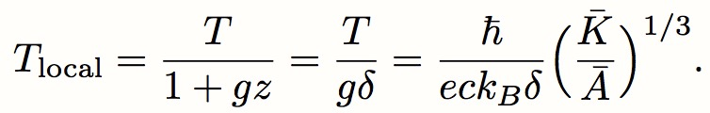
Behaviors of the adiabatic Equation of state
Newtonian gravity limit:
Reproduce the Newtonian result.
Strong gravity limit:
Unruh temperature?
At present, we cannot determine the dimensionless part.
Local temperature:

Slide 23
Originally, Unruh temperature comes from quantum mechanical
radiation from Rindler horizon.
The classical Fulling-Davies-Unruh effect (Higuchi et.al., 93).
Unruh temperature from classical statistics near horizon system
(But outside the horizon).
~ The situation is similar to the case of the classical blackhole
dynamics of Bardeen-Carter-Hawking(73).
~ Can quantum(?) treatment determine the coefficient?
Q: Is there,
anything to say on a blackhole formation?
implication to information paradox?

Slide 24
Fundamental Limits of the present approach
The (background) curvature effect is ignored.
→ The curvature effect should be considered. (as talked by V. Frolov)
The energy density at the bottom of the box will be large. Then, the size of the curvature increase.
→ Self gravity should be considered.
The present work deals classical ideal gas.
→ Quantum statistics can be introduced.
Deals only static system.
→ When the system is dynamical?

Slide 25
Thanks, All Participants.

