Slide 1
Possible Experiments for Frequency Dependence of Light Deflection in Yang-Mills Gravity
Yun Hao, Yiyi Zhu and Jong-Ping Hsu
Department of Physics
University of Massachusetts Dartmouth,
Massachusetts, USA

Slide 2
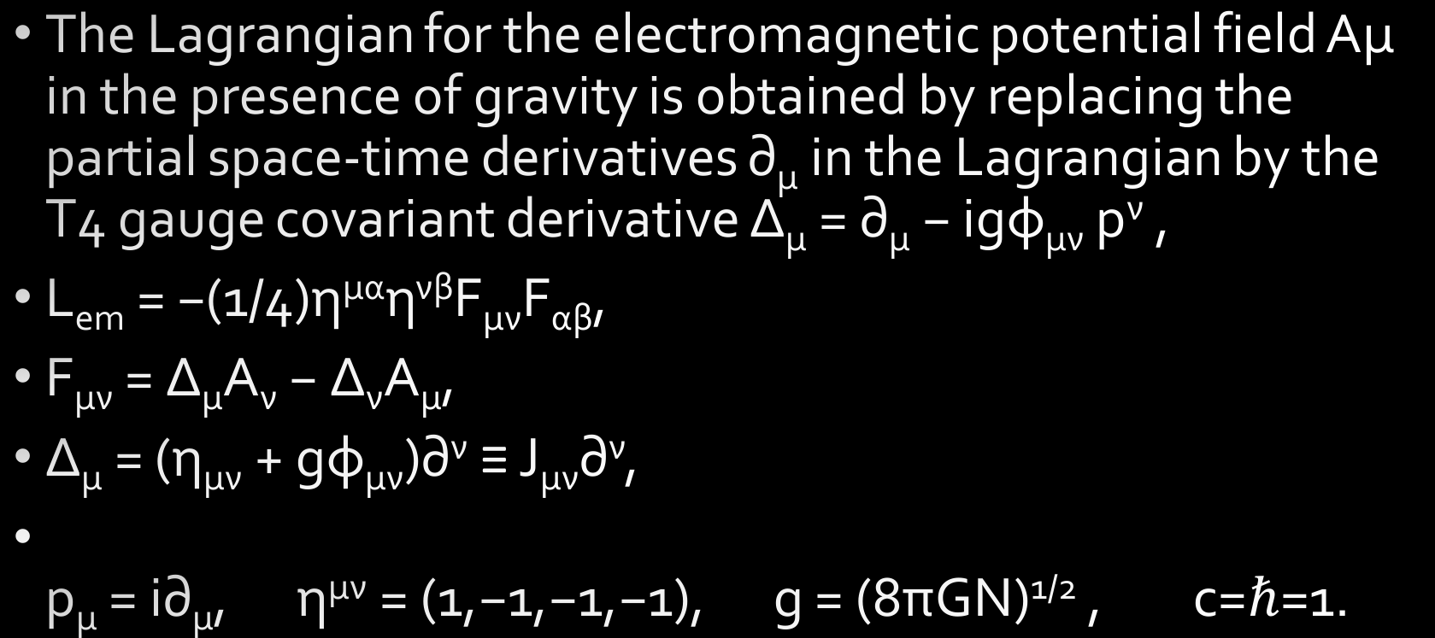
Yang-Mills gravity is a gauge theory with the translational T4 group in flat space- time and is consistent with experiments.
The Lagrangian for the electromagnetic potential field Aμ in the presence of gravity is obtained by replacing the partial space-time derivatives ∂_{μ} in the Lagrangian by the T4 gauge covariant derivative ∆_{μ} = ∂_{μ} − igφ_{μν} p^{ν} ,
L_{em} = −(1/4)η^{μα}η^{νβ}F_{μν}F_{αβ},
F_{μν} = ∆_{μ}A_{ν} − ∆_{ν}A_{μ},
∆_{μ} = (η_{μν} + gφ_{μν})∂^{ν} ≡ J_{μν}∂^{ν},
p_{μ} = i∂_{μ}, η^{μν} = (1,−1,−1,−1), g = (8πGN)^{1/2} , c=$ℏ$=1.

Slide 3
The modified Maxwell’s wave equations by (Yang-Mills) gravity are
∂_{μ}(J_{α}^{μ}F^{αν}) = 0,
For the geometric-optics limit, we use the usual limiting expression (Landau & Lifshitz, The Classical Theory of….)
A_{μ} = a_{μ}e^{iΨ(x)}, a_{μ} = ε_{μ}(k, λ)=polarization vector,
where the eikonal ψ and the wave vector ∂_{μ}ψ = k_{μ} are large in the geometric-optics limit.

Slide 4
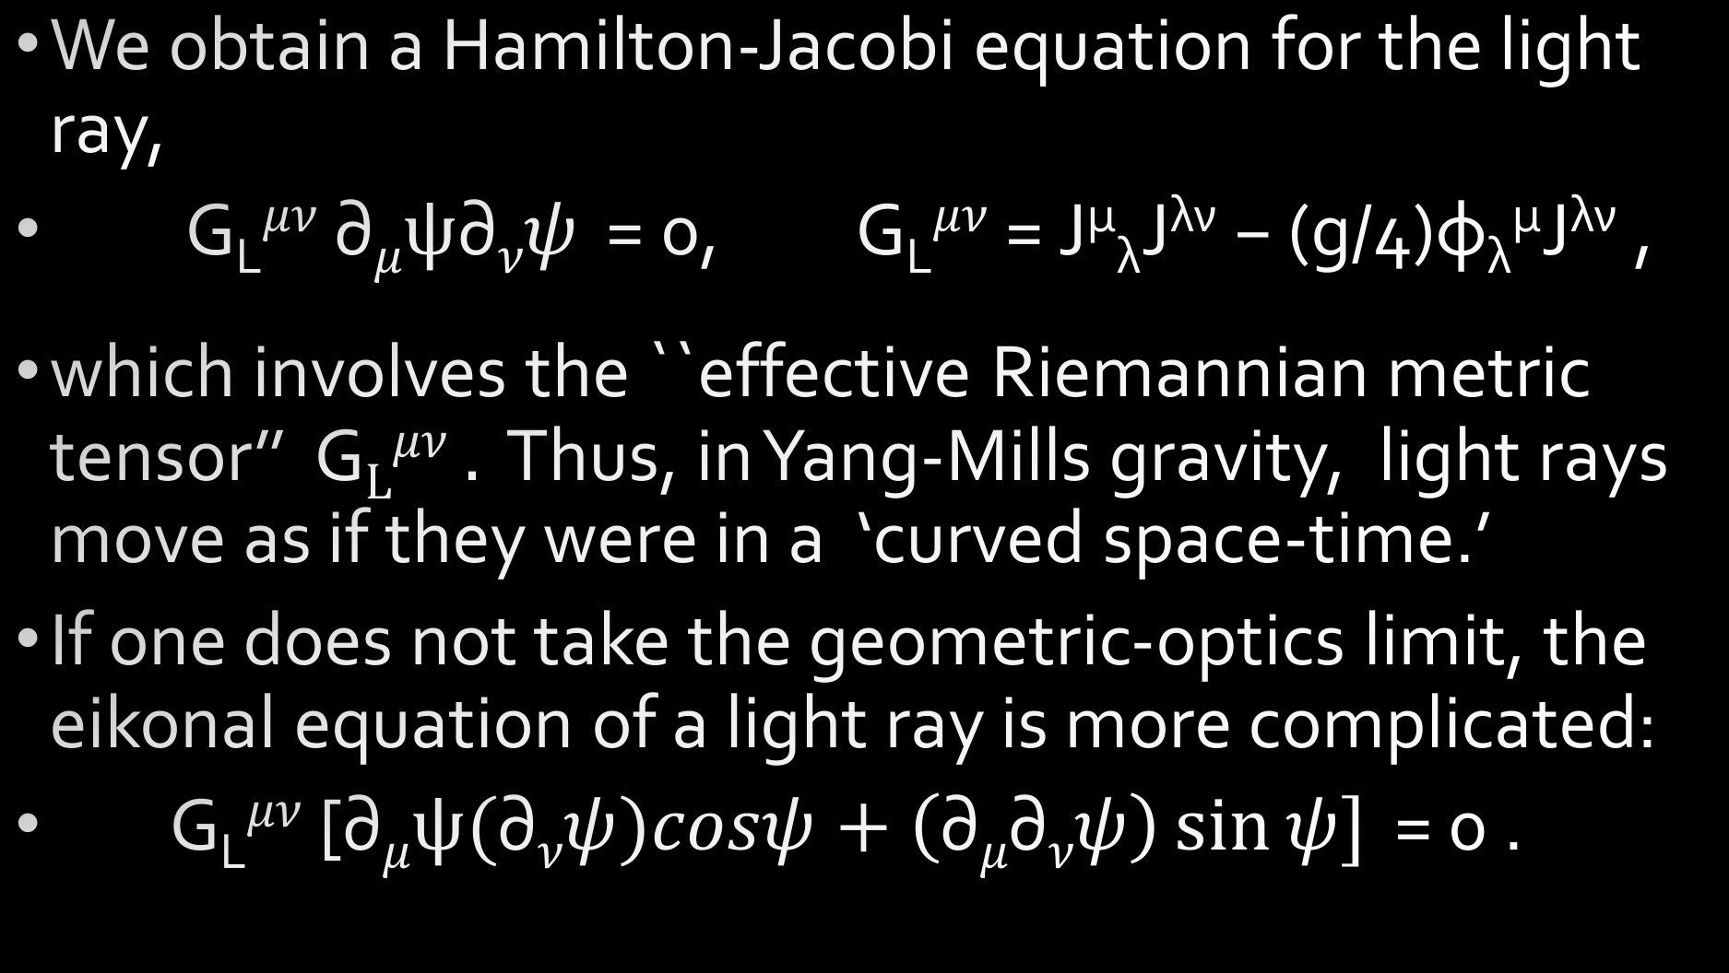
We obtain a Hamilton-Jacobi equation for the light ray,
G_{L}$μν$ $\text{∂}μψ\text{∂}νψ$ = 0, G_{L}$μν$ = J^{μ}_{λ}J^{λν} − (g/4)φ_{λ}^{μ}J^{λν} ,
which involves the ``effective Riemannian metric tensor’’ G$Lμν$ $.$ Thus, in Yang-Mills gravity, light rays move as if they were in a ‘curved space-time.’
If one does not take the geometric-optics limit, the eikonal equation of a light ray is more complicated:
G_{L}$μν$ [$\text{∂}μψ\text{(}\text{∂}νψ)cosψ+\left(\text{∂}μ\text{∂}νψ\right)\sin{ψ}]$ = 0 .

Slide 5
This more complicated eikonal equation suggests that the angle of light deflection by the sun is frequency dependent.
As usual, one may consider the optical frequency range can be approximated as the geometric-optics limit. We find that the deflection angle of a light ray by the sun is about 1.53”, which is roughly 12 % smaller than the value 1.75” in general relativity. However, the experimental data for the bending of light by the sun in optical frequencies have large uncertainties 10-20% due to large systematic errors.

Slide 6
The experiments with a ray in the radio frequencies have a much better accuracy. However, they cannot be used to test the prediction of Yang-Mills gravity in the geometric limit.
We suggest that Yang-Mills gravity could be tested by detecting possible frequency-dependent of the deflection angle.

Slide 7
All recent accurate measurements of the light deflection angle by the sun are carried out in the radio frequency ~ 10⁹ Hz.
We suggest that one carries out a new measurement in the frequency ~ 10¹² Hz with an accuracy of about 0.1 %, which is technically possible.
Such an experiment could test a new frequency-dependence (qualitatively) of the light deflection angle predicted by Yang-Mills gravity.

