Slide 1
Effective-One-body BBH construction for Numerical Relativity BBH Initial data
Hangil choi
Seoul National university
Icgac-xiii&IK15
july 04, 2017

Slide 2
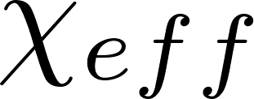
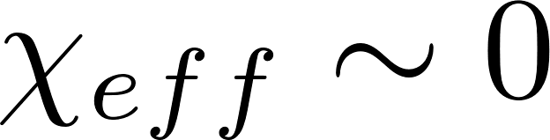
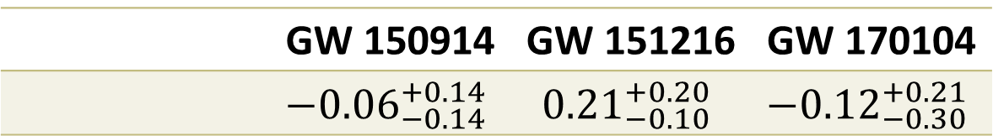
Motivation
Needs of Precessing BBH model
Abbott et al. (2017)
 | GW 150914 | GW 151216 | GW 170104
 | $${−0.06}_{−0.14}^{+0.14}$$ | $${0.21}_{−0.10}^{+0.20}$$ | $${−0.12}_{−0.30}^{+0.21}$$
: Effective inspiral spin.
Non-trivial spin directions
Precessing BBH model is essential for GW analysis!

Slide 3
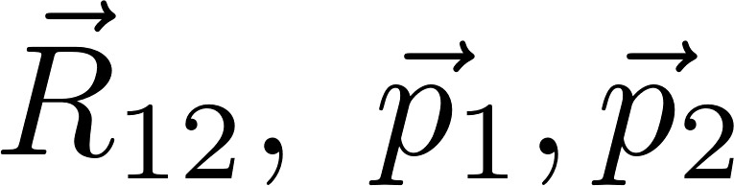
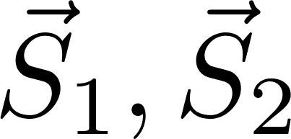
Motivation
BBH Models
Approximation
  Post-Newtonian formalism
  Effective-One-Body formalism
Full General Relativity
  Numerical Relativity
Ultimate Goal!
Initial data
BBH space-time

Slide 4
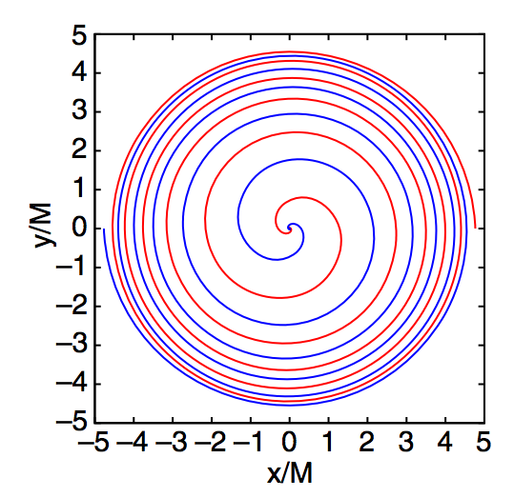
Motivation
Quasi-Circular(Spherical) Orbit
Orbit of BBH near merger
  Due to GW emission
  (Peters (1963))
Quasi-Circular initial data
  Husa (2008), Tichy (2011), Healy (2017) - PN
  Pürrer (2012) – EOB
Motivation of EOB model construction
Ruchlin (2017)

Slide 5
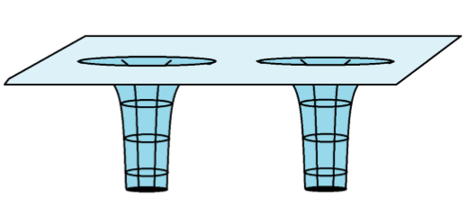
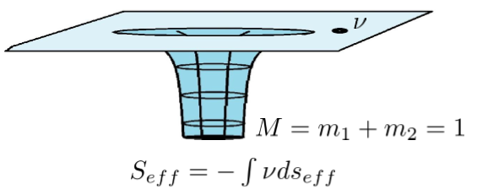
Effective One Body Formalism
Effective One Body Model
BBH
Test particle + Curved metric
Buonanno (1999)

Slide 6
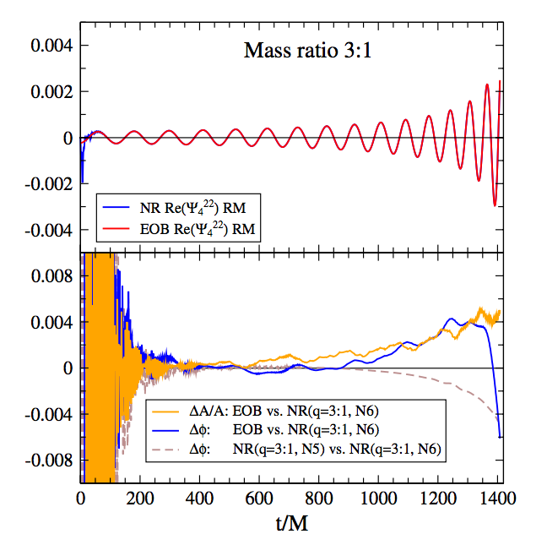
Effective One Body Formalism
Effective One Body Model
Equation of motion – ODE
  Fast calculation
Good approximation
  Even near merger
Buonanno (2009)

Slide 7
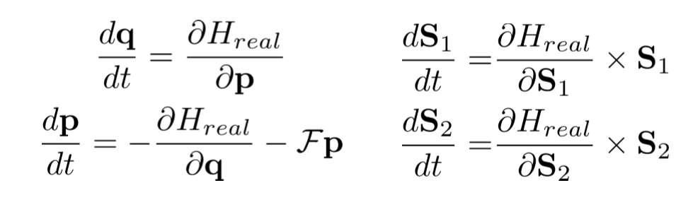

Effective One Body Formalism
Effective One Body Model
Hamiltonian of test mass
Specific form : SEOBNRv4 (Bohé (2017))
Hamiltonian equation of motion

Slide 8
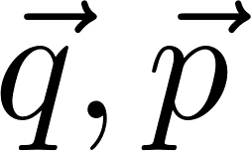
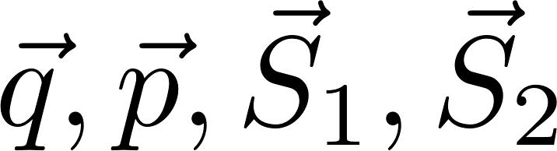
EOB construction
Difficulties in memory management
Too many dynamic variables
6 dim
Aligned/Anti-Aligned BBH
12 dim
General BBH
Equation of motions are too heavy!
  I could not run a integration code on my PC(16 GB memory).

Slide 9
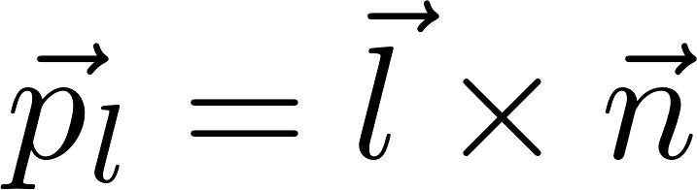
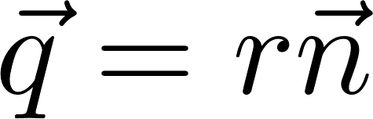
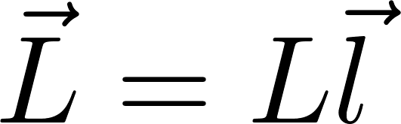
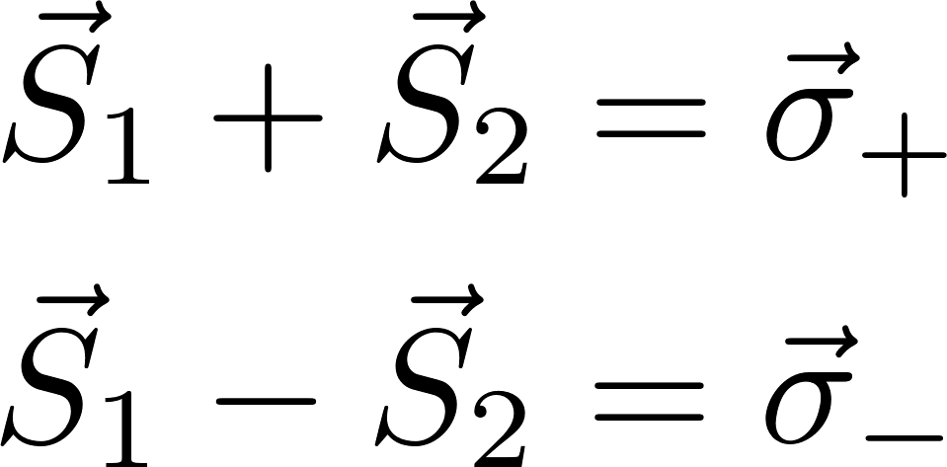
EOB construction
Change of variables
Cartesian basis to Orthonormal triad
Change of spin variables

Slide 10
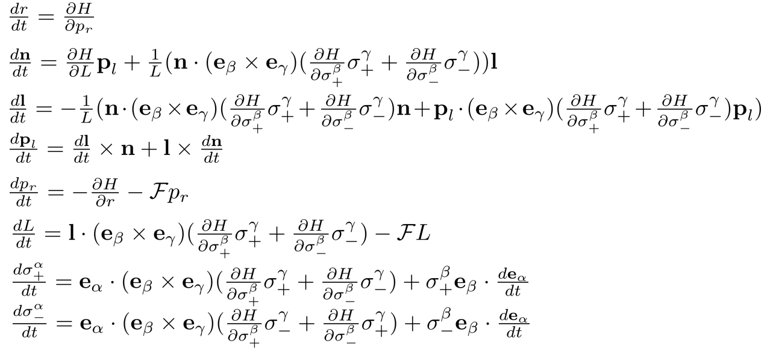
EOB construction
New equation of motion
18 dim
Each terms are simpler then it were in cartesian.

Slide 11
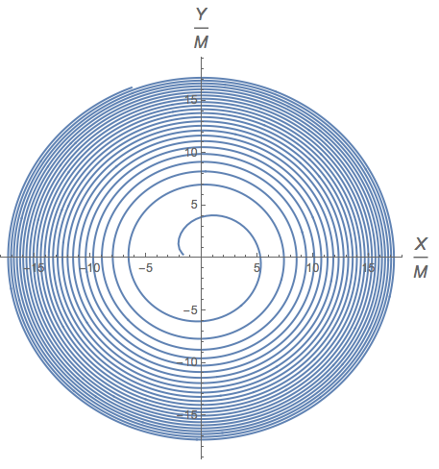
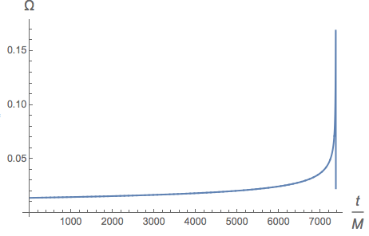
EOB results
Non-spinning BBH mass ratio m₁/m₂=2

Slide 12
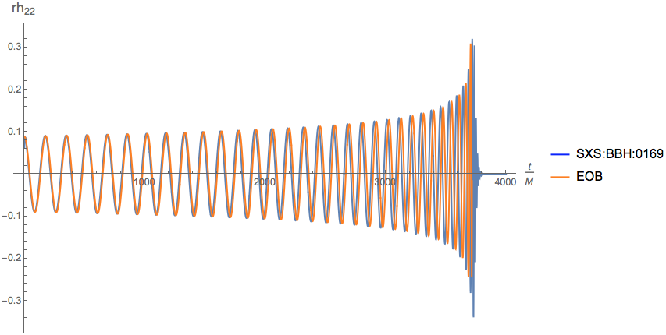
EOB results
Non-spinning BBH mass ratio m₁/m₂=2

Slide 13
Future works
Verifying existence of Innermost Stable Circular Orbit(ISCO) for any (anti)aligned spin parameters
Comparison with NR waveform
Applying Pürrer’s method for NR BBH
To confirm accuracy
Thank You!

