Slide 1


Generalized quasi-Keplerian parametrization for compact binaries in hyperbolic orbits
Gihyuk Cho (SNU)
Collaborate with H.M. Lee (SNU), Achamveedu Gopakumar (TIFR)
The conference ICGAC13-IK15 on Gravitation
2017.07.04

Slide 2
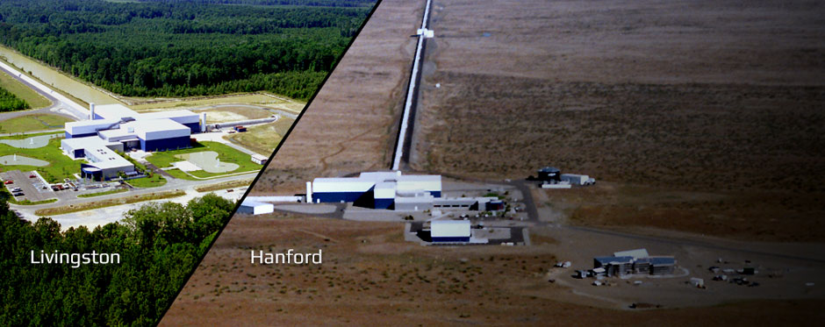
1
Motivation

Slide 3
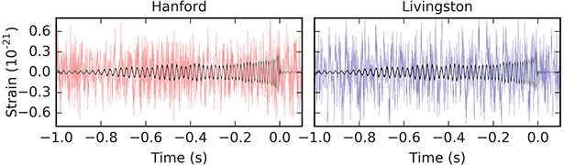


1
Motivation
$$(\left|h\right|<|n|)$$
$$s\left(t\right)=h\left(t\right)+n(t)$$
in general

Slide 4
1
Motivation
$$(\left|h\right|<|n|)$$
$$s\left(t\right)=h\left(t\right)+n(t)$$
in general
Go outside
Detection characterization
Matched Filtering

Slide 5
1
Motivation
$$(\left|h\right|<|n|)$$
$$s\left(t\right)=h\left(t\right)+n(t)$$
in general
To have more reliable Detection
We need more accurate Pre-knowledge
Go outside
Detection characterization
Matched Filtering

Slide 6
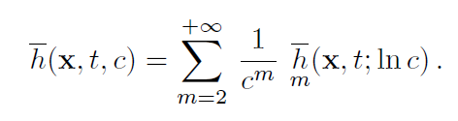
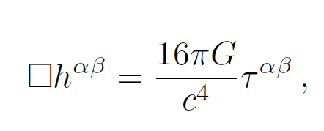
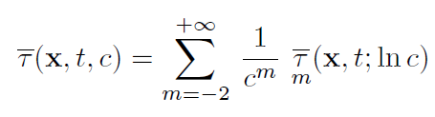

2
Analytic Methodology
Post-Newtonian theory
: Expand the Einstein field equation around $\frac{1}{c}\sim 0.$
2. Gravitational self force theory
3. Blackhole perturbation theory
Blanchet (2014)
The relaxed Einstein’s field equation

Slide 7
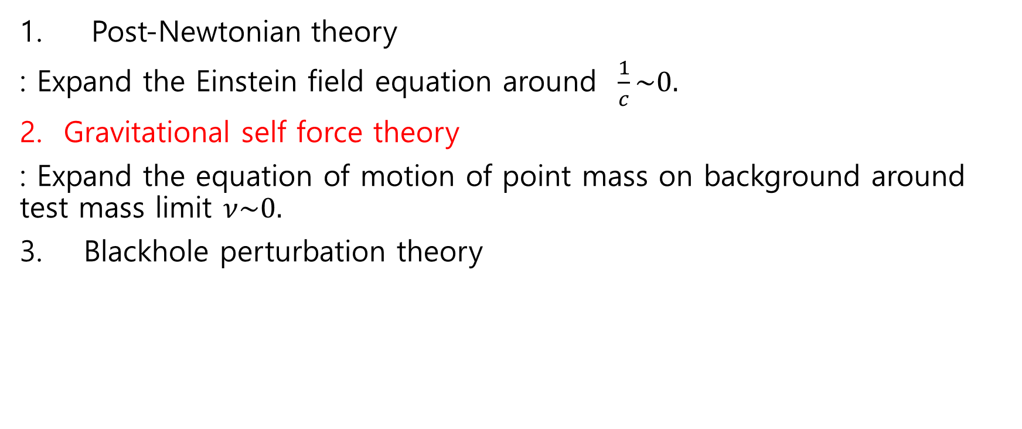
2
Analytic Methodology
Post-Newtonian theory
: Expand the Einstein field equation around $\frac{1}{c}\sim 0.$
Gravitational self force theory
: Expand the equation of motion of point mass on background around test mass limit $ν\sim 0.$
3. Blackhole perturbation theory

Slide 8
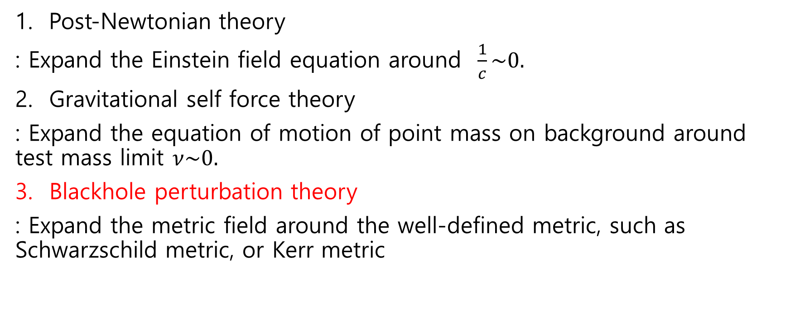
2
Analytic Methodology
1. Post-Newtonian theory
: Expand the Einstein field equation around $\frac{1}{c}\sim 0.$
Gravitational self force theory
: Expand the equation of motion of point mass on background around test mass limit $ν\sim 0.$
Blackhole perturbation theory
: Expand the metric field around the well-defined metric, such as Schwarzschild metric, or Kerr metric

Slide 9
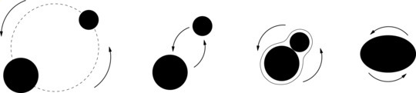
3 Bounded case
Inspiral-Merger-Ringdown phase

Slide 10
3 Bounded case
Inspiral-Merger-Ringdown phase
Post-Newtonian Theory
Numerical Relativity
Blackhole perturbation theory

Slide 11

4 Unbounded case
3.5PN accurate dynamics of Compact Binary
We have well-established 3.5PN Post-Newtonian equation of motion..
$$\vec{a}={\vec{a}}_{N}+{\frac{1}{c}\vec{a}}_{1}+\frac{1}{c^{2}}{\vec{a}}_{2}+\frac{1}{c^{3}}{\vec{a}}_{3}+\frac{1}{c^{4}}{\vec{a}}_{4}+\frac{1}{c^{5}}{\vec{a}}_{5}+\frac{1}{c^{6}}{\vec{a}}_{6}+\frac{1}{c^{7}}{\vec{a}}_{7}$$

Slide 12

4 Unbounded case
3.5PN accurate dynamics of Compact Binary
We have well-established 3.5PN Post-Newtonian equation of motion..
$$\vec{a}(\vec{v},\vec{r})={\vec{a}}_{N}+{\frac{1}{c}\vec{a}}_{1}+\frac{1}{c^{2}}{\vec{a}}_{2}+\frac{1}{c^{3}}{\vec{a}}_{3}+\frac{1}{c^{4}}{\vec{a}}_{4}+\frac{1}{c^{5}}{\vec{a}}_{5}+\frac{1}{c^{6}}{\vec{a}}_{6}+\frac{1}{c^{7}}{\vec{a}}_{7}$$
Vanishing!

Slide 13

4 Unbounded case
3.5PN accurate dynamics of Compact Binary
We have well-established 3.5PN Post-Newtonian equation of motion..
$$\vec{a}={\vec{a}}_{N}+\frac{1}{c^{2}}{\vec{a}}_{2}+\frac{1}{c^{4}}{\vec{a}}_{4}+\frac{1}{c^{5}}{\vec{a}}_{5}+\frac{1}{c^{6}}{\vec{a}}_{6}+\frac{1}{c^{7}}{\vec{a}}_{7}$$
Ignore Them!

Slide 14

4 Unbounded case
3.5PN accurate dynamics of Compact Binary
We have well-established 3.5PN Post-Newtonian equation of motion..
$$\vec{a}={\vec{a}}_{N}+\frac{1}{c^{2}}{\vec{a}}_{2}+\frac{1}{c^{4}}{\vec{a}}_{4}+\frac{1}{c^{6}}{\vec{a}}_{6}$$
Extremely Complicated

Slide 15

4 Unbounded case
Generalized quasi-Keplerian parametrization
$$r−r_{0}=a_{r}(e_{r}\cosh{u}−1)$$
$$φ−φ_{0}=\frac{Φ}{2π}(ν+f_{φ}\sin{2ν}+g_{φ}\sin{3ν}+h_{φ}\sin{4ν}+i_{φ}\sin{5ν})$$
$$t−t_{0}=\frac{P}{2π}(e_{t}\sinh{u}−u+f_{t}ν+g_{t}\sin{ν}+h_{t}\sin{2ν}+i_{t}\sin{3ν})$$
$$ν=2arctan(\sqrt{\frac{e_{φ}+1}{e_{φ}−1 }}tanh(\frac{u}{2}))$$

Slide 16

4 Unbounded case
Generalized quasi-Keplerian parametrization
$$r−r_{0}=a_{r}(e_{r}\cosh{u}−1)$$
$$φ−φ_{0}=\frac{Φ}{2π}(ν+f_{φ}\sin{2ν}+g_{φ}\sin{3ν}+h_{φ}\sin{4ν}+i_{φ}\sin{5ν})$$
$$t−t_{0}=\frac{P}{2π}(e_{t}\sinh{u}−u+f_{t}ν+g_{t}\sin{ν}+h_{t}\sin{2ν}+i_{t}\sin{3ν})$$
$$ν=2arctan(\sqrt{\frac{e_{φ}+1}{e_{φ}−1 }}tanh(\frac{u}{2}))$$

Slide 17

4 Unbounded case
Generalized quasi-Keplerian parametrization
$$r−r_{0}=a_{r}(e_{r}\cosh{u}−1)$$
$$φ−φ_{0}=\frac{Φ}{2π}(ν+f_{φ}\sin{2ν}+g_{φ}\sin{3ν}+h_{φ}\sin{4ν}+i_{φ}\sin{5ν})$$
$$t−t_{0}=\frac{P}{2π}(e_{t}\sinh{u}−u+f_{t}ν+g_{t}\sin{ν}+h_{t}\sin{2ν}+i_{t}\sin{3ν})$$
$$ν=2arctan(\sqrt{\frac{e_{φ}+1}{e_{φ}−1 }}tanh(\frac{u}{2}))$$

Slide 18

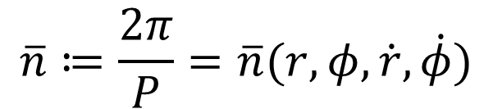
4 Unbounded case
Incorporating the Radiation Reaction
$$\overline{n}≔\frac{2π}{P}=\overline{n}(r,φ,\dot{r}, \dot{φ})$$
$$e_{t}=e_{t} (r,φ,\dot{r}, \dot{φ})$$

Slide 19
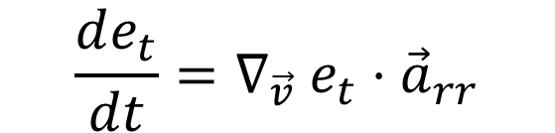
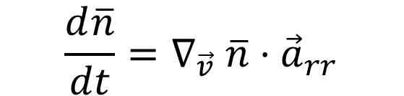
4 Unbounded case
Incorporating the Radiation Reaction
$$\overline{n}≔\frac{2π}{P}=\overline{n}(r,φ,\dot{r}, \dot{φ})$$
$$\frac{d\overline{n}}{dt}=∇_{\vec{v}} \overline{n}⋅{\vec{a}}_{rr}$$
$$e_{t}=e_{t} (r,φ,\dot{r}, \dot{φ})$$
$$\frac{de_{t}}{dt}=∇_{\vec{v}} e_{t}⋅{\vec{a}}_{rr}$$

Slide 20


4 Unbounded case
Incorporating the Radiation Reaction
$$\overline{n}≔\frac{2π}{P}=\overline{n}(r,φ,\dot{r}, \dot{φ})$$
$$\frac{d\overline{n}}{dt}=∇_{\vec{v}} \overline{n}⋅{\vec{a}}_{rr}$$
$$\overline{n}(t)$$
$$e_{t}=e_{t} (r,φ,\dot{r}, \dot{φ})$$
$$\frac{de_{t}}{dt}=∇_{\vec{v}} e_{t}⋅{\vec{a}}_{rr}$$
$$e_{t}(t)$$

Slide 21
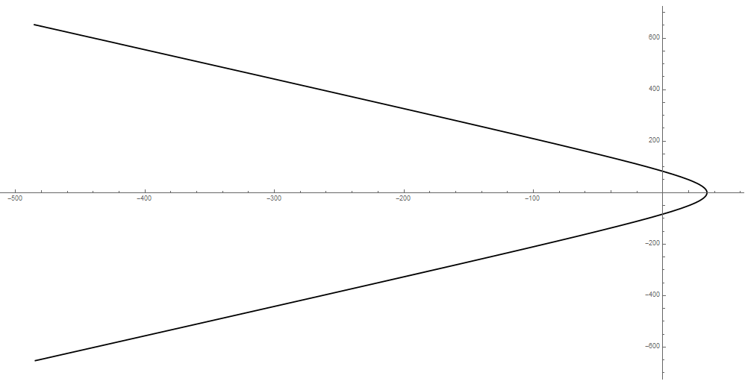
Energy : 0.01
Angular Momentum : 10

Slide 22
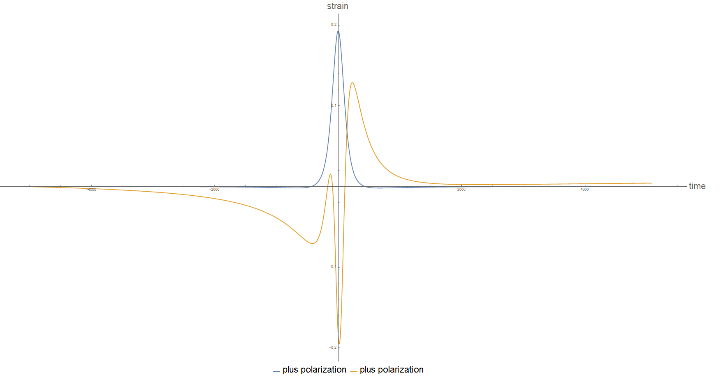
Energy : 0.01
Angular Momentum : 10

Slide 23
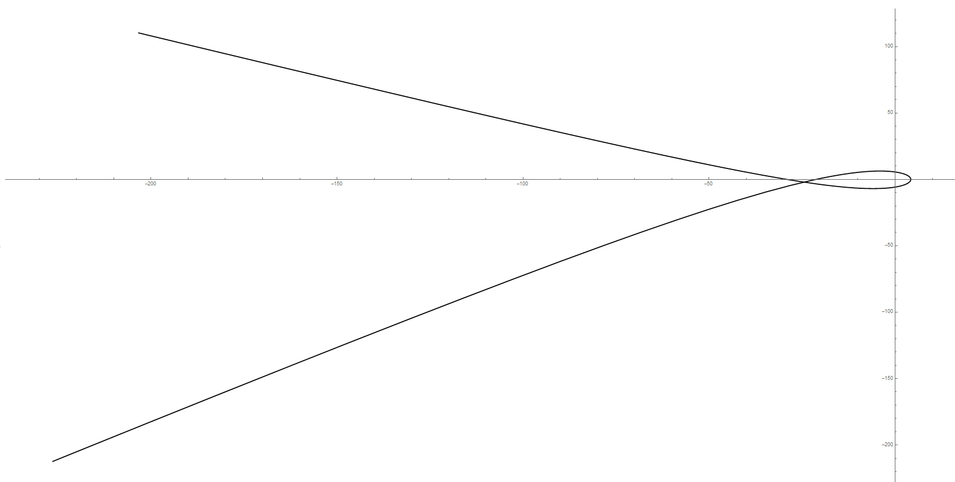
Energy : 0.01
Angular Momentum : 4

Slide 24
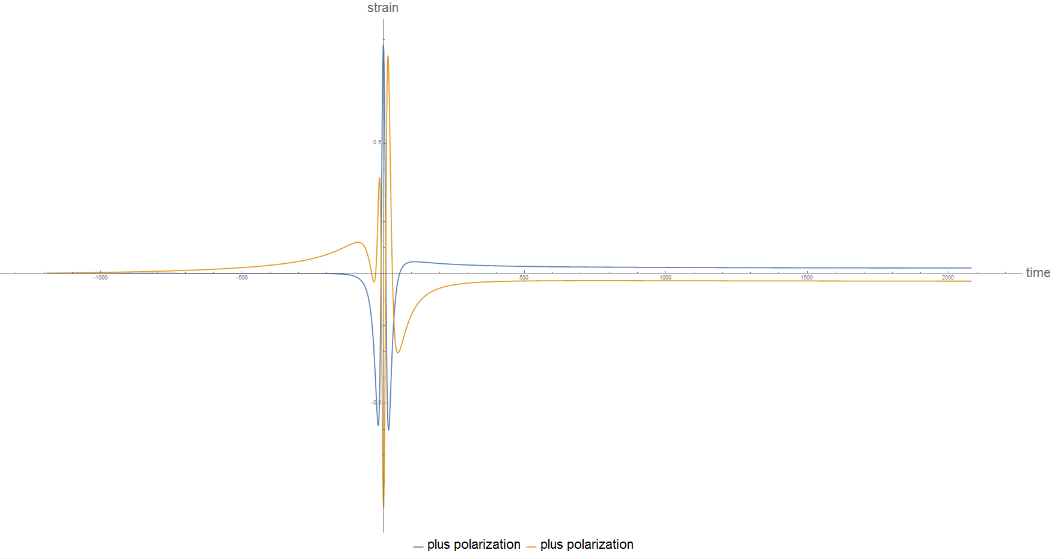
Energy : 0.01
Angular Momentum :4
Non-oscillating and Persisting Effect
: Linear Memory Effect
: Soft bremsstrahlung
: SSB of BMS super-translation

Slide 25
4 Unbounded case
Ongoing projects on Hyperbolic case
Computation of tail effect
(Yannick(UZH), Gopakumar(TIFR), Cho(SNU))
2. Preparing future usages for Data analysis
(Shubhanshu Tiwari(INFN), Gopakumar(TIFR),Cho(SNU)
3. More accurate Capturing process

Slide 26
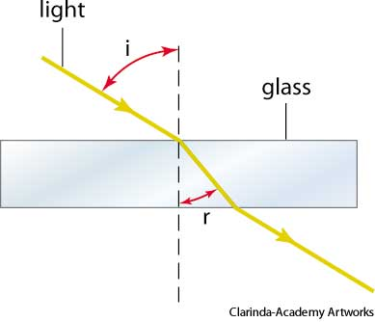
5
Non-Local effect at 4PN order
Hyperbolicity : Finite Speed of propagation
Non Linearity : Graviton-Graviton interaction
Speed of propagation slower than speed of light

Slide 27

5
Non-Local effect at 4PN order
Future
past
Gravitational Interaction with yourself in the past.

Slide 28
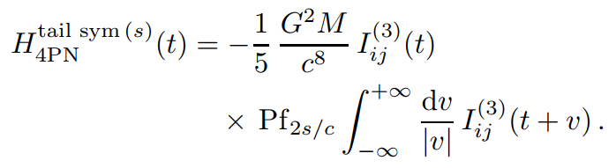
5
Non-Local effect at 4PN order
Damour, Jaranowski, Schafer (2014)

Slide 29
6
Spin dynamics
Spin effects in the phasing of gravitational waves from binaries on eccentric orbit. (Antoine Klein, Philippe Jetzer, 2014)

Slide 30
6
Summary
I derived 3PN accurate generalized quasi-Keplerian parametrization of Hyperbolic orbit.
This derivation allow us extend accuracy of hyperbolic passage waveform from hyperbolic passage to 3.5PN accurate.
I am now working on 4.5PN accurate Eccentric waveform which includes the spin effect and non-local effect.

Slide 31
Thank you

