Slide 1
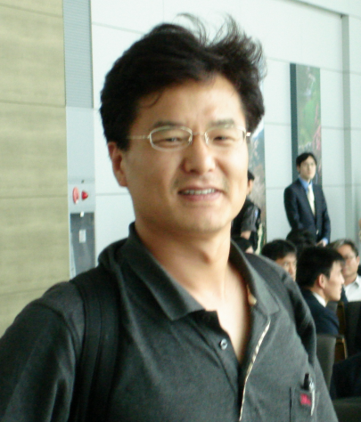

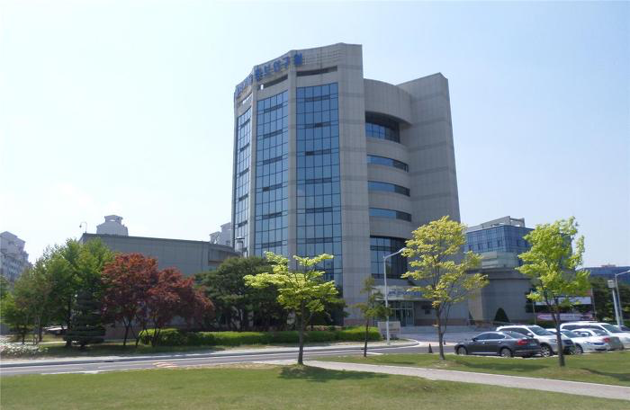
Structural analysis of the SOGRO platform
July 4, 2017 at Int’l Conference on Gravitation: Joint Meeting of ICGAC-XIII & IK15 held at Ewha Womans U., Seoul in Korea
Gungwon Kang, Minjoong Jeong (KISTI)
and Edwin Son (NIMS)
On behalf of the Platform Design Study Group

Slide 2
Outline
Motivation
Thermal noise
Structural analysis and results
Discussion

Slide 3
I. Motivation
SOGRO is an Earth-based proposal to detect low-frequency (e.g., 01.~10Hz) gravitational waves. (See Paik’s talk)
Platform design is very important and challenging.
  Rigidity for common mode rejections
  Modal frequencies (FEM analysis)
  Operation at ~1.5K: Have to cool it down ➔ “Light Platform” preferred
  Seismic and Newtonian noises in addition to other environmental ones
  Suspension
  Construction with budget constraints.

Slide 4
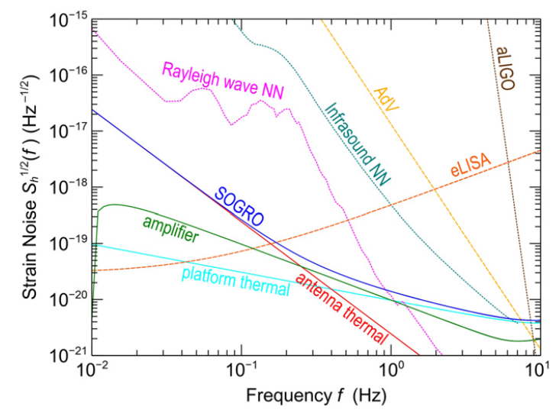
Main Noises
Understanding its characteristic features is essential for designing the whole experiments.
Goal: Find out the optimal design(s) for the platform which satisfies (all) desired requirements.
So, we have investigated the thermal noise features of various SOGRO platforms, and report some preliminary results.

Slide 5
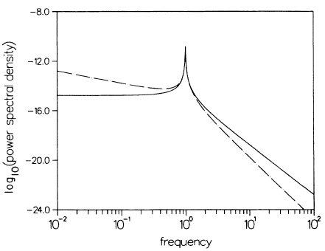


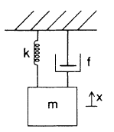




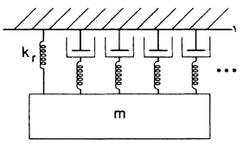

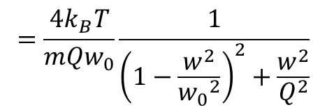

II. Thermal noise
Fluctuation-dissipation theorem: Callen & Greene ‘52
w/ $σ$: mechanical conductance, i.e., $Re[Y]$
Ex) For a simple harmonic oscillator,
Impedance:
Admittance:
$$=\frac{4k_{B}T}{mQw_{0}}\frac{1}{{\left(1−\frac{w^{2}}{{w_{0}}^{2}}\right)}^{2}+\frac{w^{2}}{Q^{2}}}$$

Slide 6
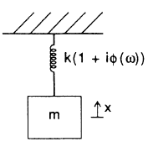


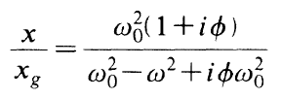




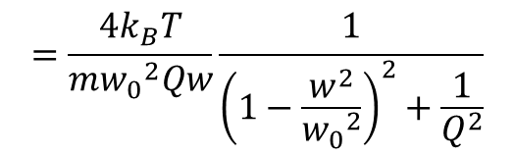
At a finite non-vanishing temperature ➔ Brownian motions ➔ Fluctuations ➔ Dissipations ➔ Mechanical noises
External damping: Negligible in a vacuum probably
Internal damping: Saulson ’90
$$=\frac{4k_{B}T}{m{w_{0}}^{2}Qw}\frac{1}{{\left(1−\frac{w^{2}}{{w_{0}}^{2}}\right)}^{2}+\frac{1}{Q^{2}}}$$

Slide 7
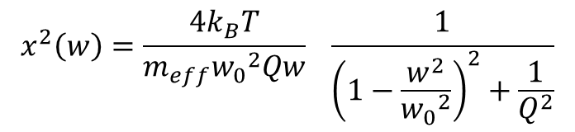
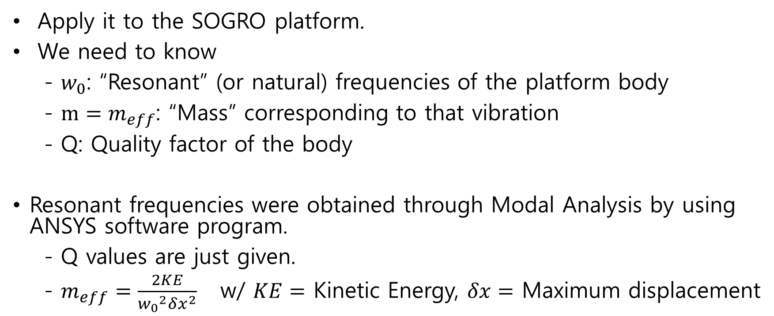
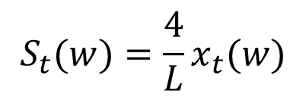
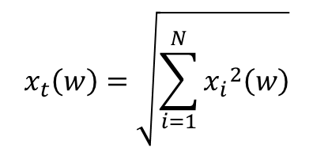
III. Structural analysis and results
Apply it to the SOGRO platform.
We need to know
- $w_{0}$: “Resonant” (or natural) frequencies of the platform body
- $m=m_{eff}$: “Mass” corresponding to that vibration
- Q: Quality factor of the body
Resonant frequencies were obtained through Modal Analysis by using ANSYS software program.
- Q values are just given.
- $m_{eff}=\frac{2KE}{{w_{0}}^{2}δx^{2}}$ w/ $KE=$ Kinetic Energy, $δx=$ Maximum displacement
$$x_{t}\left(w\right)=\sqrt{\sum_{i=1}^{N}{{x_{i}}^{2}\left(w\right)}}$$
$$x^{2}\left(w\right)=\frac{4k_{B}T}{m_{eff}{w_{0}}^{2}Qw} \frac{1}{{\left(1−\frac{w^{2}}{{w_{0}}^{2}}\right)}^{2}+\frac{1}{Q^{2}}}$$
$$S_{t}(w)=\frac{4}{L}x_{t}(w)$$
Strain noise:

Slide 8
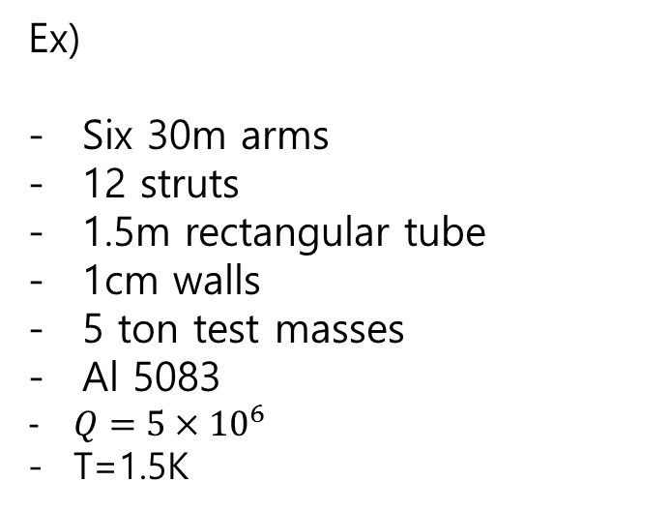
Distribution of modal frequencies:
Ex)
Six 30m arms
12 struts
1.5m rectangular tube
1cm walls
5 ton test masses
Al 5083
$Q=5×{10}^{6}$
T=1.5K
Mode Frequency [Hz]
1. 6.7317e-002
2. 6.7417e-002
3. 7.3653e-002
4. 7.4266e-002
5. 7.4596e-002
6. 15.284
7. 19.09
8. 19.09
9. 19.09
10. 19.461
11. 19.461
12. 21.629
13. 21.629
14. 21.629
15. 21.852
16. 21.852
17. 22.114
18. 24.854
19. 24.854
20. 24.854
21. 27.572
22. 27.572
23. 27.572
24. 29.719
25. 29.794
26. 29.794
27. 29.878
28. 29.878
29. 30.075
30. 30.075
31. 30.075
32. 30.21
33. 30.635
…….

Slide 9
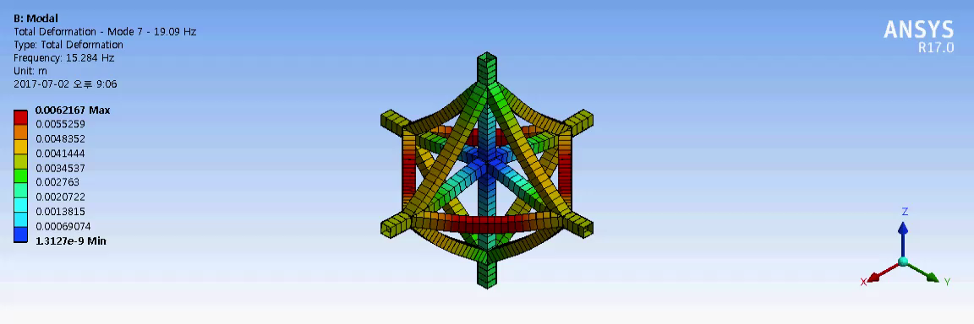
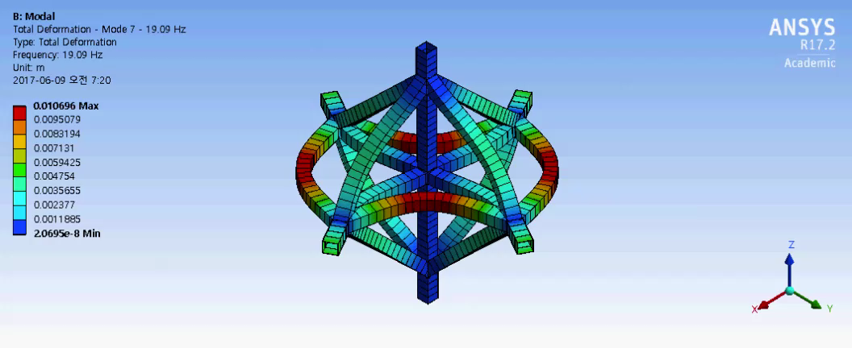
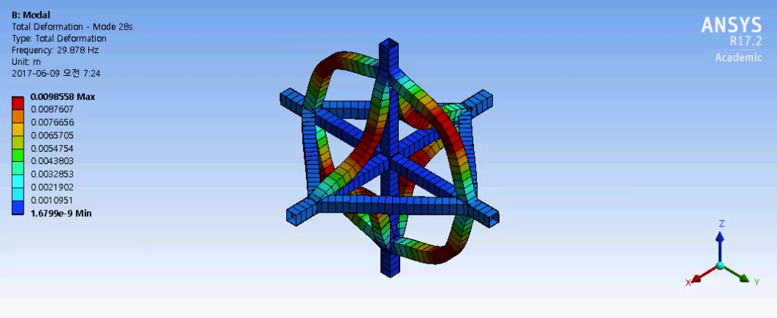
Mode 6 @ 15.284Hz : Common mode
Mode 7 @ 19.09Hz : Scissor mode
Mode 27 @ 29.878Hz : Diagonal mode

Slide 10
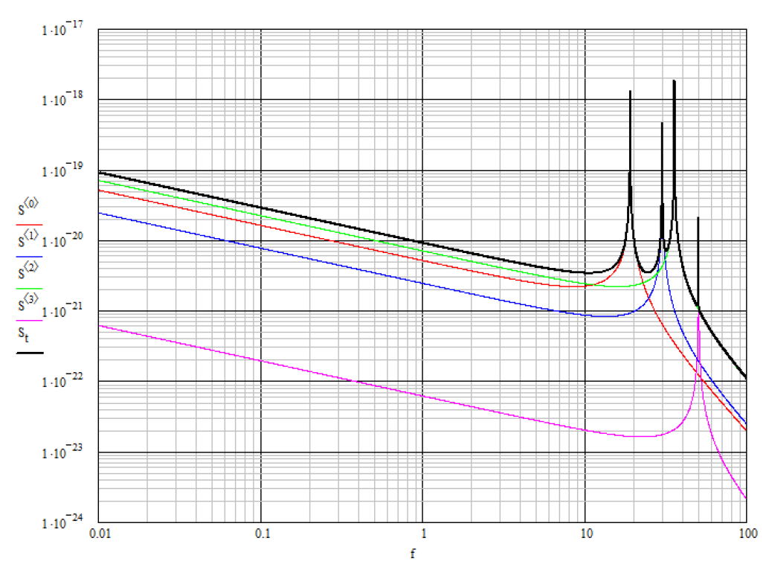

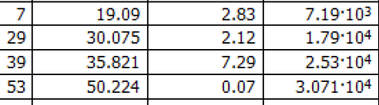
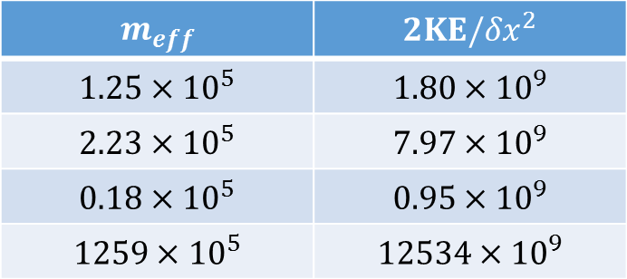
Platform thermal strain noise for first 4 XY scissor modes and total: Ron Norton (UMD)
$$m_{eff}$$ | $${2KE/δx}^{2}$$
$$1.25×{10}^{5}$$ | $$1.80×{10}^{9}$$
$$2.23×{10}^{5}$$ | $$7.97×{10}^{9}$$
$$0.18×{10}^{5}$$ | $$0.95×{10}^{9}$$
$$1259×{10}^{5}$$ | $$12534×{10}^{9}$$

Slide 11
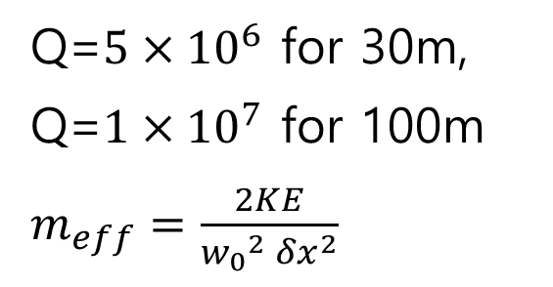
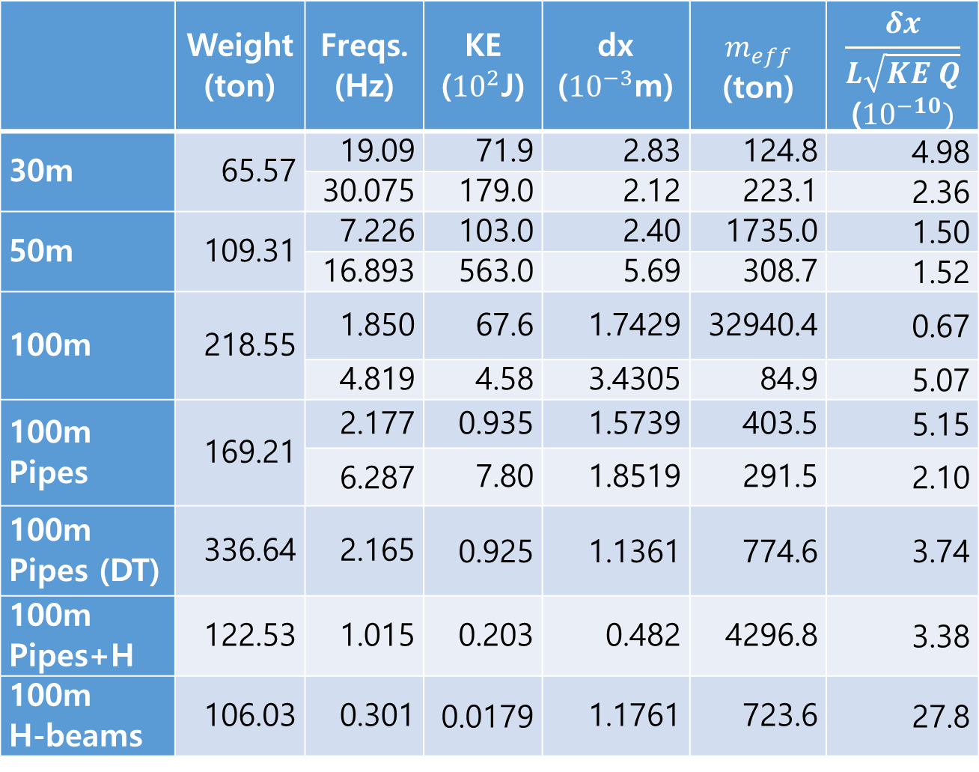
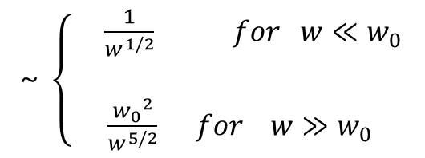
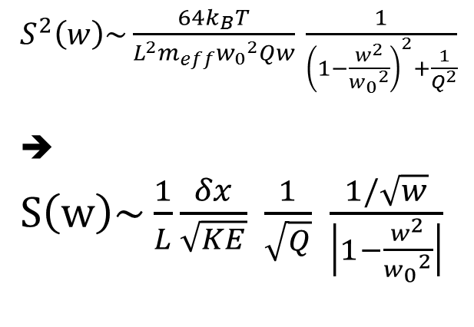
Various design parameters:
 | Weight (ton) | Freqs. (Hz) | KE (${10}^{2}$J) | dx (${10}^{−3}$m) | $$m_{eff}$$ (ton) | $$\frac{δx}{L\sqrt{KE Q}}$$ (${10}^{−10})$
30m | 65.57 | 19.09 | 71.9 | 2.83 | 124.8 | 4.98
 |  | 30.075 | 179.0 | 2.12 | 223.1 | 2.36
50m | 109.31 | 7.226 | 103.0 | 2.40 | 1735.0 | 1.50
 |  | 16.893 | 563.0 | 5.69 | 308.7 | 1.52
100m | 218.55 | 1.850 | 67.6 | 1.7429 | 32940.4 | 0.67
 |  | 4.819 | 4.58 | 3.4305 | 84.9 | 5.07
100m Pipes | 169.21 | 2.177 | 0.935 | 1.5739 | 403.5 | 5.15
 |  | 6.287 | 7.80 | 1.8519 | 291.5 | 2.10
100m Pipes (DT) | 336.64 | 2.165 | 0.925 | 1.1361 | 774.6 | 3.74
100m Pipes+H | 122.53 | 1.015 | 0.203 | 0.482 | 4296.8 | 3.38
100m H-beams | 106.03 | 0.301 | 0.0179 | 1.1761 | 723.6 | 27.8
Q=$5×{10}^{6}$ for 30m,
Q=$1×{10}^{7}$ for 100m
$m_{eff}=\frac{2KE}{{w_{0}}^{2} {δx}^{2}}$
$S^{2}\left(w\right)\sim \frac{64k_{B}T}{{L_{}^{2}m}_{eff}{w_{0}}^{2}Qw}$ $\frac{1}{{\left(1−\frac{w^{2}}{{w_{0}}^{2}}\right)}^{2}+\frac{1}{Q^{2}}}$
➔ $S\left(w\right)\sim \frac{1}{L}\frac{δx}{\sqrt{KE}} \frac{1}{\sqrt{Q}} \frac{1/\sqrt{w}}{\left|1−\frac{w^{2}}{{w_{0}}^{2}}\right|}$
~ $\left\{\begin{aligned} \frac{1}{w^{1/2}} for w≪w_{0} \\ \\ \frac{{w_{0}}^{2}}{w^{5/2}} for w≫w_{0}\end{aligned}\right.$

Slide 12
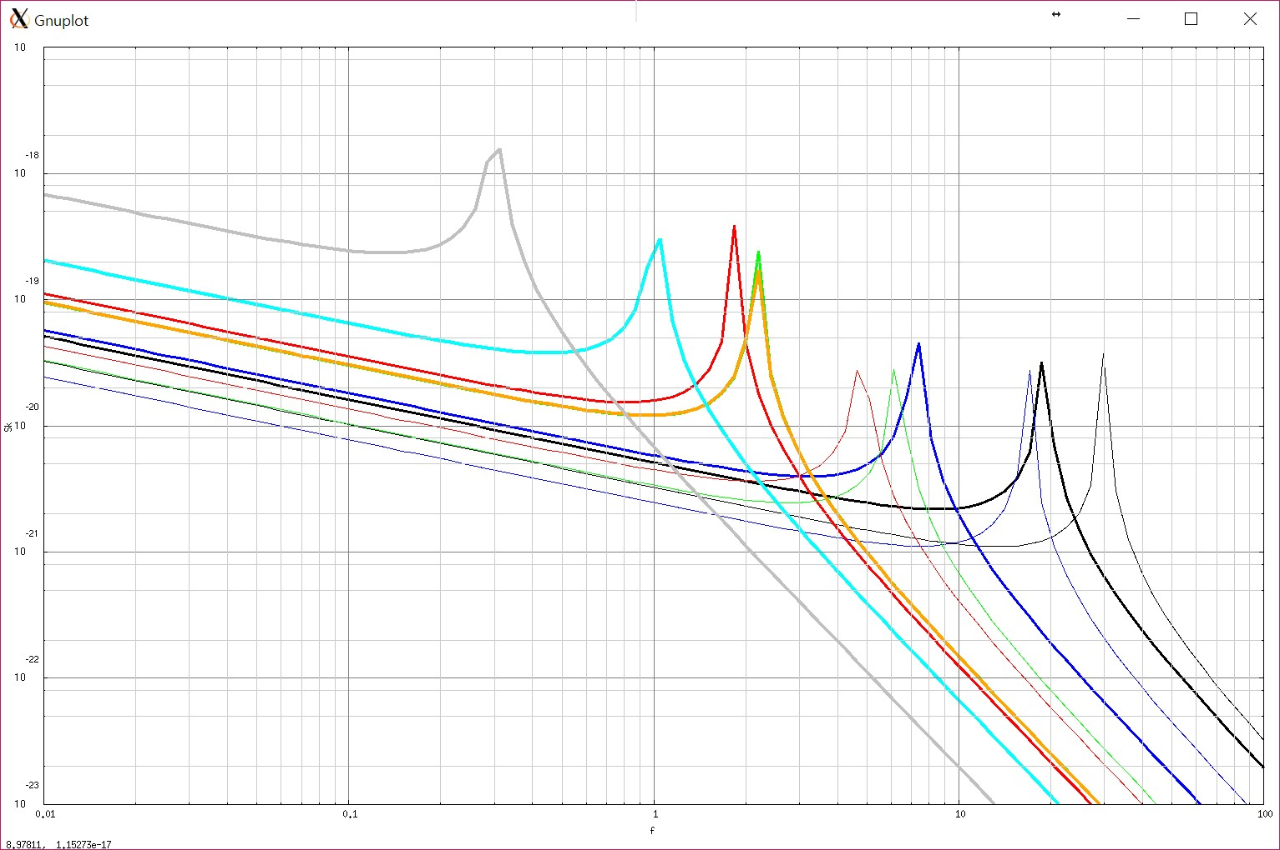
Platform thermal strain noise for XY scissor modes:
Cross-sections
100-H
100
Rectangular:
100-PH
100-P
100-P
100-PDT
50
30
30
100
50
Pipe:
H-beam:

Slide 13
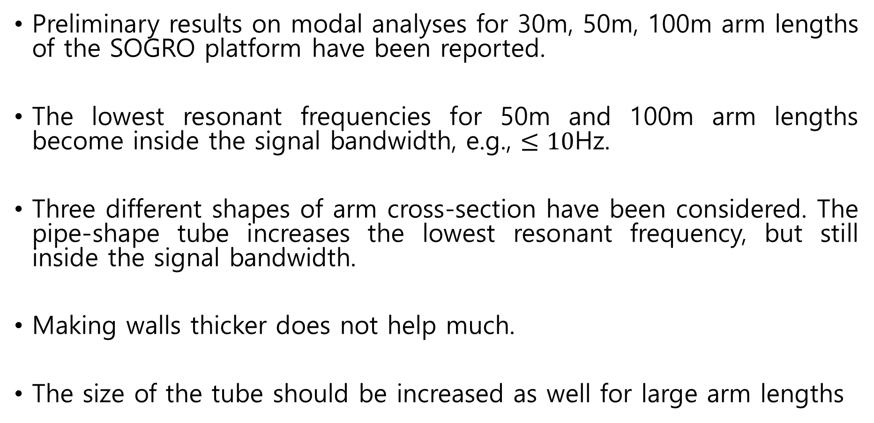
IV. Discussion
Preliminary results on modal analyses for 30m, 50m, 100m arm lengths of the SOGRO platform have been reported.
The lowest resonant frequencies for 50m and 100m arm lengths become inside the signal bandwidth, e.g., $≤10$Hz.
Three different shapes of arm cross-section have been considered. The pipe-shape tube increases the lowest resonant frequency, but still inside the signal bandwidth.
Making walls thicker does not help much.
The size of the tube should be increased as well for large arm lengths

Slide 14
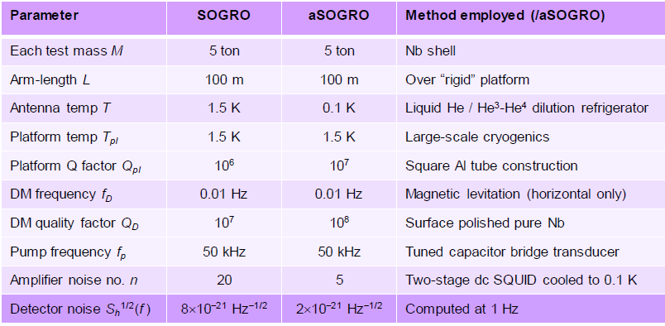
Design Parameters Updated: Paik (May ’17)
Lots of additional studies have to be done to extract feasible design parameters which fulfill all desired requirements.
But, we’re ready to begin the investigation now.

Slide 15
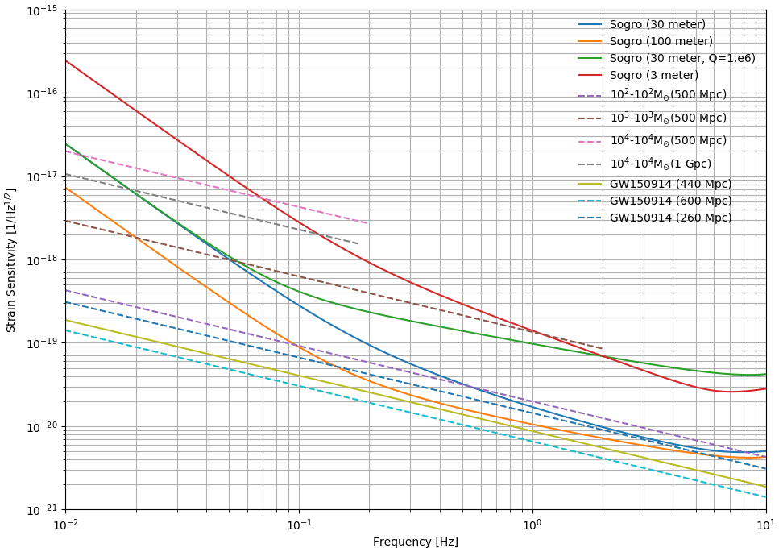
Credit: Y. Bae

Slide 16
THANKS!
Back-up slides below

Slide 17
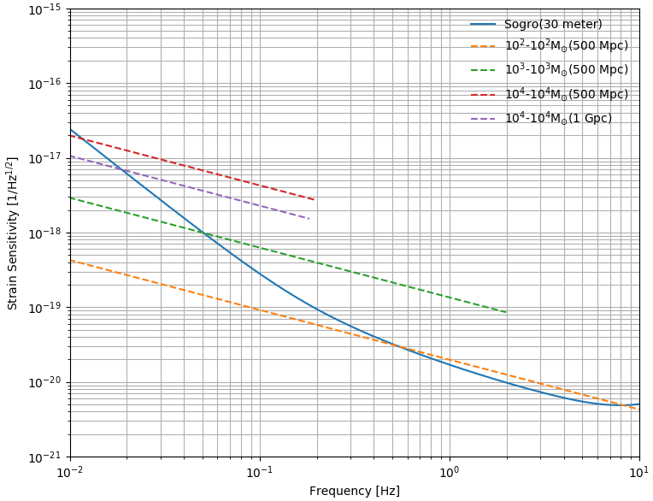
Credit: Y. Bae ‘17
Observation time
10²-10² M⊙ (500 Mpc): ~1.8 day (0.1≾f ≾ 10)
(※f_{isco}~20)
10³-10³ M⊙ (500 Mpc): ~6 hr (0.05 ≾ f ≾ 2.0)
10⁴-10⁴ M⊙ (500 Mpc): ~6 hr (0.01 ≾ f ≾ 0.2)
10⁴-10⁴ M⊙ (1 Gpc): ~1.5 hr (0.02 ≾ f ≾ 0.18)
SNR
10²-10² M⊙ (500 Mpc): ~1.6 (0.1 ≾ f ≾ 10)
10³-10³ M⊙ (500 Mpc): ~7.8 (0.05 ≾ f ≾ 2.0)
10⁴-10⁴ M⊙ (500 Mpc): ~15 (0.01 ≾ f ≾ 0.2)
10⁴-10⁴ M⊙ (1 Gpc): ~7.2 (0.02 ≾ f ≾ 0.18)

Slide 18
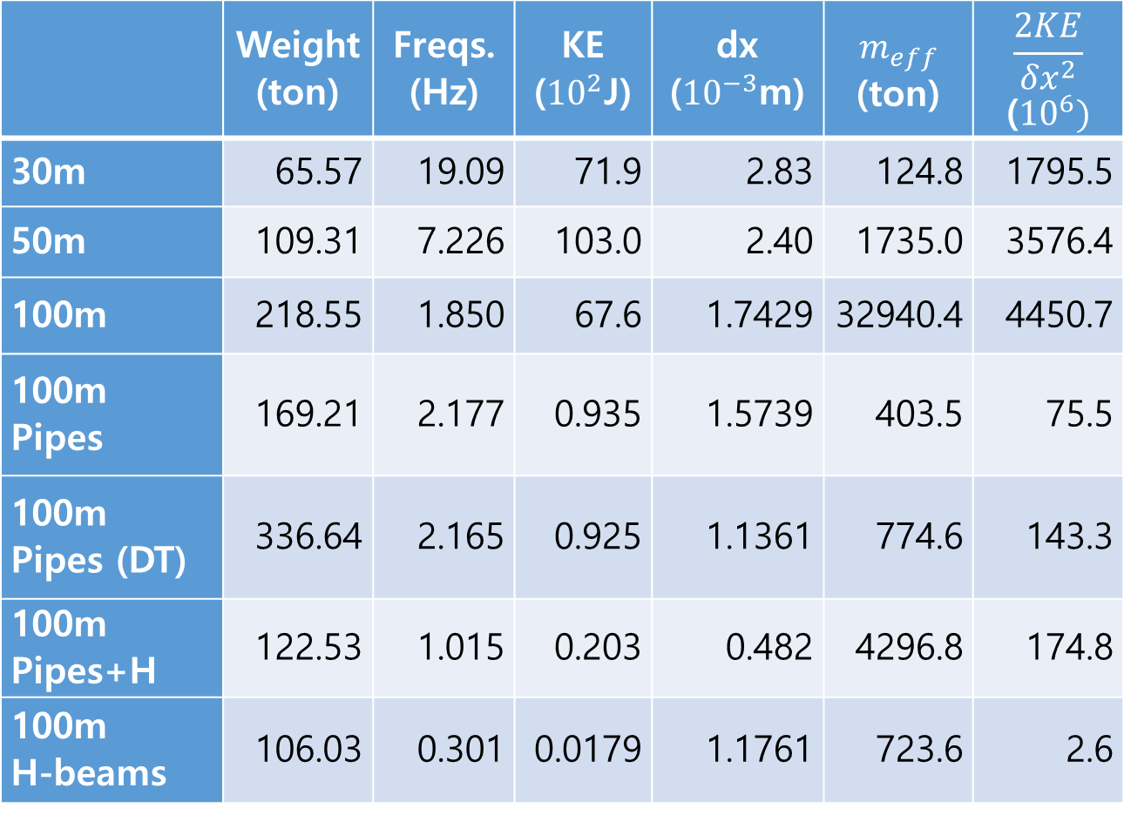
 | Weight (ton) | Freqs. (Hz) | KE (${10}^{2}$J) | dx (${10}^{−3}$m) | $$m_{eff}$$ (ton) | $$\frac{2KE}{{δx}^{2}}$$ (${10}^{6})$
30m | 65.57 | 19.09 | 71.9 | 2.83 | 124.8 | 1795.5
50m | 109.31 | 7.226 | 103.0 | 2.40 | 1735.0 | 3576.4
100m | 218.55 | 1.850 | 67.6 | 1.7429 | 32940.4 | 4450.7
100m Pipes | 169.21 | 2.177 | 0.935 | 1.5739 | 403.5 | 75.5
100m Pipes (DT) | 336.64 | 2.165 | 0.925 | 1.1361 | 774.6 | 143.3
100m Pipes+H | 122.53 | 1.015 | 0.203 | 0.482 | 4296.8 | 174.8
100m H-beams | 106.03 | 0.301 | 0.0179 | 1.1761 | 723.6 | 2.6

