Slide 1

Baryonic Force for Accelerated Cosmic Expansion and Generalized Yang-Mills Symmetry
13th International Conference on Gravitation, Astrophysics, and Cosmology
15th Italian-Korean Symposium on Relativistic Astrophysics
Ewha University, Seoul, South Korea, 4th July, 2017
Mehbub Khan
M.S., Department of Physics
University of Massachusetts Dartmouth, MA, USA
Advisor: Prof. Jong-ping Hsu

Slide 2
“Man Delights in Novelty”
– Dorothy Parker
Explore physical implications of the generalized Yang-Mills symmetry
- leads to 4th order gauge field equations and linear static potential
Magnitude of Baryon force
Orbit due to Baryon force

Slide 3

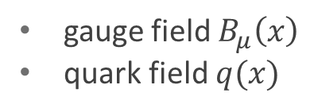



Generalized Yang-Mills Symmetry
$B_{μ}^{′}\left(x\right)=B_{μ}\left(x\right)+ω_{μ}(x)$ where $μ=0, 1, 2, 3$
  $q^{′}\left(x\right)=e^{−iP_{ω}\left(x\right)}q(x)$
  ${\overline{q}}^{′}\left(x\right)=\overline{q}{(x)e}^{iP_{ω}\left(x\right)}$
gauge field $B_{μ}\left(x\right)$
quark field $q(x)$
$P_{ω}\left(x\right)=g_{b}\int^{x}{ω_{λ}\left(x^{′}\right)dx^{′λ}}$
$\left.∂_{μ}P_{ω}\left(x\right)=g_{b}ω_{μ}(x\right)$
$∂^{2}ω_{μ}\left(x\right)−∂_{μ}∂^{λ}ω_{λ}\left(x\right)=0$, $∂^{2}=∂_{μ}∂_{υ}η^{μυ}$
${ η}^{μυ}=(1, −1, −1, −1)$

Slide 4
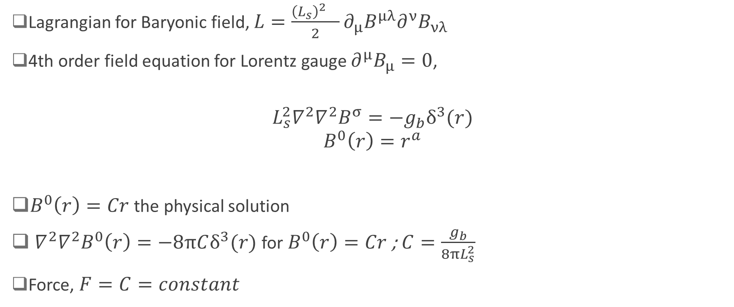
Baryonic Force between Point Charges
Lagrangian for Baryonic field, $L=\frac{{\left(L_{s}\right)}^{2} }{2}∂_{µ}B^{µλ}∂^{ν}B_{νλ}$
4th order field equation for Lorentz gauge $∂^{µ}B_{µ}=0$,
$$L_{s}^{2}∇^{2}∇^{2}B^{σ}=−g_{b}δ^{3}(r)$$
$$B^{0}\left(r\right)=r^{a}$$
$B^{0}\left(r\right)=Cr$ the physical solution
${ ∇}^{2}∇^{2}B^{0}\left(r\right)=−8πCδ^{3}(r)$ for $B^{0}\left(r\right)=Cr$ ; $C=\frac{g_{b}}{8πL_{s}^{2}}$
Force, $F=C=constant$
Solution for potential,
function of space only

Slide 5








Baryonic Force Acting on a Supernova in a Sphere of Galaxies
$$dR$$
P
$$dӨ$$
$$s$$
$$R$$
$$Ө$$
$$φ$$
$$r$$
S
C
$$R_{0}$$

Slide 6

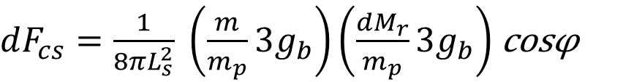

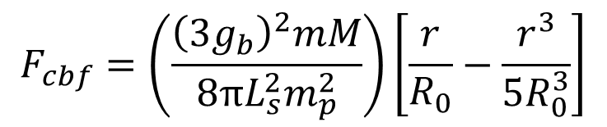
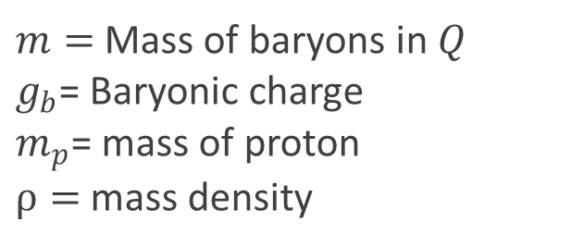
Baryonic Force Acting on a Supernova in a Sphere of Galaxies
Radial Baryonic Force
Here,
$dF_{cs}=\frac{1}{8πL_{s}^{2}} \left(\frac{m}{m_{p}}3g_{b}\right)\left(\frac{dM_{r}}{m_{p}}3g_{b}\right)$ cosφ
$m=$Mass of baryons in $Q$
$g_{b}$= Baryonic charge
$m_{p}$= mass of proton
$ρ=$ mass density
$$dM_{r}=ρ_{1}\left(2πR sinθ\right)\left(R dθ\right)dR$$
$$F_{cbf}=\left(\frac{{\left(3g_{b}\right)}^{2}mM}{8πL_{s}^{2}m_{p}^{2}}\right)\left[\frac{r}{R_{0}}−\frac{r^{3}}{5R_{0}^{3}}\right]$$
Cosmological object$Q$

Slide 7
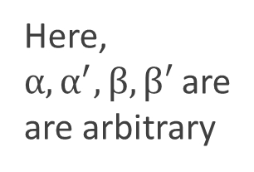
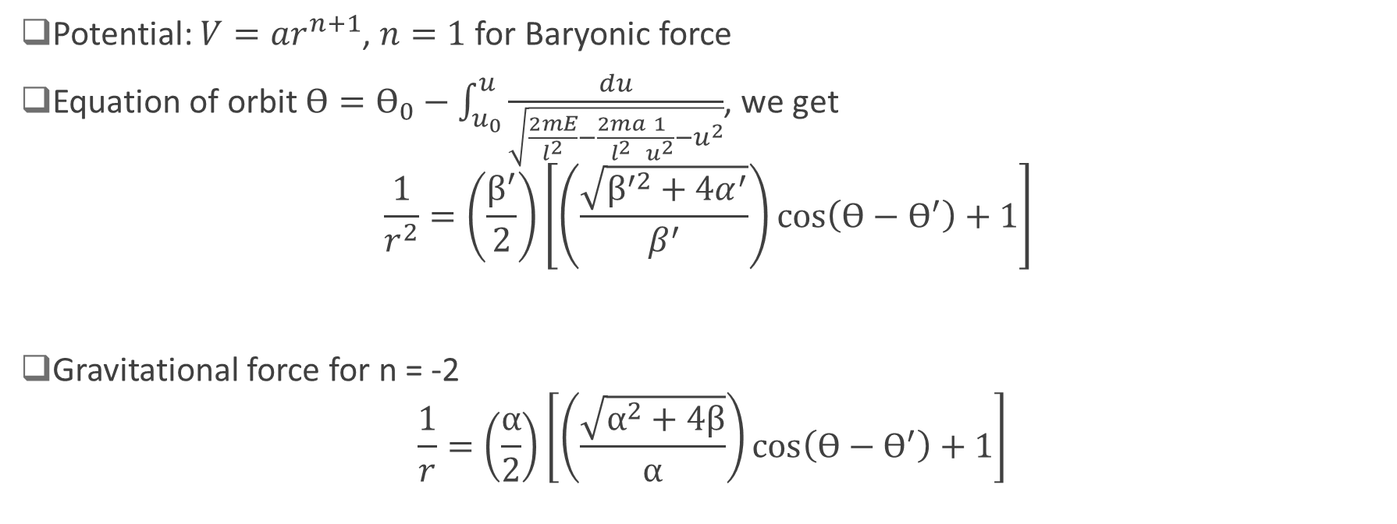
Baryonic Orbit
Potential: $V=ar^{n+1}$, $n=1$ for Baryonic force
Equation of orbit $Ө=Ө_{0}−\int_{u_{0}}^{u}{\frac{du}{\sqrt{\frac{2mE}{l^{2}}−\frac{2ma}{l^{2}}\frac{1}{u^{2}}−u^{2}}}}$, we get
$$\frac{1}{r^{2}}=\left(\frac{β^{′}}{2}\right)\left[\left(\frac{\sqrt{β^{′2}+4α^{′}}}{β^{′}}\right)\cos\left(Ө−Ө^{′}\right)+1\right]$$
Gravitational force for n = -2
$$\frac{1}{r}=\left(\frac{α}{2}\right)\left[\left(\frac{\sqrt{α^{2}+4β}}{α}\right)\cos\left(Ө−Ө^{′}\right)+1\right]$$
Here,
$α,α^{′},β,β′$ are
are arbitrary

Slide 8

Comparison of Two Orbits
Suppose $M_{r}≫m$
$\frac{\sqrt{β^{′2}+4α^{′}}}{β^{′}}=\frac{\sqrt{α^{2}+4β}}{α}$
and $\frac{{ β}^{′}}{2 }$ = $\frac{ α}{2}$
eccentricity

Slide 9
Comparison of Two Orbits (contd.)

Slide 10

Orbit for Two Comparable Baryon Masses
$M_{r}=m$
Reduced mass
$µ=\frac{m_{1}m_{2}}{m_{1}+m_{2}}=\frac{m}{2}$

Slide 11

Wrestle between Baryonic Force and Gravitational Force
Critical Distance for two galaxies
$R_{c}≈(\frac{Gm_{p}^{2} 8π{ L}_{s}^{2} }{9g_{b}^{2}})$
$g_{b}≈{10}^{−70}$
$R_{c}≈{10}^{22}$ m

Slide 12
Conclusion
Baryonic force between point Baryon charges is independent of their distance
Baryonic force between two massive Baryonic depends on their distances
Qualitatively equivalent to the cosmological constant of the Einstein filed equation
Repulsive Baryonic force between two Baryonic bodies could be an explanation for the cosmic acceleration

Slide 13
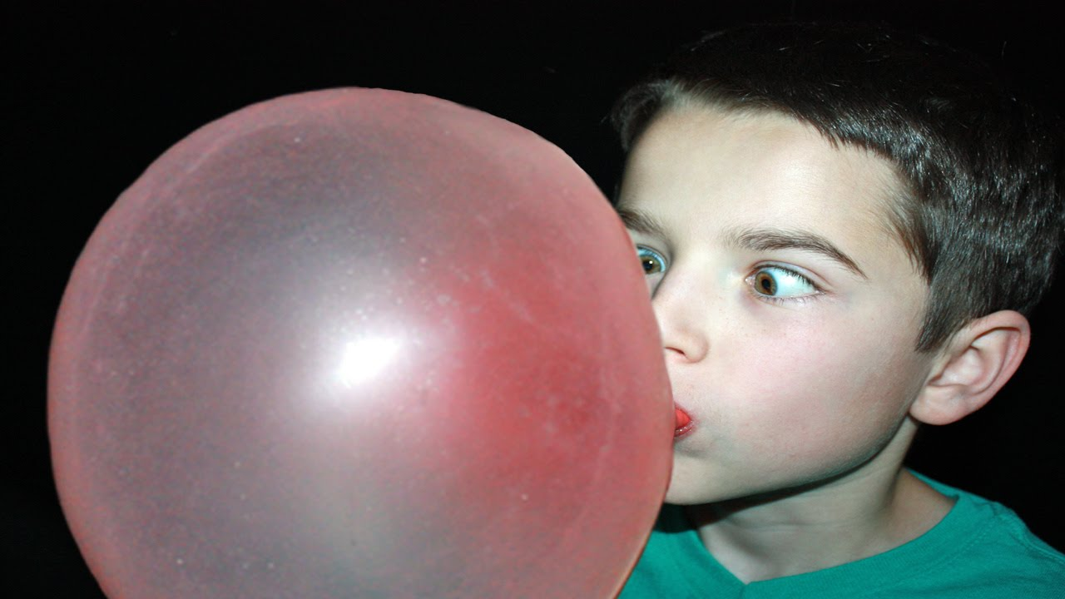
THANKS
?Baryonic Force?

