Slide 1
Accretion onto Black Holes
with Outflow
Myeong-Gu Park
(Kyungpook National University, KOREA)
July 4, 2017 ICGAC-XIII/IK15 Ewha Womans U.

Slide 2
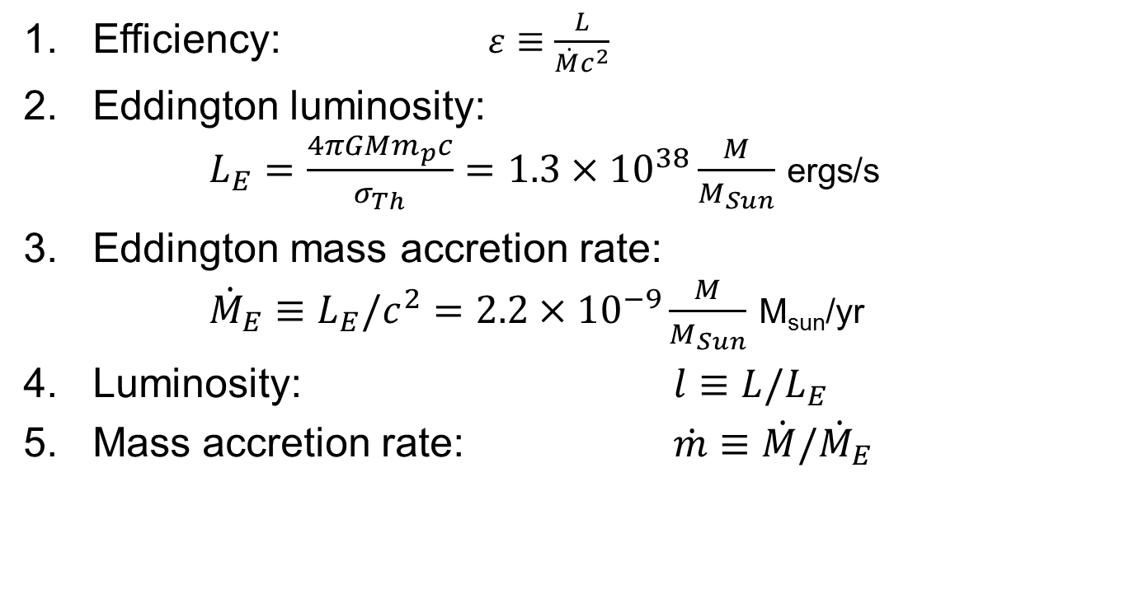
Definitions
Efficiency: $ε≡\frac{L}{\dot{M}c^{2}}$
Eddington luminosity:
  $L_{E}=\frac{4πGMm_{p}c}{σ_{Th}}=1.3×{10}^{38}\frac{M}{M_{Sun}}$ ergs/s
Eddington mass accretion rate:
  ${\dot{M}}_{E}≡L_{E}/c^{2}=2.2×{10}^{−9}\frac{M}{M_{Sun}}$ M_{sun}/yr
Luminosity: ${l≡L/L}_{E}$
Mass accretion rate: $\dot{m}≡\dot{M}/{\dot{M}}_{E}$

Slide 3
Efficiency

Slide 4
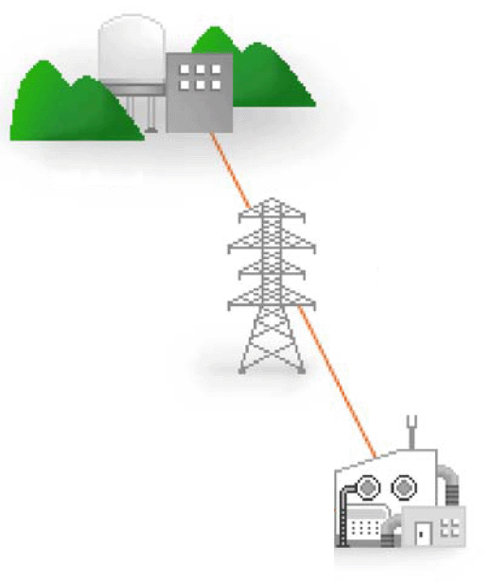


$$ε\sim 1$$
$$ε\sim 0$$

Slide 5
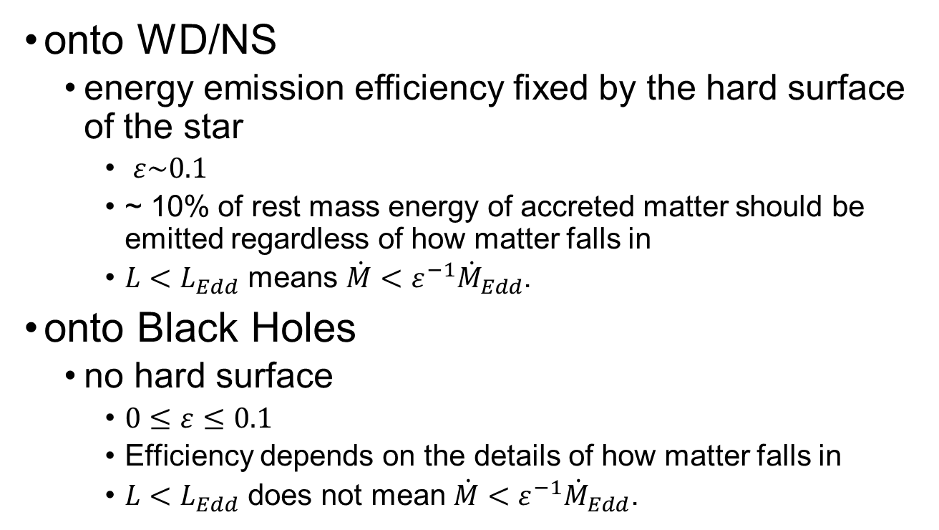
Efficiency of Accretion
onto WD/NS
  energy emission efficiency fixed by the hard surface of the star
    $ε\sim 0.1$
    ~ 10% of rest mass energy of accreted matter should be emitted regardless of how matter falls in
    $L<L_{Edd}$ means $\dot{M}<ε^{−1}{\dot{M}}_{Edd}$.
onto Black Holes
  no hard surface
    $0≤ε≤0.1$
    Efficiency depends on the details of how matter falls in
    $L<L_{Edd}$ does not mean $\dot{M}<ε^{−1}{\dot{M}}_{Edd}$.

Slide 6
Mass Accretion Rate

Slide 7
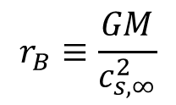
How much can a black hole eat?
$$r_{B}≡\frac{GM}{c_{s,∞}^{2}}$$
Black Hole in a Uniform Medium

Slide 8

Bondi flow
Bondi (1952)
Zero angular momentum
Polytropic EOS
Inviscid
$$r_{B}≡\frac{GM}{c_{s,∞}^{2}}$$

Slide 9

Critical/Sonic Point
$$\frac{dv_{r}}{dr}=\frac{F(v_{r},r,Ω,α,c_{s},q^{+},q^{−},…)}{v_{r}^{2}−\frac{2γ}{γ+1}c_{s}^{2}}$$

Slide 10
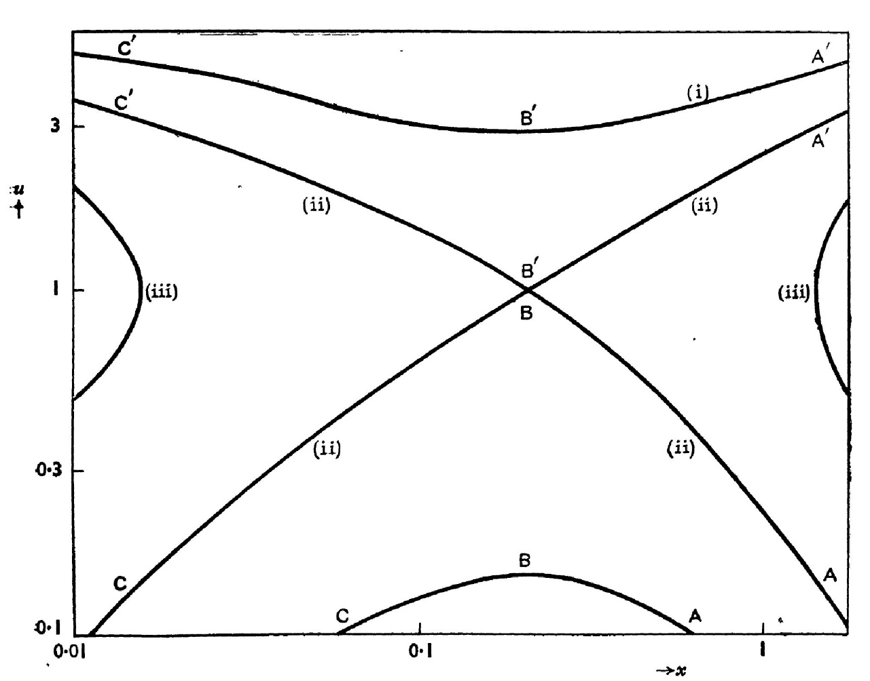
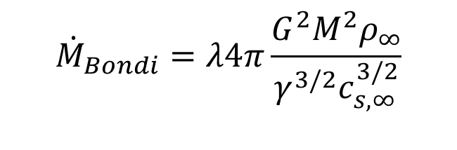
Bondi solutions
Supersonic
Transonic
Non-physical
Subsonic
  $${\dot{M}}_{Bondi}=λ4π\frac{G^{2}M^{2}ρ_{∞}}{γ^{3/2}c_{s,∞}^{3/2}}$$

Slide 11
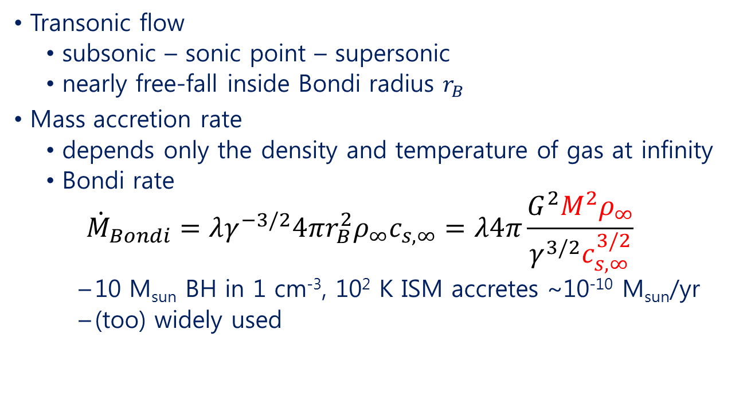
Bondi flow
Transonic flow
  subsonic – sonic point – supersonic
  nearly free-fall inside Bondi radius $r_{B}$
Mass accretion rate
  depends only the density and temperature of gas at infinity
  Bondi rate
  $${\dot{M}}_{Bondi}=λγ^{−3/2}4πr_{B}^{2}ρ_{∞}c_{s,∞}=λ4π\frac{G^{2}M^{2}ρ_{∞}}{γ^{3/2}c_{s,∞}^{3/2}}$$
    10 M_{sun} BH in 1 cm⁻³, 10² K ISM accretes ~10⁻¹⁰ M_{sun}/yr
    (too) widely used

Slide 12
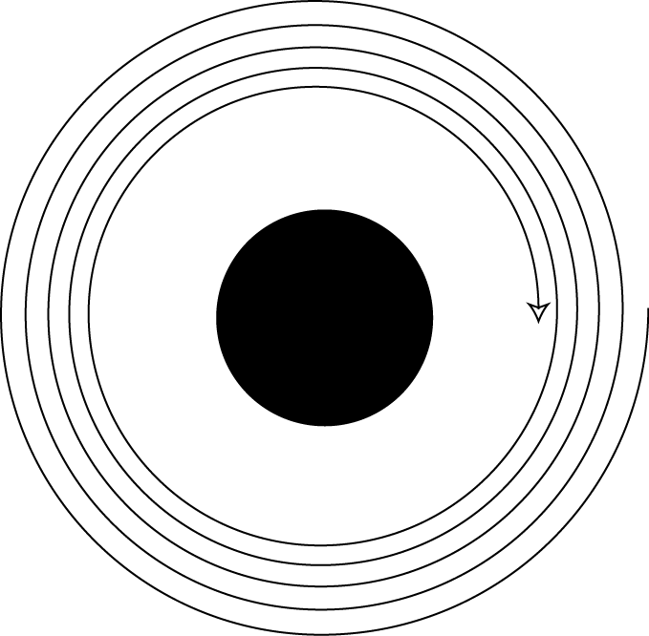

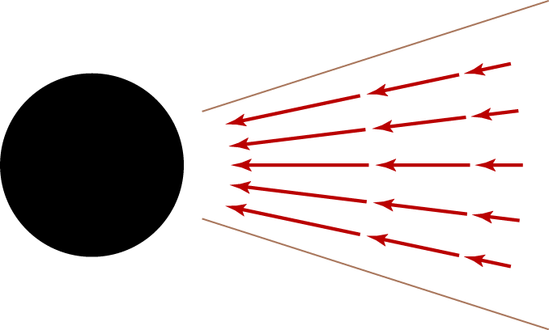
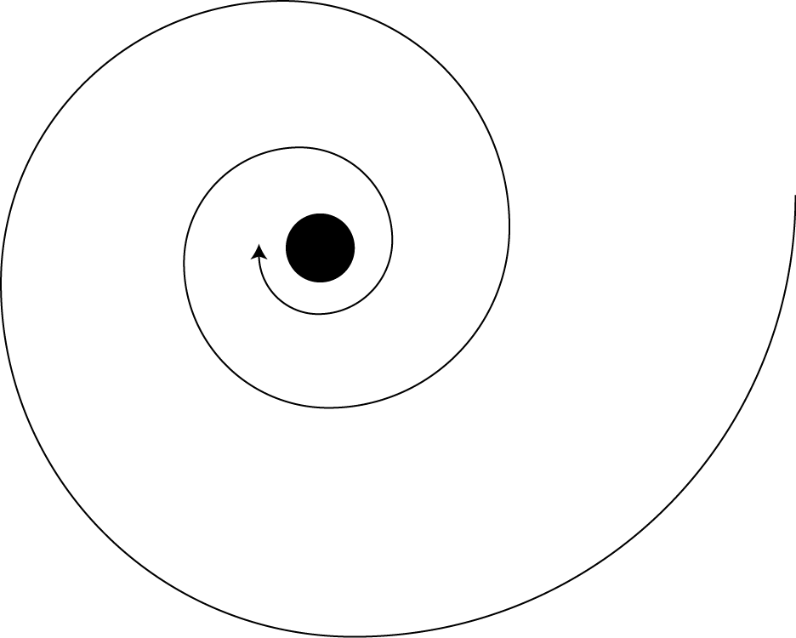
Disk accretion
Thin Disk
Slim Disk
Advection Dominated Accretion Flow
Radiatively Inefficient Accretion Flow

Slide 13
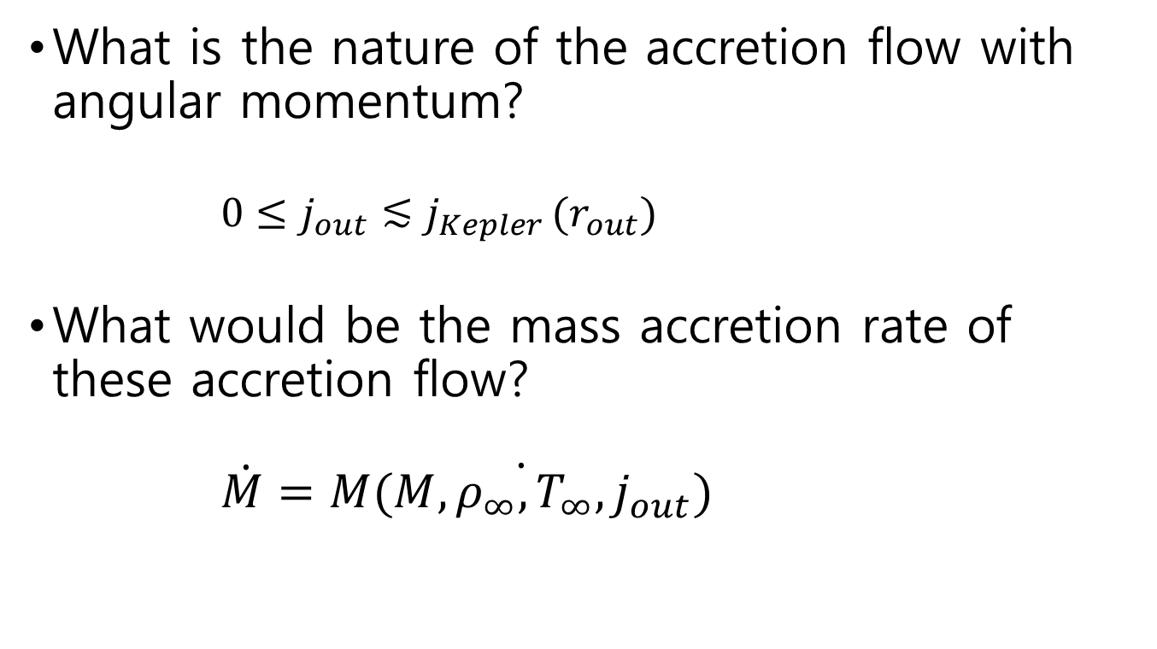
Rotating viscous accretion flow
What is the nature of the accretion flow with angular momentum?
  ${0≤j}_{out}≲j_{Kepler }(r_{out})$
What would be the mass accretion rate of these accretion flow?
  $\dot{M}=\dot{M(M,ρ_{∞},T_{∞},j_{out})}$

Slide 14
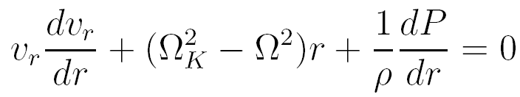


Equations (Park 2009)
Mass conservation
Radial momentum
Angular momentum
Energy equation
  viscous dissipation
  relativistic bremsstrahlung cooling

Slide 15

Critical/Sonic Point
$$\frac{dv_{r}}{dr}=\frac{F(v_{r},r,Ω,α,c_{s},q^{+},q^{−},…)}{\left[\frac{γ+1}{γ−1}+O(α^{2})\right]v_{r}^{2}−\left[\frac{2γ}{γ−1}+O(α^{2})\right]c_{s}^{2}}$$

Slide 16
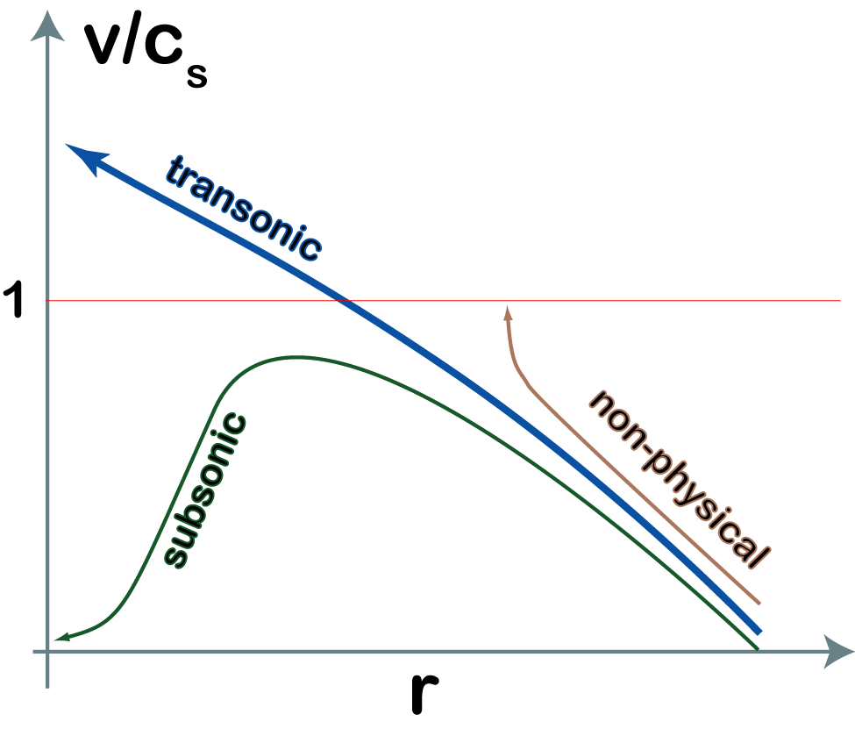

Method of Finding Solutions
Find a transonic solution for given $M, α, ρ_{∞},T_{∞},j_{out}$
Shooting method
Mass accretion rate
is an eigenvalue.

Slide 17
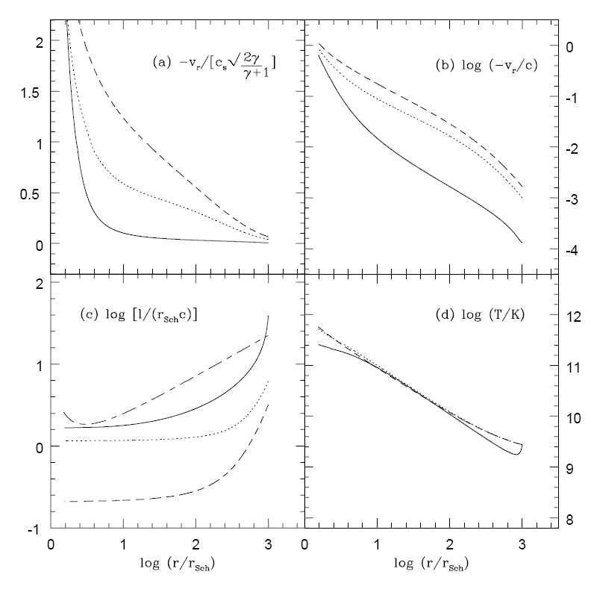


Flow Properties
low $j_{out}$
high $j_{out}$

Slide 18
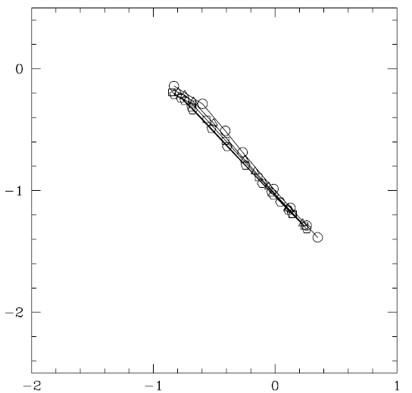



Mass Accretion Rate
For $r_{out}=r_{B}$
$\frac{\dot{M}}{{\dot{M}}_{B}}≅9α{\left(\frac{j_{out}}{j_{B}}\right)}^{−1}$
$$\log{\frac{\dot{M}}{{\dot{M}}_{B}}}$$
$$\log{\frac{j_{out}}{j_{B}}}$$

Slide 19
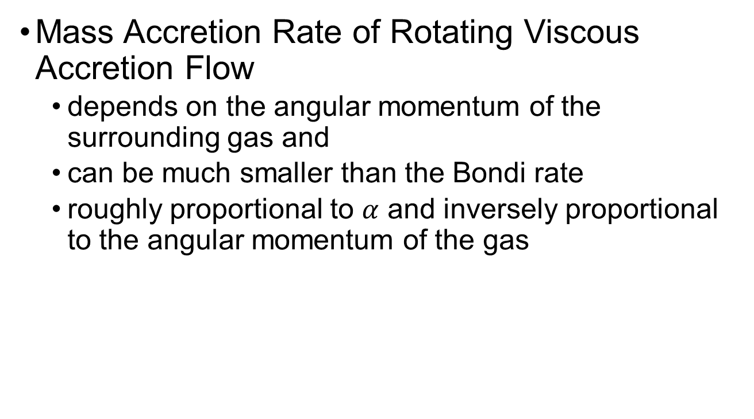
Park (2009)
Mass Accretion Rate of Rotating Viscous Accretion Flow
  depends on the angular momentum of the surrounding gas and
  can be much smaller than the Bondi rate
  roughly proportional to $α$ and inversely proportional to the angular momentum of the gas

Slide 20
Narayan & Fabian (2011)
Bondi flow from a slowly rotating hot atmosphere
Solutions have similar properties.

Slide 21

discrepancy?
$$L≡\frac{l_{out}}{l_{ms}}$$

Slide 22
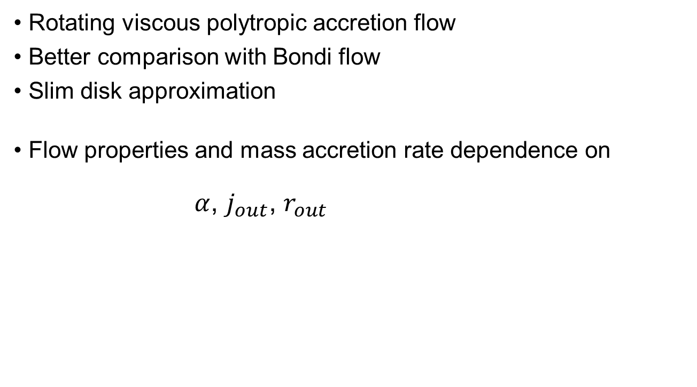
Generalized Bondi Flow
Rotating viscous polytropic accretion flow
Better comparison with Bondi flow
Slim disk approximation
Flow properties and mass accretion rate dependence on
$α$, $j_{out}$, $r_{out}$

Slide 23



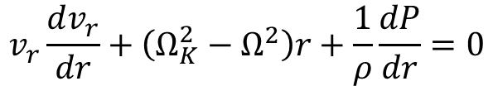
Equations
Mass conservation
Radial momentum
Angular momentum
Equation of State
$$\dot{M}=−4πHρv_{r}$$
$$v_{r}\frac{dv_{r}}{dr}+\left(Ω_{K}^{2}−Ω^{2}\right)r+\frac{1}{ρ}\frac{dP}{dr}=0$$
$$ρv_{r}\left(Ωr^{2}−j_{0}\right)=−αrP$$
$$P=P_{out}{\left(\frac{ρ}{ρ_{out}}\right)}^{γ}$$

Slide 24
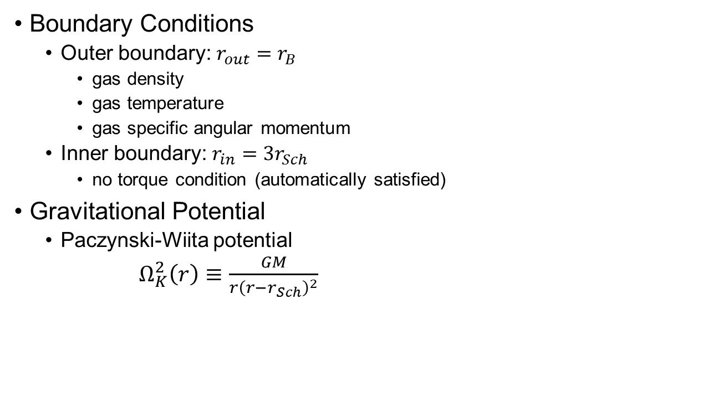
Boundary Conditions
  Outer boundary: $r_{out}=r_{B}$
    gas density
    gas temperature
    gas specific angular momentum
  Inner boundary: $r_{in}=3r_{Sch}$
    no torque condition (automatically satisfied)
Gravitational Potential
  Paczynski-Wiita potential
  $Ω_{K}^{2}\left(r\right)≡\frac{GM}{r{\left(r−r_{Sch}\right)}^{2}}$

Slide 25
Flow profiles

Slide 26


Dependence on $r_{B}$ (or $T_{out}$)
Dependence on viscosity parameter $α$
$$\frac{\dot{M}}{{\dot{M}}_{B}}≅\left(\frac{α}{0.1}\right){\left(\frac{j_{out}}{j_{B}}\right)}^{−1}$$

Slide 27

Dependence adiabatic index $γ$
  $\dot{M}/{\dot{M}}_{B}$ insensitive to $γ$.

Slide 28
Outflows
Inflow-outflow by
  hydrodynamic process
  magnetic process
  radiative process
Radiation driven outflow (WADAF, WCDAF)
  Park & Ostriker 2001, 2007
ADiabatic Inflow-Outflow Solution (ADIOS)
  Blandford & Begelman 1999
  simple scaling assumption
Numerical Simulations
  Li, Ostriker & Sunyaev 2013

Slide 29
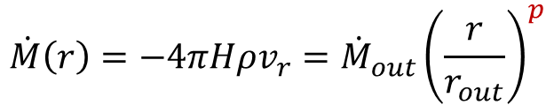


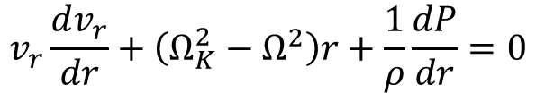
Equations for Accretion with Outflow
Blanford & Begelman (1999)
  Simple scaling model for Advection-Dominated Inflow-Outflow Solutions (ADIOS)
Mass conservation
Radial momentum
Angular momentum
Equation of State
$$\dot{M}\left(r\right)=−4πHρv_{r}={\dot{M}}_{out}{\left(\frac{r}{r_{out}}\right)}^{p}$$
$$v_{r}\frac{dv_{r}}{dr}+\left(Ω_{K}^{2}−Ω^{2}\right)r+\frac{1}{ρ}\frac{dP}{dr}=0$$
$$−{ρv}_{r}\left[ (1−λ_{BB})Ωr^{2}−\frac{j_{0}}{r^{p}}\right]=−αrP$$
$$P=P_{out}{\left(\frac{ρ}{ρ_{out}}\right)}^{γ}$$

Slide 30


Flow profiles
magnetic wind
gas outflow
$$p=0, λ_{BB}=1/2$$
$$p=3/4, λ_{BB}=1/2$$

Slide 31

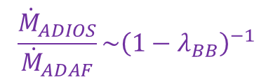
Mass accretion rate
No dependence on mass loss parameter $p$.
Dependence on angular momentum loss parameter $λ_{BB}$:
$$\frac{{\dot{M}}_{ADIOS}}{{\dot{M}}_{ADAF}}\sim {\left(1−λ_{BB}\right)}^{−1}$$

Slide 32
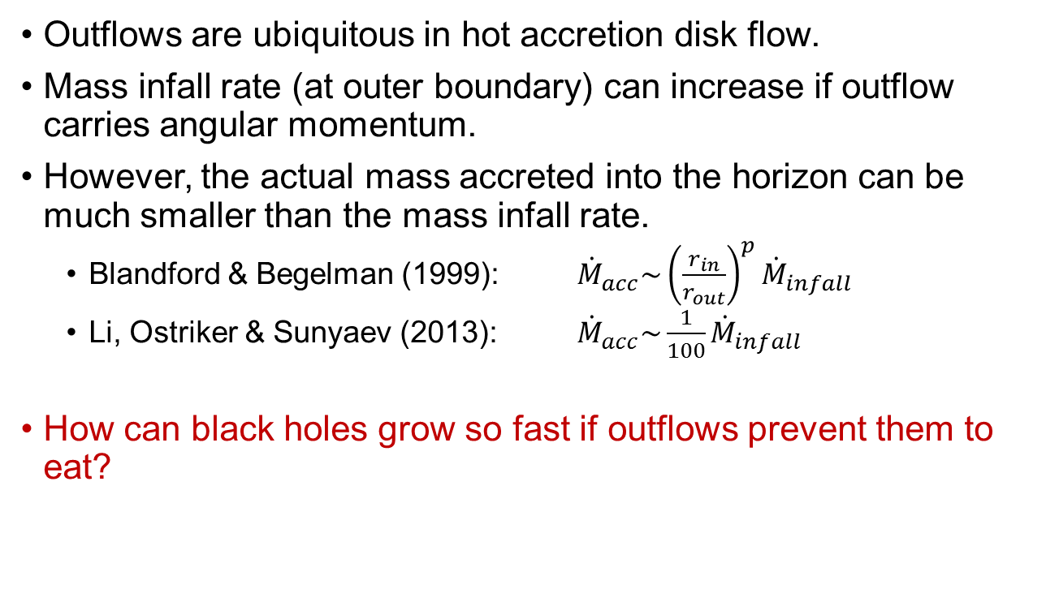
Implications
Outflows are ubiquitous in hot accretion disk flow.
Mass infall rate (at outer boundary) can increase if outflow carries angular momentum.
However, the actual mass accreted into the horizon can be much smaller than the mass infall rate.
  Blandford & Begelman (1999): ${\dot{M}}_{acc}\sim {\left(\frac{r_{in}}{r_{out}}\right)}^{p}{\dot{M}}_{infall}$
  Li, Ostriker & Sunyaev (2013): ${\dot{M}}_{acc}\sim \frac{1}{100}{\dot{M}}_{infall}$
How can black holes grow so fast if outflows prevent them to eat?

