Slide 1
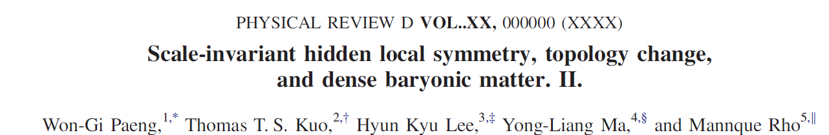
“ICGAC-13 & IK15
July 03-07, 2017, Ewha Womans Univ.
Hadronic matter with emergent symmetries
at high density
Hyun Kyu Lee
Hanyang University

Slide 2
I. Dense hadronic matter (DHM)
Nuclei, Fe ,
normal nuclear density n₀ = 0.16/fm³
Heavy ion collision
RHIC, LHC, RIKEN, FAIR, FRIB, RAON
Neutron star(NS) core
Merger remnant
binary neutron star merger

Slide 3
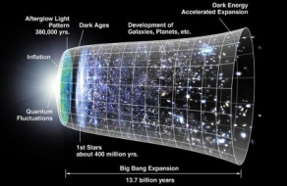
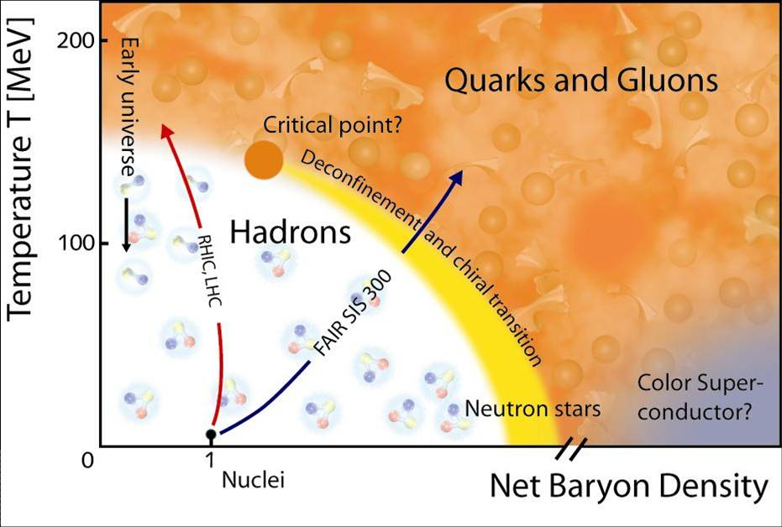
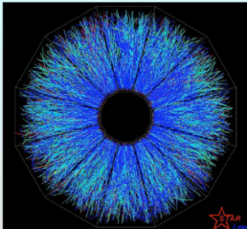
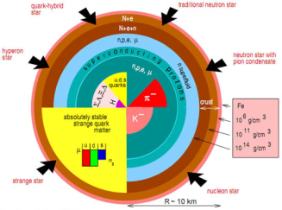
Phase Diagram of Quantum Chromo Dynamics(QCD)

Slide 4
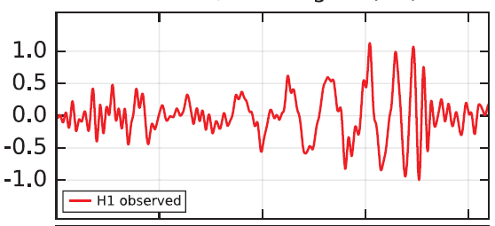
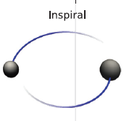



Gravitational waves from binary merger
- Mass

Slide 5
- Tidal deformation

Slide 6
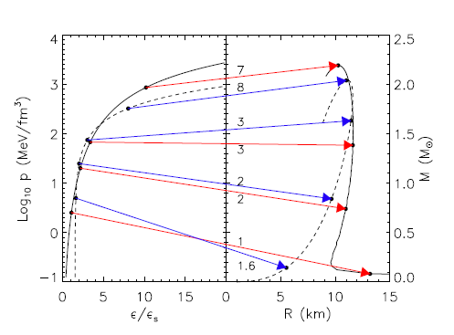
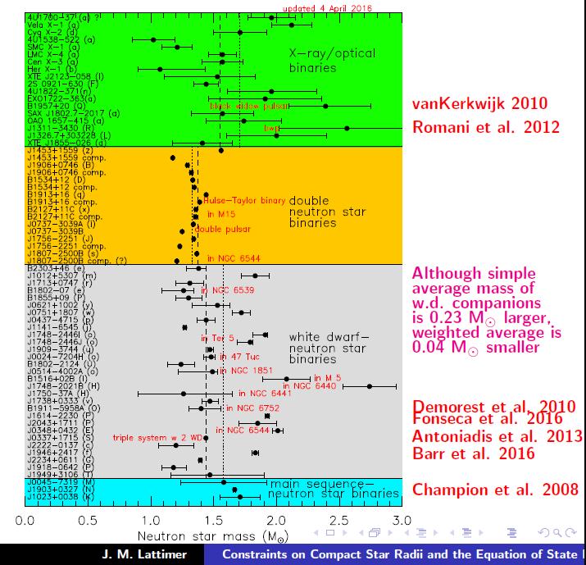
Core density of neutron stars
Lattimer, arXiv: 1305.3510

Slide 7
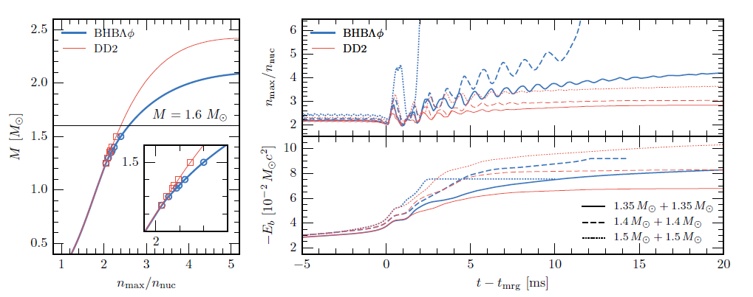
- Merger Remnant : n > 2 n₀
Radice et al. 1612.06429

Slide 8
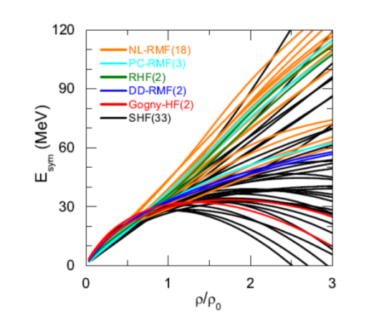
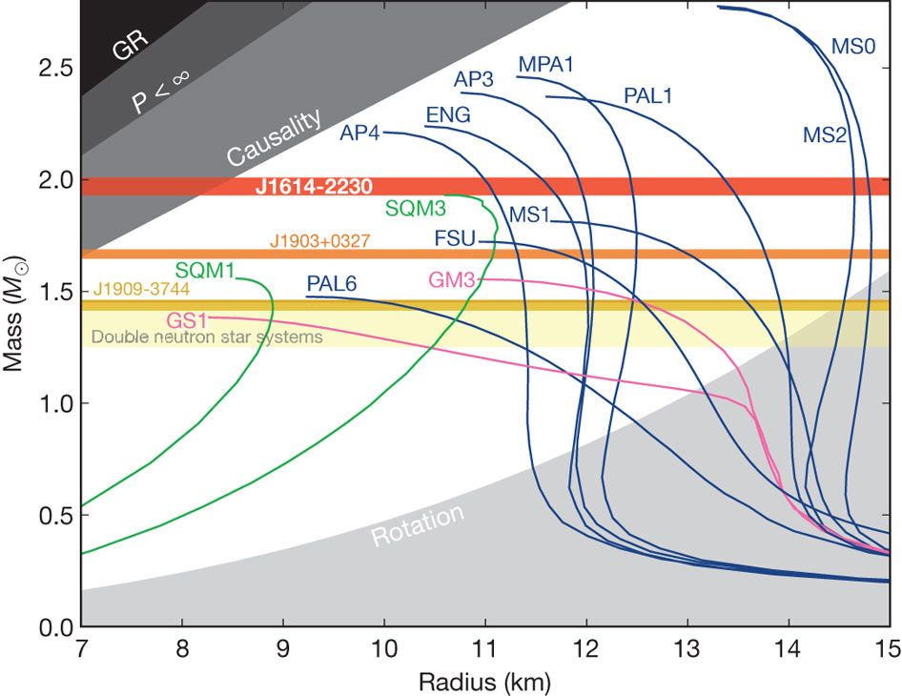
II. Equation of state of dense hadronic matter
Simple extrapolation from low density nuclear matter ?
Symmetry Energy
Mass -Radius
Deformation parameter
Chen, 1506.09057

Slide 9

New degrees of freedom and symmetries
Chiral symmetry → pions
Hidden local symmetry → vector mesons as gauge bosons
Scale symmetry → scalar meson
Flavor SU(2) symmetry → nucleon as iso-doublet

Slide 10

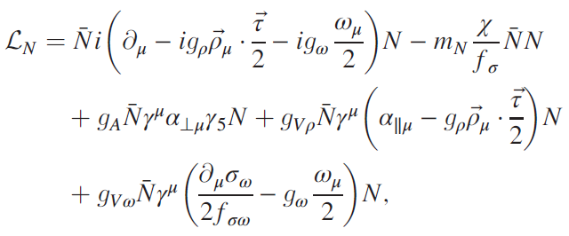
Effective theory

Slide 11
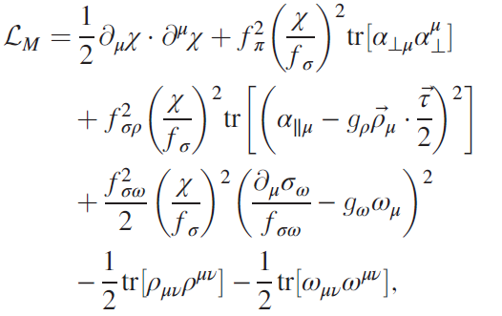

Slide 12

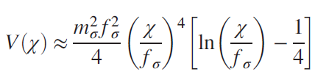
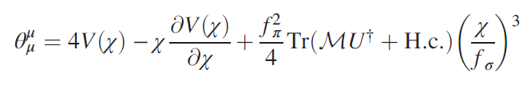
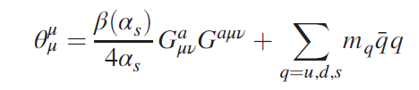
Explicit symmetry breaking(chiral and scale)
Trace of energy momentum tensor
Trace anomaly of QCD

Slide 13
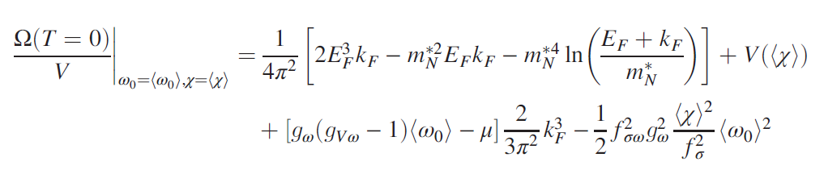
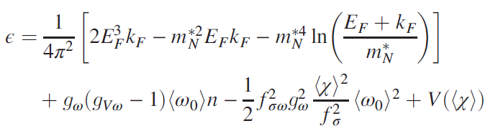
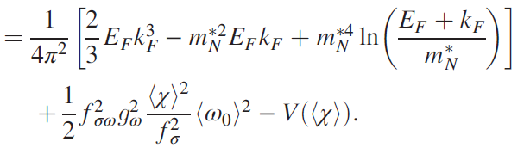

Relativistic mean field (nucleon ,vector mesons, and scalar)
-Thermodynamic potential

Slide 14



-Trace of energy momentum tensor
-nucleon mass is introduced scale symmetric way !

Slide 15

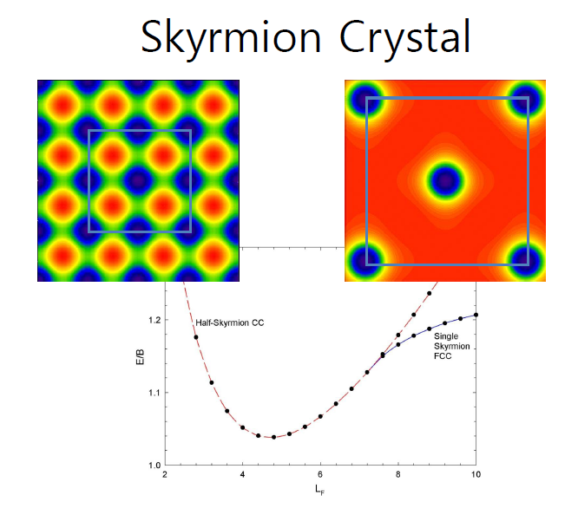
Hint: dense nuclear matter - skyrmion on the lattice:
nucleon as skyrmion (toplogical soliton) in pionic lagrangian
baryonic matter : skyrmion on the lattice
Half skyrmion phase
skyrmions → half skyrmions on lattice
Goldhaber and Manton(1987); Park et al. (2003), …

Slide 16
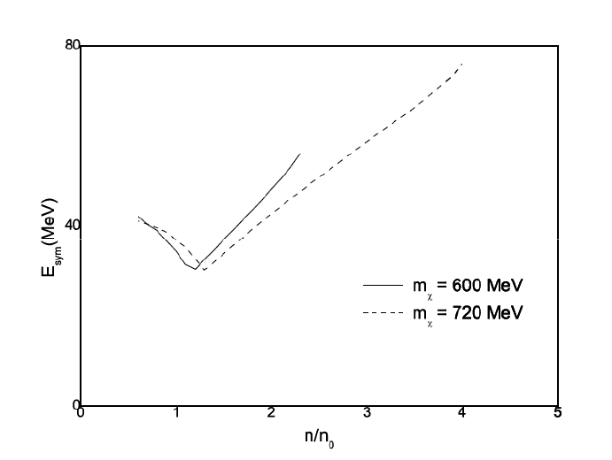




1. symmetry energy
HKL, Park and Rho, PRC 83,025206(2011)
2. homogeneous dilaton condensation
3. inhomogeneous ‘chiral’ condensation
Y. Ma et al. Phys. Rev. D 91, 096011 (2015)

Slide 17
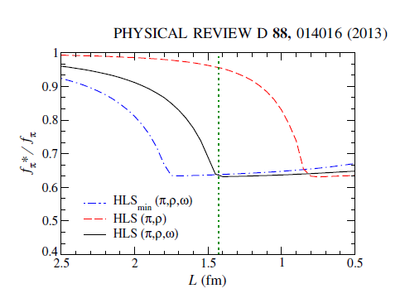

Slide 18
B. Change of scaling law from low density to high density regime
hints from walking ideas
1. topological phase change:
half skyrmion phase at higher density
2. vector manifestation at high density .
3. two solar mass neutron stars
→ implemented in the scaling with density:
two different scalings : low - and high density
- nucleon and meson coupling constants
- masses of nucleon and mesons

Slide 19

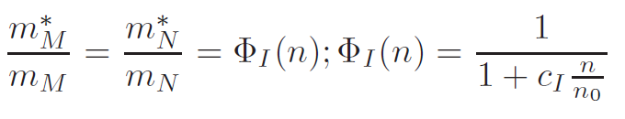

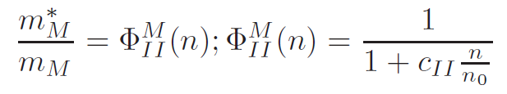


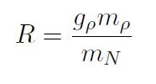



Implementation of half skyrmion into nuclear matter:
equation of state using V_{low-k}
old BR scaling at low density
new scaling at higher density
tensor force strength
, HKL, M. Rho Eur. Phys. J. A50, 14(2014)
H. Dong, T. Kuo, HKL, R. Machleidt, M. Rho PRC 87, 054332(2013)
Paeng et al. Phys. Rev. C 93, 055203 (2016)

Slide 20
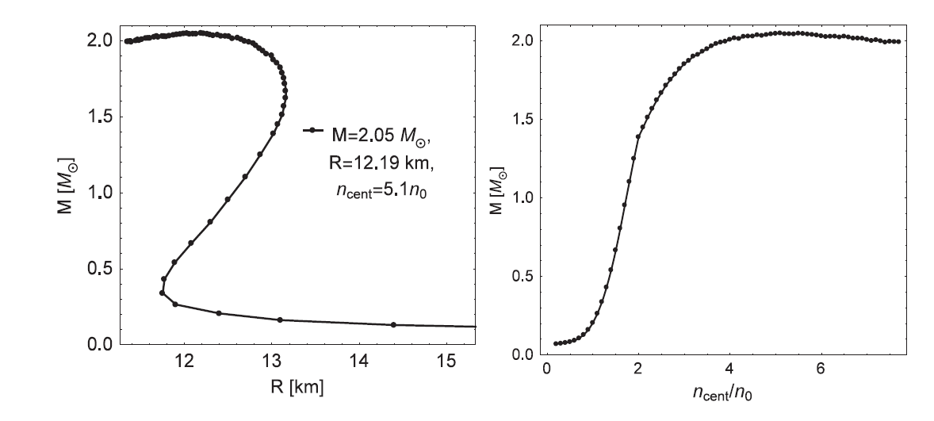
Mass- radius and central density

Slide 21
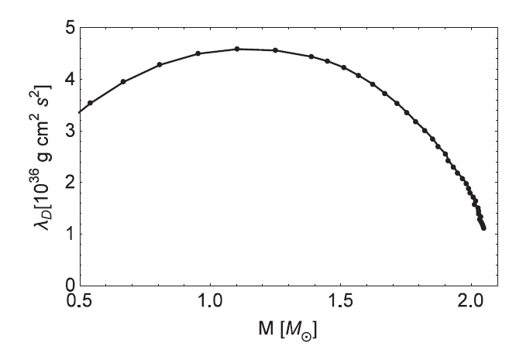
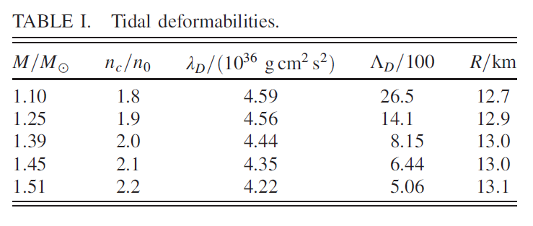
Tidal deformation

Slide 22
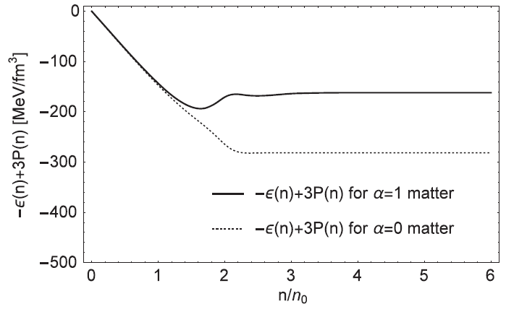
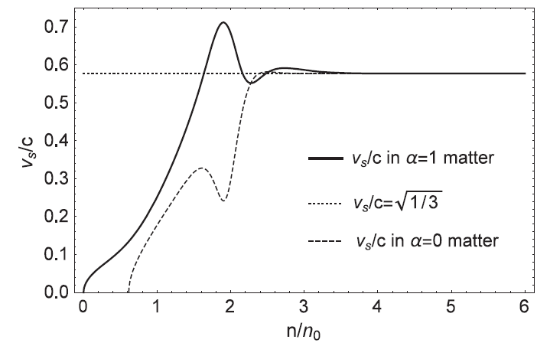
Sound velocity v → 1/3 c
Precursor of scale symmetry restoration ?

Slide 23
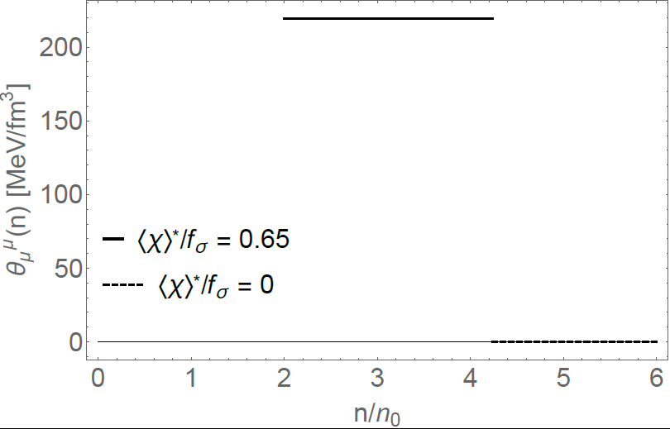
Transition to scale symmetric phase(Dilatonic Phase)
IR fixed point , Crewther and Tunstall PRD 91 034016(2015)
Dilaton fixed point, Paeng et al

Slide 24
Discussion
Equation of state of nuclear matter at high density
- Interactions between nucleon and additional degree of freedoms
Characteristics of EoS relevant to observables
- Symmetry energy : particle ratio, proton fraction, ….
- Mass, deformation parameter: gravitational waves,…
Dense matter with emergent symmetries
- scale symmetry, ……

