Slide 1
Thermodynamic Volume in AdS/CFT
13th International Conference on Gravitation, Astrophysics, and Cosmology
15th Italian-Korean Symposium on Relativistic Astrophysics
ECC, Ewha Womans University, Korea
July 03 (Mon), 2017 ~ July 07 (Fri), 2017
Kyung Kiu Kim(Sejong University)
In collaboration with By Byoungjoon Ahn, Seungjoon Hyun(Yonsei University)

Slide 2
Contents
Bulk Physics
- Black hole thermodynamics with varying a cosmological constant.
- 1st law from the Smarr relation
Boundary Physics
- Holographic renormalization
- An example (AdS4)
- 1st law from thermodynamic relation
Black holes and hyperbolic black holes
Physical Interpretations
Future direction( de Sitter case)

Slide 3
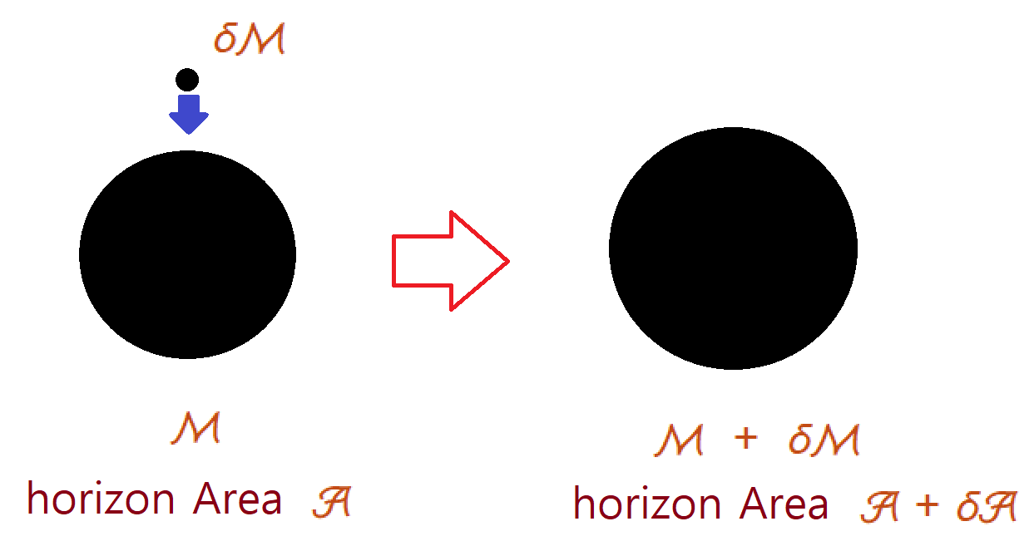
Bulk Physics
Black hole thermodynamics
Let us consider Schwarzschild BH.
Throw a particle into the BH.
The relation of the black hole parameters under this change

Slide 4
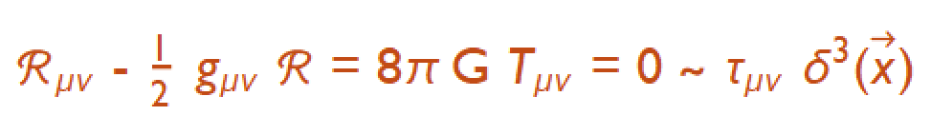

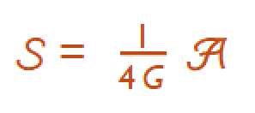
Bulk physics
It turns out that the black hole gives off the hawking radiation by considering QFT in curved spacetime.
The temperature related to this radiation is proportional to surface gravity.
Although the energy-momentum vanishes, the mass of black hole is clearly the energy of this system.
Together with the above facts, the relation of the parameter becomes the first law of the black hole systems.
And the entropy is proportional to the horizon area of the BH. One can notice that there is no PdV term. There is no concept of pressure in the bulk physics.

Slide 5

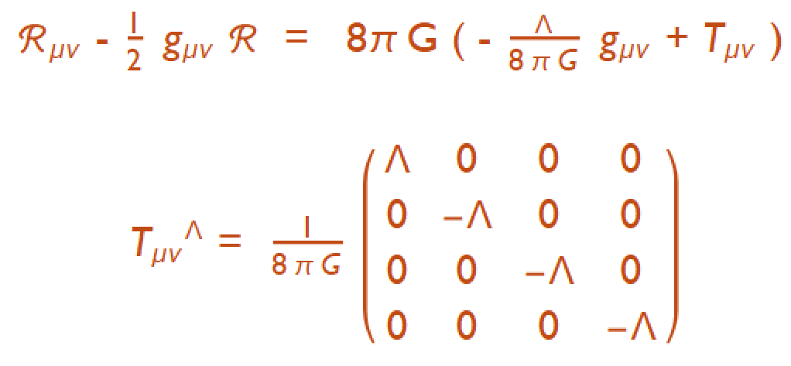
Bulk Physics
Now let us consider negative cosmological constant.
Einstein’s equation and the effective energy momentum tensor from the cosmological constant are as follows :

Slide 6

Bulk Physics
Now one can read the pressure from the energy momentum tensor
If we allow the variation of the bulk pressure or cosmological constant, one can extend the original thermodynamic law of the black holes.
There must be a thermodynamic volume dual to the pressure.
To take an explicit example, let us consider the RN BH

Slide 7
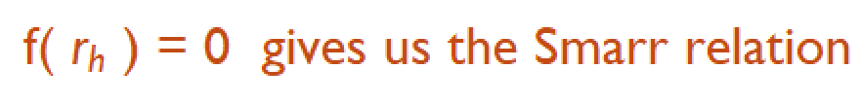
Bulk Physics
Temperature, entropy, pressure and thermodynamic volume
The smarr relation is a relation among physical quantities of the black hole.
From this, one can derive the 1st law

Slide 8
Bulk Physics
Thus the black hole mass becomes enthalpy H = E + P V.
- Kastor et al (2009)
These P and V provide a new phase structure which contains triple point.
- Dolan(2010,2011,2013, 2014)
- C. V Johnson (2014)

Slide 9
Boundary Physics
One can obtain free energy and boundary physical quantities by using AdS/CFT.
The renormalized action is
where d = D-1. 1/(d-n) term is allowed when d > n.
From this, the VEV of energy-momentum tensor can be derived as follows

Slide 10
An Example
D = 4 , AdS4 space
The Smarr relation and the bulk first law
where the thermodynamic volume and the pressure are
The first law in terms of the internal energy variation and enthalpy

Slide 11
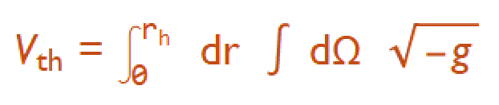
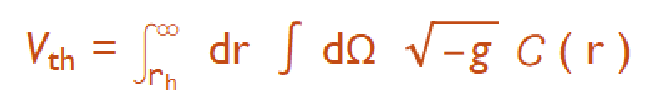
An example
The thermodynamic volume looks like the interior volume of the black hole
In general, it can be written down as an integration of out side of horizon. Hyun et al (1702.06629)
Boundary Physics (In the dual field theory)
- the boundary metric is

Slide 12
In the boundary theory, thermodynamic volume is nothing but the spatial volume
And the Free energy becomes
where we introduced a convenient coordinate
Temperature, entropy and energy momentum tensor

Slide 13
The Smarr relation becomes thermodynamic relation in the boundary theory
With the extensive quantities
The extended first law in the boundary theory

Slide 14
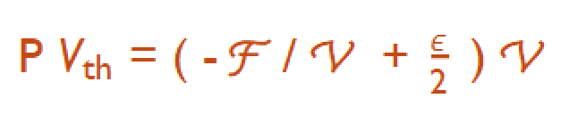
The relation between bulk PV and boundary PV is

Slide 15
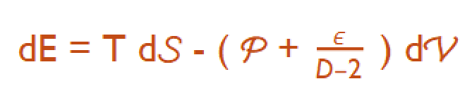
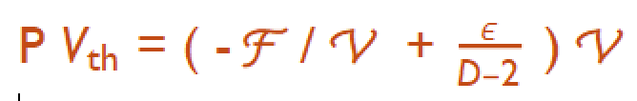
Boundary Physics
In D dimension
Thermodynamic relation has universal expression :
The extended first law is
The relation between bulk and boundary quantities

Slide 16
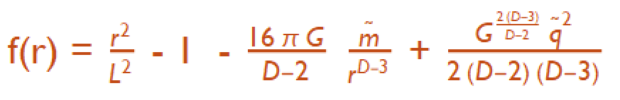
Black hole and Hyperbolic black hole
The hyperbolic black hole with k = -1
This case also admits charged black hole solution
A(r) = 0 and
When mass and charge parameter vanish, we call this a topological black hole.
Then the entropy of this black hole is same with the entanglement entropy in the dual field theory.
- Casini, Huerta and Myers (2011)

Slide 17
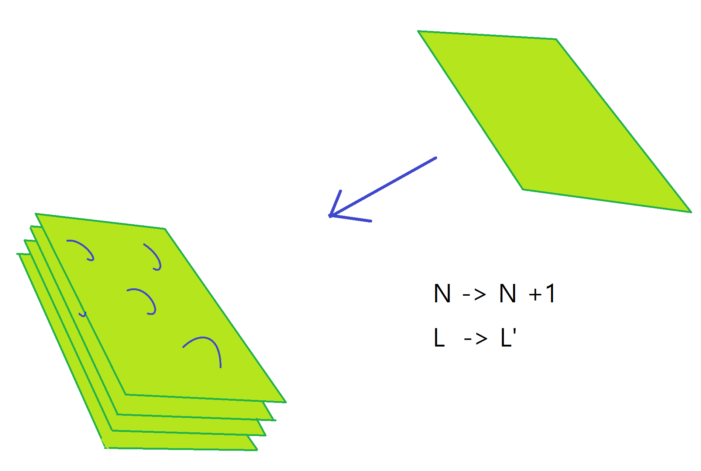
Physical interpretation
In D=5 , AdS5 , The dual theory is N=4 SYM.
Variation of L is related to variation of N, the number of D3 brane.
Thus the thermodynamic volume is a kind of D3 brane chemical potential.
- Dolan (2014)

Slide 18
Physical interpretation
D=4 , AdS4 case, the dual theory is ABJM theory.
And the AdS radius is given by
- N is the rank of gauge group and k is the CS level.
When we consider AdS Schwarzschild BH, the thermodynamic 1st law can be written in the following form :
where
These are a chemical potential for M2 brane charge and chemical potential like quantity for modding S^7.

Slide 19
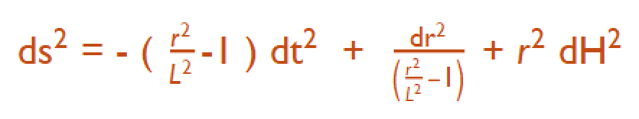

Physical Interpretaton
The topological hyperbolic black hole.
Ex AdS4
The BH entropy is same with in entanglement entropy with a disk entangling region A. And the radius of A depend on L.

Slide 20
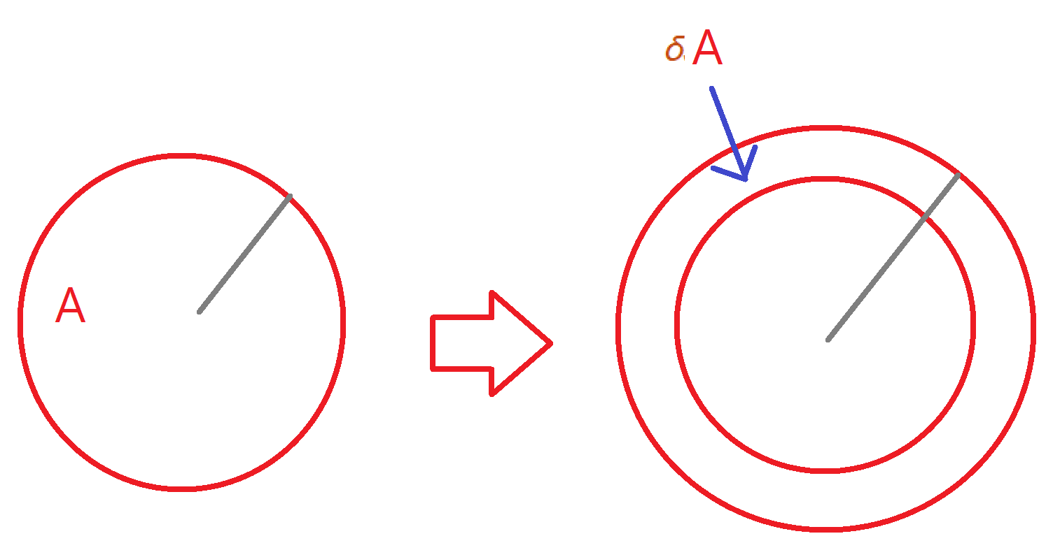
Physical interpretation
So varying L corresponds to varying radius of entangling region for the tracing out.
The thermodynamic volume in the hyperbolic black hole is related to entanglement pressure.
The entanglement pressure can be appear in an extended 1st law of the entanglement entropy.

Slide 21
Summary and Future direction
Thermodynamic volume of black hole appears naturally by extension of the 1st law with varying the cosmological constant.
We found the expression of the thermodynamic volume in terms of the boundary quantities for various BHs.
We discussed the physical interpretation of the V_th.
Same discussion of de Sitter space is very interesting.
We(I and Chang-Young Ee) consider thermodynamic volume in a recent study on dark matter(Verlinde 2016)
Varying cosmological constant in de Sitter space is very similar to the inflation.
It is interesting to see how this volume can be related to the slow roll parameters.

Slide 22
Thank you very much !

