Slide 1




APCTP-TRIUMF Joint Workshop
14-19 September
Pohang, South Korea
Marcella Grasso
From dilute matter to the equilibrium point in the energy-density-functional theory

Slide 2
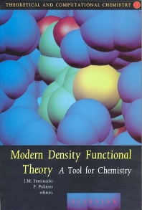
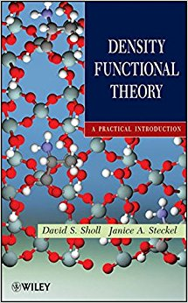
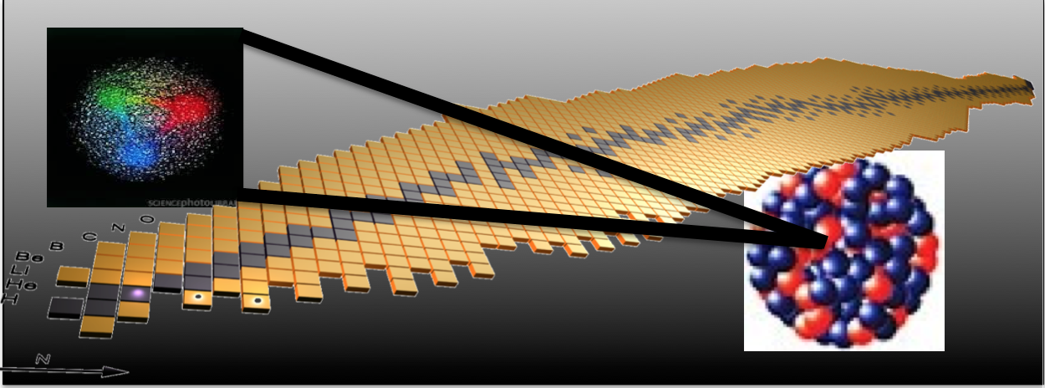
Density Functional Theory in chemistry and solid state physics
Mean-field models and beyond
Nuclear many-body problem with effective interactions
Double counting of correlations, divergences, …
- EDF designed for beyond-mean-field models
- Nuclear matter
- Bridging with EFT/ ab initio (borrowing concepts, ideas and pseudodata
-> less phenomenological)
Energy Density Functional
(EDF) theory. Powerful and versatile approach used since several decades for structure and dynamics.
- Analogies and differences with the DFT theory
- Functionals derived in most cases from effective phenomenological interactions adjusted at the mean-field level (impact on predictive power)

Slide 3
OUTLINE
Starting point. Work on EDF designed for beyond-mean-field models.
Beyond mean field: second order in the Dyson perturbative many-body expansion for nuclear matter with Skyrme-type interactions.
Divergences, double counting -> regularization procedures and parameters adjustment (for ‘usual’ nuclear density scales)
◆ Introduction of new functionals (in the EDF philosophy): very low-density nuclear matter ->
New functionals designed to correctly reproduce ALSO the low-density behavior, bridging with EFT/ ab initio
YGLO functional (resumed formula from EFT)
Lee-Yang inspired functional (density-dependent scattering length)
Applications to matter and neutron drops
Conclusions

Slide 4


Present collaborators along this research line
ENSAR2, JRA TheoS (Theoretical Support
for Nuclear Facilities in Europe)
Task: Development of suitable effective
interactions in mean-field and BMF theories
International Laboratory LIA COLL-AGAIN
(France-Italy collaborations)
Jérémy Bonnard, A. Boulet, U. van Kolck, D. Lacroix, O. Vasseur (IPN Orsay)
Jerry Yang (Chalmers)
G. Colò, X. Roca-Maza (Univ. of Milano) (second-order calculations)

Slide 5
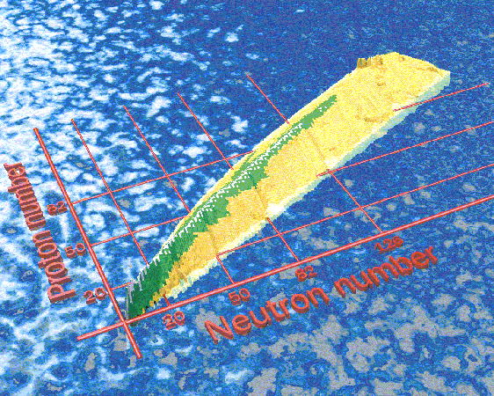
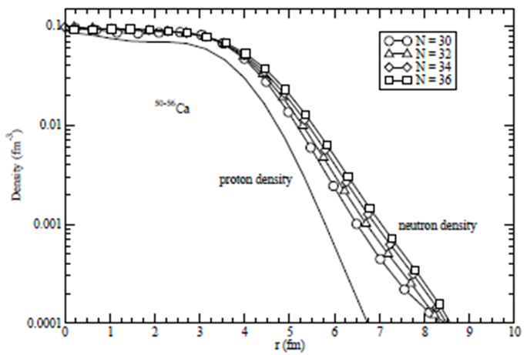
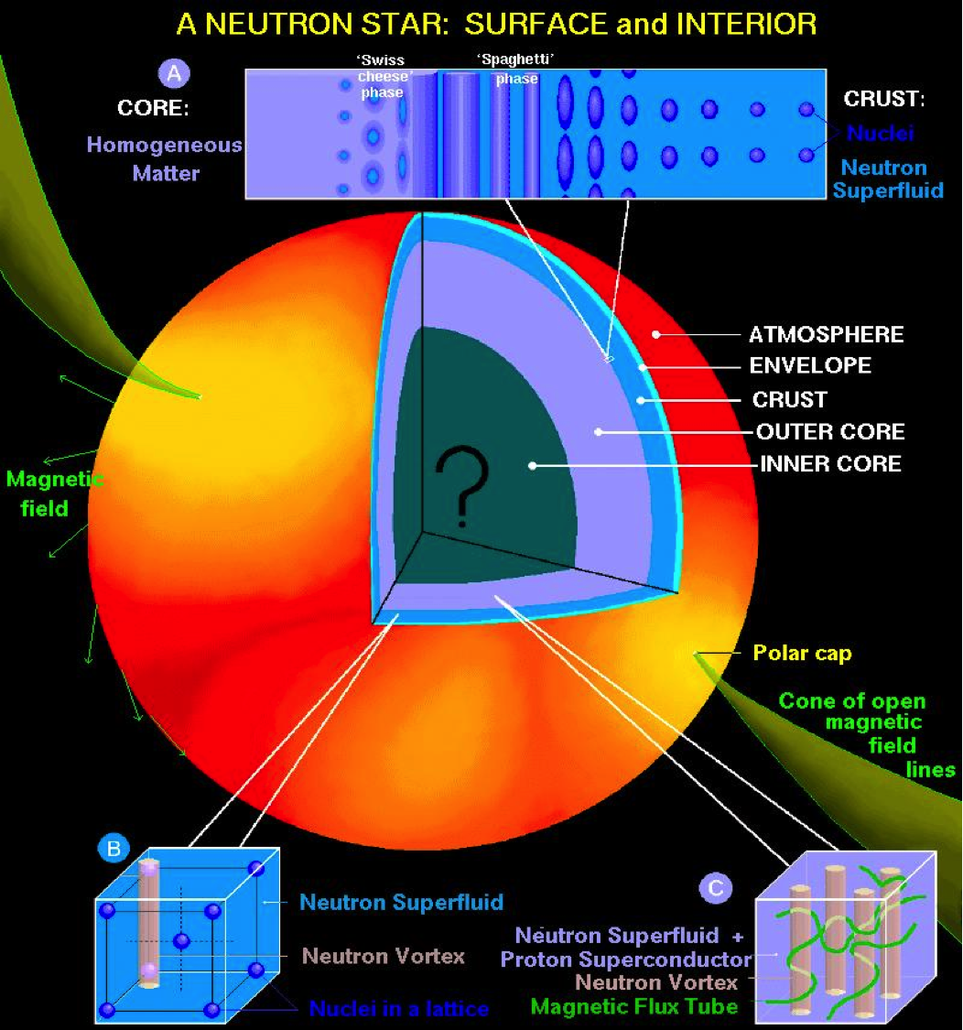
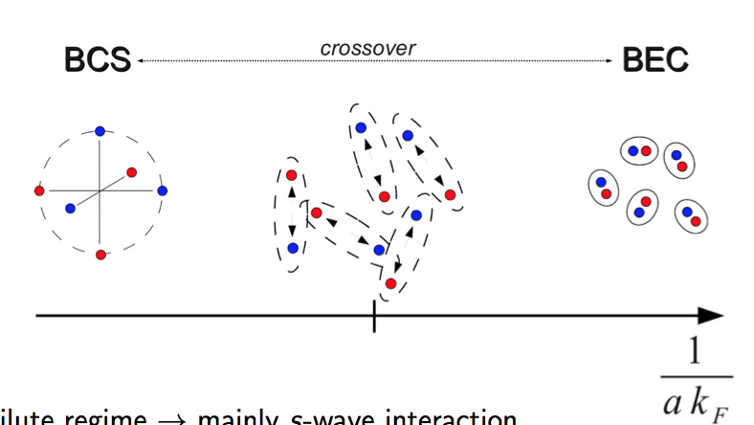
Properties of matter: relevant for constraining energy density functionals for finite nuclei and neutron stars (links matter/nuclei -> saturation density, compressibility and breathing modes, effective mass and axial breathing modes, …)
Neutron-rich matter and pure neutron matter -> physics of isospin asymmetric systems
Very low-density neutron matter
Surface properties of neutron-rich nuclei with a diffuse density.
Outer crust of neutron stars
Analogy with ultracold atomic gases at unitarity (large scattering length)

Slide 6
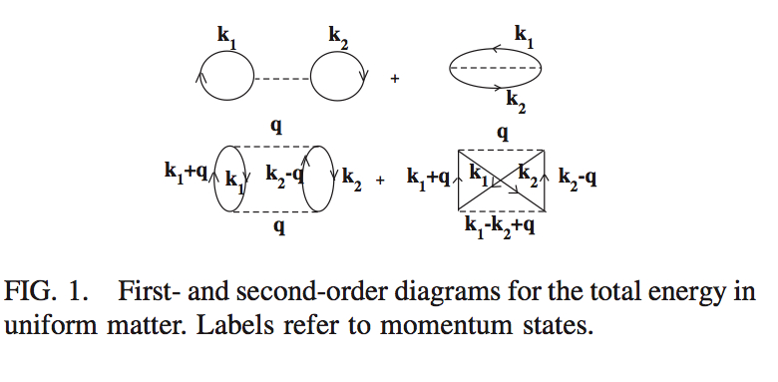
Moghrabi, Grasso, Colo’, Van Giai, PRL 105, 262501 (2010)
⬥ Yang, Grasso, Roca-Maza, Colo’ et al., PRC 94, 034311 (2016)
Grasso, Lacroix, van Kolck, Invited Comment, Phys. Scr. 91, 063005 (2016)
Yang, Grasso, and Lacroix, PRC 96, 034318 (2017)
Yang, Grasso, et al., PRC 95, 054325 (2017)
Equation of state of nuclear matter with a Skyrme-type interaction.
The perturbative many-body problem:
First order
Second order
k_{F} = (3/2 π² ρ) ^{1/3} SM
k_{F} = k_{N} = (3π² ρ) ^{1/3} NM
k_{F} -> Fermi momentum
This second-order contribution diverges ->
For ex. the square of the Skyrme t₀ term has a k_{F}⁴ dependence and is the sum of a finite part plus a term linearly dependent on the cutoff (on the transferred momentum q) -> REGULARIZATION

Slide 7

Skyrme interaction for matter (no spin orbit at the mean-field level)
s-wave
s-wave
p-wave
s-wave
Expansion in relative momenta k and k’ truncated at second order
Spin-exchange operator

Slide 8
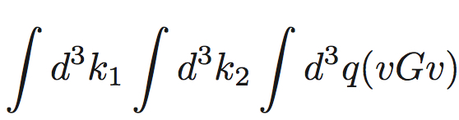
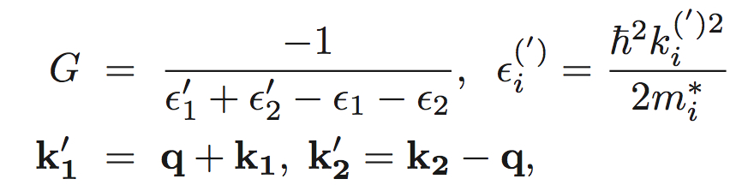
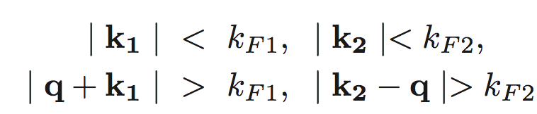
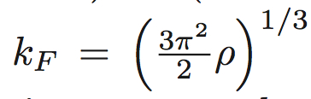
Second-order contribution to the EOS (symmetric matter)
v -> interaction
G -> propagator
q -> transferred momentum
Effective mass
k_{F1} and k_{F2} -> Fermi momenta of the two nucleons
In symmetric matter, neutron and proton Fermi momenta are the same:

Slide 9
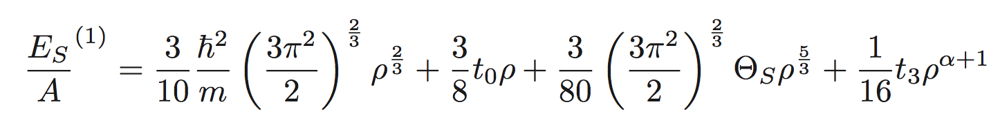

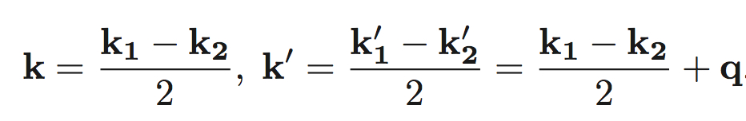
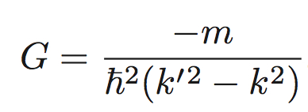
EOS of symmetric matter and cutoff regularization
First order
Second order
Convenient change of variables: using the incoming and outgoing relative momenta k and k’
Then the propagator can be simplified and written as
*

Slide 10
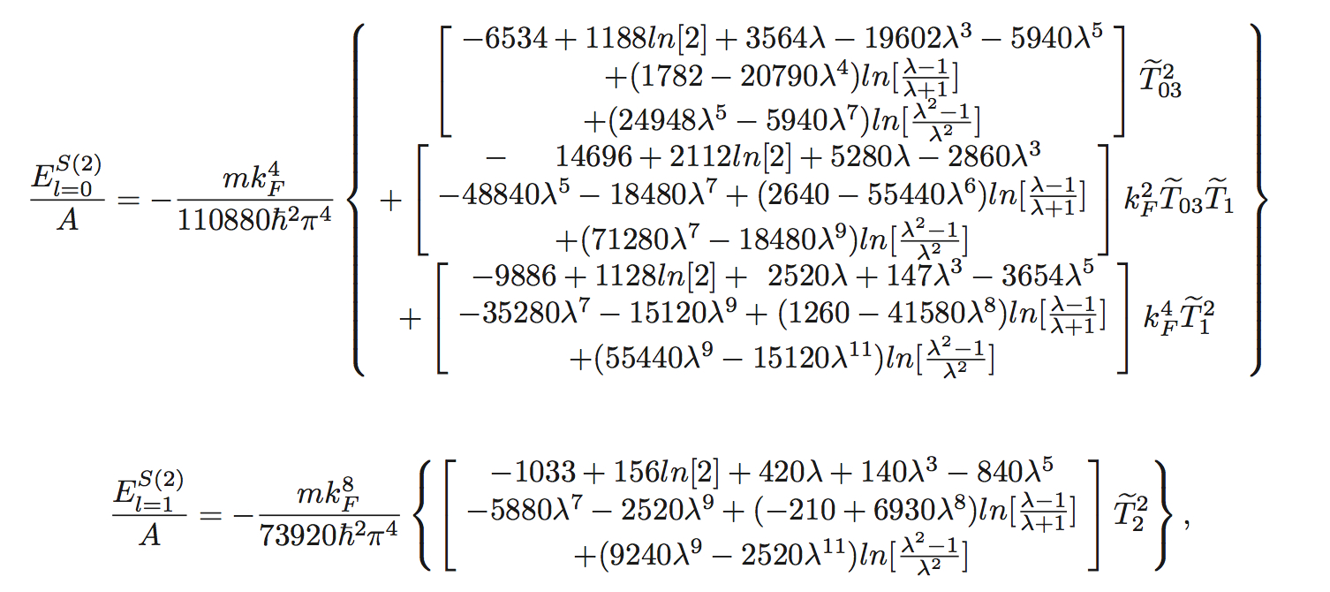
Second-order contribution for symmetric matter (without the spin-orbit and the tensor terms). Sum of the two following terms (cutoff on k’)

Slide 11
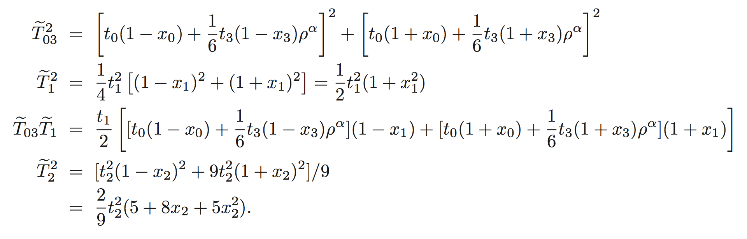
Combinations of Skyrme parameters

Slide 12
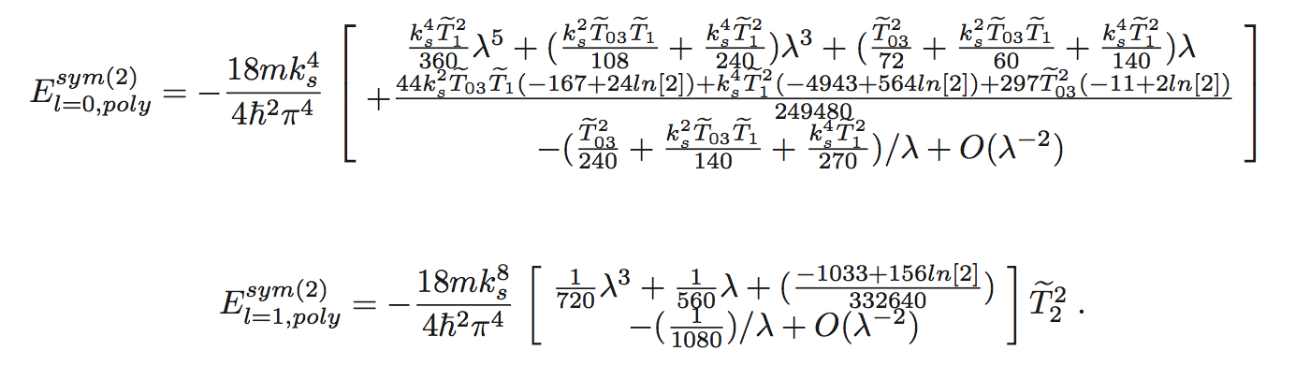
Asymptotic behavior:

Slide 13
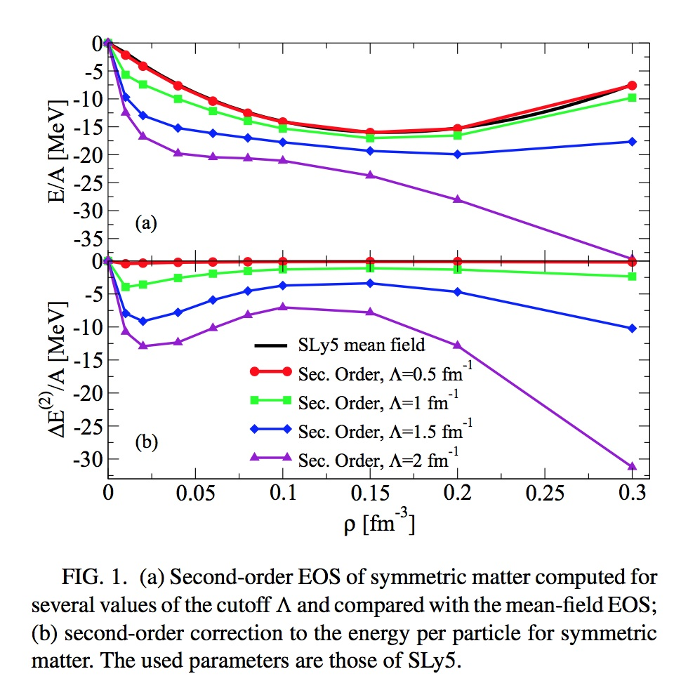
Double counting and ultraviolet divergence (equation of state of symmetric matter)
Second-order equation of state compared with SLy5 mean-field
Second-order correction
Yang, Grasso, Roca-Maza, Colo’ et al, PRC 94, 034311 (2016)

Slide 14
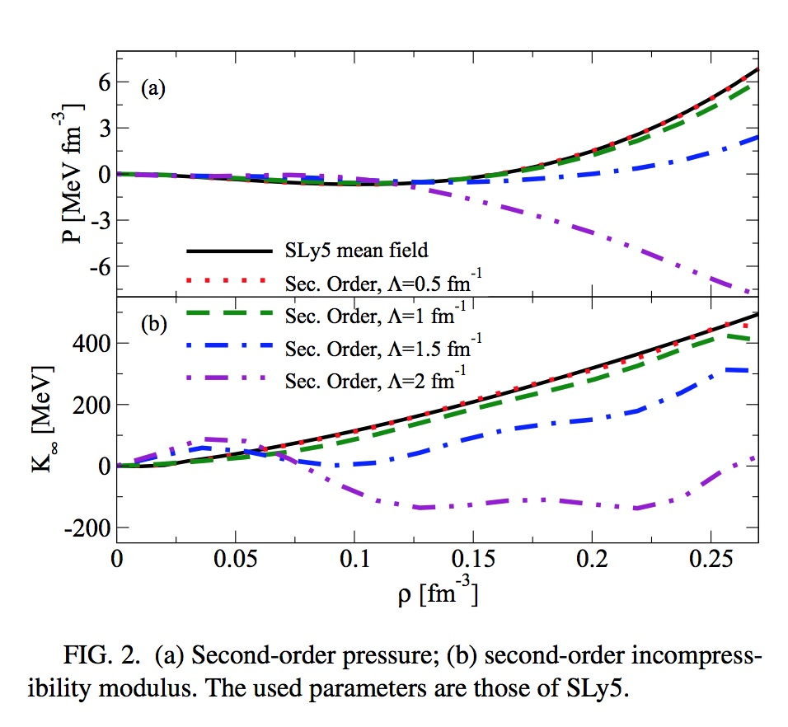
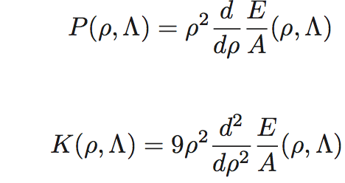
Double counting and ultraviolet divergence (pressure and incompressibility)
PRESSURE
INCOMPR.
Yang, Grasso, Roca-Maza, Colo’ et al, PRC 94, 034311 (2016)

Slide 15
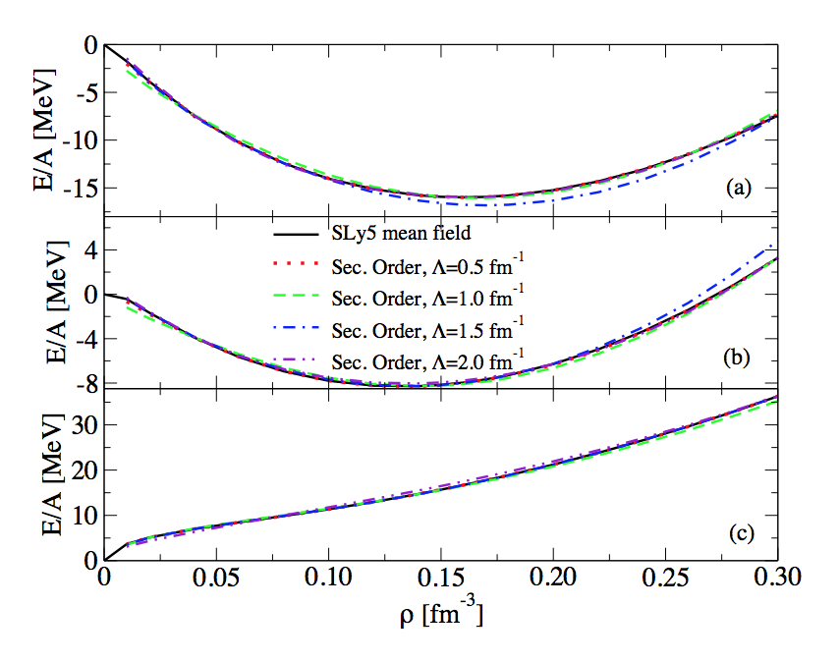
Cutoff-regularized and readjusted EOSs. Simultaneous fit for symmetric, asymmetric and neutron matter (benchmark: SLy5 mean field)
SYMM.
CUTOFF INDEPENDENCE
ASYMM.
(ρ_{n}-ρ_{p})/(ρ_{n}+ρ_{p})=0.5
NEUTR.
Yang, Grasso, Roca-Maza, Colo’, et al, PRC 94, 034311 (2016)

Slide 16
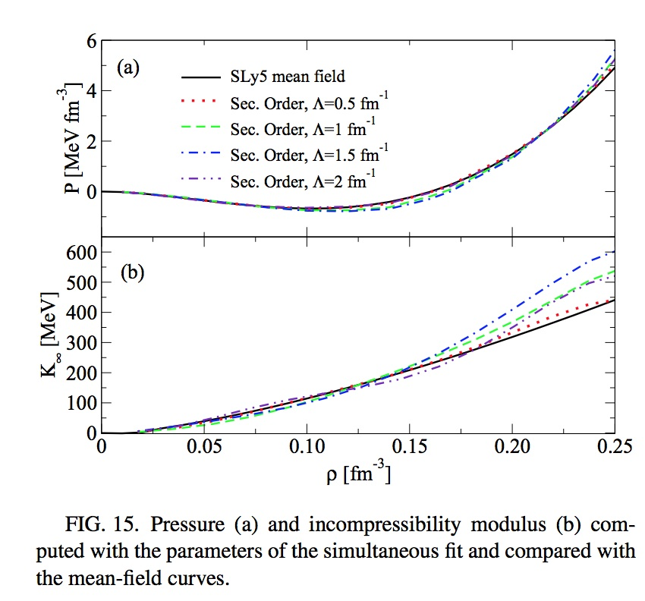
Pressure and incompressibility (not entering in the fit)
PRESSURE
INCOMPRESSIBILITY:
BENCHMARK: 229.9 MeV
Max deviation: 25 MeV
Yang, Grasso, Roca-Maza, Colo’, et al, PRC 94, 034311 (2016)

Slide 17
Remaining at leading order in the perturbative expansion
… new functionals for nuclear matter

Slide 18
YGLO functional (resummation at leading order)
Yang, Grasso, Lacroix, PRC 94 , 031301(R) (2016)

Slide 19
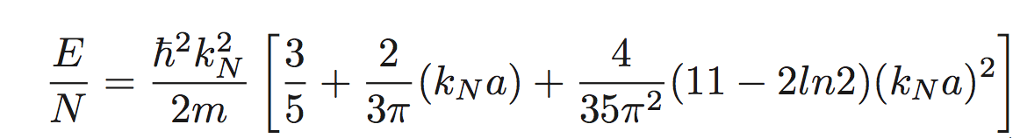
Low-density for neutron matter (EFT satisfies this regime ->
Hammer, Furnstahl, NPA 678, 277 (2000))
Lee-Yang expansion in (ak_{N}). Low-density EOS
Lee and Yang, Phys. Rev. 105, 1119 (1957)
a -> neutron-neutron scattering length, -18.9 fm
k_{N} -> neutron Fermi momentum = (3π² ρ)^{1/3}
α = 1/3
What about the mean-field Skyrme EOS?
Skyrme term | kN dependence in the EOS
t ₀ | k_{N}³
t ₃ | k_{N}^{3α+3}
t ₁ and t ₂ | k_{N}⁵

Slide 20

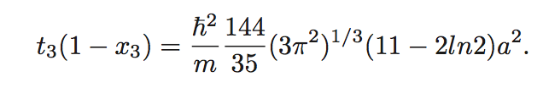
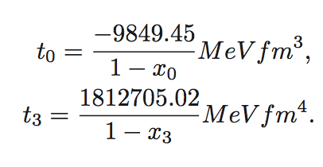
We have to constrain the parameters in the following way:

Slide 21
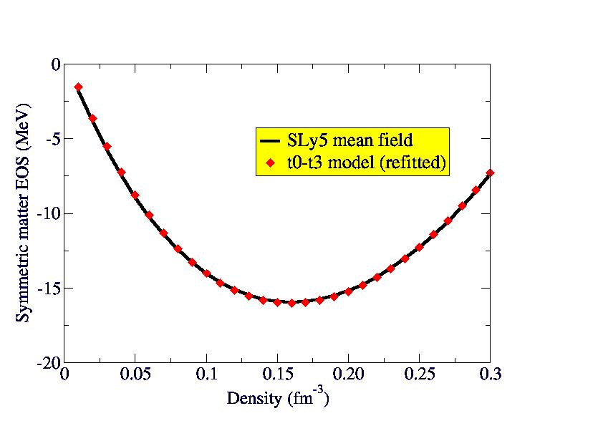
It is possible to constrain the low-density behavior of neutron matter, with α=1/3, and to adjust x0 and x3 for reproducing a reasonable EOS for symmetric matter (at ordinary densities)
But the EOS of neutron matter is completely wrong at ordinary scales of densities
Yang, Grasso, Lacroix, PRC 94 , 031301(R) (2016)

Slide 22
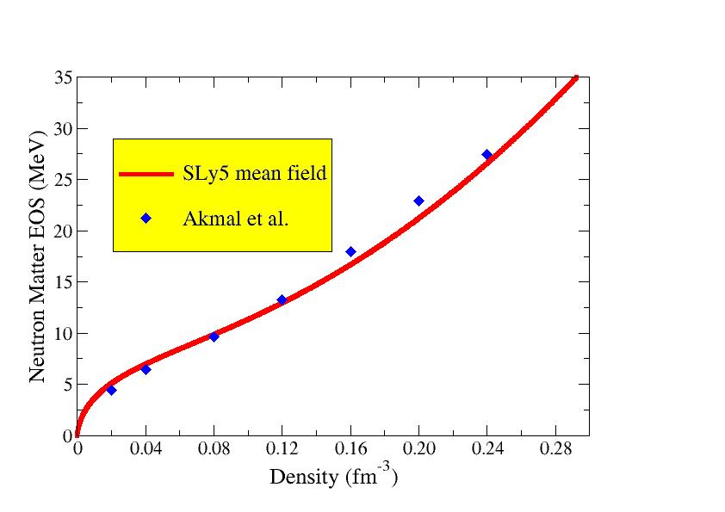
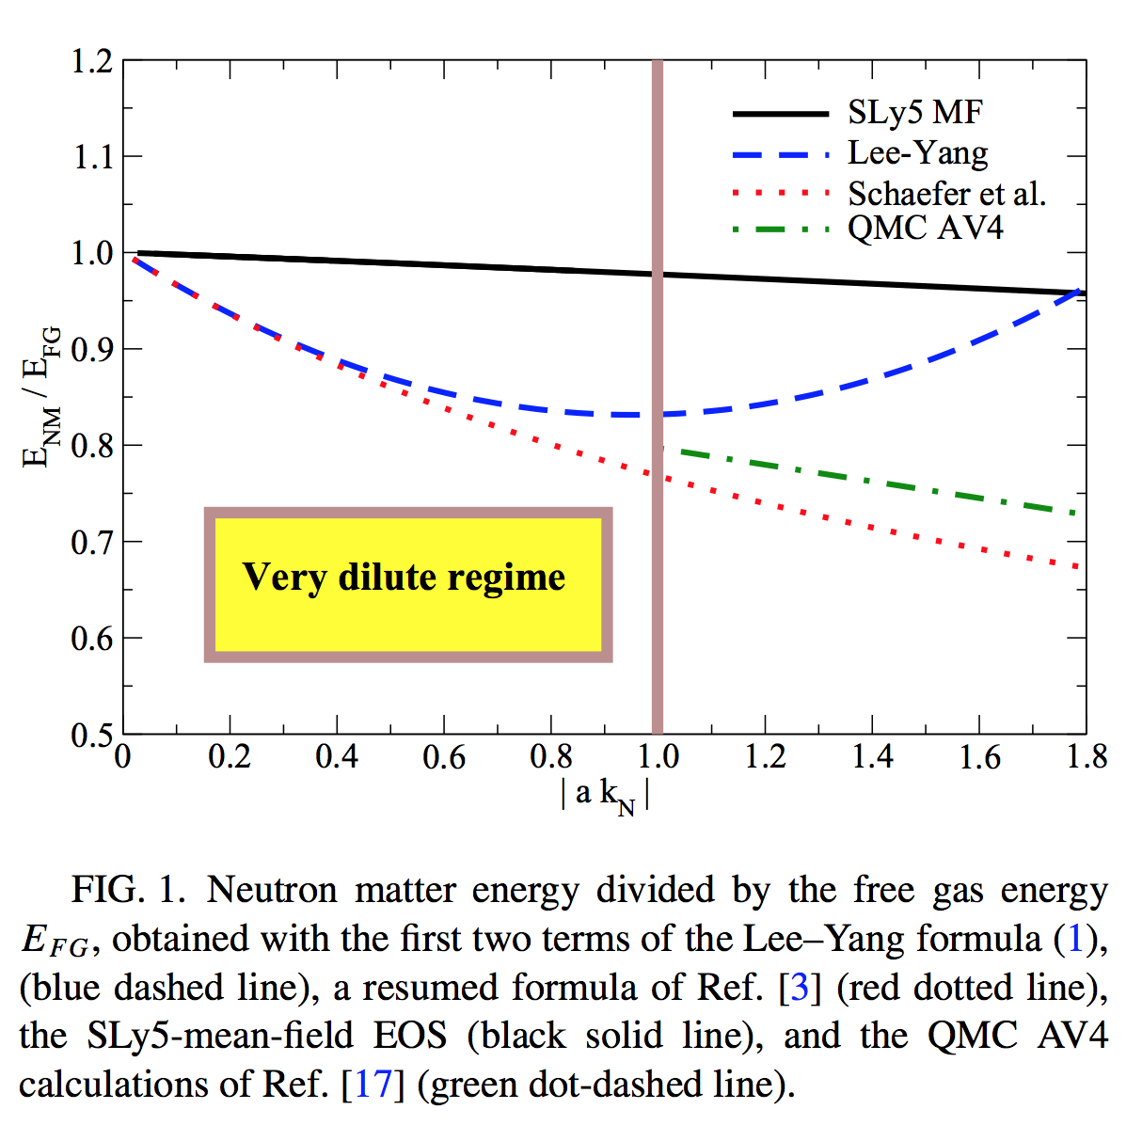
Neutron matter at ‘usual’ density scales. Example of Lyon-Saclay forces adjusted on the neutron EOS
Low-density regime
SLy5 -> Chabanat et al. NPA 627, 710 (1997); 635, 231 (1998), 643, 441 (1998)
Akmal et al. -> PRC 58, 1804 (1998)
Neutron matter energy divided by the free gas energy
Yang, Grasso, Lacroix, PRC 94 , 031301(R) (2016)

Slide 23
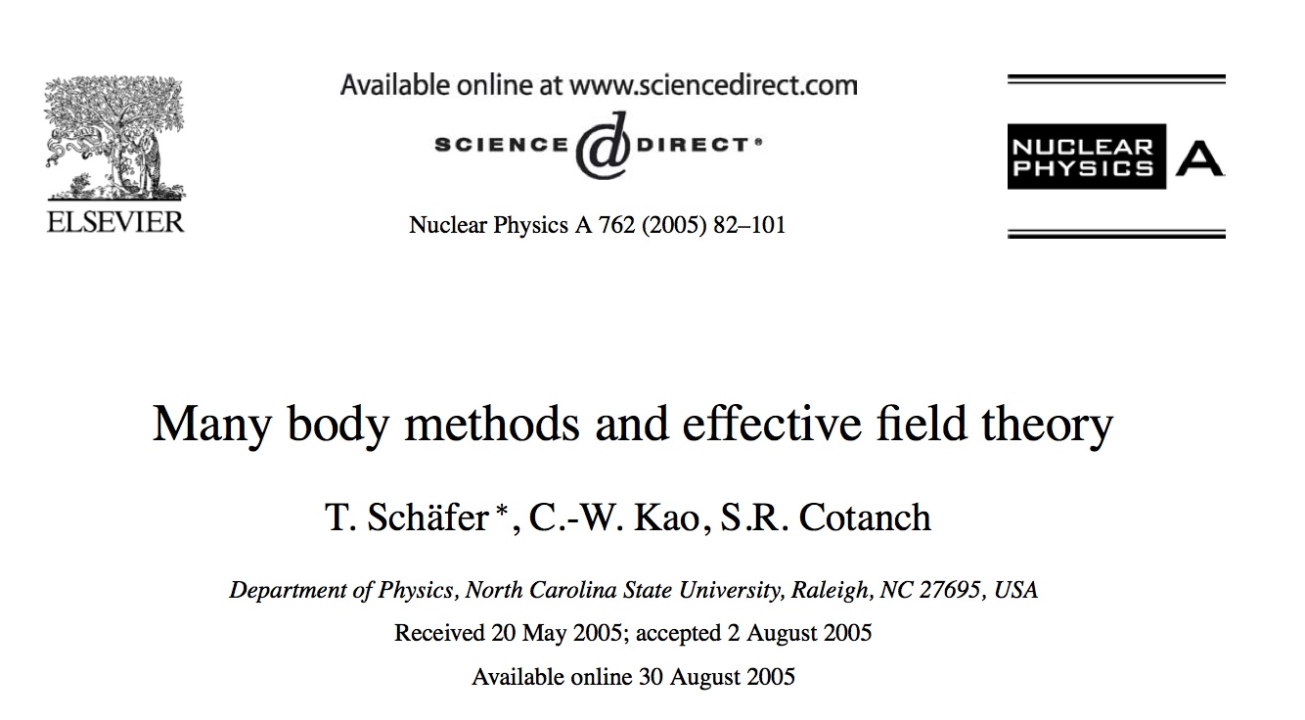
Some indications from second-order calculations: the second-order contribution has the required k_{F}⁴ term (second term of Lee-Yang exp.)
… but only second order is not enough (if one wants to keep the correct value of the scattering length)
Resummation techniques
Steele, arXiv: nucl-th/0010066v2
Kaiser, NPA 860, 41 (2011)
Schaefer, NPA 762, 82 (2005)
Effective field theories capable of describing systems with anomalously large scattering lengths require summing an infinite number of Feynman diagrams at leading order …

Slide 24
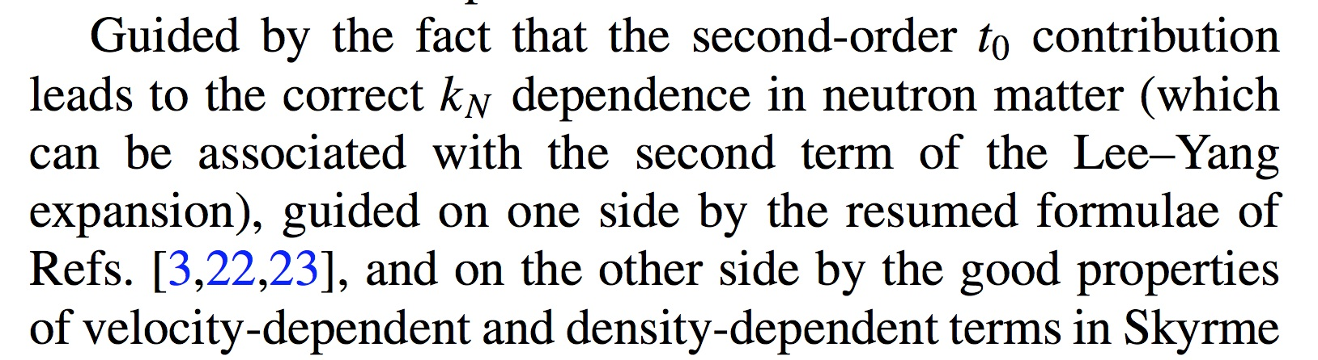
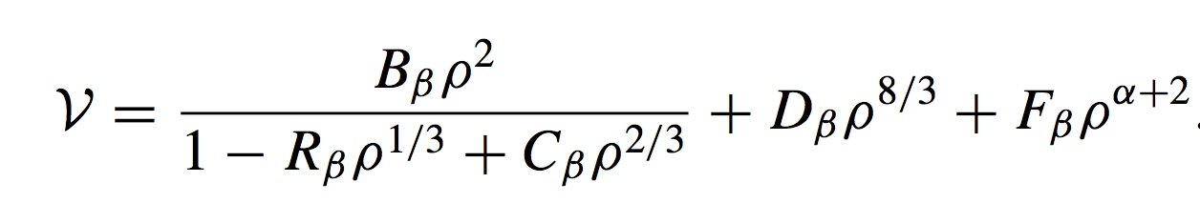
Guided by:
The fact that the second-order t₀ contribution leads to the correct dependence on the Fermi momentum in neutron matter;
The resumed formulae;
Good properties of Skyrme functionals
A hybrid functional, YGLO (Yang, Grasso, Lacroix, Orsay):
Matching the low-density limit with the Lee-Yang expansion of the energy
Beta = 1 - > symmetric matter
Beta =0 -> neutron matter

Slide 25
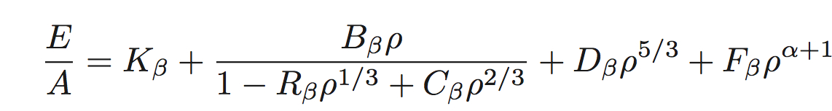
YGLO functional: Inspired by resumed expressions (resummed functional) (EFT)
Constrained by the first two terms of Lee Yang formula (scattering length)
EOS for symmetric and neutron matter:
Mimic velocity- and density-dependent terms
Resummed expression
Other parameters adjusted on QMC results at extremely low densities and on Friedman et al. or Akmal et al. EOSs at higher densities

Slide 26
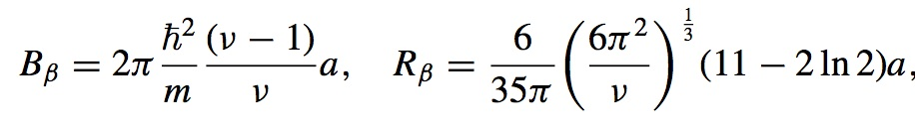
B and R are fixed by imposing to recover the Lee-Yang formula (the analog for symmetric matter may be found in Fetter-Walecka book)

Slide 27
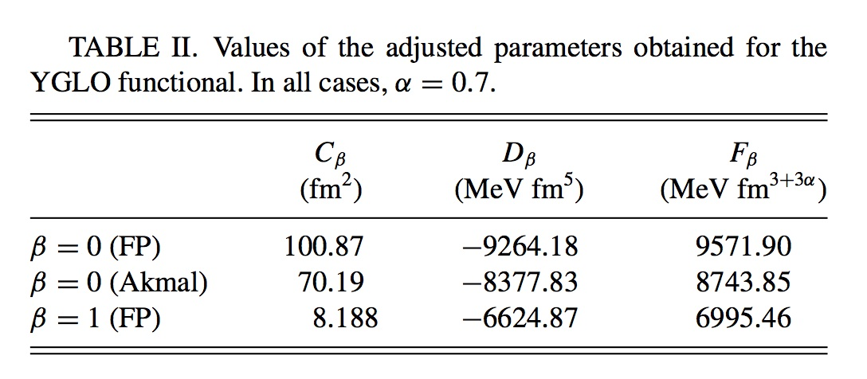
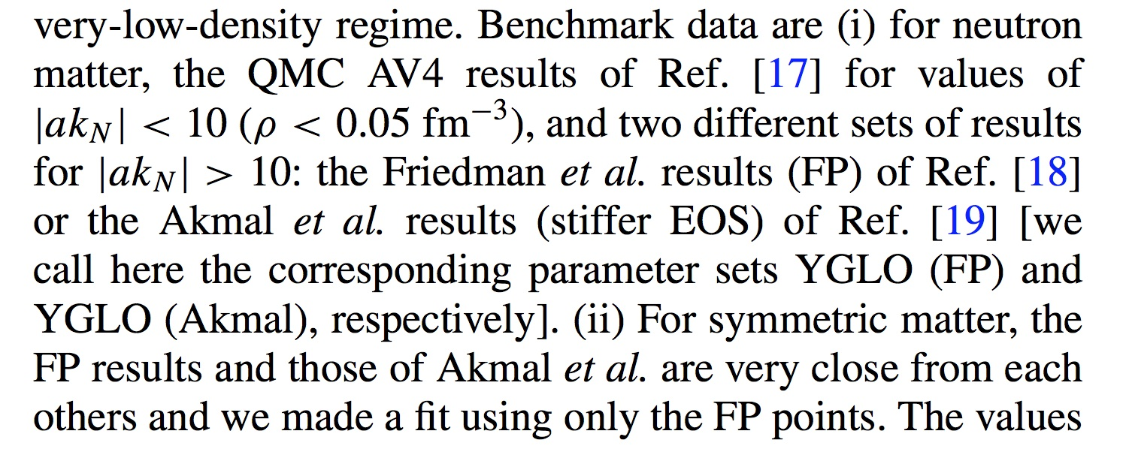
The other adjusted parameters

Slide 28
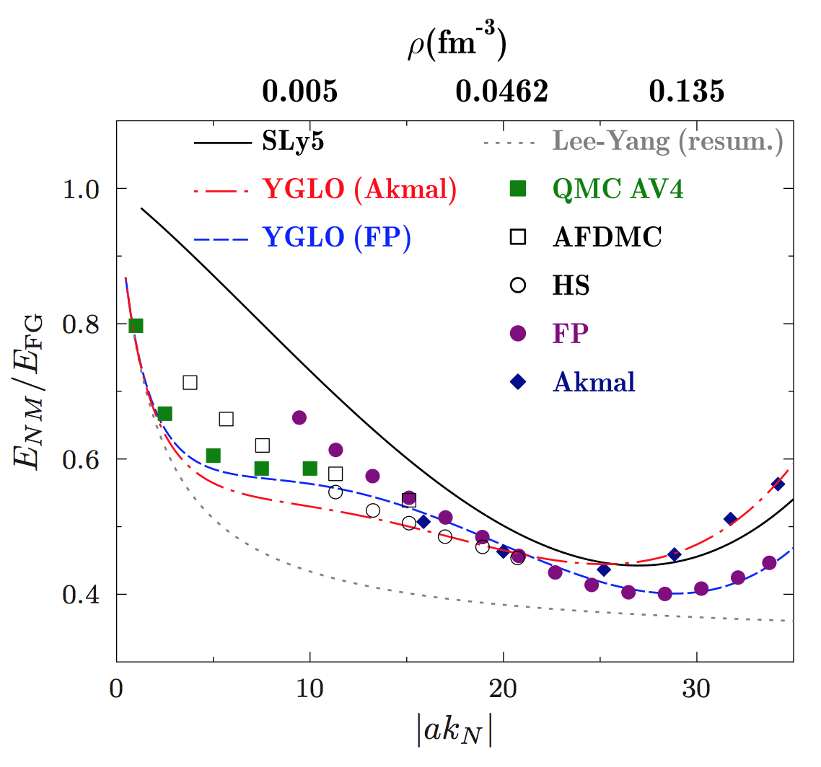
YGLO. Very low-density behavior of neutron matter
Energy divided by the free gas energy
Yang, Grasso, Lacroix, PRC 94, 031301(R) (2016)

Slide 29
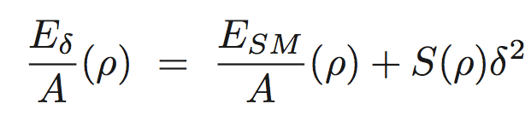

Asymmetric matter
Parabolic approximation
Neutron
density
Proton
density

Slide 30
Using the experimental values of the electric dipole polarizability in the three nuclei correlation between the electric dipole polarizability times the symmetry energy J and the slope of the symmetry energy L
²⁰⁸Pb -> J=(24.5 ± 0.8)+(0.168 ± 0.007) L
⁶⁸Ni -> J=(24.9 ± 2.0)+(0.19 ± 0.02) L
¹²⁰Sn -> J=(25.4 ± 1.1)+(0.17 ± 0.01) L
Roca-Maza et al, PRC 92, 064304 (2015)

Slide 31
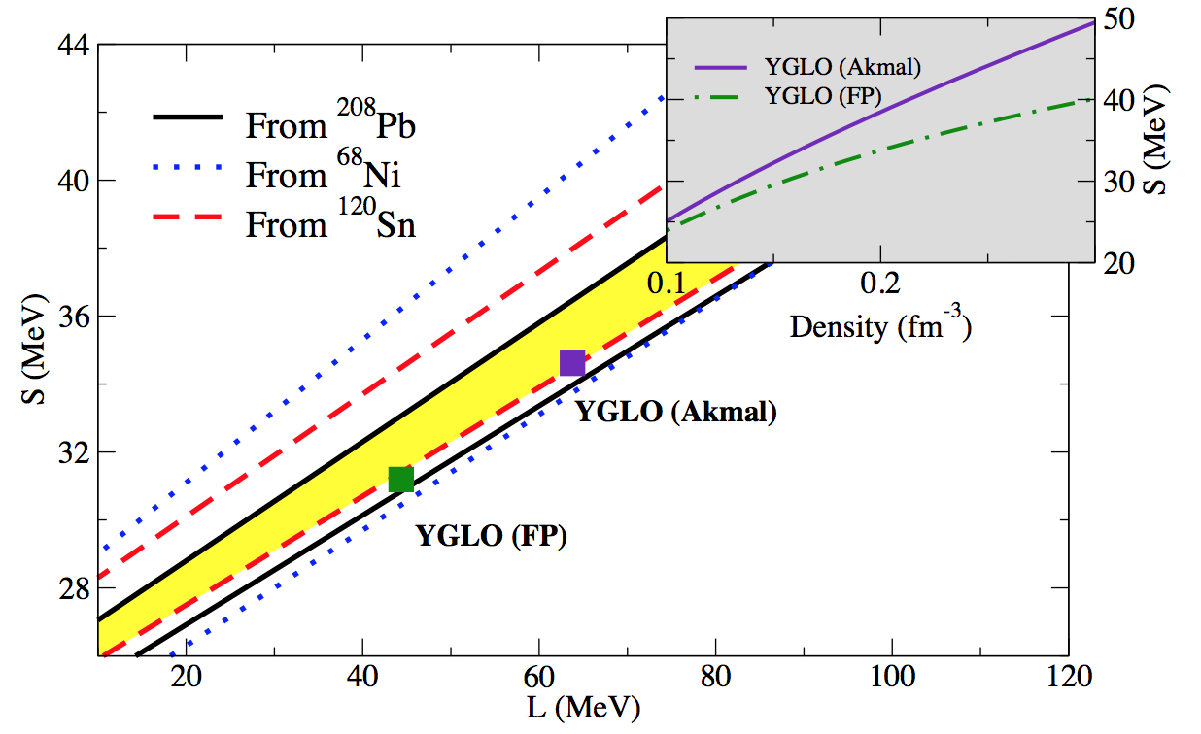
Symmetry energy and its slope
Lines delimit the phenomenological areas constrained by the exp. determination of the electric dipole polarizability
Yang, Grasso, Lacroix, PRC 94, 031301(R) (2016)

Slide 32
No resummation. Imposing a Lee-Yang regime at all densities at leading order
Grasso, Lacroix, Yang,Phys. Rev. C 95, 054327 (2017)

Slide 33
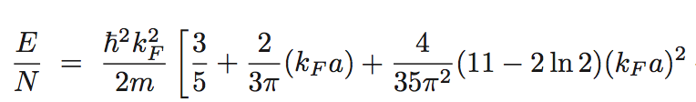
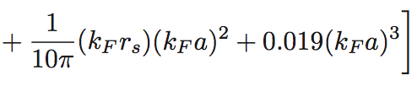
… Without resummation, how to handle the different density scales ?
… A Lee-Yang type expression for the EOS of neutron matter-> if the low-density regime is always satisfied
s-wave scattering length
Associated effective range
We choose to keep terms containing only the s-wave scattering length. The next term in the Lee-Yang expansion contains the p-wave scattering length

Slide 34

Neutron-neutron scattering length.
Low-density regime:
We impose a low-density constraint: - a k_{F}=1 ->
a =-18.9 fm up to a max momentum so that 18.9 k_{F}=1.
Beyond this value, we tune the scattering length so that –a = 1/k_{F}

Slide 35
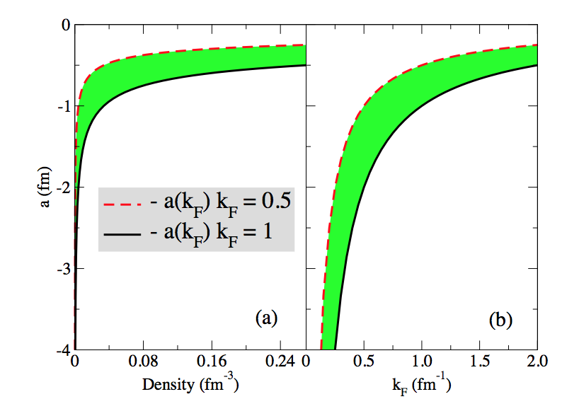
Neutron-neutron scattering length
Grasso, Lacroix, Yang, PRC 95, 054327 (2017).

Slide 36
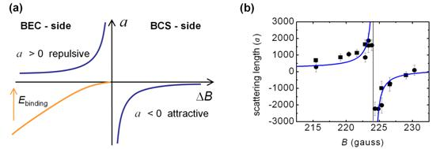
Interdisciplinary bridges
Analogy with atomic gases close to Feshbach energy in the case of a density-dependent scattering length
1/k
1/B

Slide 37
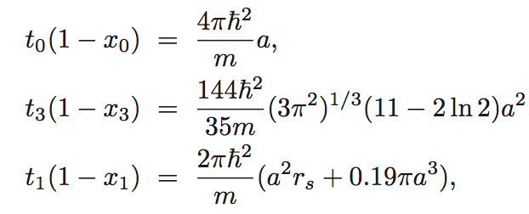
We introduce a Skyrme-type functional containing only s-wave terms and leading, at the mean-field level, to a neutron matter EOS given by the LY expression, with the relations :
The power of the density-dependent term is chosen equal to 1/3

Slide 38
We require that:
The functional correctly describes neutron matter at all density scales
The functional leads to a reasonable EOS for symmetric matter around the equilibrium point
This may be obtained by imposing a low-density regime everywhere (with a density-dependent neutron-neutron scattering length)

Slide 39
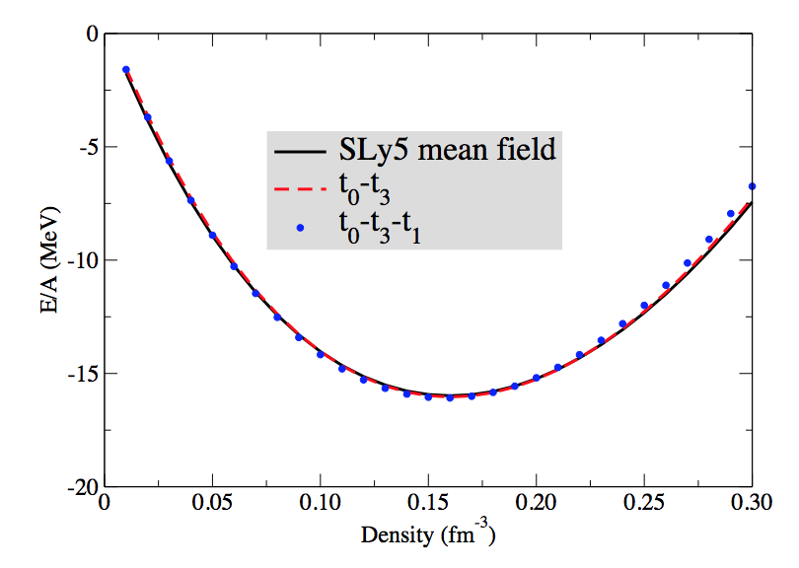
The parameters x_{i} do not enter in the EOS of symmetric matter.
We may thus adjust the parameters t_{i} to have a reasonable EOS of symmetric matter and tune the neutron-neutron scattering length by imposing, at each density scale, a low-density constraint
Symmetric matter, two cases
t₀-t₃
t₀-t₃-t₁
Grasso, Lacroix, Yang,Phys. Rev. C 95, 054327 (2017)

Slide 40
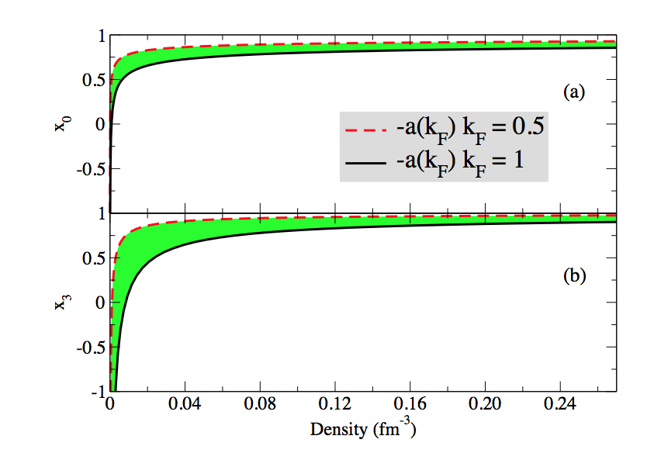
Density dependence of the parameters x₀ and x₃
Typical Skyrme values at densities around the saturation point
Grasso, Lacroix, Yang,Phys. Rev. C 95, 054327 (2017)

Slide 41
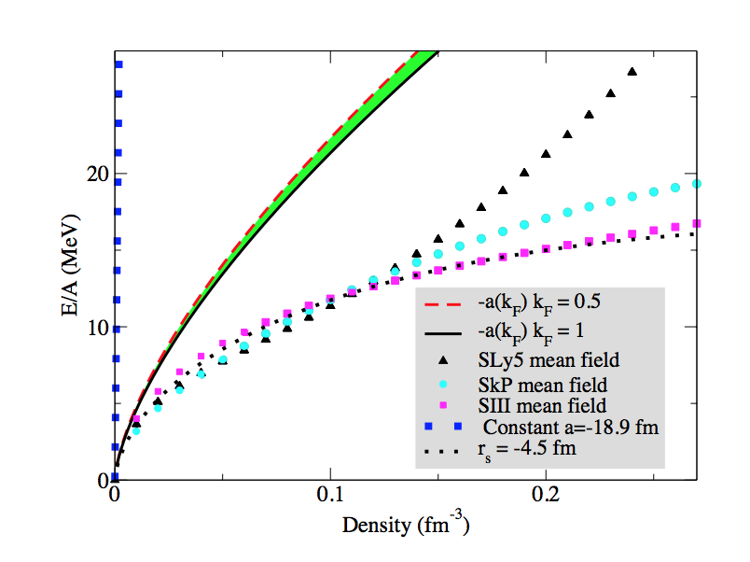
First two terms of the Lee-Yang expansion. EOS of neutron matter
LY with -18.9 fm
First two terms
SLy5 mean field
SkP mean field
Huge discrepancy
SIII mean field
Grasso, Lacroix, Yang,Phys. Rev. C 95, 054327 (2017)

Slide 42
Including the s-wave k_{F}⁵ terms and adjusting the effective range
Grasso, Lacroix, Yang, PRC 95, 054327 (2017).

Slide 43
Towards finite-size systems
Applications to neutron drops trapped in isotropic harmonic potentials of frequency ω
Applications shown for :
YGLO
ELYO (extended Lee Yang, Orsay -> density-dependent scattering length)
KIDS (Papakonstantinu et al)
Bonnard, Grasso, Lacroix, arXiv:1806.01084 , in press Phys. Rev. C

Slide 44
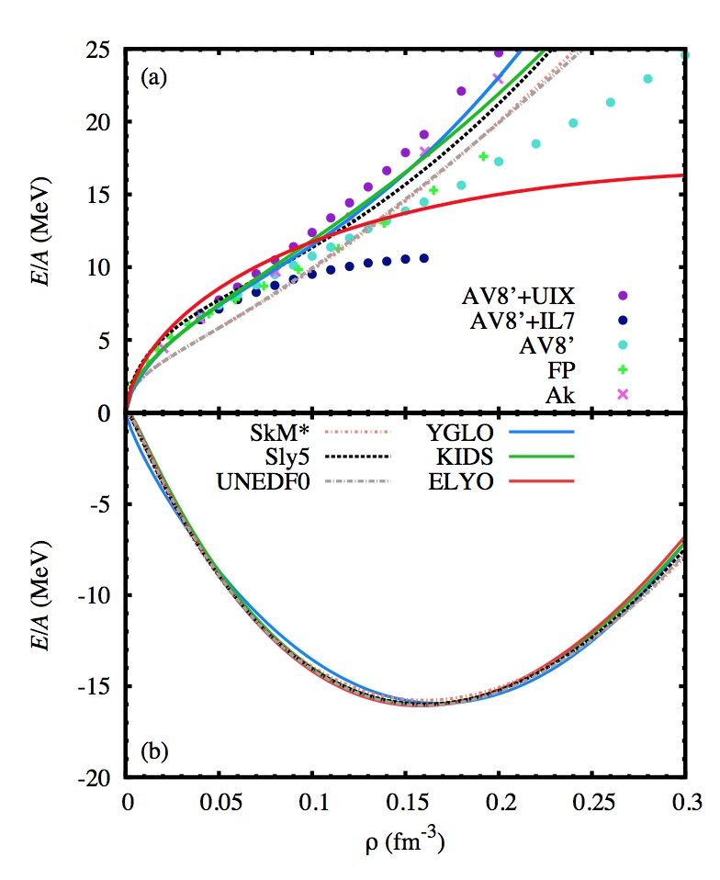
Different EOSs
Neutron
Symmetric

Slide 45
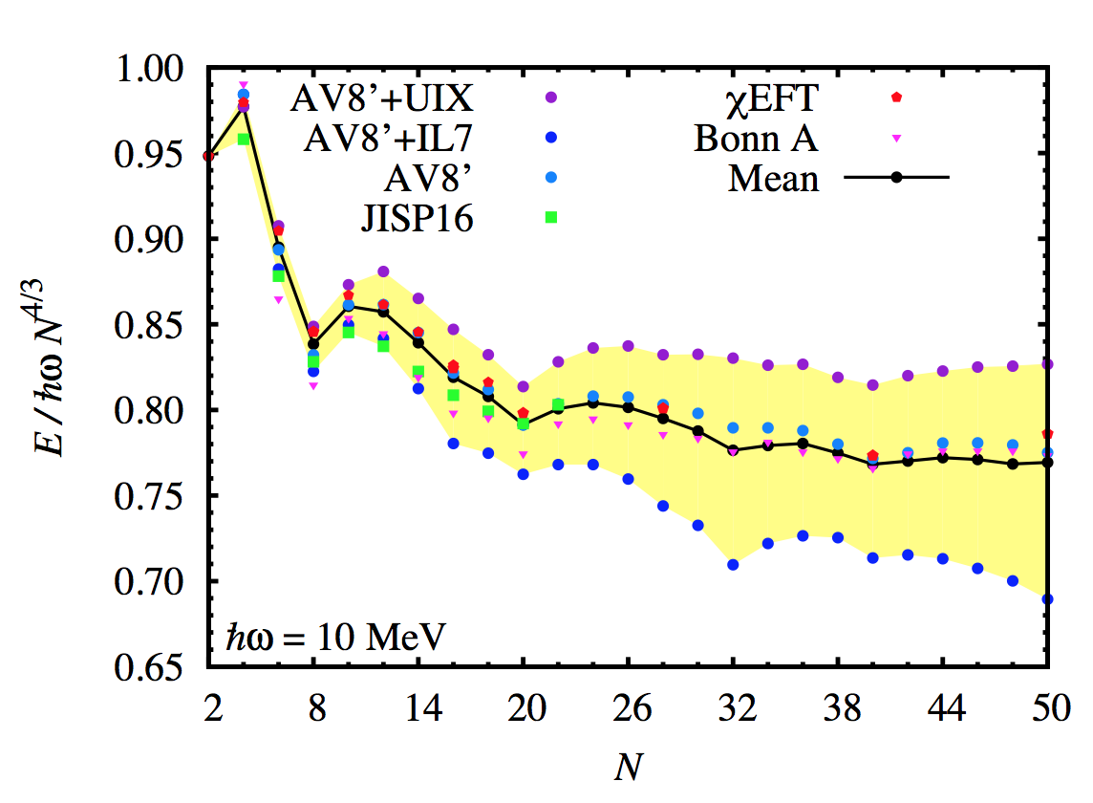
Adding spin-orbit and pairing to our functionals
Adjusting to preudodata: using the average of the results shown in the figure below (except Brueckner HF Bonn A)
Dots: Green’s function and auxiliary field diffusion QMC
- Maris et al., PRC 87, 054318 (2013)
- Gandolfi et al., PRL 106, 012501 (2011)
- 2-body AV8’, Pudliner 1997
- 3-body UIX, Pudliner 1995
- 3-body IL7, Pieper 2008
Squares: configuration-interaction (Maris et al)
Pentagones: no-core shell model and coupled cluster (Potter et al. PLB, 739, 445 (2014))
Bonnard, Grasso, Lacroix, arXiv:1806.01084 , in press Phys. Rev. C

Slide 46
Adding spin-orbit and pairing to our functionals
Adjusting to preudodata: using the average of the results shown in the figure below (except Brueckner HF Bonn A)
Additional parameters in finite-size systems:
Pairing and spin-orbit parameters adjusted for the case of a 10 MeV trap for N= 8, 12, 14, 16, 20
Benchmark data are the average (solid black line in the figure) up to N=20
Bonnard, Grasso, Lacroix, arXiv:1806.01084 , in press Phys. Rev. C

Slide 47

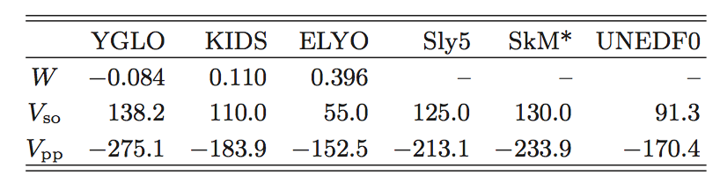
Adding spin-orbit and pairing to our functionals
Adjusting to preudodata: using the average of the results shown in the figure below (except Brueckner HF Bonn A)
Additional parameters in finite-size systems:
Additional parameter: W, to disentangle between a density-dependent term (with alpha=2/3) and velocity-dependent terms
For example, in the YGLO case:
Bonnard, Grasso, Lacroix, arXiv:1806.01084 , in press Phys. Rev. C

Slide 48



After adjustment of spin-orbit and pairing
Bonnard, Grasso, Lacroix, arXiv:1806.01084 , in press Phys. Rev. C

Slide 49
Conclusions
Starting point: second order in MBPT (Skyrme, matter)
New functionals valid at all density scales for neutron matter and at densities around saturation for symmetric matter
-> YGLO (resummation from EFT and good properties of Skyrme forces : a hybrid functional)
-> without resummation -> density-dependent neutron-neutron scattering length
-> not only nuclear matter. Towards finite-size systems: neutron drops
-> perspectives: finite nuclei and extensions (for example, p-wave terms in the ELYO functional)

Slide 50
Constraints on both low-density and unitary regime dictate
a similar behavior for the scattering length
Bare values
As for the previous case, Skyrme parameters provide similar values
Extended range of validity, but only neutron
matter
Lee-Yang
New DFT
Lacroix, PRA 94 (2016)
Lacroix, Boulet, Grasso, Yang, PRC 95 (2017)

