Slide 1
On non-Abelian
T-duality for non-semisimple groups
Based on arxiv:1801.095467 with Y. Kim, E. Ó ColgÁin

Slide 2
Contents
⃝ Integrable deformations (Yang-Baxter deformations)
⃝ Generalized supergravity and its EOMs
⃝ Non-Abelian T-duality
⃝ Bianchi classification

Slide 3
Integrable Deformations
AdS/CFT is a duality between N=4 sYM and string theory on AdS₅ⅹS⁵
It is best understood when integrability is present.
But it is not realistic.
Recently, it has been popular to take integrable deformations of type IIB superstrings on the AdS₅ⅹS⁵ into account.
Klimcik: Yang-Baxter sigma-model (integrable deformations given by r-matrices satisfying modified Classical Yang-Baxter Equation) (Delduc, Magro, Vicedo)
Integrable deformations based on r-matrices satisfying homogeneous CYBE have also been proposed by Kawaguchi, Matsumoto, Yoshida.

Slide 4
Yang-Baxter Deformation
Yang-Baxter sigma-model is a systematic way to construct integrable deformations.
Some of the deformations are generalized supergravity solutions specified by Killing vector I (Arutyunov, Frolov, Hoare, Roiban, Tseytlin).
Can study deformations from i) sigma-model or ii) target spacetime.
All work on sigma-models focuses on coset sigma-models.
It has been shown that Yang-Baxter deformations are equivalent to non-Abelian T-duality transformations (Hoare, Tseytlin; Borsato, Wulff).
This only works for r-matrix solutions to the homogeneous CYBE.

Slide 5
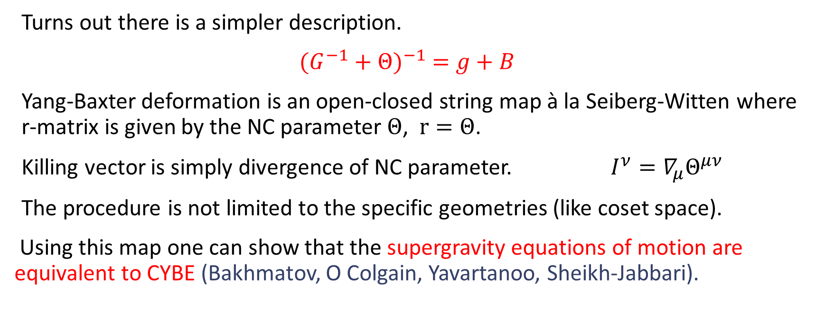
Yang-Baxter Deformation
Turns out there is a simpler description.
${(G^{−1}+Θ)}^{−1} =g+B$
Yang-Baxter deformation is an open-closed string map à la Seiberg-Witten where r-matrix is given by the NC parameter $Θ$, $r=Θ$.
Killing vector is simply divergence of NC parameter. $I^{ν}=∇_{μ}Θ^{μν}$
The procedure is not limited to the specific geometries (like coset space).
Using this map one can show that the supergravity equations of motion are equivalent to CYBE (Bakhmatov, O Colgain, Yavartanoo, Sheikh-Jabbari).

Slide 6
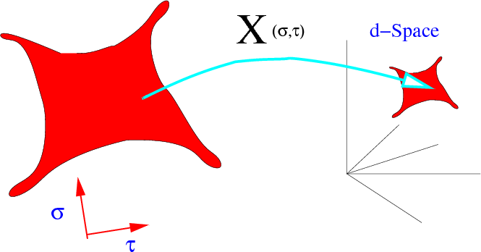
String sigma-model | Target spacetime
Couplings g, b | Metric G, two-form B
One-loop beta-functions | Supergravity EOMs
(Callan, Martinec, Perry, Friedan)

Slide 7
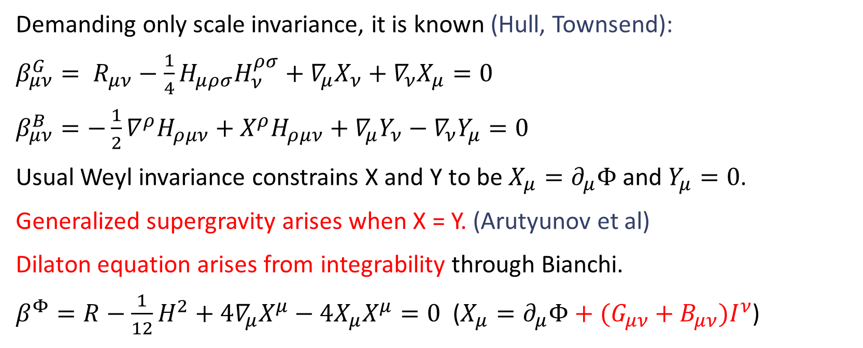
Generalized Supergravity
Demanding only scale invariance, it is known (Hull, Townsend):
$β_{μν}^{G}= R_{μν}−\frac{1}{4}H_{μρσ}H_{ν}^{ρσ}+∇_{μ}X_{ν}+∇_{ν}X_{μ}=0$
$β_{μν}^{B}=−\frac{1}{2}∇^{ρ}H_{ρμν}+X^{ρ}H_{ρμν}+∇_{μ}Y_{ν}−∇_{ν}Y_{μ}=0$
Usual Weyl invariance constrains X and Y to be $X_{μ}=∂_{μ}Φ$ and $Y_{μ}=0$.
Generalized supergravity arises when X = Y. (Arutyunov et al)
Dilaton equation arises from integrability through Bianchi.
$β^{Φ}=R−\frac{1}{12}H^{2}+4∇_{μ}X^{μ}−4X_{μ}X^{μ}=0$ ($X_{μ}=∂_{μ}Φ+(G_{μν}+B_{μν})I^{ν}$)

Slide 8
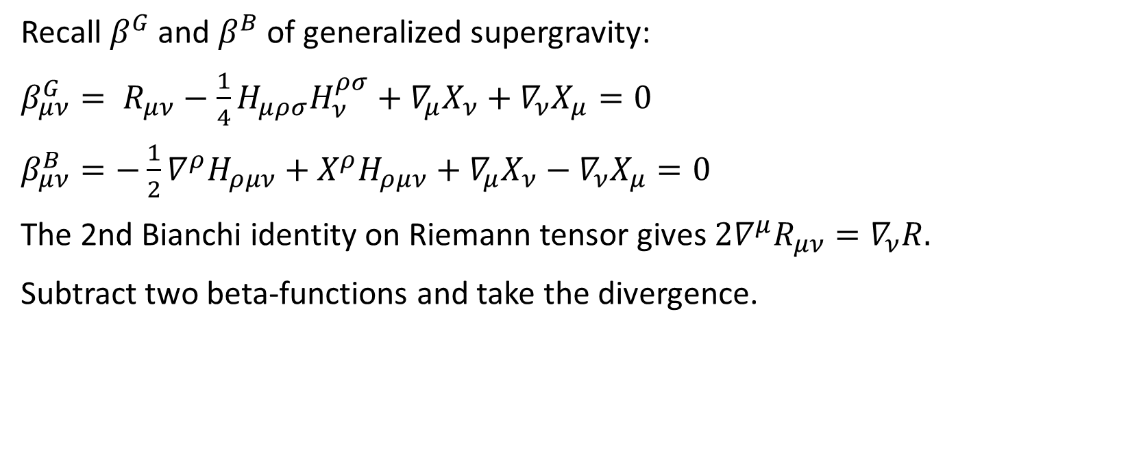
Dilaton Equation Is Not Independent!
Recall $β^{G}$ and $β^{B}$ of generalized supergravity:
$β_{μν}^{G}= R_{μν}−\frac{1}{4}H_{μρσ}H_{ν}^{ρσ}+∇_{μ}X_{ν}+∇_{ν}X_{μ}=0$
$β_{μν}^{B}=−\frac{1}{2}∇^{ρ}H_{ρμν}+X^{ρ}H_{ρμν}+∇_{μ}X_{ν}−∇_{ν}X_{μ}=0$
The 2nd Bianchi identity on Riemann tensor gives $2∇^{μ}R_{μν}=∇_{ν}R.$
Subtract two beta-functions and take the divergence.

Slide 9
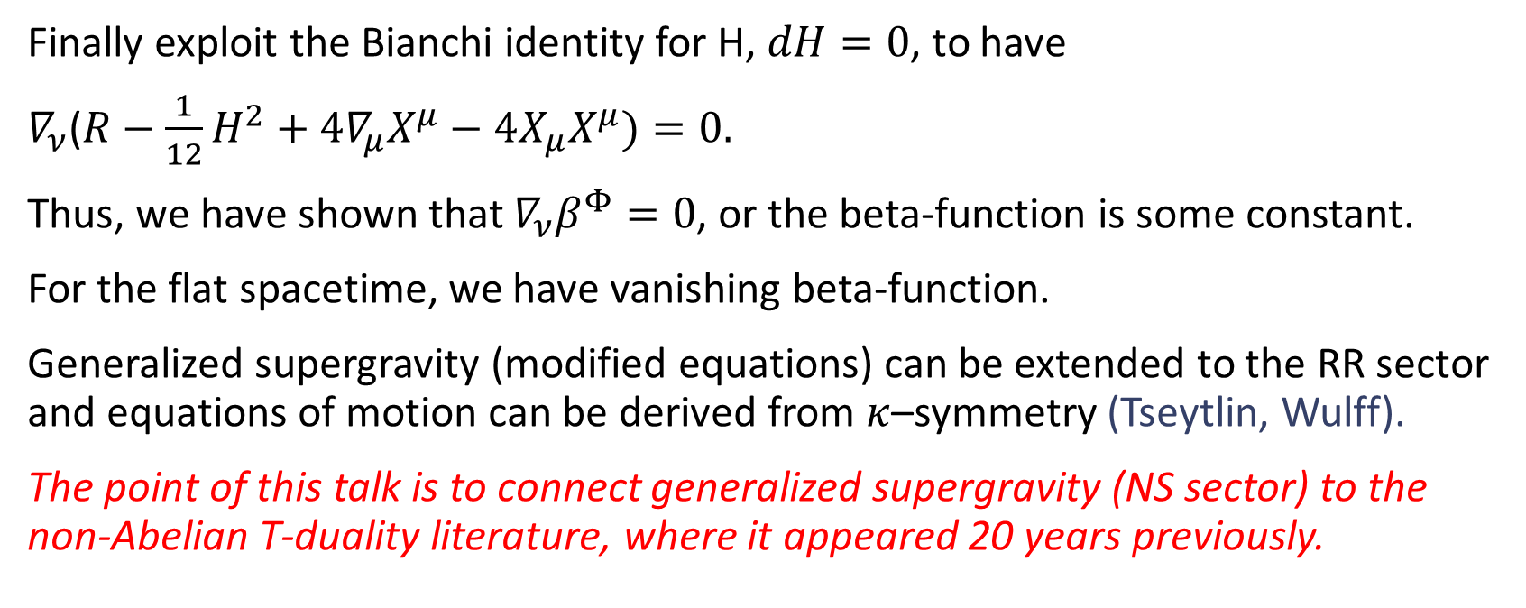
Dilaton Equation Is Not Independent!
Finally exploit the Bianchi identity for H, $dH=0$, to have
$∇_{ν}$($R−\frac{1}{12}H^{2}+4∇_{μ}X^{μ}−4X_{μ}X^{μ})=0.$
Thus, we have shown that $∇_{ν}β^{Φ}=0$, or the beta-function is some constant.
For the flat spacetime, we have vanishing beta-function.
Generalized supergravity (modified equations) can be extended to the RR sector and equations of motion can be derived from $κ$–symmetry (Tseytlin, Wulff).
The point of this talk is to connect generalized supergravity (NS sector) to the non-Abelian T-duality literature, where it appeared 20 years previously.

Slide 10
T-Duality Symmetry
String theory compactified on small circle is the same as the same theory compactified on large circle.
At the level of string worldsheet, given an Abelian isometry, one can gauge the isometry, integrate out the gauge field and produce a T-dual sigma-model.
This is commonly referred to as Buscher procedure.
Can be generalized to fermionic (Berkovits, Maldacena) and non-Abelian isometries (de la Ossa, Quevedo).

Slide 11
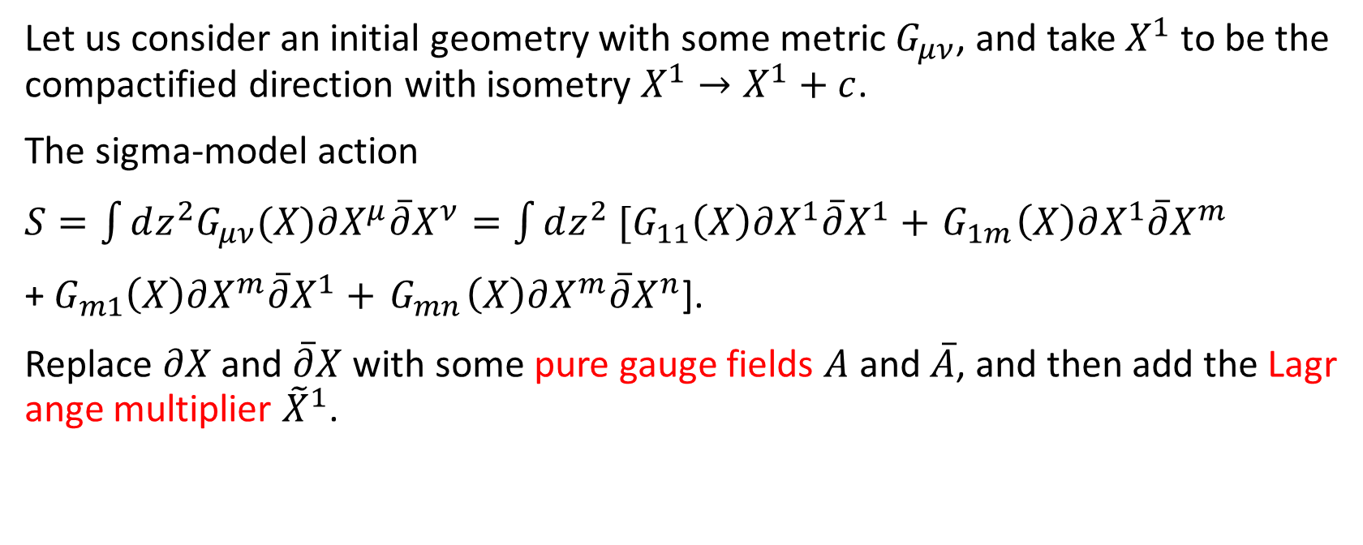
Buscher’s Procedure (Abelian T-duality)
Let us consider an initial geometry with some metric $G_{μν}$, and take $X^{1}$ to be the compactified direction with isometry $X^{1}→X^{1}+c$.
The sigma-model action
$S=\int{dz^{2}G_{μν}(X)∂X^{μ}\overline{∂}X^{ν}}=\int{dz^{2}{ [G}_{11}\left(X\right)∂X^{1}\overline{∂}X^{1}+}{ G}_{1m}\left(X\right)∂X^{1}\overline{∂}X^{m}$
+${ G}_{m1}\left(X\right)∂X^{m}\overline{∂}X^{1}+{ G}_{mn}\left(X\right)∂X^{m}\overline{∂}X^{n}$].
Replace $∂X$ and $\overline{∂}X$ with some pure gauge fields $A$ and $\overline{A}$, and then add the Lagrange multiplier ${\tilde{X}}^{1}$.

Slide 12
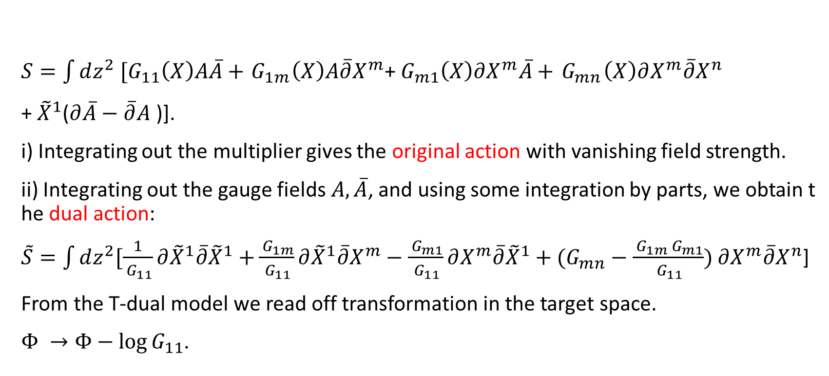
Buscher’s Procedure (Abelian T-duality)
$S=\int{dz^{2}{ [G}_{11}\left(X\right)A\overline{A}+}{ G}_{1m}\left(X\right)A\overline{∂}X^{m}$+${ G}_{m1}\left(X\right)∂X^{m}\overline{A}+{ G}_{mn}\left(X\right)∂X^{m}\overline{∂}X^{n}$
+ ${\tilde{X}}^{1}$($∂\overline{A}−\overline{∂}A$ )].
i) Integrating out the multiplier gives the original action with vanishing field strength.
ii) Integrating out the gauge fields $A,\overline{A}$, and using some integration by parts, we obtain the dual action:
$\tilde{S}=\int{dz^{2}[\frac{1}{{ G}_{11}}{∂\tilde{X}}^{1}\overline{∂}{\tilde{X}}^{1}+}\frac{{ G}_{1m}}{{ G}_{11}}{∂\tilde{X}}^{1}\overline{∂}X^{m}−\frac{{ G}_{m1}}{{ G}_{11}}∂X^{m}\overline{∂}{\tilde{X}}^{1}+(G_{mn}−\frac{{ G}_{1m}{ G}_{m1}}{{ G}_{11}})$ $∂X^{m}\overline{∂}X^{n}$]
From the T-dual model we read off transformation in the target space.
$Φ →Φ−\log{G_{11}}$.

Slide 13
Non-Abelian T-duality
Non-Abelian T-duality not a proper duality: there is no inverse.
Non-Abelian isometries are not preserved under “dualization”.
But it is a powerful solution generating technique.
In fact, using T-duality two explicit supersymmetric AdS6 solutions to type IIB supergravity were written down (Lozano, Ó Colgáin, Rodríguez-Gomez, Sfetsos).
See earlier talk of C. Uehlmann on a large class of solutions.

Slide 14
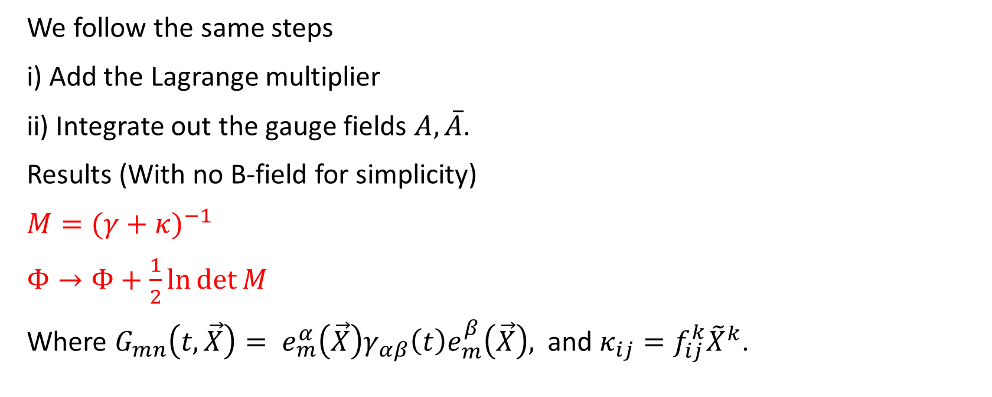
NATD Procedure
We follow the same steps
i) Add the Lagrange multiplier
ii) Integrate out the gauge fields $A,\overline{A}$.
Results (With no B-field for simplicity)
$M={(γ+κ)}^{−1}$
$Φ→Φ+\frac{1}{2}\ln{\det{M}}$
Where $G_{mn}\left(t,\vec{X}\right)= e_{m}^{α}\left(\vec{X}\right)γ_{αβ}\left(t\right)e_{m}^{β}\left(\vec{X}\right),$ and $κ_{ij}=f_{ij}^{k}{\tilde{X}}^{k}$.

Slide 15
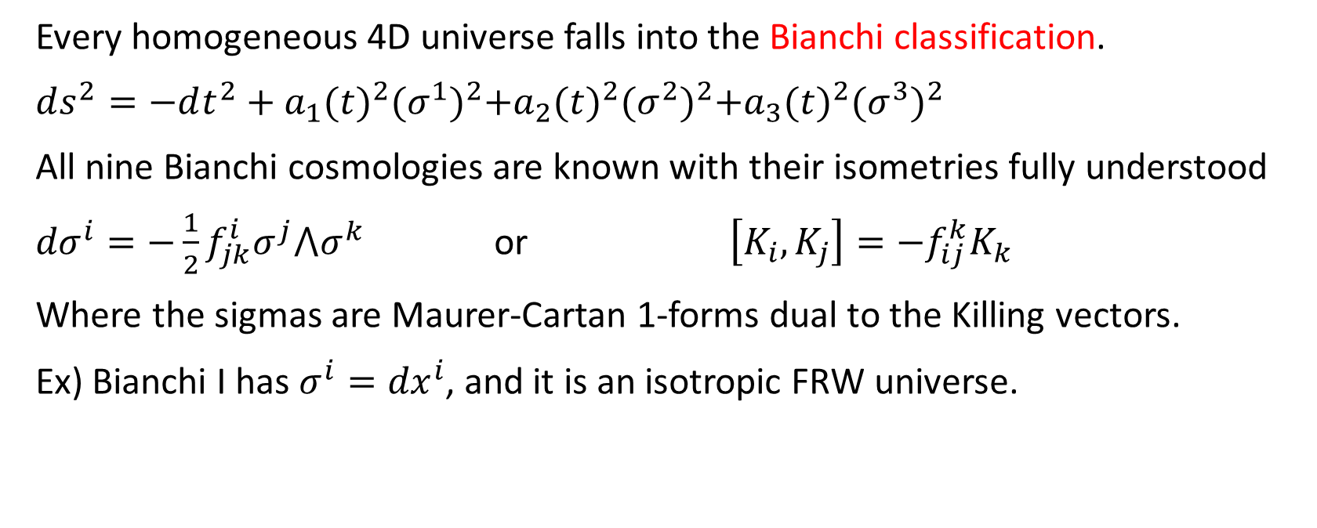
Bianchi Universes
Every homogeneous 4D universe falls into the Bianchi classification.
$ds^{2}=−dt^{2}+{a_{1}(t)}^{2}{(σ^{1})}^{2}+{a_{2}(t)}^{2}{(σ^{2})}^{2}+{a_{3}(t)}^{2}{(σ^{3})}^{2}$
All nine Bianchi cosmologies are known with their isometries fully understood
${dσ}^{i}=−\frac{1}{2}f_{jk}^{i}σ^{j}{⋀σ}^{k}$ or $\left[K_{i},K_{j}\right]=−f_{ij}^{k}K_{k}$
Where the sigmas are Maurer-Cartan 1-forms dual to the Killing vectors.
Ex) Bianchi I has $σ^{i}={dx}^{i}$, and it is an isotropic FRW universe.

Slide 16
Problem
Non-Abelian T-duality works for the semisimple groups, but it does not work for the non-semisimple groups like Bianchi V. (Veneziano)
More precisely, the beta-functions do not vanish, and they cannot be cancelled by an appropriate dilaton term.
In other words, the naïve non-Abelian T-dual is no longer a supergravity solution. This can be traced to a mixed gravitational-gauge anomaly. (Alvarez, Alvarez-Gaume, Lozano)

Slide 17
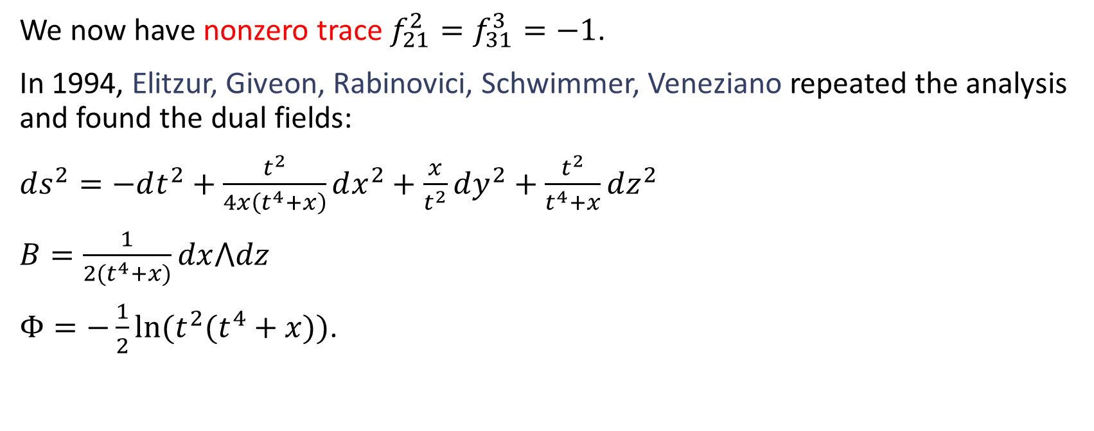
Bianchi V – Non-semisimple Example
We now have nonzero trace $f_{21}^{2}=f_{31}^{3}=−1$.
In 1994, Elitzur, Giveon, Rabinovici, Schwimmer, Veneziano repeated the analysis and found the dual fields:
$ds^{2}=−dt^{2}+\frac{t^{2}}{4x\left(t^{4}+x\right)}dx^{2}+\frac{x}{t^{2}}dy^{2}+\frac{t^{2}}{t^{4}+x}dz^{2}$
$B=\frac{1}{2(t^{4}+x)}dx⋀dz$
$Φ=−\frac{1}{2}\ln{(t^{2}(t^{4}+x))}$.

Slide 18
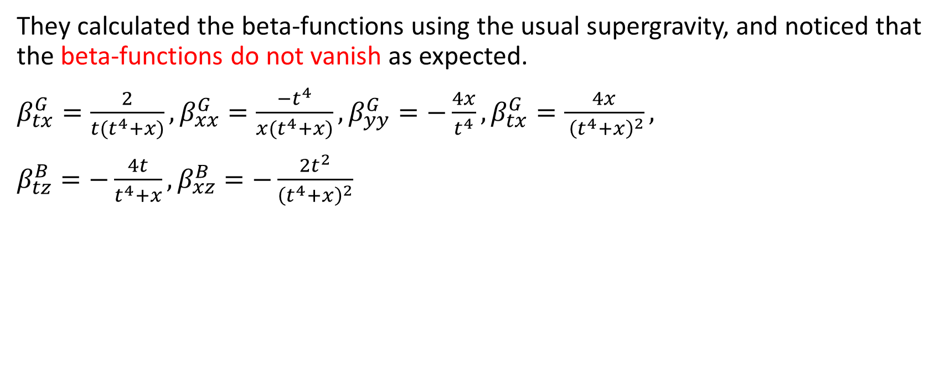
Bianchi V – Non-semisimple Example
They calculated the beta-functions using the usual supergravity, and noticed that the beta-functions do not vanish as expected.
$β_{tx}^{G}=\frac{2}{t(t^{4}+x)},β_{xx}^{G}=\frac{−t^{4}}{x(t^{4}+x)}, β_{yy}^{G}=−\frac{4x}{t^{4}}, β_{tx}^{G}=\frac{4x}{ {\left(t^{4}+x\right)}^{2}},$
$β_{tz}^{B}=−\frac{4t}{t^{4}+x}, β_{xz}^{B}=−\frac{2t^{2}}{{\left(t^{4}+x\right)}^{2}}$

Slide 19
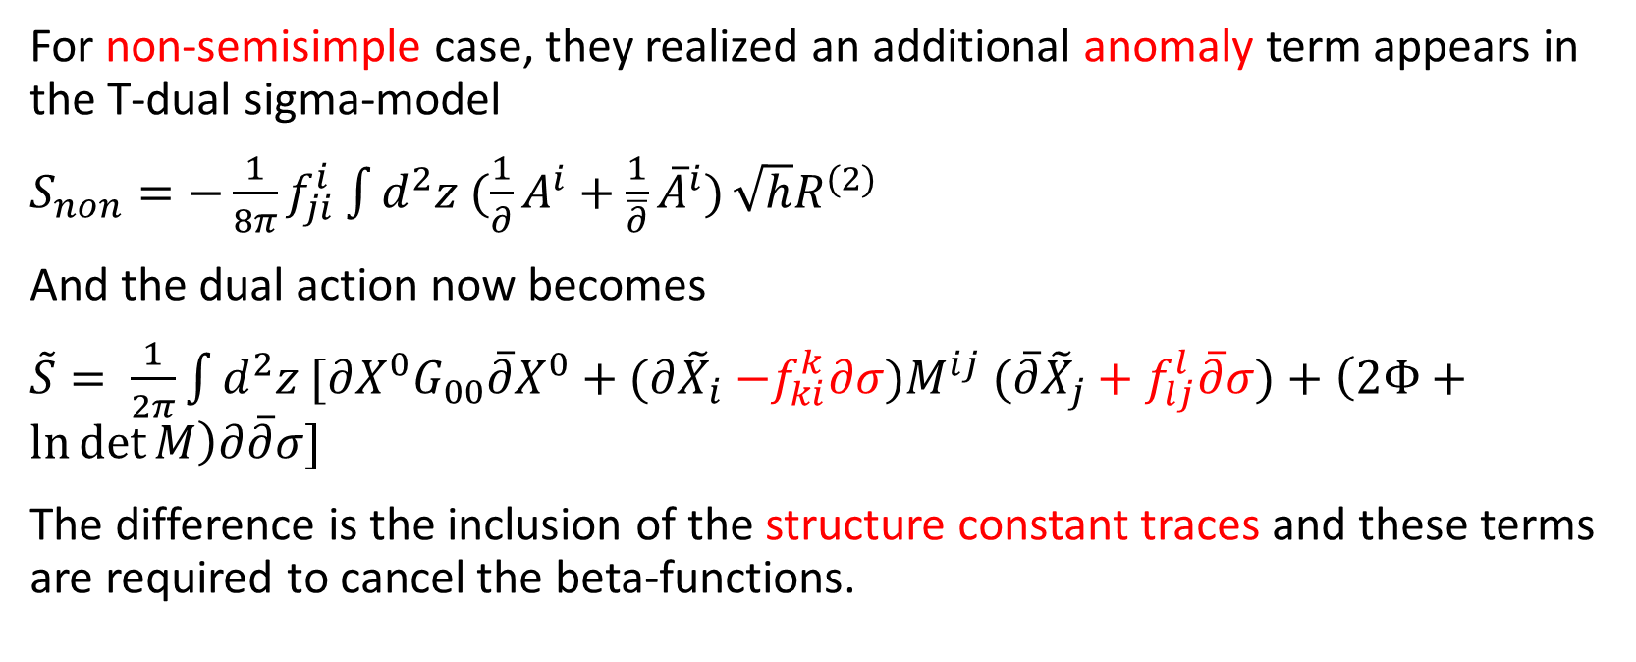
NATD(non-semisimple)
For non-semisimple case, they realized an additional anomaly term appears in the T-dual sigma-model
$S_{non}=−\frac{1}{8π}f_{ji}^{i}\int{d^{2}z (\frac{1}{∂}A^{i}+\frac{1}{\overline{∂}}{\overline{A}}^{i})}\sqrt{h}R^{(2)}$
And the dual action now becomes
$\tilde{S}= \frac{1}{2π}\int{d^{2}z [∂X^{0}G_{00}\overline{∂}X^{0}+(∂{\tilde{X}}_{i}{−f_{ki}^{k}∂σ)M}^{ij}(\overline{∂}{\tilde{X}}_{j}+f_{lj}^{l}\overline{∂}σ)+\left(2Φ+\ln{\det{M}}\right)∂\overline{∂}σ]}$
The difference is the inclusion of the structure constant traces and these terms are required to cancel the beta-functions.

Slide 20
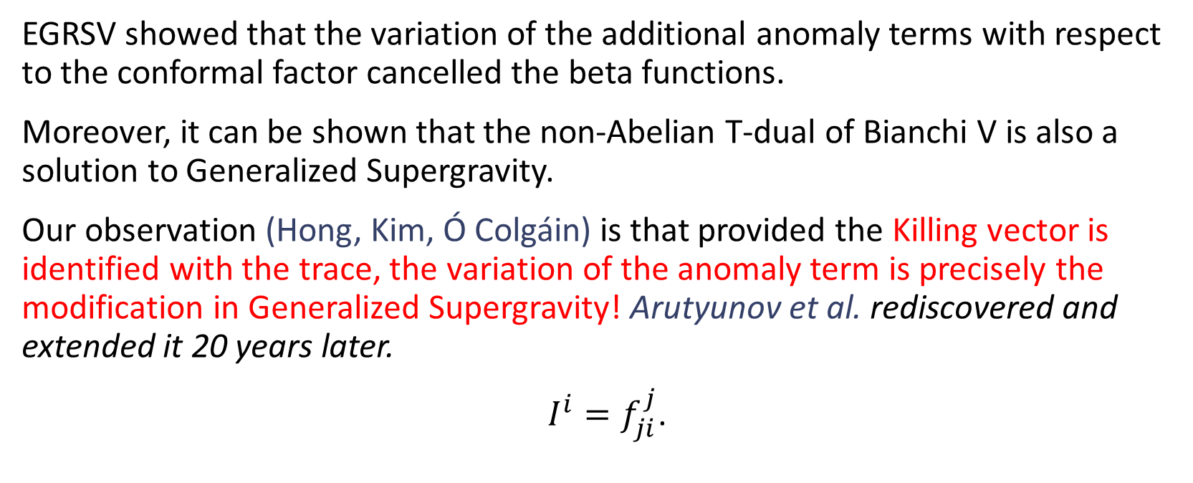
Observation
EGRSV showed that the variation of the additional anomaly terms with respect to the conformal factor cancelled the beta functions.
Moreover, it can be shown that the non-Abelian T-dual of Bianchi V is also a solution to Generalized Supergravity.
Our observation (Hong, Kim, Ó Colgáin) is that provided the Killing vector is identified with the trace, the variation of the anomaly term is precisely the modification in Generalized Supergravity! Arutyunov et al. rediscovered and extended it 20 years later.
$I^{i}=f_{ji}^{j}$.

Slide 21

Example - Bianchi VIh
The structure constants are $f_{12}^{2}=h, f_{13}^{3}=1$, so the trace is $−(h+1)$.
Identifying this with the Killing vector, $I=−(h+1)∂_{x}$, the generalized supergravity equation holds.

Slide 22
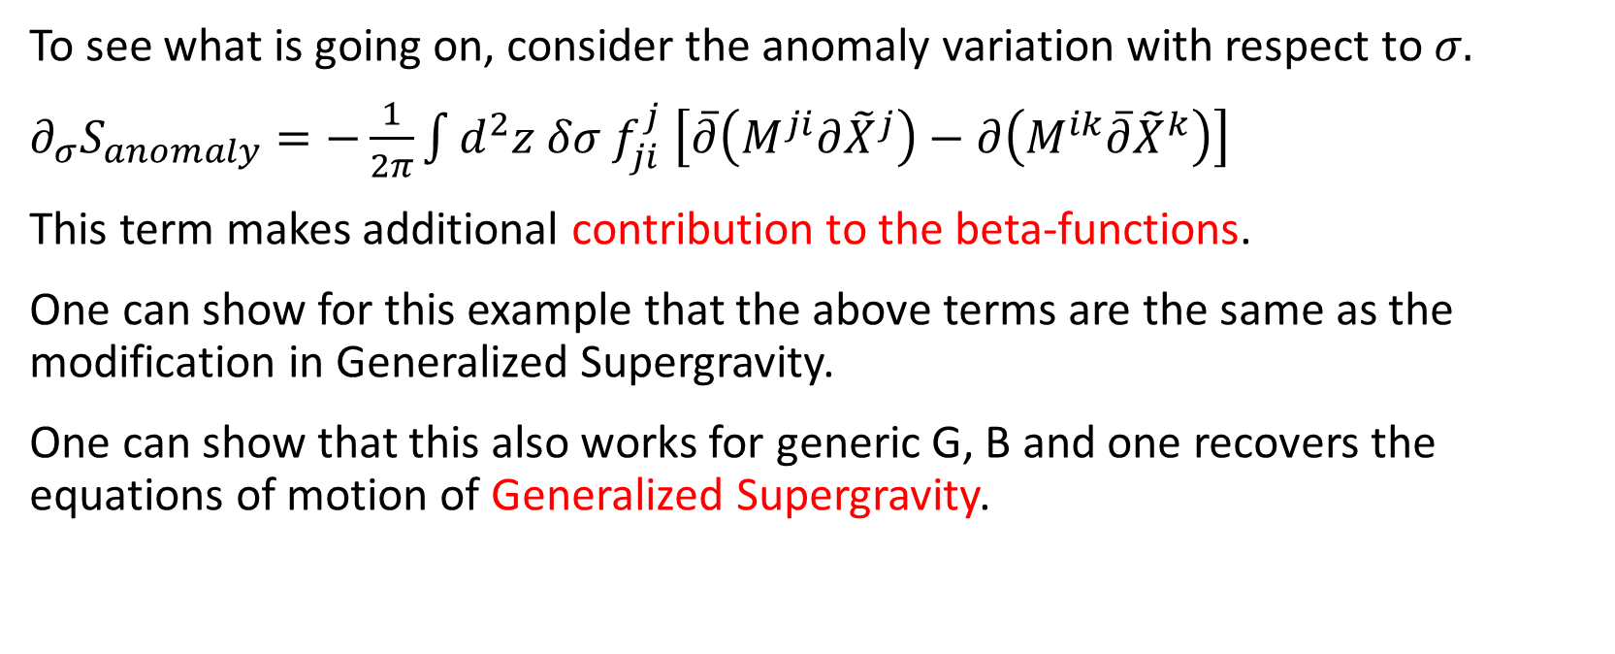
Generalized Supergravity And NATD
To see what is going on, consider the anomaly variation with respect to $σ.$
$∂_{σ}S_{anomaly}=−\frac{1}{2π}\int{d^{2}z δσ f_{ji}^{j} \left[\overline{∂}\left(M^{ji}∂{\tilde{X}}^{j}\right)−∂\left(M^{ik}\overline{∂}{\tilde{X}}^{k}\right)\right]}$
This term makes additional contribution to the beta-functions.
One can show for this example that the above terms are the same as the modification in Generalized Supergravity.
One can show that this also works for generic G, B and one recovers the equations of motion of Generalized Supergravity.

Slide 23
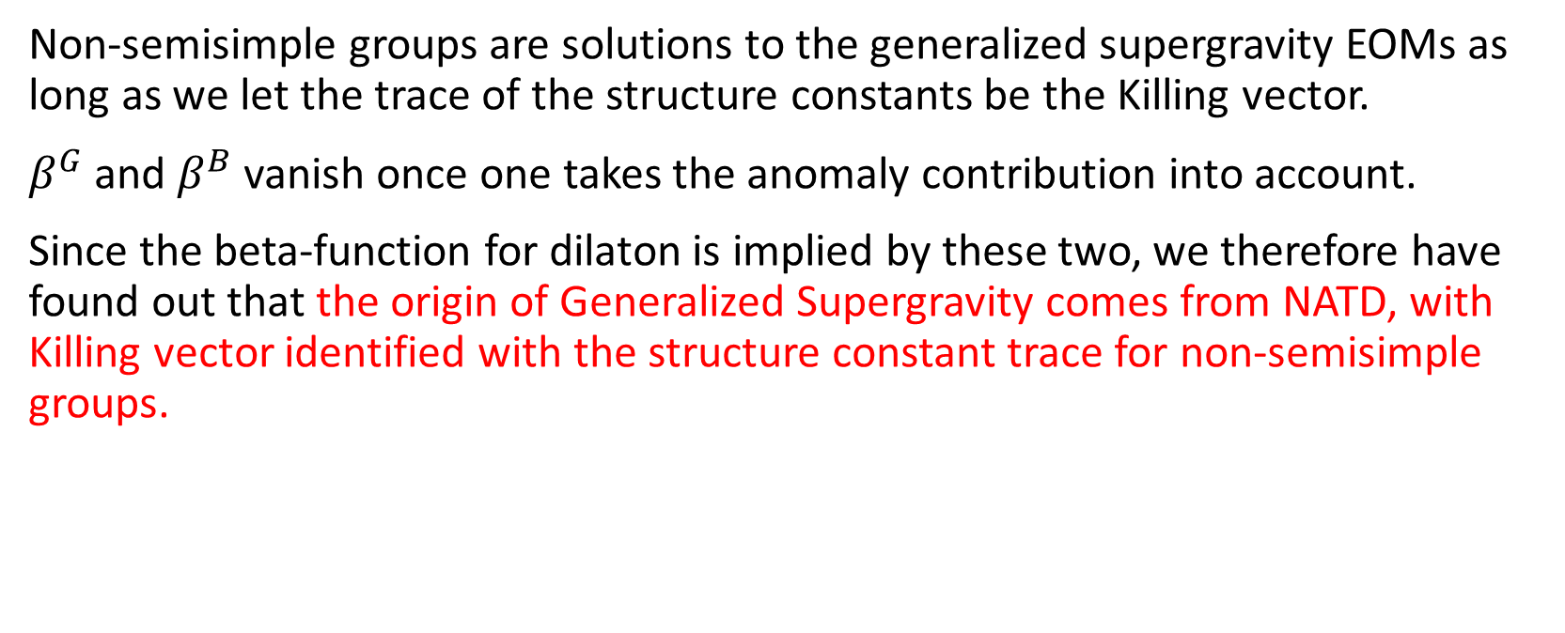
Results
Non-semisimple groups are solutions to the generalized supergravity EOMs as long as we let the trace of the structure constants be the Killing vector.
$β^{G}$ and $β^{B}$ vanish once one takes the anomaly contribution into account.
Since the beta-function for dilaton is implied by these two, we therefore have found out that the origin of Generalized Supergravity comes from NATD, with Killing vector identified with the structure constant trace for non-semisimple groups.

Slide 24
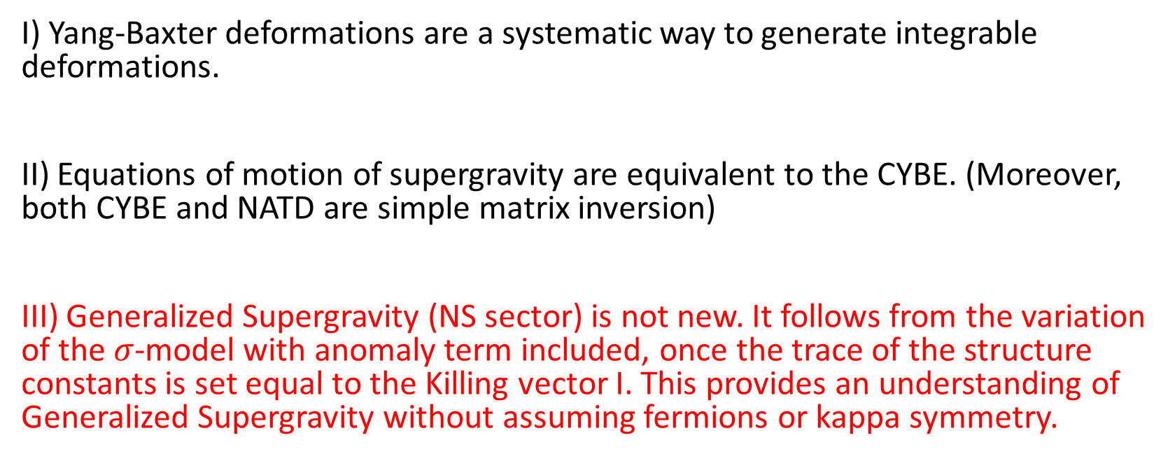
Summary
I) Yang-Baxter deformations are a systematic way to generate integrable deformations.
II) Equations of motion of supergravity are equivalent to the CYBE. (Moreover, both CYBE and NATD are simple matrix inversion)
III) Generalized Supergravity (NS sector) is not new. It follows from the variation of the $σ$-model with anomaly term included, once the trace of the structure constants is set equal to the Killing vector I. This provides an understanding of Generalized Supergravity without assuming fermions or kappa symmetry.

