Slide 1
Thermodynamics and phase transitions of non-linear charged AdS black hole
Based on the work submitted to EPJC
International Workshop for String theory, Gravitation and Cosmology
June 18-20, 2018
Cao H. Nam
Yonsei University

Slide 2
Plan of the talk
Introduction and motivations
The black hole solution
Thermodynamics and thermal phase transitions
Conclusions

Slide 3
Introduction and motivations

Slide 4
In General Relativity, the black holes have a singularity at the origin surrounded by the event horizon.
It is widely believed that the black hole singularity would be removed by a complete theory of quantum gravity. However, up to now there has no a complete understanding of quantum gravity. Thus, the resolution of the black hole singularity at the (semi-) classical level is still open.
The black hole without singularity at the origin was first proposed by Bardeen However,
Bardeen black hole was reobtained by E. Ayon-Beato and A. Garcia as the gravitational collapse of some magnetic monopole in the non-linear electrodynamics. Later, the non-linear electrodynamics has received considerable attention in studying regular black holes.
In recent years, the cosmological constant was considered as the thermodynamic pressure and its conjugate variable is the thermodynamic volume, leading to the extended phase space. Studying thermodynamics of the black holes in the extended phase space have led to new phenomena, such as a Van der Waals-like criticality or multiply reentrant phase transition, etc..

Slide 5
The black hole solution

Slide 6



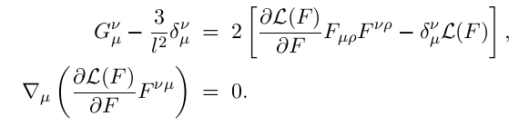
We consider Einstein gravity coupled to a non-linear electromagnetic field in the AdS
spacetime, described by the action
where the non-linear electrodynamic term is given as [E. Beato and A. Garcia PRL 98]
with to be mass and charge of the system. In the weak field limit
The equations of the motion

Slide 7




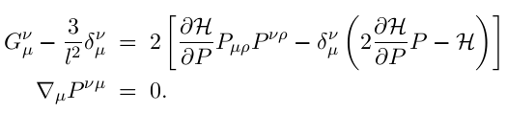
Instead of solving these equations in terms of , it is easier to solve them in terms of which are derived by means of a Legendre transformation
[H. Salazar, etc. , JMP 87] as
It can be shown
The equations of the motion in terms of

Slide 8
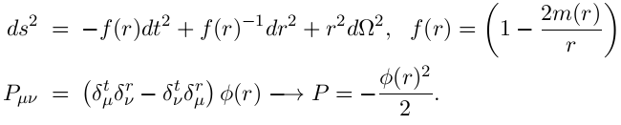


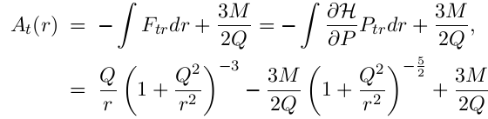
Now let us look at a spherically-symmetric and static black hole with the following ansatz
Integrating the equation of the non-linear electrostatic field with
we have
leading to the electrostatic potential

Slide 9







Integrating Einstein’s equations with
one can get
At large distances :
which means that the black hole looks asymtotically like the RN-AdS black hole
At short distances :
which means that the black hole solution behaves like a dS geometry.

Slide 10

This implies that the singularity at the origin should be replaced by the dS geometry core which produces a negative pressure and thus prevents a singular end-state of the gravitationally collapsed matter.
We can check the curvature scalars to see that they are all finite everywhere.

Slide 11

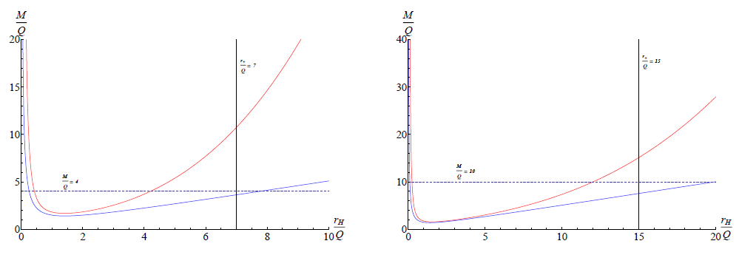

The black hole mass is related to its horizon radius
where red and blue curves correspond to the non-linear charged black hole and the RN-
AdS black hole

Slide 12



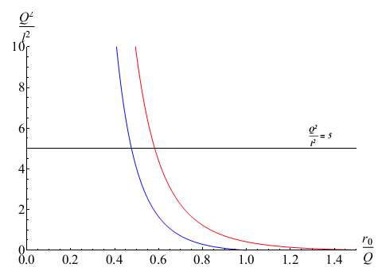
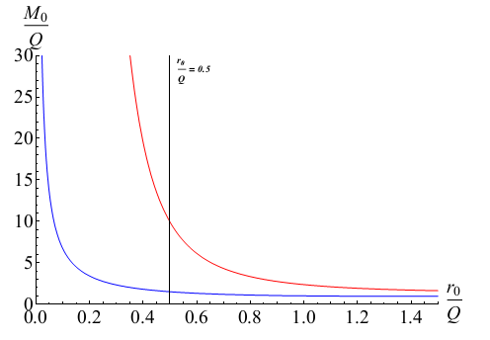


The reduced extremal horizon radius and the reduced extremal mass of the black hole are determined as, respectively
From these, one can get an upper limit for the reduced extremal horizon radius and a lower limit for the reduced extremal mass
corresponding to the limit of the zero cosmological constant.

Slide 13
Thermodynamics and thermal phase transitions

Slide 14



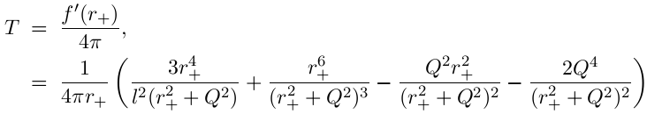
The thermodynamic quantities
In the following, the black hole charge is kept fixed. The first law of the black hole
thermodynamics is defined as
The black hole temperature is defined by the surface gravity as

Slide 15
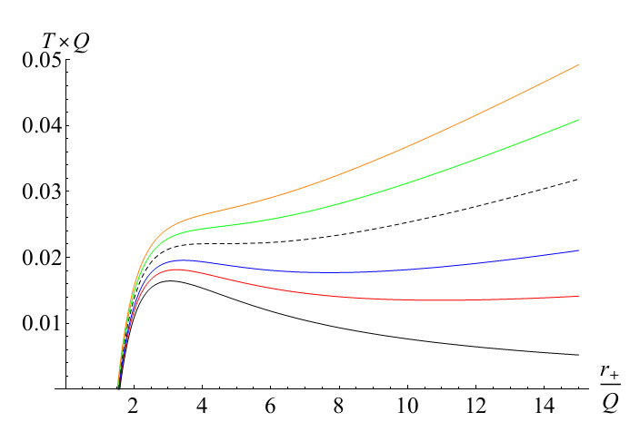
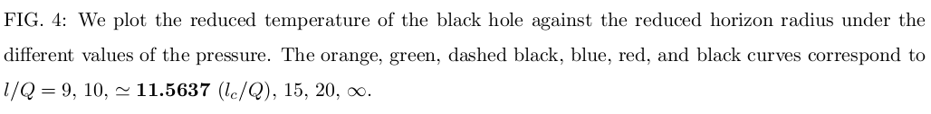

Slide 16
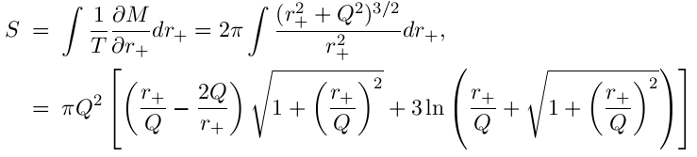



The black hole entropy
In the non-linear electrodynamics, the area law is not held but it is approximately
recovered in the limit of the large distances
Because , the second term is neglected in the limit of the
large distances

Slide 17

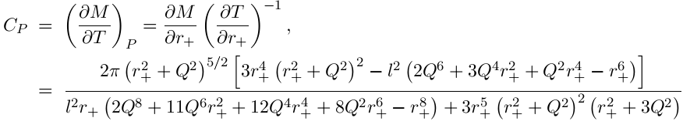
The thermodynamic volume
The heat capacity at constant pressure

Slide 18
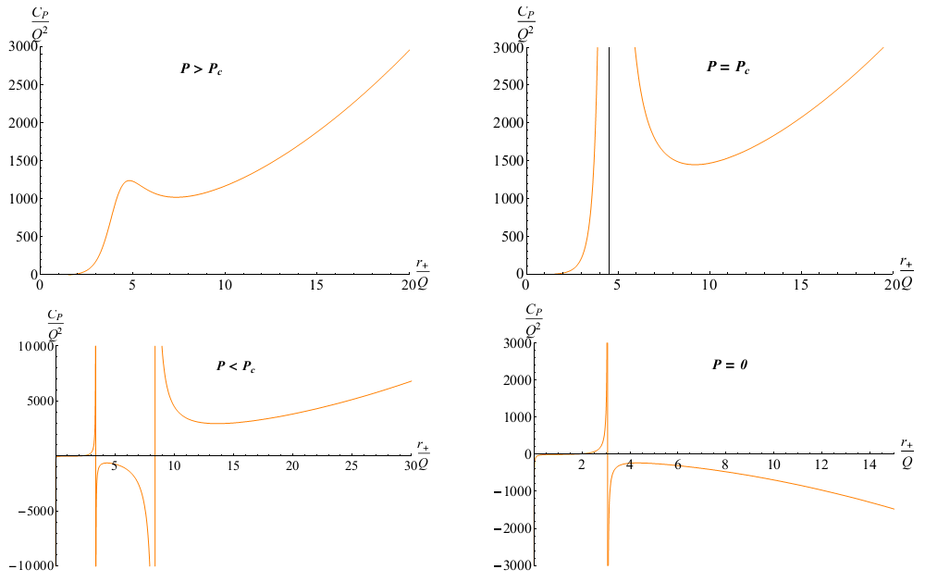
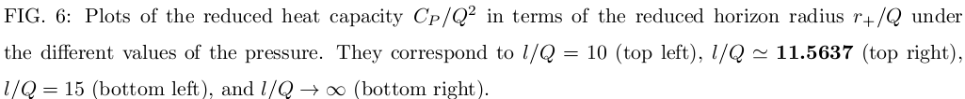

Slide 19



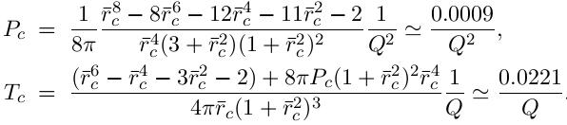
The thermal phase transitions
Depending on the value of the pressure (or the temperature), there are the first-order, second-order phase transitions, or no the phase transition.
Critical point occurs as the isobar (or isotherm) has an inflexion point defined by
leading to the equation for the reduced critical event horizon radius
and the critical temperature and pressure

Slide 20


Above the critical pressure, the heat capacity is always regular and positive and thus there is no phase transition happening.
Below critical pressure, the black hole can undergo a first-order phase transition between a small stable black hole of the radius and a large stable black hole of the radius
, where correspond to the local maximum temperature and local minimum temperature . This phase transition is indicated from the intersection of the Gibbs free energy curves (or surfaces) in later.
This first-order phase transition is performed via two second-order phase transitions happing at the extremal points because the heat capacity suffers from discontinuities at these points.
The point corresponds to the phase transition between a small stable black hole and medium unstable one. The point corresponds to the phase transition between a large stable black hole and medium unstable one

Slide 21
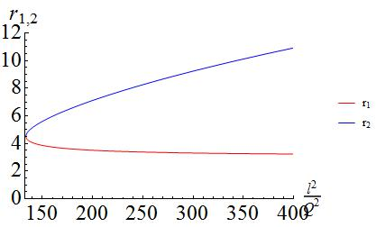
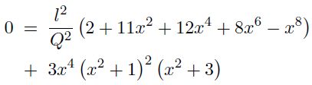

Reduced values of the second-order phase transition points are positive real solutions of the following equation.
In limit we have , and thus the phase point should disappear. Whereas, the phase transition point and the corresponding temperature approach the lower limits, , respectively.

Slide 22
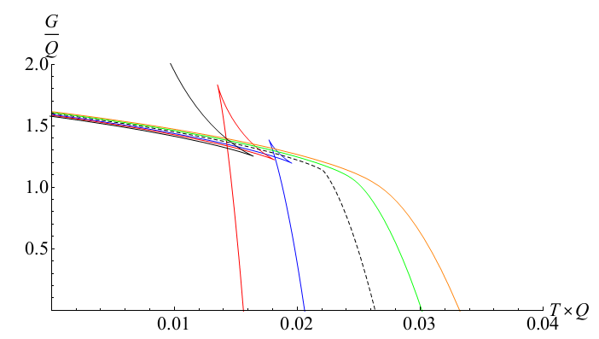

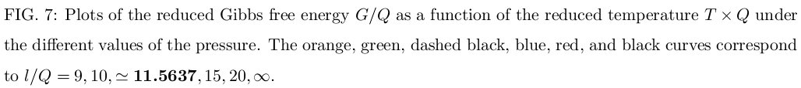
In order to obtain more details on the phase transitions of the black hole, we investigate
the Gibbs free energy

Slide 23


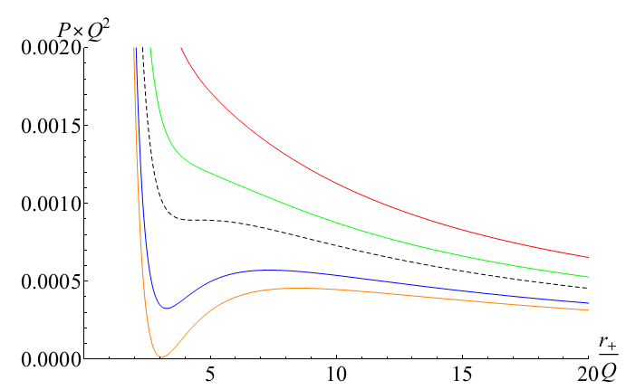


Let us indicate a van der Waals-like criticality in diagram. First, the equation of state for the black hole

Slide 24
Conclusions:
We have derived a regular charged AdS black hole in the non-linear electrodynamics, and investigated its horizon structure.
We have specified the first-order, second-order phase transitions, as well as Van der
Waals-like criticality.
Here, we have not discussed the Hawking-Page phase transition, the phase structure of the black hole, as well as the critical exponents. All of them are given in our paper.

