Slide 1
Quantum cosmology
with
canonical quantization of gravity
Dong-han Yeom
APCTP
2018. 6. 18.
Based on Brahma and DY, in preparation

Slide 2
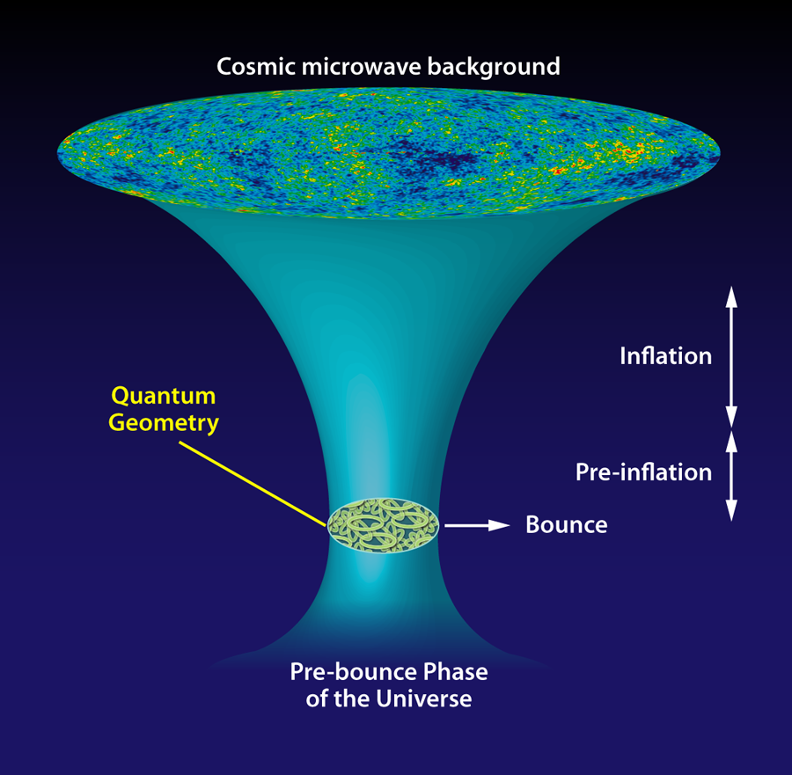
Loop quantum cosmology
LQG resolves the singularity and predicts the big-bounce picture.

Slide 3
Loop quantum cosmology
However, why does it predict a deterministic history?

Slide 4
Superposition of manyworlds
Present universe:
we want to know
the probability of here.
alternative histories:
many-world interpretation
initial singularity → wave function
Traditional quantum cosmology explains superposition of histories.

Slide 5
Can there be a connection?
LQC
Hartle-Hawking wave function
New interpretation of LQC?
?

Slide 6
CONTENTS
Quantum cosmology
with canonical quantization
of gravity
I
Brief review of LQG program
II
Hartle-Hawking wave function
III
HH LQC instantons

Slide 7
I
Brief review of LQG program

Slide 8
What is the quantization?
Step 1: Lagrangian/Action
Step 2: Legendre transformation
Step 3: Hamiltonian
Step 4: Commutation relations
Step 5: Quantization (substitution to operators)
Step 6: Schrodinger equation
Step 7: Solve it

Slide 9
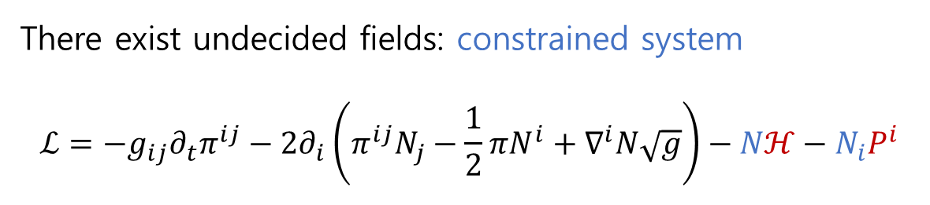
Trouble with gravity
There exist undecided fields: constrained system
$$ℒ=−g_{ij}∂_{t}π^{ij}−2∂_{i}\left(π^{ij}N_{j}−\frac{1}{2}πN^{i}+∇^{i}N\sqrt{g}\right)−Nℋ−N_{i}P^{i}$$
What we have experienced is the constrained system with a gauge symmetry.
Can we quantize gravity including the constraints that have a gauge symmetric structure?

Slide 10
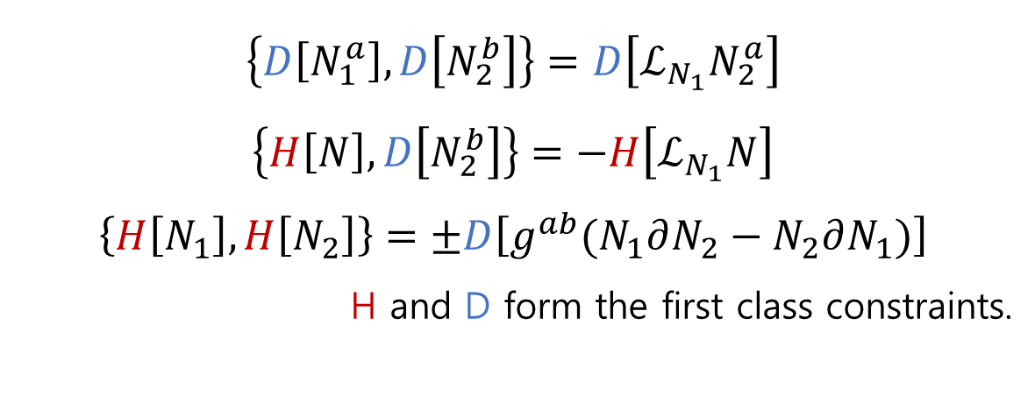
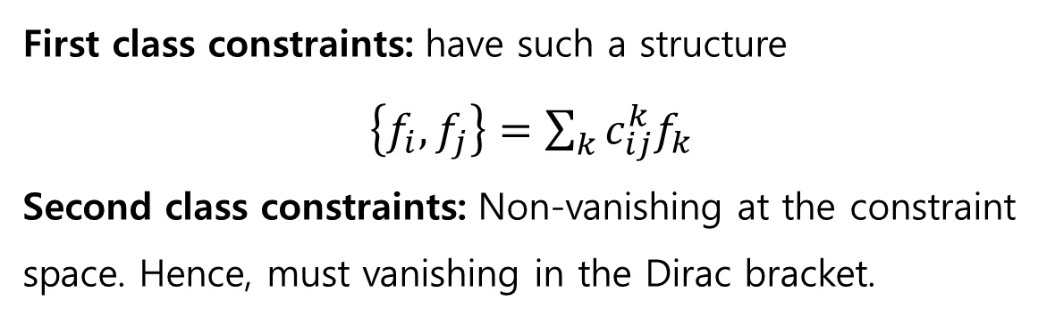
Two classes of constraints
First class constraints: have such a structure
$\left\{f_{i},f_{j}\right\}=\sum_{k}{c_{ij}^{k}f_{k}}$
Second class constraints: Non-vanishing at the constraint space. Hence, must vanishing in the Dirac bracket.
$$\left\{D\left[N_{1}^{a}\right],D\left[N_{2}^{b}\right]\right\}=D\left[ℒ_{N_{1}}N_{2}^{a}\right]$$
$$\left\{H\left[N\right],D\left[N_{2}^{b}\right]\right\}=−H\left[ℒ_{N_{1}}N\right]$$
$$\left\{H\left[N_{1}\right],H\left[N_{2}\right]\right\}=±D\left[g^{ab}(N_{1}∂N_{2}−N_{2}∂N_{1})\right]$$
H and D form the first class constraints.

Slide 11
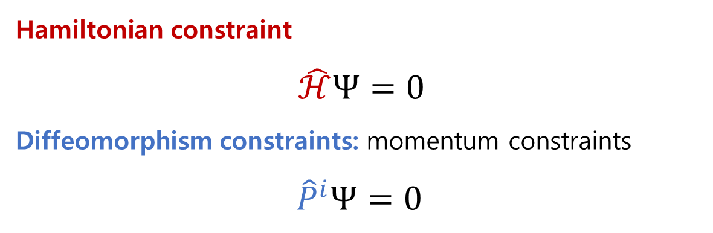
Quantum constraint equations
Hamiltonian constraint
$\hat{ℋ}Ψ=0$
Diffeomorphism constraints: momentum constraints
$${\hat{P}}^{i}Ψ=0$$

Slide 12
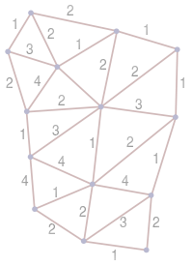
LOST theorem and holonomic representation
Lewandowski-Okolow-Sahlmann-Thiemann, 2006
For (kinematical) quantum states that satisfy diffeomorphism constraints, the holonomic representation is the unique description.

Slide 13
Quantum corrections
The loop representation implies the existence of a minimal length. Based on this, effectively we need two quantum corrections:
Holonomy corrections: corrections to conjugate momentum
Inverse-triad corrections: corrections to volume

Slide 14
II
Hartle-Hawking wave function
Hartle and Hawking, 1983

Slide 15
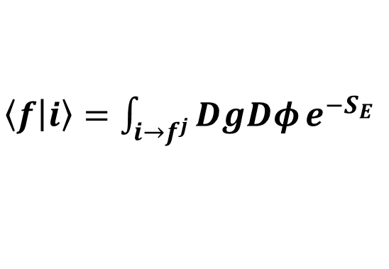

Euclidean path-integral
$\left\langle f | i\right\rangle =\int_{i→f^{j}}^{ }{DgDφ}e^{−S_{E}}$
$$|i⟩$$

Slide 16

Euclidean path-integral
$\left\langle f | i\right\rangle =\int_{i→f^{j}}^{ }{DgDφ}e^{−S_{E}}$
$$|f^{1}⟩$$
$$|i⟩$$

Slide 17


Euclidean path-integral
$\left\langle f | i\right\rangle =\int_{i→f^{j}}^{ }{DgDφ}e^{−S_{E}}$
$$|f^{1}⟩$$
$$|f^{j}⟩$$
$$|f⟩=\sum_{j}{a_{j}|f^{j}⟩}$$
$$|i⟩$$

Slide 18
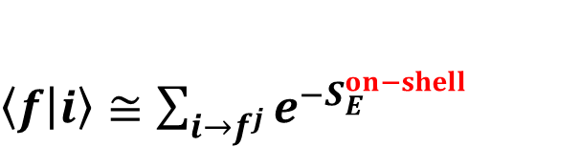
Euclidean path-integral
$\left\langle f | i\right\rangle ≅\sum_{i→f^{j}}^{ }{e^{−S_{E}^{on−shell}}}$
$$|f^{1}⟩$$
$$|f^{j}⟩$$
$$|f⟩=\sum_{j}{a_{j}|f^{j}⟩}$$
Lorentzian
Euclidean
Lorentzian
$$|i⟩$$

Slide 19

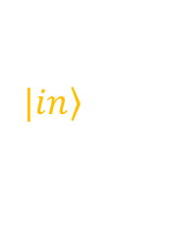
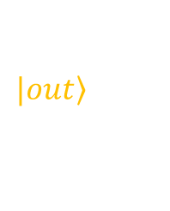

$$|\left.out\right\rangle$$
disconnected
$$\left\langle out | in\right\rangle$$
$$|\left.in\right\rangle$$

Slide 20

$$|\left.out\right\rangle$$
$$\left\langle out | 0\right\rangle$$
no-boundary proposal

Slide 21
No-boundary proposal
Present universe:
we want to know
the probability of here.
alternative histories:
many-world interpretation
initial singularity → wave function

Slide 22


No-boundary proposal
$$t→t−iτ$$

Slide 23
Can there be a connection?
LQC
Hartle-Hawking wave function
New interpretation of LQC?
?

Slide 24
III
HH LQC instantons
Brahma and DY, in preparation

Slide 25
Mathematical construction
Minisuperspace
Equation of motion
(no scalar field potential)
On-shell action

Slide 26
De Sitter space
where

Slide 27
De Sitter space

Slide 28
Kinetic-dominated case
where
The scalar field equation is solvable.

Slide 29
Kinetic-dominated case
There exists four zeros.

Slide 30
Kinetic-dominated case
Big Bounce
of LQC

Slide 31
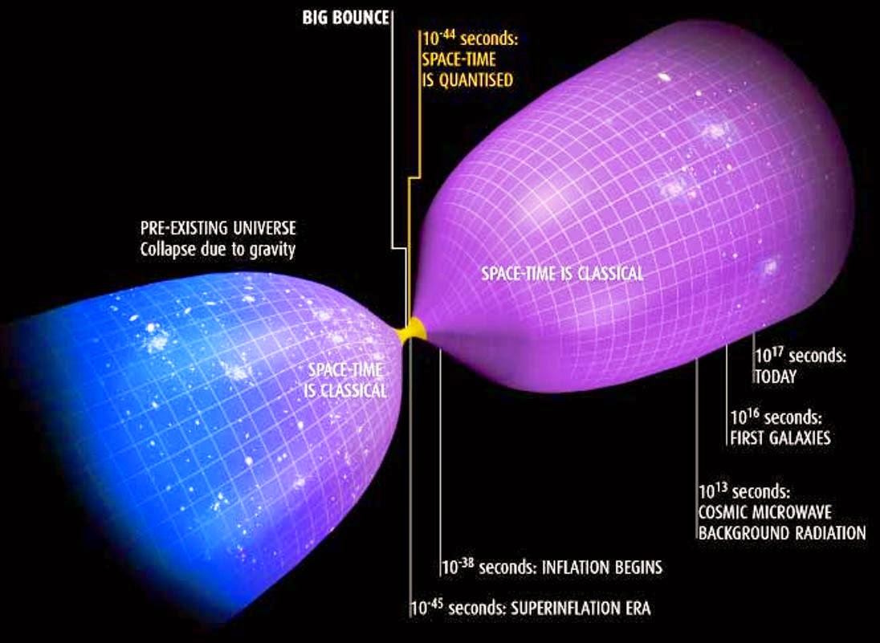
Two possible interpretations of LQC
Deterministic big bounce vs. Creation of two universes from nothing

Slide 32
Summarize
We can successfully apply the no-boundary wave function in the context of the loop quantum cosmology, as a WKB approximation.
For pure de Sitter space, one can reproduce consistent result with Einstein gravity with small corrections.
For kinetic-dominated case, instantons can explain a creation (of two universes) from nothing around the bouncing point, rather than the deterministic big bounce.

Slide 33
Future perspectives
Can we extend/apply to generic situations, e.g.,
  Coleman-DeLuccia instantons?
  Hawking-Turok singular instantons?
  Halliwell-Hawking’s quantum fluctuations?
  Complexified fuzzy instantons?

Slide 34
Thank you

