Slide 1
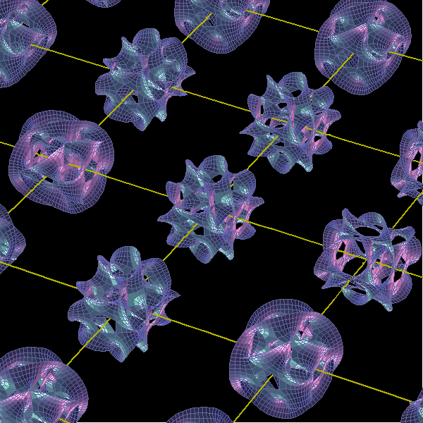

Quantized K$\ddot{a}$hler Geometry
and Quantum Gravity
Center for Qauntum Spacetime
Hyun Seok Yang
100+3 General Relativity Meeting
The King Cherry Blossom meeting
Jeju National University
April 05 - 07, 2018
STGCOS 2018, June 18~20
APCTP

Slide 2
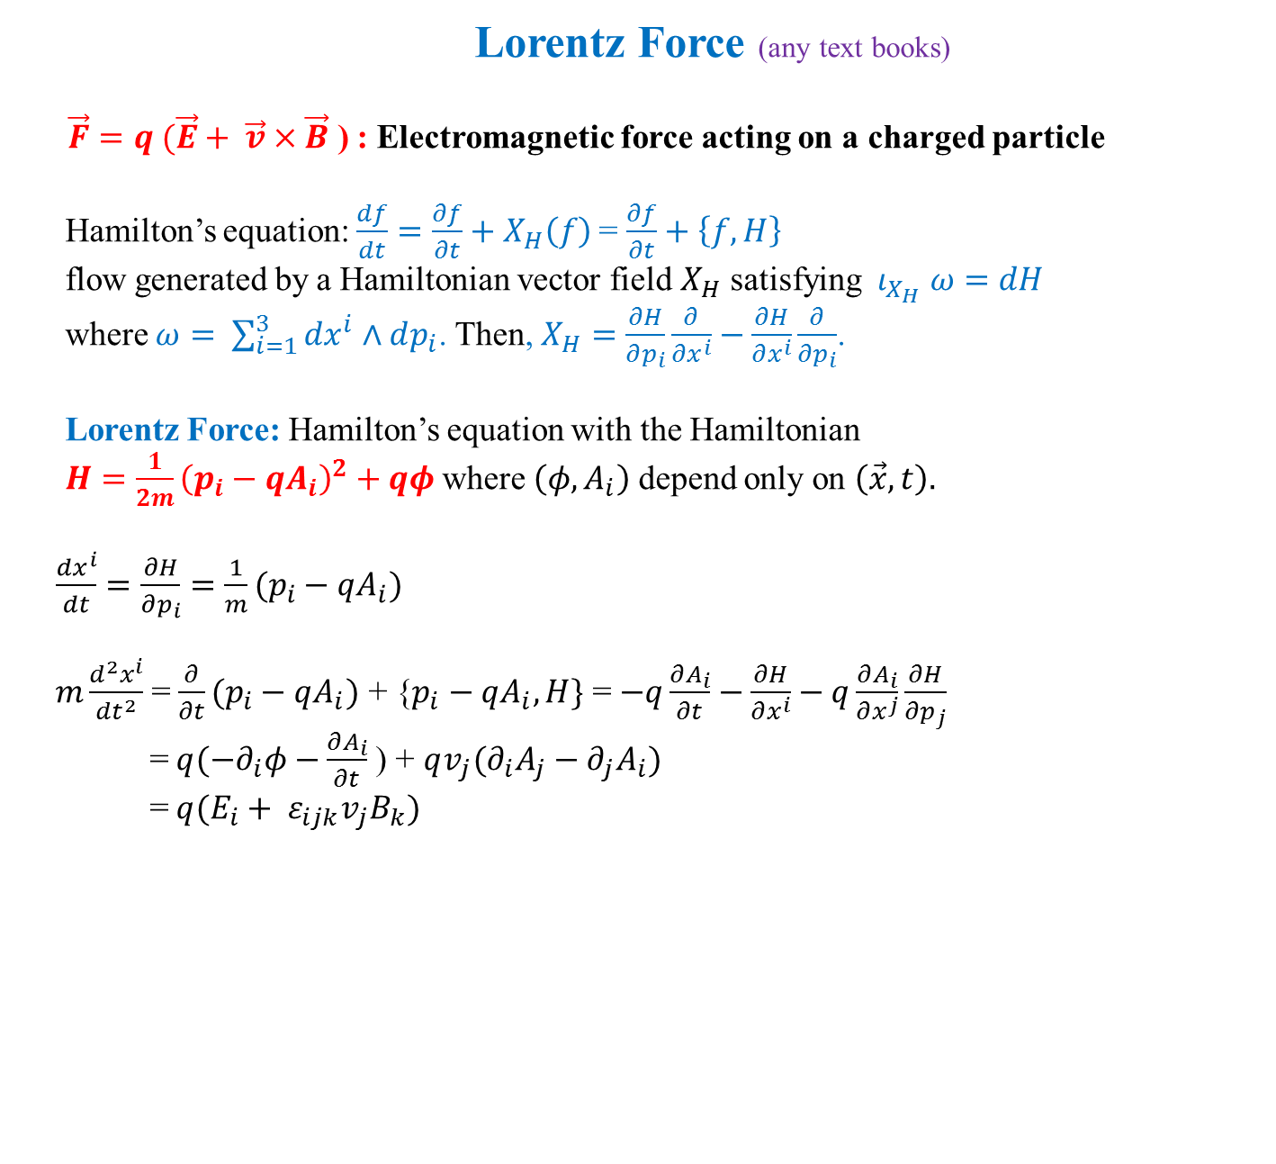
Lorentz Force (any text books)
$\vec{F}=q (\vec{E}+ \vec{v}×\vec{B}$ ) : Electromagnetic force acting on a charged particle
Hamilton’s equation: $\frac{df}{dt}=\frac{∂f}{∂t}+X_{H}\left(f\right)$= $\frac{∂f}{∂t}+\left\{f, H\right\}$
flow generated by a Hamiltonian vector field $X_{H}$ satisfying $ι_{X_{H}} ω=dH$
where $ω= \sum_{i=1}^{3}{dx^{i}∧dp_{i}}$. Then, $X_{H}=\frac{∂H}{∂p_{i}}\frac{∂}{∂x^{i}}−\frac{∂H}{∂x^{i}}\frac{∂}{∂p_{i}}$.
Lorentz Force: Hamilton’s equation with the Hamiltonian
$H=\frac{1}{2m}{\left(p_{i}−qA_{i}\right)}^{2}+qφ$ where $\left(φ, A_{i}\right)$ depend only on $\left(\vec{x}, t\right).$
$\frac{dx^{i}}{dt}=\frac{∂H}{∂p_{i}}=\frac{1}{m}(p_{i}−qA_{i})$
$m\frac{d^{2}x^{i}}{dt^{2}}$ = $\frac{∂}{∂t}(p_{i}−qA_{i})$ + {$p_{i}−qA_{i}, H\}$ = $−q\frac{∂A_{i}}{∂t}−\frac{∂H}{∂x^{i}}−q\frac{∂A_{i}}{∂x^{j}}\frac{∂H}{∂p_{j}}$
= $q({−∂}_{i}φ−\frac{∂A_{i}}{∂t}$) + $qv_{j}(∂_{i}A_{j}−∂_{j}A_{i})$
= $q(E_{i}+ ε_{ijk}v_{j}B_{k})$

Slide 3
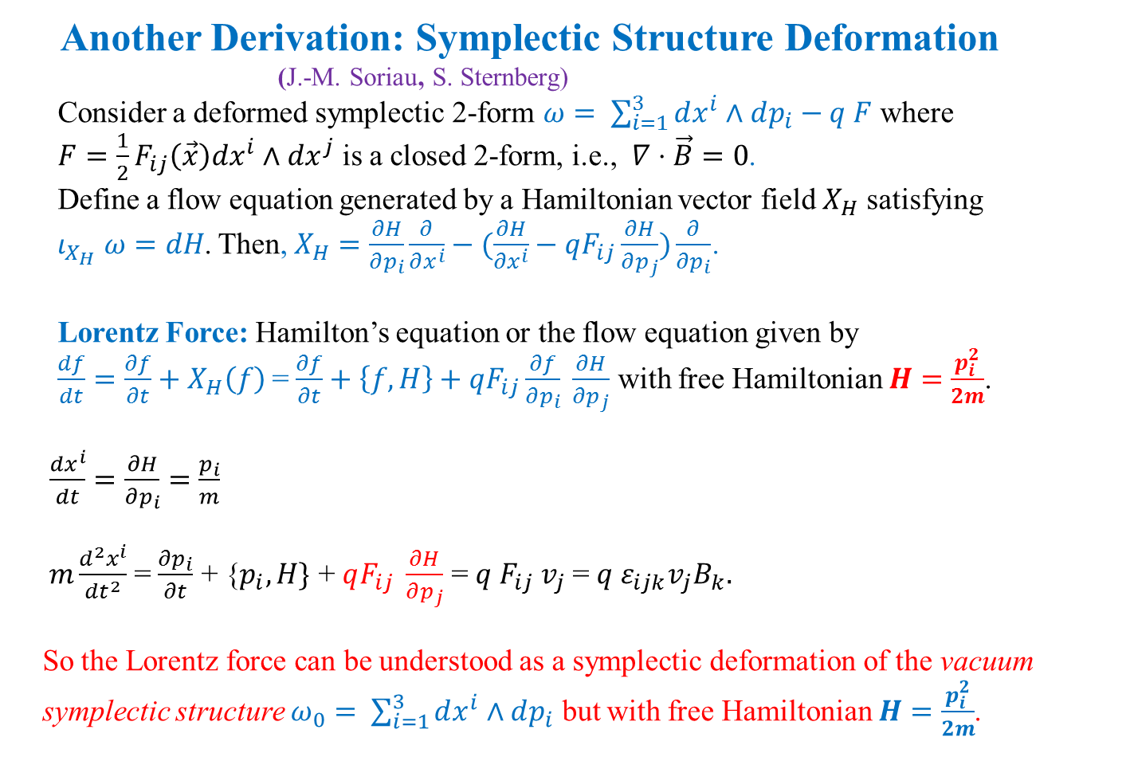
Another Derivation: Symplectic Structure Deformation
(J.-M. Soriau, S. Sternberg)
Consider a deformed symplectic 2-form $ω= \sum_{i=1}^{3}{dx^{i}∧dp_{i}}−q F$ where
$F=\frac{1}{2}F_{ij}\left(\vec{x}\right)dx^{i}∧dx^{j}$ is a closed 2-form, i.e., $∇⋅\vec{B}=0$.
Define a flow equation generated by a Hamiltonian vector field $X_{H}$ satisfying
$ι_{X_{H}} ω=dH$. Then, $X_{H}=\frac{∂H}{∂p_{i}}\frac{∂}{∂x^{i}}−(\frac{∂H}{∂x^{i}}−qF_{ij}\frac{∂H}{∂p_{j}})\frac{∂}{∂p_{i}}$.
Lorentz Force: Hamilton’s equation or the flow equation given by
$\frac{df}{dt}=\frac{∂f}{∂t}+X_{H}\left(f\right)$= $\frac{∂f}{∂t}+\left\{f, H\right\}+qF_{ij}\frac{∂f}{∂p_{i}} \frac{∂H}{∂p_{j}}$ with free Hamiltonian $H=\frac{p_{i}^{2}}{2m}$.
$\frac{dx^{i}}{dt}=\frac{∂H}{∂p_{i}}=\frac{p_{i}}{m}$
$m\frac{d^{2}x^{i}}{dt^{2}}$ = $\frac{∂p_{i}}{∂t}$ + {$p_{i}, H\}$ + $qF_{ij} \frac{∂H}{∂p_{j}}$ = $q F_{ij} v_{j}$= $q ε_{ijk}v_{j}B_{k}.$
So the Lorentz force can be understood as a symplectic deformation of the vacuum
symplectic structure $ω_{0}= \sum_{i=1}^{3}{dx^{i}∧dp_{i}}$ but with free Hamiltonian $H=\frac{p_{i}^{2}}{2m}$.

Slide 4
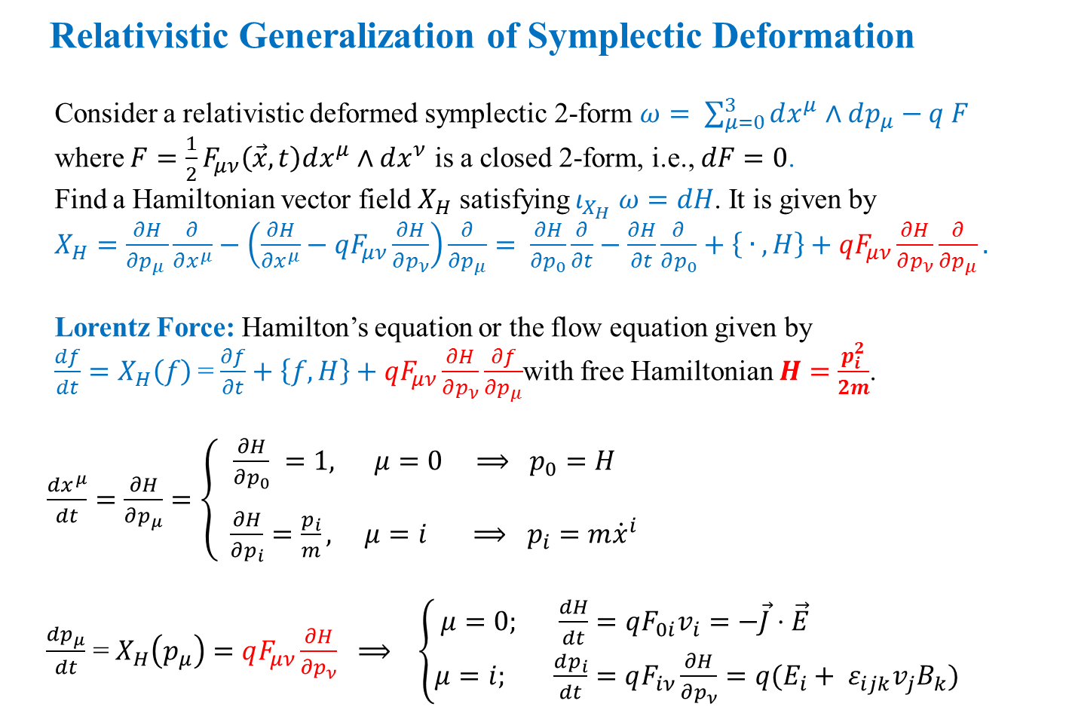
Relativistic Generalization of Symplectic Deformation
Consider a relativistic deformed symplectic 2-form $ω= \sum_{μ=0}^{3}{dx^{μ}∧dp_{μ}}−q F$
where $F=\frac{1}{2}F_{μν}\left(\vec{x}, t\right)dx^{μ}∧dx^{ν}$ is a closed 2-form, i.e., $dF=0$.
Find a Hamiltonian vector field $X_{H}$ satisfying $ι_{X_{H}} ω=dH$. It is given by
$X_{H}=\frac{∂H}{∂p_{μ }}\frac{∂}{∂x^{μ}}−\left(\frac{∂H}{∂x^{μ}}−qF_{μν}\frac{∂H}{∂p_{ν}}\right)\frac{∂}{∂p_{μ}}= \frac{∂H}{∂p_{0}}\frac{∂}{∂t}−\frac{∂H}{∂t}\frac{∂}{∂p_{0}}+\left\{ ∙ , H\right\}+qF_{μν}\frac{∂H}{∂p_{ν}}\frac{∂}{∂p_{μ}}.$
Lorentz Force: Hamilton’s equation or the flow equation given by
$\frac{df}{dt}=X_{H}\left(f\right)$= $\frac{∂f}{∂t}+\left\{f, H\right\}+qF_{μν}\frac{∂H}{∂p_{ν}}\frac{∂f}{∂p_{μ}}$with free Hamiltonian $H=\frac{p_{i}^{2}}{2m}$.
$\frac{dx^{μ}}{dt}=\frac{∂H}{∂p_{μ}}=\left\{\begin{aligned} \frac{∂H}{∂p_{0}} =1, μ=0 ⟹ p_{0}=H \\ \\ \frac{∂H}{∂p_{i}}=\frac{p_{i}}{m}, μ=i ⟹ p_{i}=m{\dot{x}}^{i} \end{aligned}\right.$
$\frac{dp_{μ}}{dt}$ = $X_{H}\left(p_{μ}\right)=$ $qF_{μν}\frac{∂H}{∂p_{ν}} ⟹ \left\{\begin{aligned}μ=0; \frac{dH}{dt}=qF_{0i}v_{i}=−\vec{J}⋅\vec{E} \\ μ=i; \frac{dp_{i}}{dt}=qF_{iν}\frac{∂H}{∂p_{ν}}=q(E_{i}+ ε_{ijk}v_{j}B_{k}) \end{aligned}\right.$

Slide 5
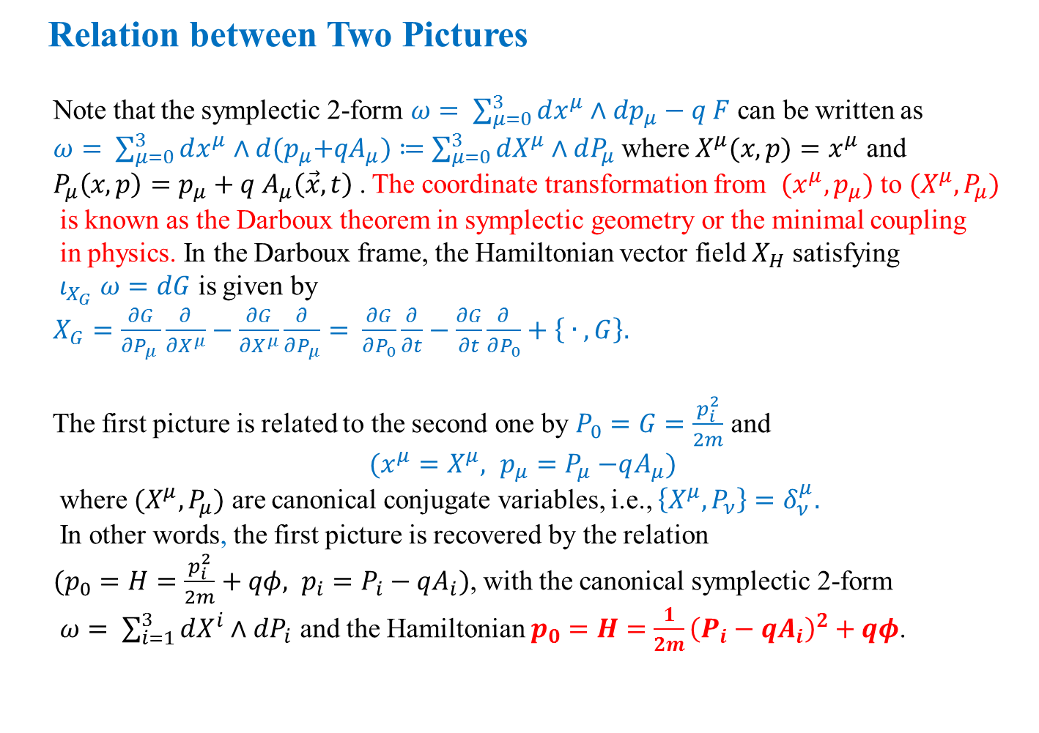
Relation between Two Pictures
Note that the symplectic 2-form $ω= \sum_{μ=0}^{3}{dx^{μ}∧dp_{μ}}−q F$ can be written as
$ω= \sum_{μ=0}^{3}{dx^{μ}∧d{(p}_{μ}+qA_{μ})}≔\sum_{μ=0}^{3}{dX^{μ}∧dP_{μ}}$ where $X^{μ}(x,p)=x^{μ}$ and
$P_{μ}\left(x,p\right)=p_{μ}+q A_{μ}\left(\vec{x}, t\right)$. The coordinate transformation from $(x^{μ}, p_{μ})$ to $(X^{μ}, P_{μ})$
is known as the Darboux theorem in symplectic geometry or the minimal coupling
in physics. In the Darboux frame, the Hamiltonian vector field $X_{H}$ satisfying
$ι_{X_{G}} ω=dG$ is given by
$X_{G}=\frac{∂G}{∂P_{μ }}\frac{∂}{∂X^{μ}}−\frac{∂G}{∂X^{μ}}\frac{∂}{∂P_{μ}}= \frac{∂G}{∂P_{0}}\frac{∂}{∂t}−\frac{∂G}{∂t}\frac{∂}{∂P_{0}}+\left\{ ∙ , G\right\}.$
The first picture is related to the second one by $P_{0}=G=\frac{p_{i}^{2}}{2m}$ and
$$(x^{μ}=X^{μ}, { p_{μ}=P}_{μ }−qA_{μ})$$
where $(X^{μ}, P_{μ})$ are canonical conjugate variables, i.e., $\left\{X^{μ}, P_{ν}\right\}=δ_{ν}^{μ}.$
In other words, the first picture is recovered by the relation
$(p_{0}=H=\frac{p_{i}^{2}}{2m}+qφ, p_{i}=P_{i}−qA_{i})$, with the canonical symplectic 2-form
$ω= \sum_{i=1}^{3}{dX^{i}∧dP_{i}}$ and the Hamiltonian $p_{0}=H=\frac{1}{2m}{\left(P_{i}−qA_{i}\right)}^{2}+qφ$.

Slide 6
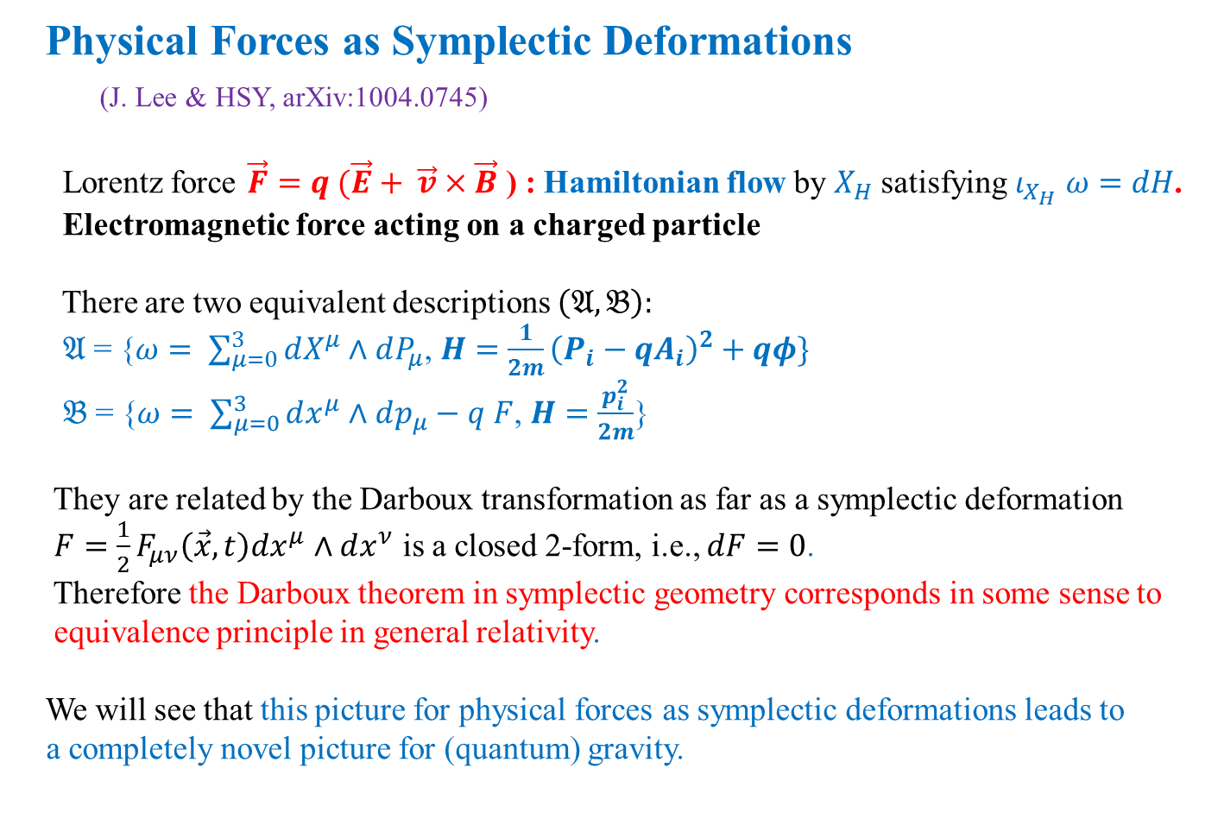
Physical Forces as Symplectic Deformations
(J. Lee & HSY, arXiv:1004.0745)
Lorentz force $\vec{F}=q (\vec{E}+ \vec{v}×\vec{B}$ ) : Hamiltonian flow by $X_{H}$ satisfying $ι_{X_{H}} ω=dH$.
Electromagnetic force acting on a charged particle
There are two equivalent descriptions $\left(𝔄, 𝔅\right):$
$𝔄$ = {$ω= \sum_{μ=0}^{3}{dX^{μ}∧dP_{μ}}$, $H=\frac{1}{2m}{\left(P_{i}−qA_{i}\right)}^{2}+qφ\}$
$𝔅$ = {$ω= \sum_{μ=0}^{3}{dx^{μ}∧dp_{μ}}−q F$, $H=\frac{p_{i}^{2}}{2m}$}
They are related by the Darboux transformation as far as a symplectic deformation
$F=\frac{1}{2}F_{μν}\left(\vec{x}, t\right)dx^{μ}∧dx^{ν}$ is a closed 2-form, i.e., $dF=0$.
Therefore the Darboux theorem in symplectic geometry corresponds in some sense to
equivalence principle in general relativity.
We will see that this picture for physical forces as symplectic deformations leads to
a completely novel picture for (quantum) gravity.

Slide 7
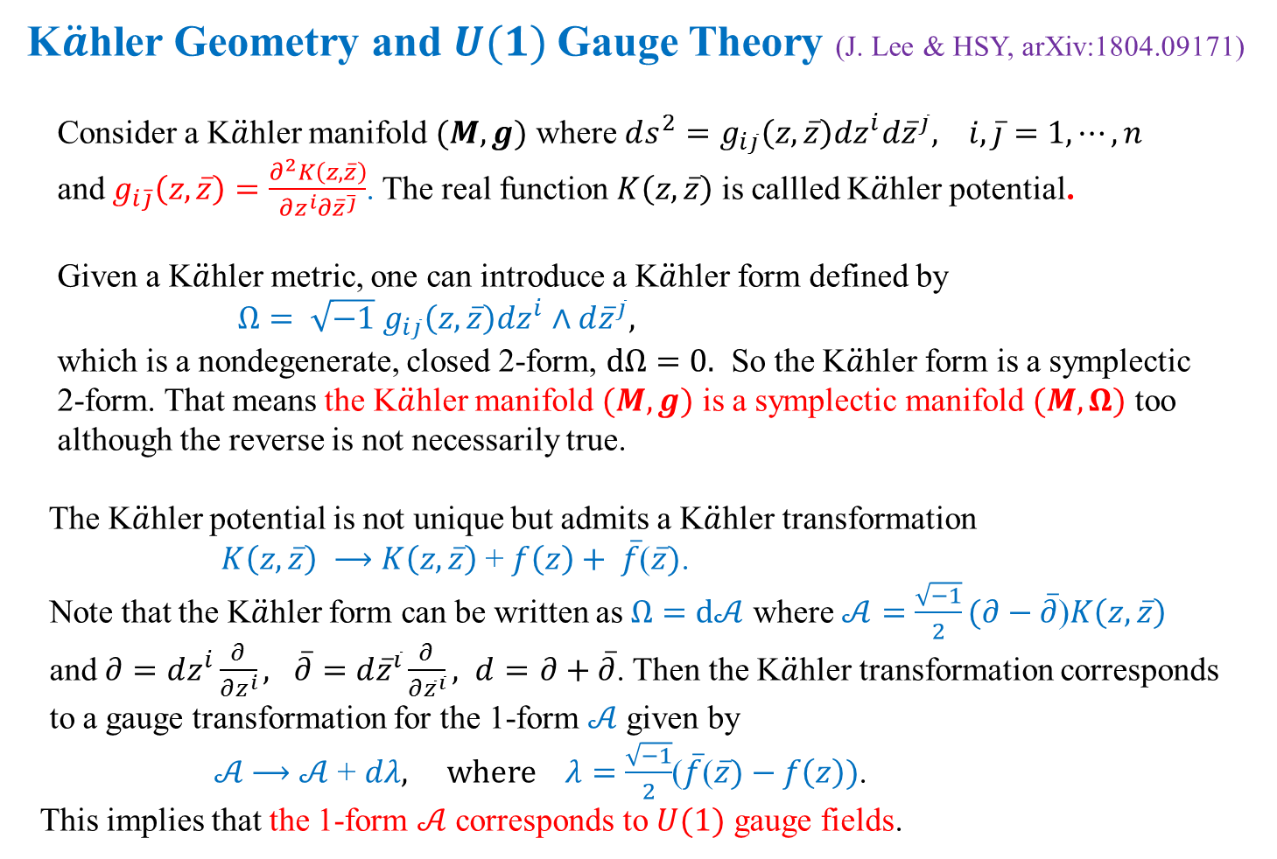
K$\ddot{a}$hler Geometry and $U(1)$Gauge Theory (J. Lee & HSY, arXiv:1804.09171)
Consider a K$\ddot{a}$hler manifold $(M, g)$ where $ds^{2}=g_{i\overline{j}}\left(z, \overline{z}\right)dz^{i}d{\overline{z}}^{\overline{j}}, i, \overline{j}=1, ⋯, n$
and $g_{i\overline{j}}\left(z, \overline{z}\right)=\frac{∂^{2}K\left(z, \overline{z}\right)}{∂z^{i}∂{\overline{z}}^{\overline{j}}}$. The real function $K\left(z, \overline{z}\right)$ is callled K$\ddot{a}$hler potential.
Given a K$\ddot{a}$hler metric, one can introduce a K$\ddot{a}$hler form defined by
$Ω= \sqrt{−1}$ $g_{i\overline{j}}\left(z, \overline{z}\right)dz^{i}∧d{\overline{z}}^{\overline{j}},$
which is a nondegenerate, closed 2-form, $dΩ=0.$ So the K$\ddot{a}$hler form is a symplectic
2-form. That means the K$\ddot{a}$hler manifold $(M, g)$ is a symplectic manifold $(M, Ω)$ too
although the reverse is not necessarily true.
The K$\ddot{a}$hler potential is not unique but admits a K$\ddot{a}$hler transformation
$K\left(z, \overline{z}\right)$ $⟶$ $K\left(z, \overline{z}\right)$ + $f\left(z\right)+ \overline{f}$($\overline{z})$.
Note that the K$\ddot{a}$hler form can be written as $Ω=d𝒜$ where $𝒜=\frac{\sqrt{−1}}{2}(∂−\overline{∂}$)$K\left(z, \overline{z}\right)$
and $∂=dz^{i}\frac{∂}{∂z^{i}}, \overline{∂}=d{\overline{z}}^{\overline{i}}\frac{∂}{∂{\overline{z}}^{\overline{i}}}, d=$ $∂+\overline{∂}$. Then the K$\ddot{a}$hler transformation corresponds
to a gauge transformation for the 1-form $𝒜$ given by
$𝒜$ $⟶$ $𝒜$ + $dλ, where λ=\frac{\sqrt{−1}}{2}$($\overline{f}$($\overline{z})−$ $f\left(z\right))$.
This implies that the 1-form $𝒜$ corresponds to $U(1)$ gauge fields.

Slide 8
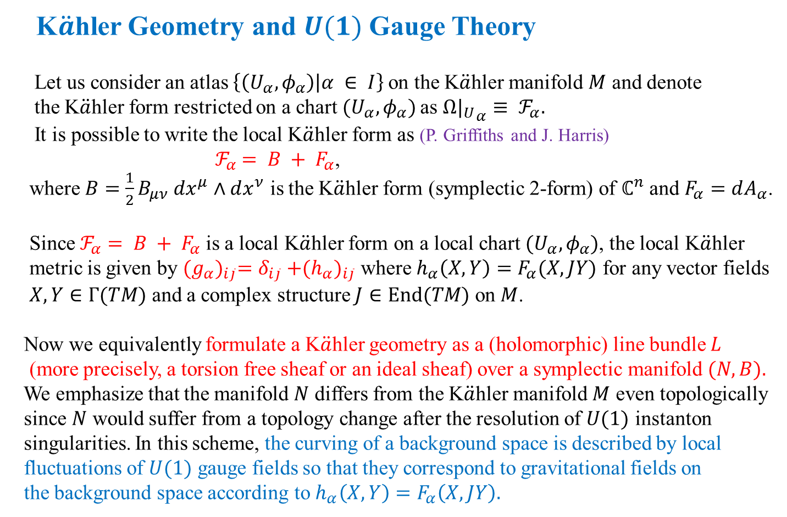
K$\ddot{a}$hler Geometry and $U(1)$Gauge Theory
Let us consider an atlas $\left\{\left(U_{α}, φ_{α}\right) | α ∈ I\right\}$on the K$\ddot{a}$hler manifold $M$ and denote
the K$\ddot{a}$hler form restricted on a chart $(U_{α}, φ_{α})$as ${{Ω|}_{U}}_{α}≡ ℱ_{α}.$
It is possible to write the local K$\ddot{a}$hler form as (P. Griffiths and J. Harris)
$ℱ_{α}$ $= B + F_{α}$,
where $B=\frac{1}{2}B_{μν} dx^{μ}∧dx^{ν}$ is the K$\ddot{a}$hler form (symplectic 2-form) of $ℂ^{n}$ and $F_{α}=dA_{α}$.
Since $ℱ_{α}$ $= B + F_{α}$ is a local K$\ddot{a}$hler form on a local chart $(U_{α}, φ_{α})$, the local K$\ddot{a}$hler
metric is given by ${(g_{α})}_{i\overline{j}}=δ_{i\overline{j}}{+(h_{α})}_{i\overline{j}}$ where $h_{α}\left(X,Y\right)=F_{α}(X, JY)$ for any vector fields
$X,Y∈Γ(TM)$ and a complex structure $J∈End(TM)$ on $M$.
Now we equivalently formulate a K$\ddot{a}$hler geometry as a (holomorphic) line bundle $L$
(more precisely, a torsion free sheaf or an ideal sheaf) over a symplectic manifold $(N, B).$
We emphasize that the manifold $N$ differs from the K$\ddot{a}$hler manifold $M$ even topologically
since $N$ would suffer from a topology change after the resolution of $U(1)$ instanton
singularities. In this scheme, the curving of a background space is described by local
fluctuations of $U(1)$ gauge fields so that they correspond to gravitational fields on
the background space according to $h_{α}\left(X,Y\right)=F_{α}\left(X, JY\right).$

Slide 9
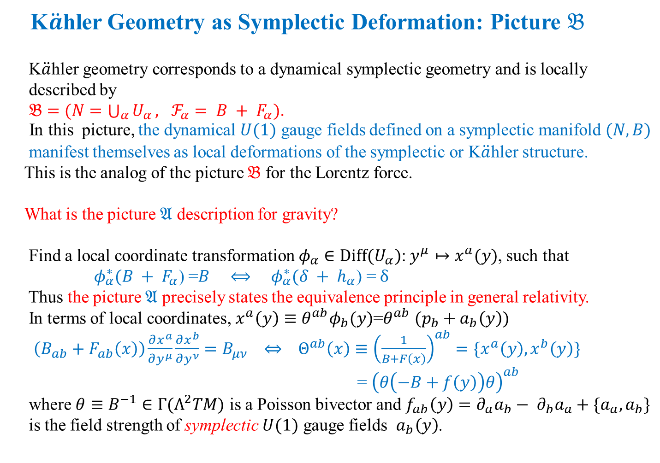
K$\ddot{a}$hler Geometry as Symplectic Deformation: Picture $𝔅$
K$\ddot{a}$hler geometry corresponds to a dynamical symplectic geometry and is locally
described by
$𝔅=$ $(N=\bigcup_{α}{U_{α}}, ℱ_{α}$ $= B + F_{α}).$
In this picture, the dynamical $U(1)$ gauge fields defined on a symplectic manifold $(N,B)$
manifest themselves as local deformations of the symplectic or K$\ddot{a}$hler structure.
This is the analog of the picture $𝔅$ for the Lorentz force.
What is the picture $𝔄$ description for gravity?
Find a local coordinate transformation$φ_{α}∈Diff(U_{α})$: $y^{μ}↦x^{a}(y)$, such that
$φ_{α}^{∗}(B + F_{α}$) =$B ⟺ φ_{α}^{∗}(δ + h_{α}\text{) =} δ$
Thus the picture $𝔄$ precisely states the equivalence principle in general relativity.
In terms of local coordinates, $x^{a}\left(y\right)≡θ^{ab}φ_{b}(y)$=$θ^{ab} (p_{b}+a_{b}\left(y\right))$
$\left(B_{ab}+F_{ab}\left(x\right)\right)\frac{∂x^{a}}{∂y^{μ}}\frac{∂x^{b}}{∂y^{ν}}=B_{μν} ⇔ Θ^{ab}\left(x\right)≡{\left(\frac{1}{B+F\left(x\right)}\right)}^{ab}=\{x^{a}\left(y\right), x^{b}\left(y\right)\}$
= ${\left(θ\left(−B+f\left(y\right)\right)θ\right)}^{ab}$
where $θ≡B^{−1}∈Γ(Λ^{2}TM)$ is a Poisson bivector and $f_{ab}\left(y\right)=∂_{a}a_{b}− ∂_{b}a_{a}+\{a_{a},a_{b}\}$
is the field strength of symplectic $U(1)$ gauge fields $a_{b}\left(y\right)$.

Slide 10


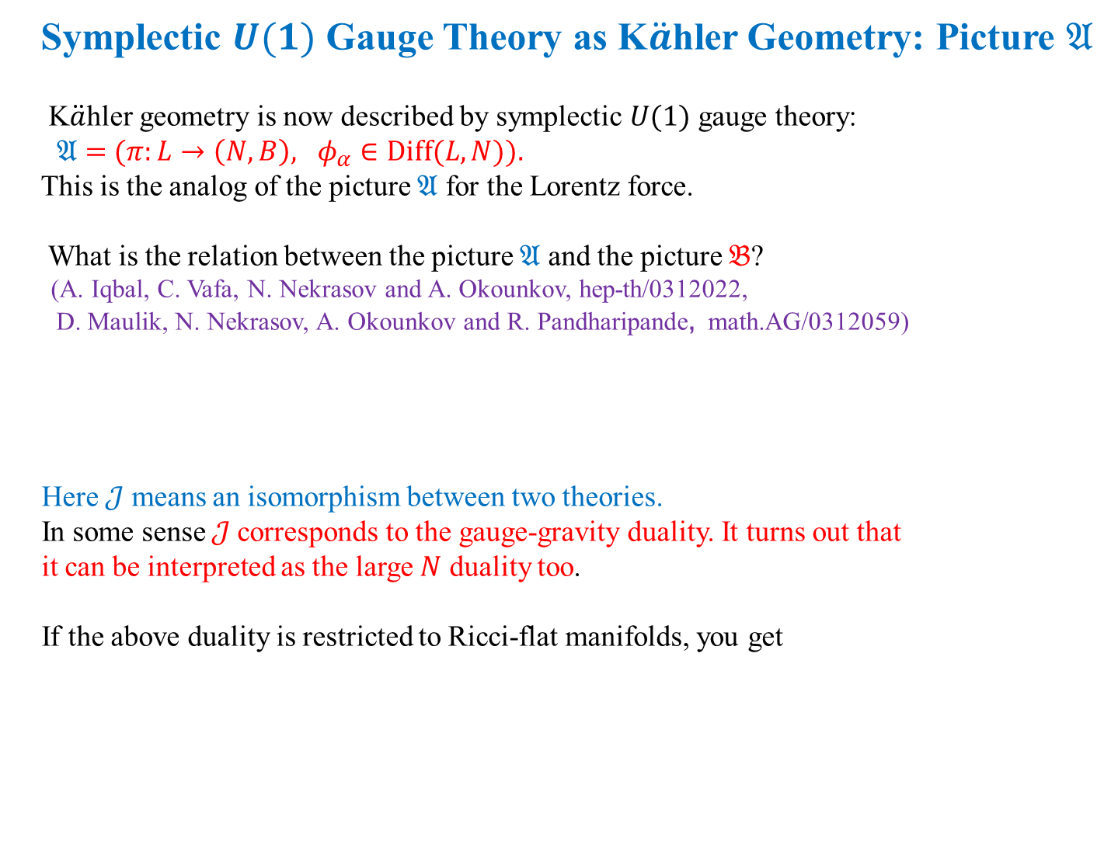
Symplectic $U(1)$ Gauge Theory as K$\ddot{a}$hler Geometry: Picture $𝔄$
K$\ddot{a}$hler geometry is now described by symplectic $U(1)$ gauge theory:
$𝔄=$ $(π:L→\left(N, B\right), φ_{α}∈Diff(L,N)).$
This is the analog of the picture $𝔄$ for the Lorentz force.
What is the relation between the picture $𝔄$ and the picture $𝔅$?
(A. Iqbal, C. Vafa, N. Nekrasov and A. Okounkov, hep-th/0312022,
D. Maulik, N. Nekrasov, A. Okounkov and R. Pandharipande, math.AG/0312059)
Here $𝒥$ means an isomorphism between two theories.
In some sense $𝒥$corresponds to the gauge-gravity duality. It turns out that
it can be interpreted as the large $N$ duality too.
If the above duality is restricted to Ricci-flat manifolds, you get

Slide 11
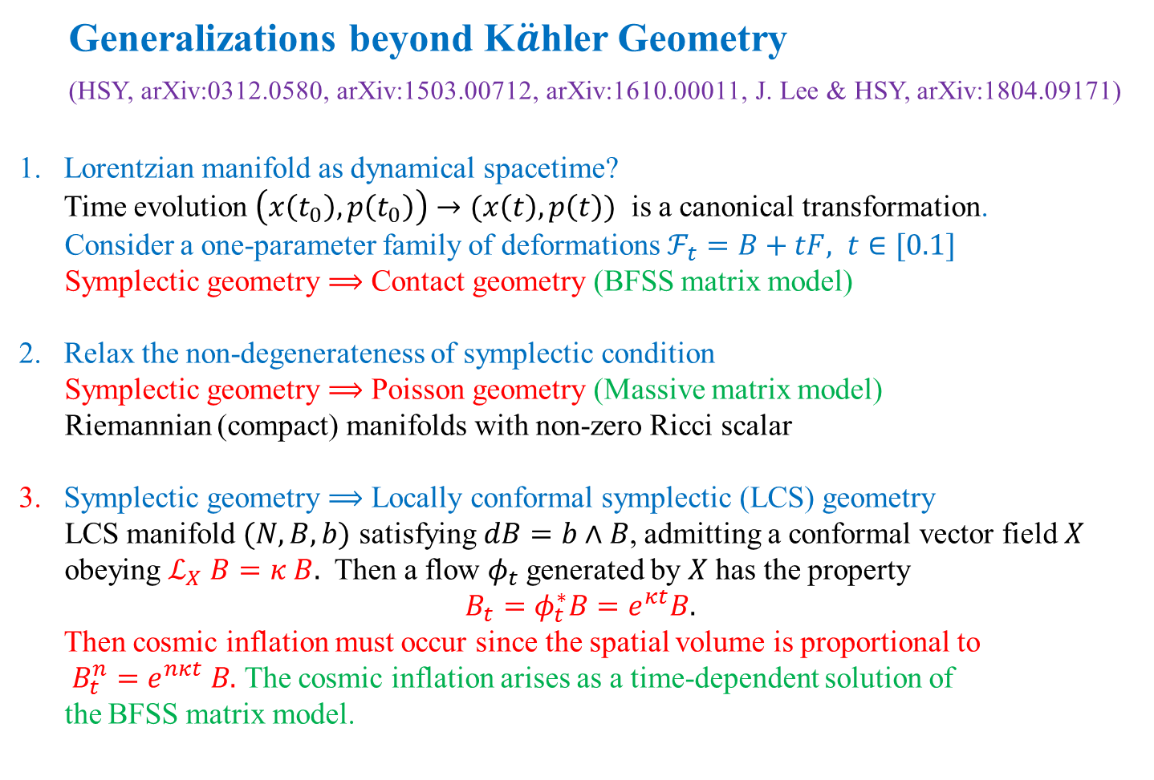
Generalizations beyond K$\ddot{a}$hler Geometry
(HSY, arXiv:0312.0580, arXiv:1503.00712, arXiv:1610.00011, J. Lee & HSY, arXiv:1804.09171)
Lorentzian manifold as dynamical spacetime?
Time evolution $\left(x\left(t_{0}\right), p\left(t_{0}\right)\right)→(x\left(t\right), p\left(t\right))$ is a canonical transformation.
Consider a one-parameter family of deformations $ℱ_{t}=B+tF, t∈[0.1]$
Symplectic geometry $⟹$ Contact geometry (BFSS matrix model)
Relax the non-degenerateness of symplectic condition
Symplectic geometry $⟹$ Poisson geometry (Massive matrix model)
Riemannian (compact) manifolds with non-zero Ricci scalar
3. Symplectic geometry $⟹$ Locally conformal symplectic (LCS) geometry
LCS manifold $(N,B,b)$ satisfying $dB=b∧B$, admitting a conformal vector field $X$
obeying $ℒ_{X} B=κ B.$ Then a flow $φ_{t}$generated by $X$ has the property
$$B_{t}=φ_{t}^{∗}B=e^{κt}B.$$
Then cosmic inflation must occur since the spatial volume is proportional to
$B_{t}^{n}=e^{nκt }B.$ The cosmic inflation arises as a time-dependent solution of
the BFSS matrix model.

