Slide 1
Entanglement Entropy in Electric Field
Mini workshop for the entanglement entropy at SKKU
[June 21 (Thu.) - June 22 (Fri.), 2018]
SKKU, Suwon, Korea
Kyung Kiu Kim (Sejong Univ.)
In collaboration with
Chanyong Park(GIST), Jung Hun Lee(GIST) and Byoungjoon Ahn(Yonsei Univ.)
Based on 1804.00412

Slide 2
Contents
Motivation
Bulk dual to a system in an external field
Response of Entanglement Entropy to DC Electric Field
- Strip case
- Wedge case
Discussion and Future Direction

Slide 3
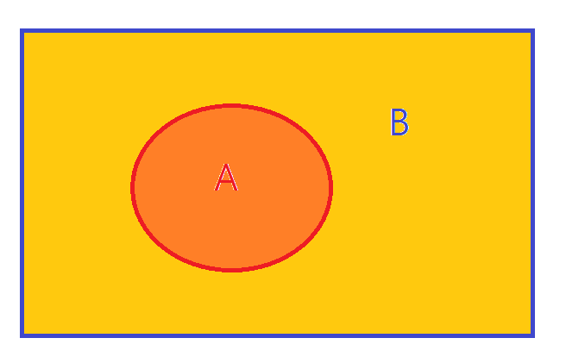

(Holographic) entanglement entropy
Entanglement Entropy of a state
This quantity is non-local, because of nontrivial trace on the subspace.
In most cases, it is not easy to calculate this quantity.
-Almost free theories.

Slide 4

(Holographic) entanglement entropy
How can we study this quantity through the AdS/CFT correspondence?
Ryu and Takayanagi’s proposal.

Slide 5
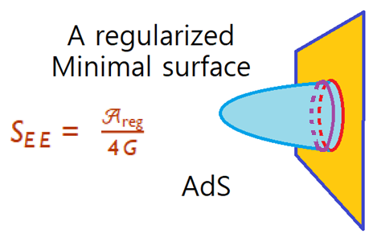
(Holographic) entanglement entropy
What is a dual quantity to this entropy?
Their answer is
It is much easier to calculate this quantities than to do same thing by the field theory calculation.
The first law of entanglement entropy = linearized Einstein equation. Raamsdonk(2017)
See Raamsdonk(2017) and Sin(2017) for nonlinear extension.

Slide 6
Motivation
So we can obtain entanglement entropy through this proposal.
How can we trust the proposal?
It can be a reliable approach for two dimensional field theories.
In 2 dimensional CFT or FT, we have some results to compare Ryu-Takayanagi’s formula.
They are consistent each other.
For other dimensions?
There are many plausible explanations for the agreement.

Slide 7
Motivation
However, it is very difficult to compute the entanglement entropy in the strong coupling regime by field theory calculation.
Thus we don’t know in which regime and how much the formula is fine.
What can be compared to various results from Ryu-Takayanagi’s formula?
If entanglement entropy can be measured in experiments, then we may compare results from the RT formula to the experimental data.

Slide 8
Motivation
Can we measure the entanglement entropy?
Usually an entropy is not a direct observable.
Variations of entropy can be considered as observables through the first law.
If we measure entanglement entropy changes under some external sources, those may be compared to the Ryu-Takayangi’s calculations.

Slide 9

Motivation
Recent papers on measurement of EE, Renyi entropy and mutual information in very simple systems.

Slide 10
Motivation
Therefore, we study the holographic entanglement entropy in an external source.
This could be compared to result from some experiment near future.
Since one of the basic experiment to investigate matters to see responses to an electric field, we choose the electric field as a source.
Thus, we will examine entanglement entropy changes by applying an electric field in gauge/gravity duality.

Slide 11
Response of Entanglement Entropy to DC Electric Field
How does a system change by turning an external electric field?
The electric field induces a current.
In addition it also induces a heat current.
The coefficients are given by Green’s Function(Two point Functions)

Slide 12
Response of Entanglement Entropy to DC Electric Field
These two point functions are called
electric conductivity, thermoelectric conductivity, thermal conductivity

Slide 13

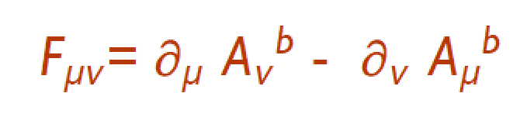
Background dual to a system in an external fields
A non-dynamical electric and magnetic field in gauge/gravity duality correspond to a local bulk gauge field.
We choose d = 3, i.e, 2+1 dimensional CFT, because there have been a lot of works on this topic recently.

Slide 14
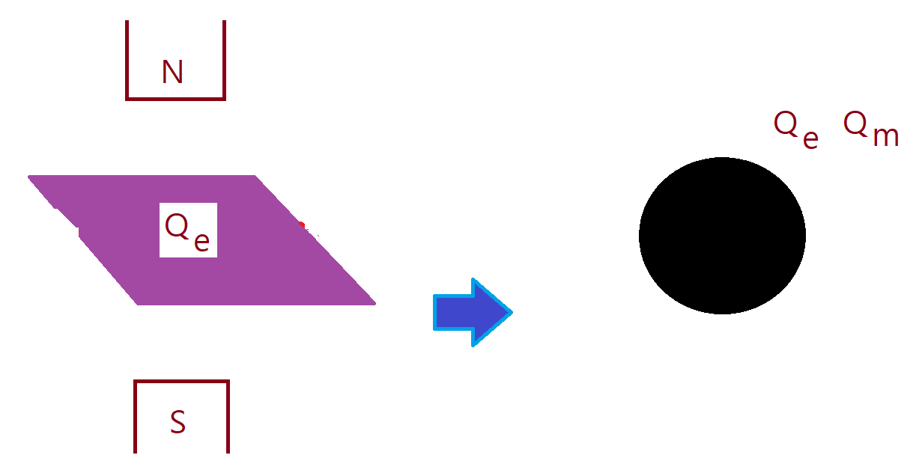
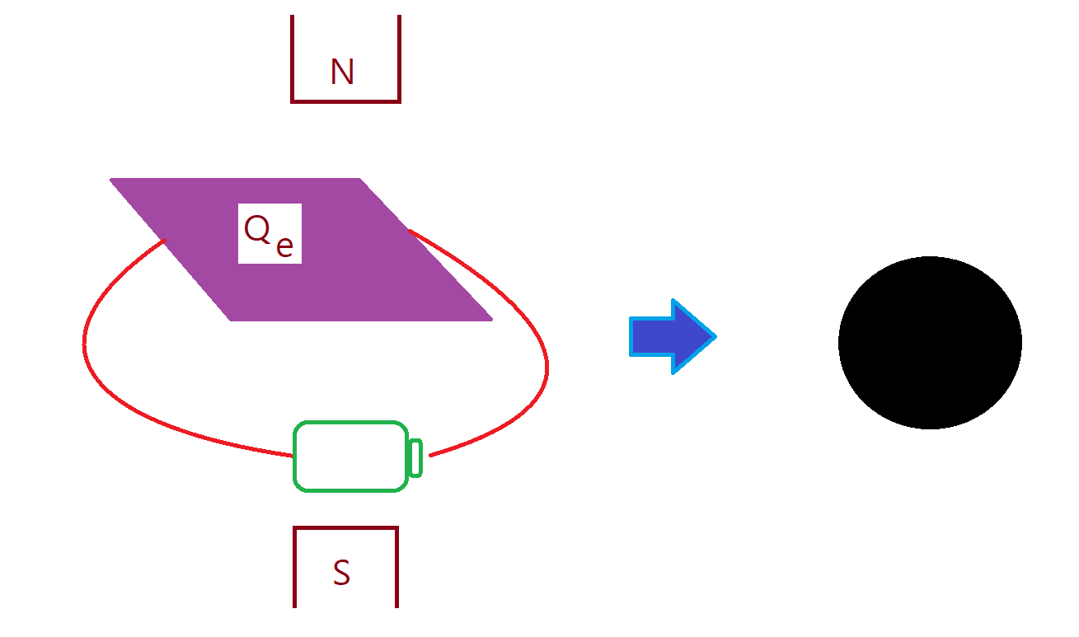
Background dual to a system in an external fields
Dyonic BH
Dyonic BH + gauge field
; weak electric field
( DC or AC )

Slide 15

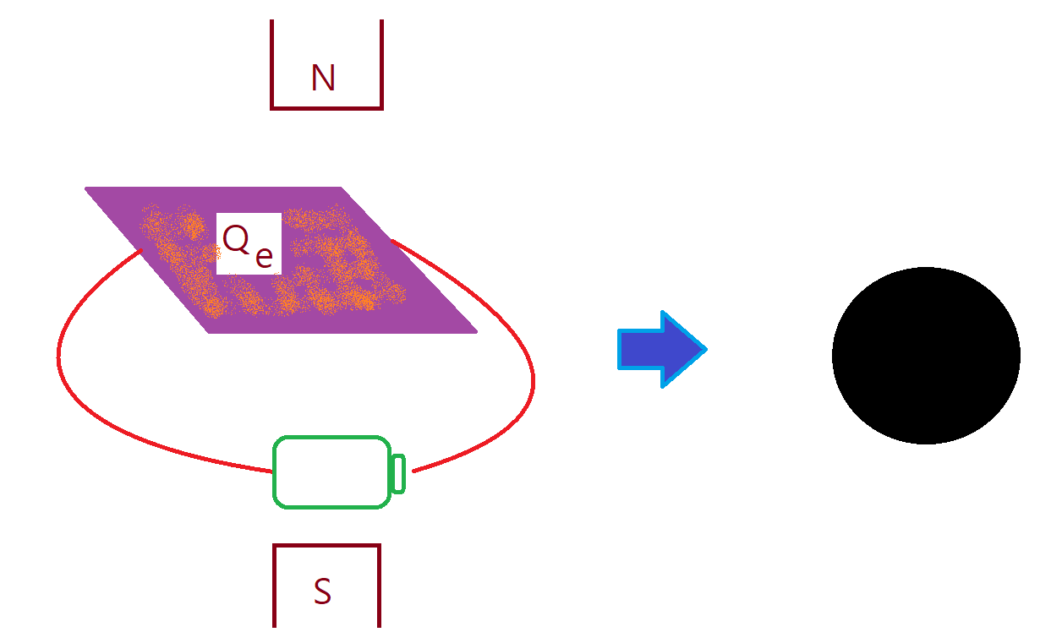
DC electric field for simplicity
Axion Model( To have finite DC conductivity )

Slide 16
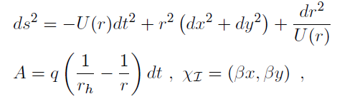

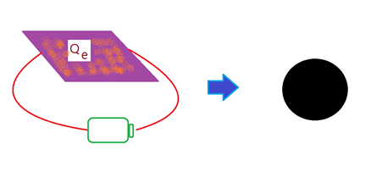
This bulk theory admits a black brane solution.

Slide 17
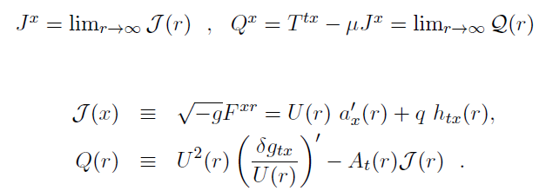

Slide 18


Current and Heat current
In-falling BC

Slide 19


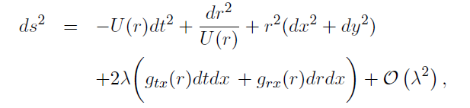
Contents
Conductivities

Slide 20

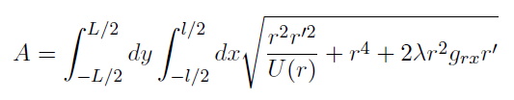
HEE in this background
Ryu-Takayanagi Formula (The Strip case)

Slide 21
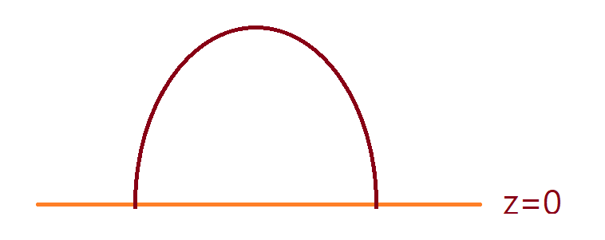
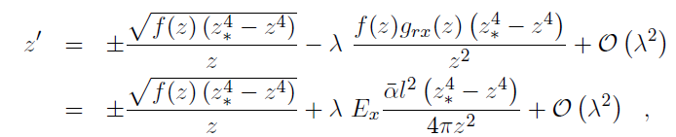
A convenient coordinate

Slide 22


S = A /4 G
Expand z
Eom : Even and Odd

Slide 23
Zeroth order : we obtained analytic result in some limits and numerical result.
Analytic results in the small l limit

Slide 24
Zero temperature result

Slide 28
No linear response to the electric field!
To see the effect of entanglement entropy from electric field, we have to consider quadratic order in the electric field.
We don’t know the background.
We cannot see the change under an electric field in this case.

Slide 29
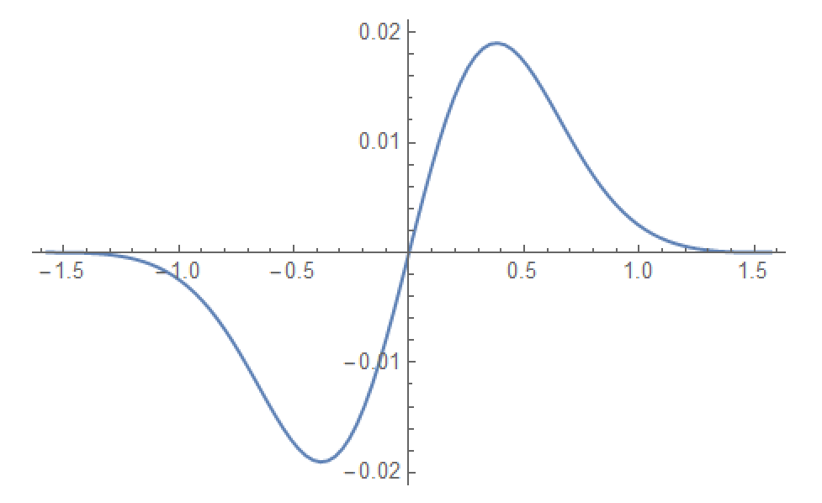
Why can’t we see the linear response?
This case is so symmetric case. The solution of first order equation is an odd function!

Slide 30

To obtain the effect of the electric field, we may try two kinds of situations
- finding the quadratic order background in the electric field
- Or we can try an asymmetric case.
Entanglement entropy with a wedge entangling region!

Slide 31
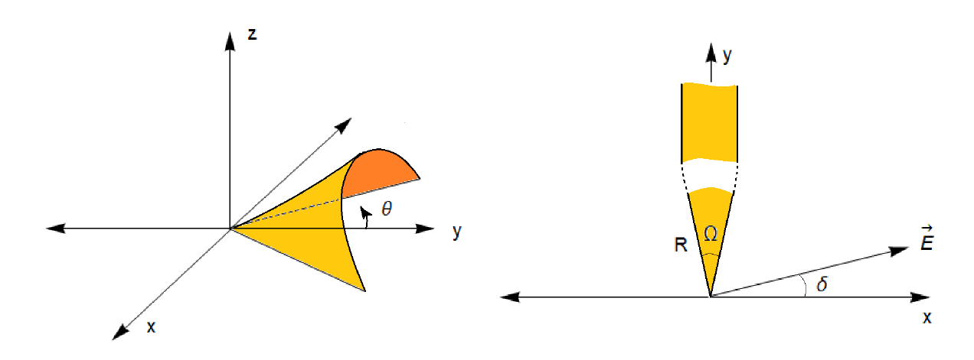
Wedge Type

Slide 32
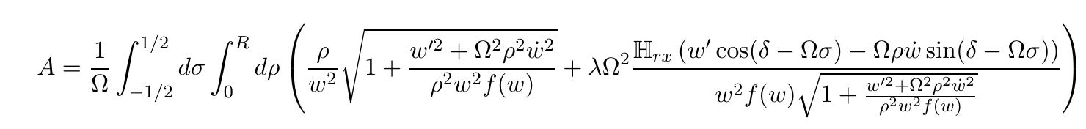
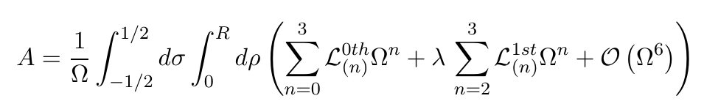
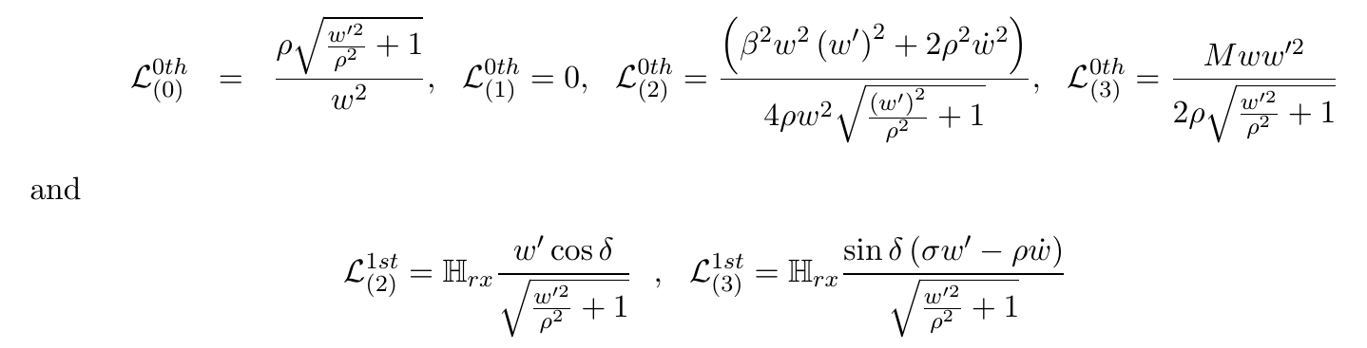
The area
Small angle limit

Slide 33
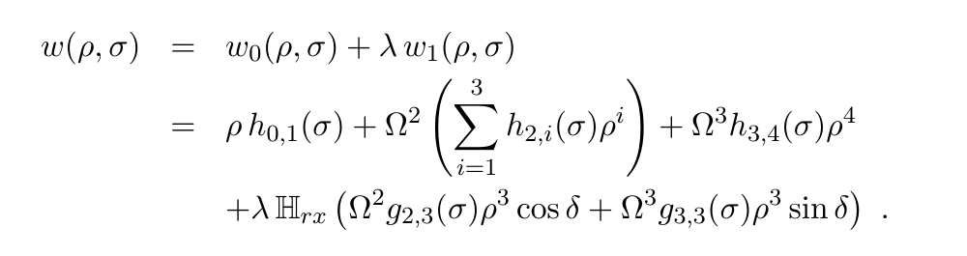
Small R → the solution can be expanded in terms of polynomials of rho.

Slide 34
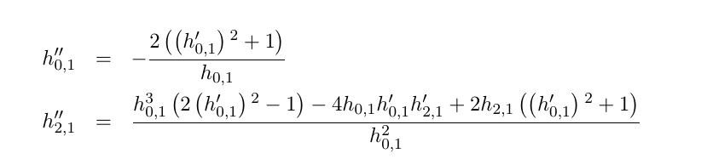
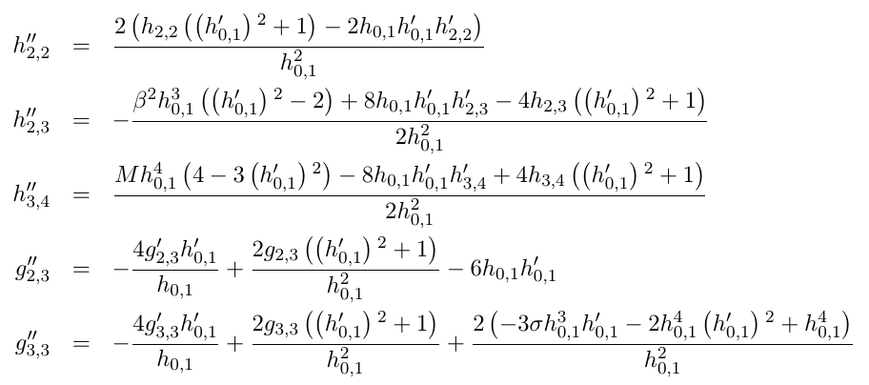
eoms

Slide 35
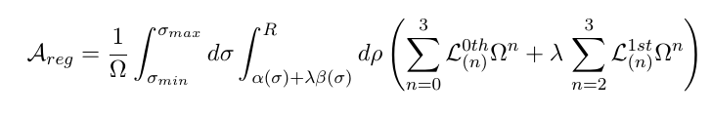
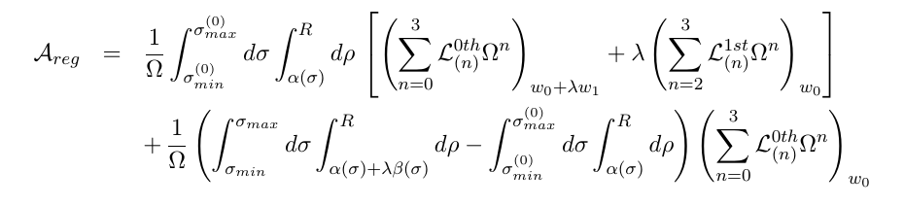
Regularized Area
Linear term from the integrand and the integral region

Slide 36
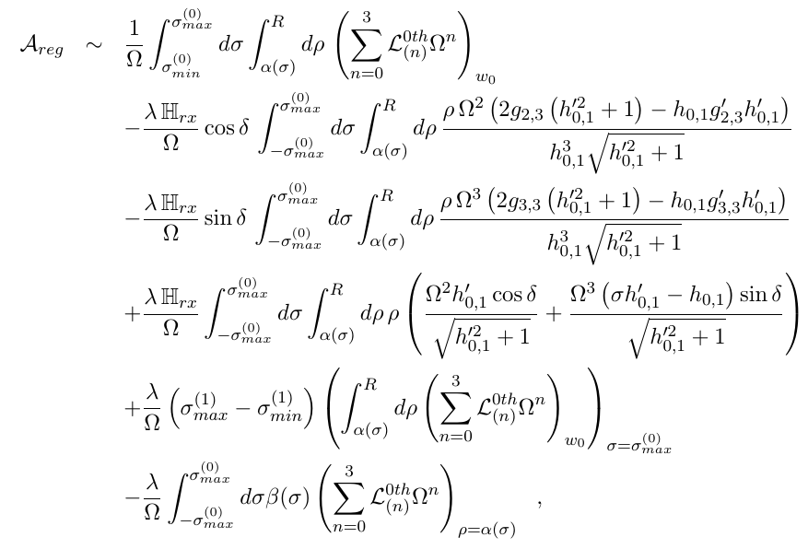

Slide 37
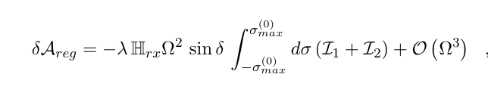
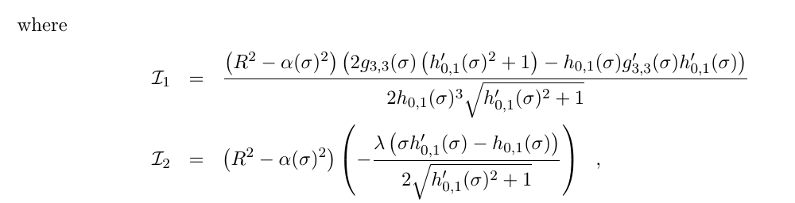

Slide 38
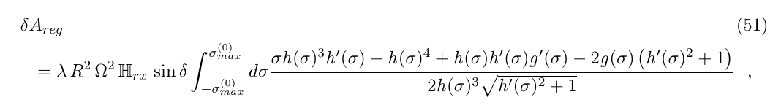
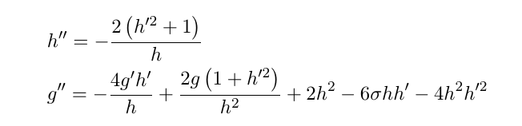
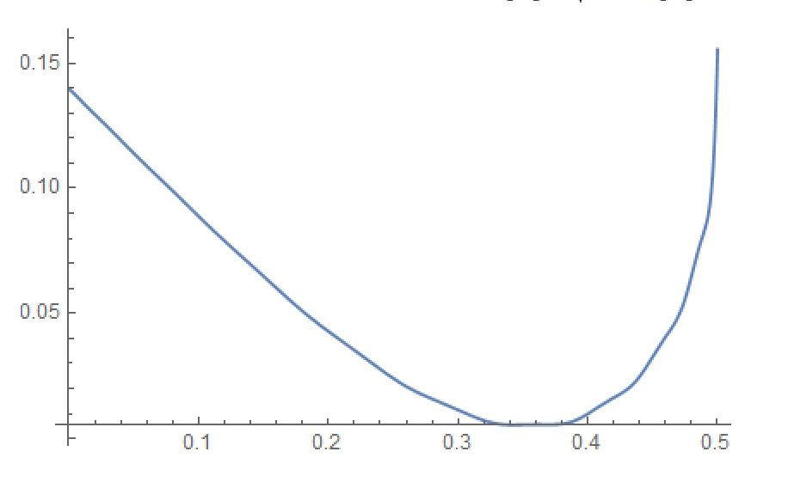
Finally we obtain the linear term in the electric field.
The integrand is a positive function

Slide 39

The linear response of the holographic entanglement entropy is

Slide 40
Discussion and Future Direction
Response of the entanglement entropy to an external electric field can be written in terms of measurable quantity.
The correction is proportional to the thermo-electric coefficient a measurable quantity(Wedge type HEE).
----------Future Directions---------
Quadratic order in E
Response to AC Electric field
Response to the temperature gradient
Spherical entangling surfaces : What happens to the F-theorem.
Response to magnetic field (comparable to field theory calculations).
Various field theory calculations with an electric field.

