Slide 1
Gravity from Entanglement and RG Flow
in a Top-down Approach
O-Kab Kwon
(Sungkyunkwan University)
In collaboration with
Dongmin Jang, Yoonbai Kim, Driba Tolla
arXiv:1610.01490(EPJC)
arXiv:1612.05066(JHEP) arXiv:1712.09101(JHEP)
arXiv:1803.10660
STGCOS2018 meeting, Pohang
June 18 – 20, 2018

Slide 2
Outline
gauge/gravity duality in a top-down approach
Holographic entanglement entropy
Construction of 4-dimensional LLM
Holography and entanglement entropy
Einstein equation from entanglement entropy of
nonconformal field theory
Summary

Slide 3
AdS/CFT correspondence by Maldacena (1997)
QFT with fixed spacetime
Quantum gravity
Exactly equivalent
GKP-W relation (1998)

Slide 4
Gauge/gravity
Duality properties of field theory and gravity theory
Very useful but difficult to check the duality!
For some BPS objects which have no quantum corrections,
it is possible to check the duality using supersymmetry
and conformal symmetry in the large N limit.
duality
Quantum field theory
Quantum gravity
Strongly coupled gauge theory
Large N
Weakly curved gravity (classical gravity)

Slide 5
Gauge/gravity
Duality properties of field theory and gravity theory
Many evidences
Origin of gauge/gravity duality??
duality
Quantum field theory
Quantum gravity
Strongly coupled gauge theory
Large N
Weakly curved gravity (classical gravity)

Slide 6
One clue from quantum information theory
QFT with fixed spacetime
Quantum gravity
Quantum information theory
Holographic EE
Emergent gravity from EE
Quantum complexity
…..

Slide 7
Entanglement Entropy
Quantum entanglement is a physical phenomenon that occurs
when pairs of particles interact. Then the quantum state of each
particle cannot be described independently.
➔ entanglement entropy (EE)
Density matrix of a ground state :
Reduced density matrix:
Entanglement entropy (EE) = von Neumann entropy

Slide 8

Entanglement Entropy
In QFT?
Replica trick for the Renyi entropy in path integral method
B
A

Slide 9
Properties of the EE in QFT
The lattice size a is a UV cut-off.
B
A
a

Slide 10
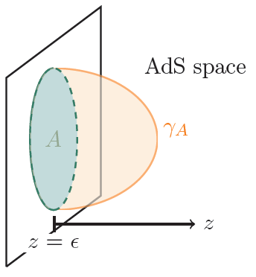
Holographic entanglement entropy (HEE)
[Ryu-Takayanagi 06]
is the codimension 2 minimal surface
How can we relate the EE and gravity?

Slide 11
Entanglement entropy 1st law
Small fluctuation around the vacuum

Slide 12
Entanglement entropy 1st law
Ball-shaped region A
modular Hamiltonian
A
hyperbolic energy

Slide 13
Entanglement entropy 1st law
Ball-shaped region A
modular Hamiltonian
A
hyperbolic energy
Gauge/gravity duality
RT formula
[Raamsdonk et al, 2013]
Linearized Einstein equation

Slide 14
How about non-conformal CFT?
Corresponding 1st law for EE?
Extended 1st law?
Emergent gravity in a top-down approach?

Slide 15
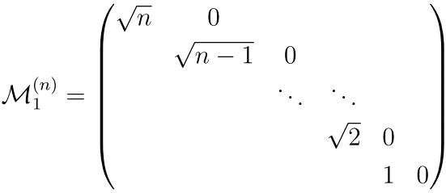
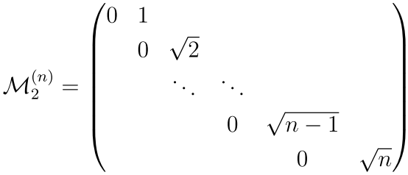
Mass-deformed ABJM and LLM
ABJM (CFT) + mass deformation = mABJM
(non-CFT)
Vacua of mABJM
LLM geometry with orbifold
[Lin-Lunin-Maldacena, 2004]
Discrete Higgs vacua
denoted by numerical values
➔Quantitative comparison is possible!!
[Gomis et al 08]
[Cheon-Kim-Kim 2011]

Slide 16
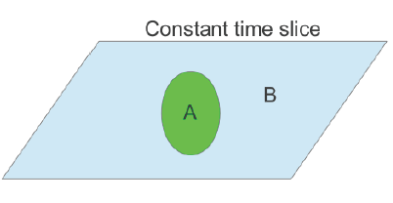
Gauge/gravity duality and entanglement entropy (EE)
Relevant deformation by inserting relevant operators to the CFT (i.e. mass deformation) ➔ non-conformal deformation
ABJM(3d CFT)
+ relevant deformations
correspondence
asymptotically
Solution in 11d SUGRA
(GKP-W relation)
Gauge/gravity mapping
KK reduction
for and
asymptotically
solutions in 4d gravity of KK modes
EE for an entangling surface (replica method)
RT conjecture
HEE deformed from the AdS case
in the large N limit

Slide 17
Gauge/gravity duality and entanglement entropy (EE)
Relevant deformation by inserting relevant operators to the CFT (i.e. mass deformation) ➔ non-conformal deformation
ABJM(3d CFT)
+ relevant deformations
correspondence
asymptotically
Solution in 11d SUGRA
(GKP-W relation)
Gauge/gravity mapping
KK reduction
for and
asymptotically
solutions in 4d gravity of KK modes
EE for an entangling surface (replica method)
RT conjecture
HEE deformed from the AdS case
in the large N limit

Slide 18
Construction of 4-dimensional gravity
EOM for graviton mode in 11d:
Linear order
quadratic order and higher derivative terms appears
EOM for scalar modes in 11d:

Slide 19
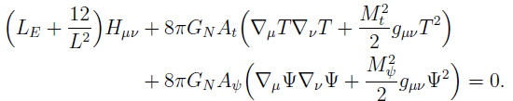


Construction of 4-dimensional gravity
EOM for graviton mode in 4d:
To absorb higher derivatives, we needs field redefinition:

Slide 20

Construction of 4-dimensional gravity
Near the UV fixed point where the ABJM theory lives on, (in the small mass expansion,) the dual 4-dimensional gravity action is given by
Fluctuations around AdS_4 space:
Asymptotically AdS solution with relevant deformations

Slide 21

Holographic entanglement entropy
Metric fluctuations around AdS_4 and induced metric:

Slide 22
Holographic entanglement entropy
Variation of the EE is determined by source and vev
This result exactly reproduces the HEE using PDE from the 11d LLM. [Kim-Kim-OK 2016]
[Jang-Kim-OK-Tolla 2017]
Vev:
Source:
Field theory calculation for the vev
Gauge/gravity duality (GKP-W relation)
Holographic entanglement entropy (RT formula)

Slide 23


[2014 Faulkner]
Variation of entanglement entropy
EE calculation using path integral method in CFT with relevant perturbation

Slide 24
[2014 Faulkner]
Variation of entanglement entropy
In the mass-deformed ABJM theory, there are two
relevant operators which are dual to
Path integral in QFT
Gauge/gravity duality
Normalization ambiguity
in gauge/gravity duality

Slide 25


Variation of entanglement entropy
Gauge/gravity duality
LLM sol.
KK reduction
RT formula
[Iyer and Wald 1994]
Einstein equation from EE of non-conformal field theory

Slide 26

Conclusion
Using the LLM geometry in 4-dim. gravity:
1.
2. extended thermodynamic-like first law of
for all droplet solution in non-conformal field theory
3. relation using exact holography
and the entropic counterpart of the Einstein equation
Generalized 1st law for the entanglement entropy
IR entanglement entropy for the mABJM and LLM
Thank you!!

