Slide 1
The basics and history of the fractal/crumpled globule model for the large-scale chromatin folding/organization
Angelo Rosa
Scuola Internazionale Superiore di Studi Avanzati (SISSA, Trieste)
Email: anrosa@sissa.it

Slide 2
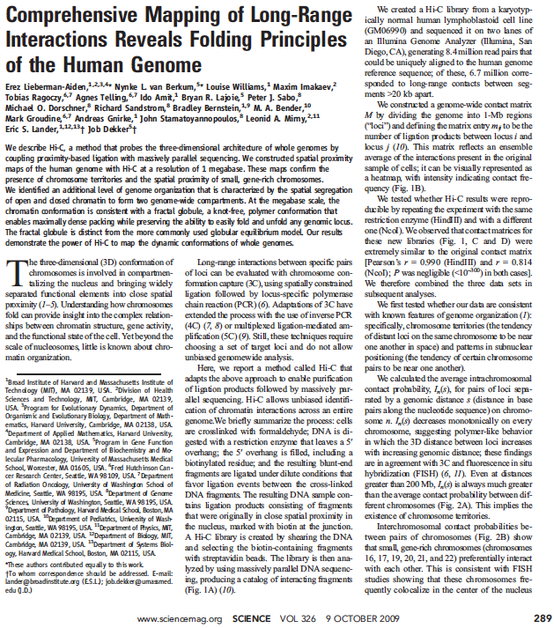
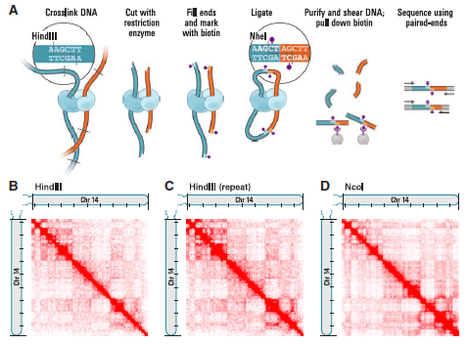
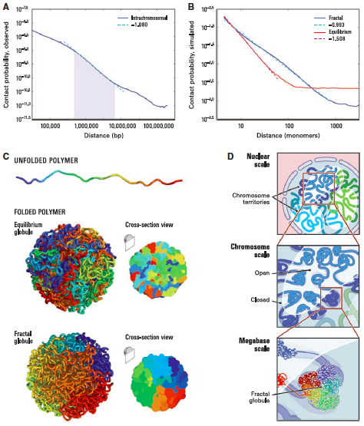

Slide 3
What is a fractal/crumpled globule?

Slide 4
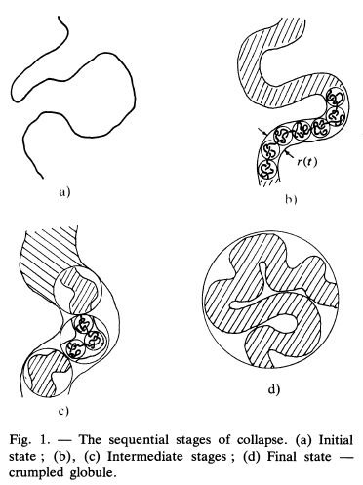
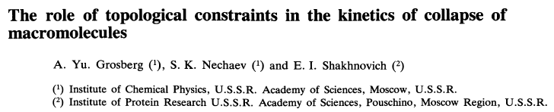
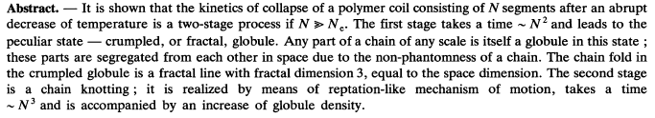
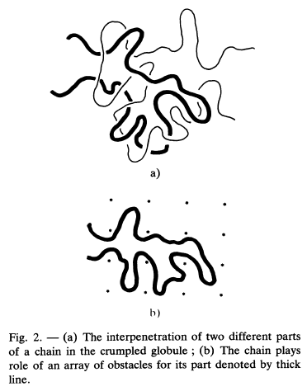
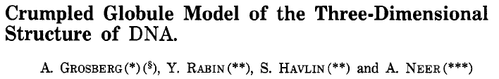
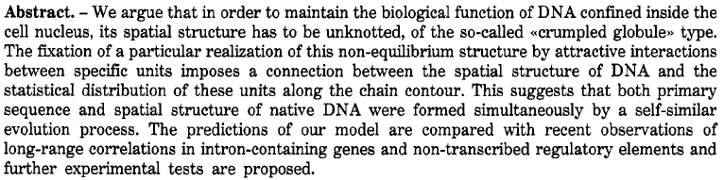
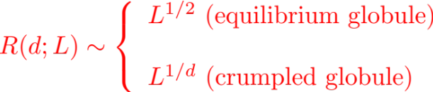
What is a fractal/crumpled globule?

Slide 5
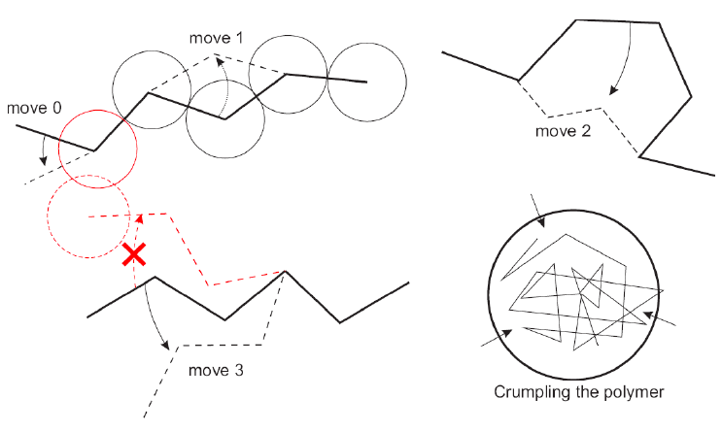
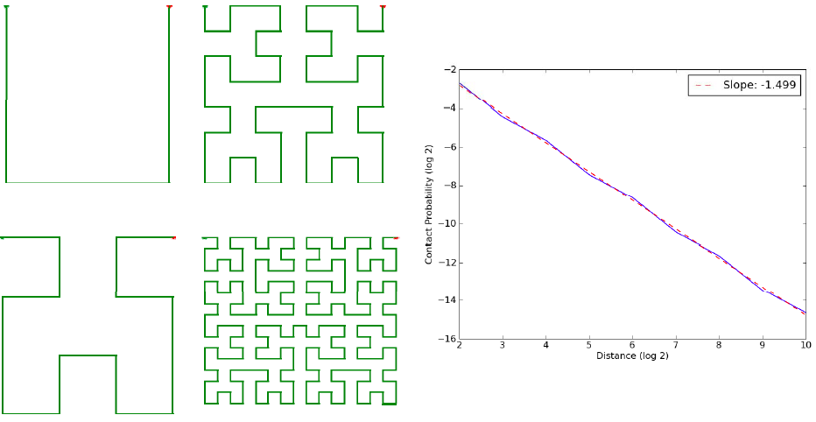
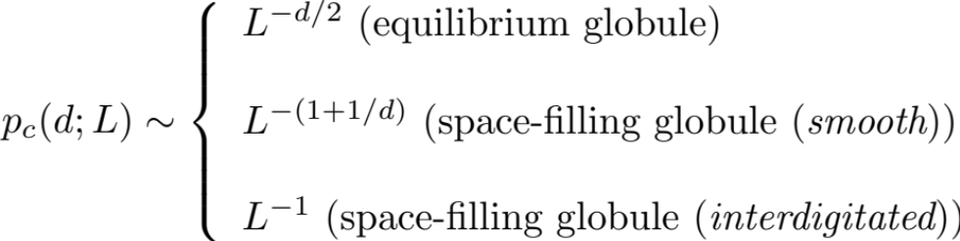
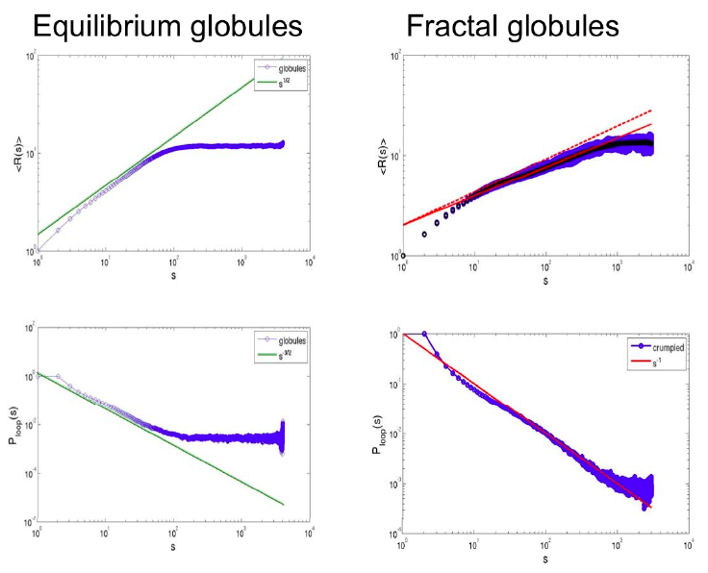
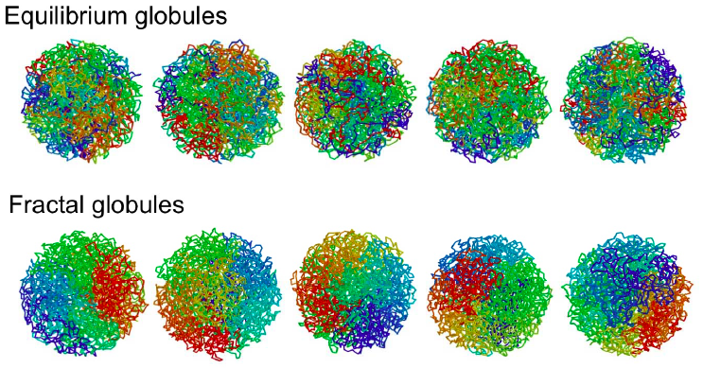
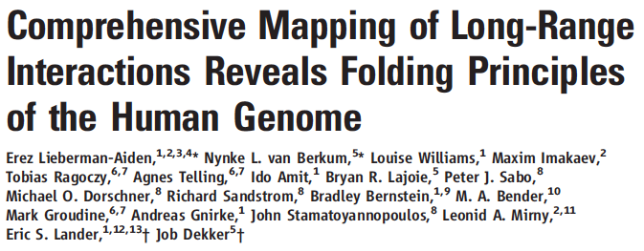
How to model a crumpled globule
1 – Space-filling curves
“Classical” Peano-Hilbert curve
Monte Carlo moves + adiabatic compression by spherical caging

Slide 6
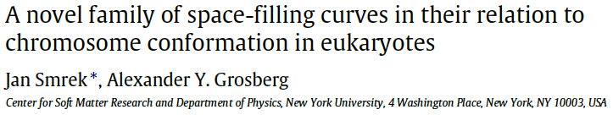
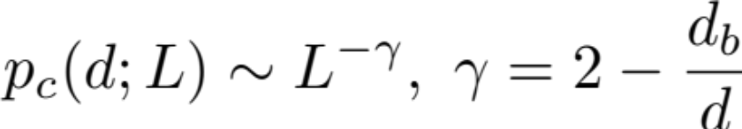
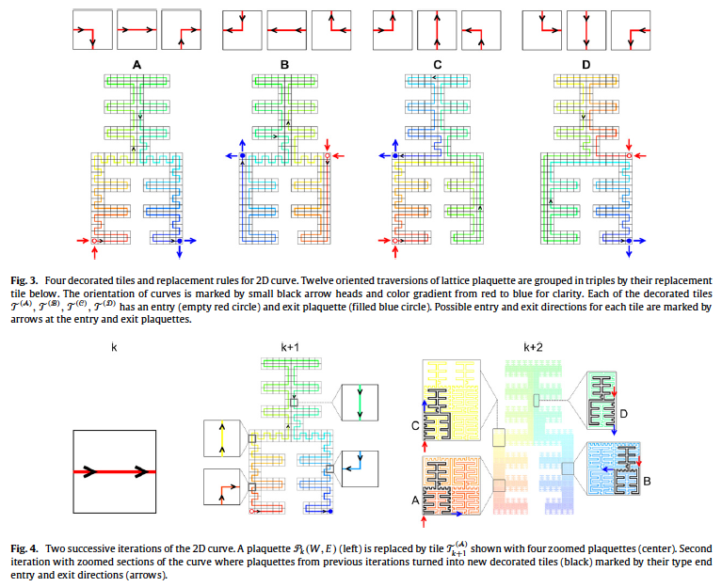
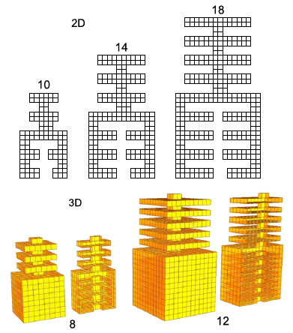
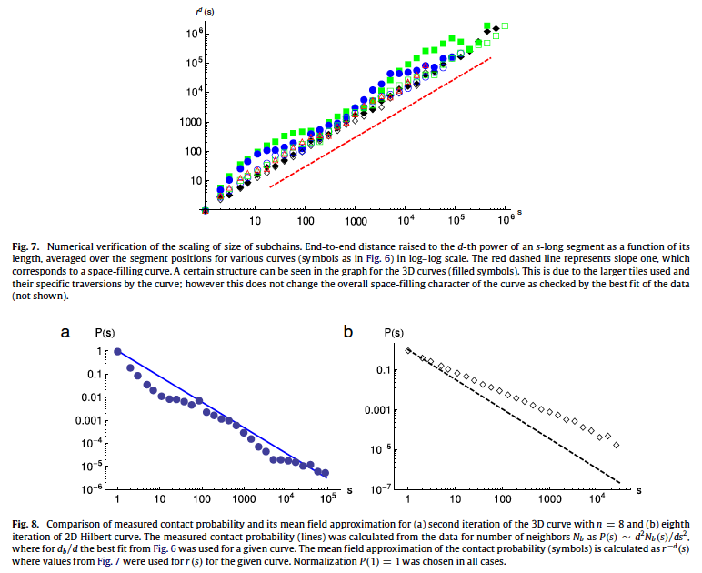
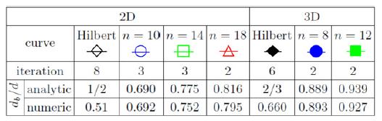
How to model a crumpled globule
1 – Space-filling curves

Slide 7
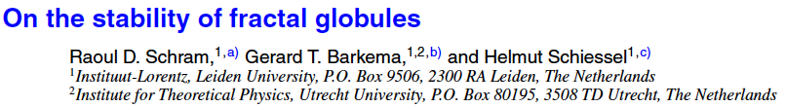
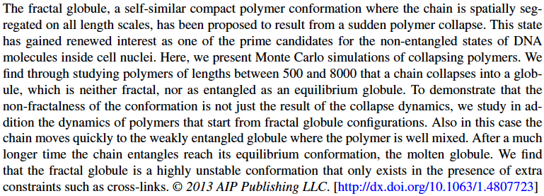
How to model a crumpled globule
2 – Criticisms to “polymer collapse”

Slide 8
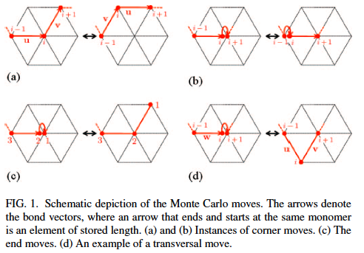
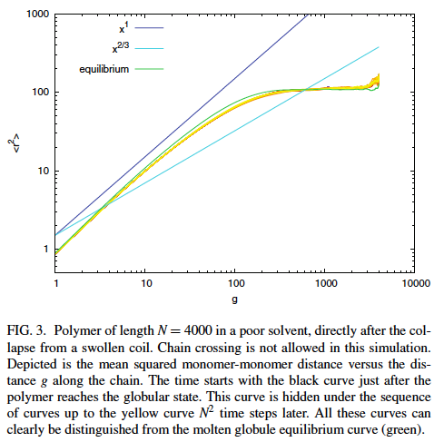
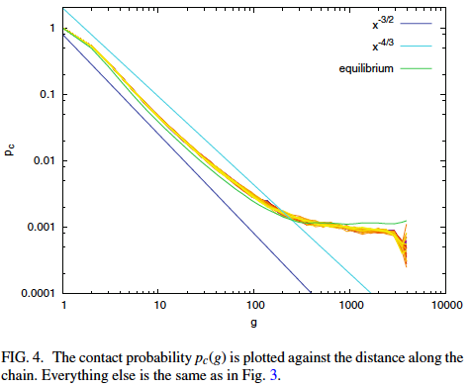
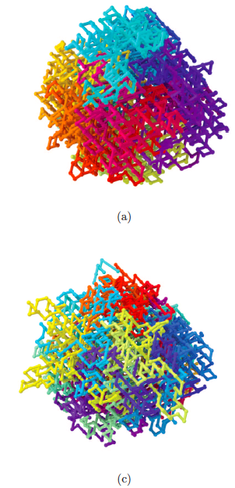
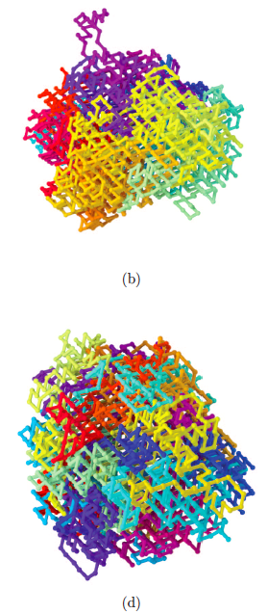
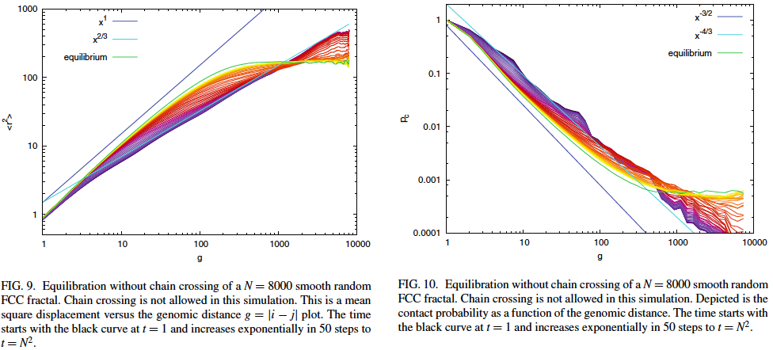
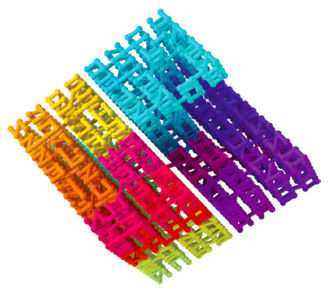
How to model a crumpled globule
2 – Criticisms to “polymer collapse”
Without chain crossing
With chain crossing
After N time steps
After N² time steps

Slide 9
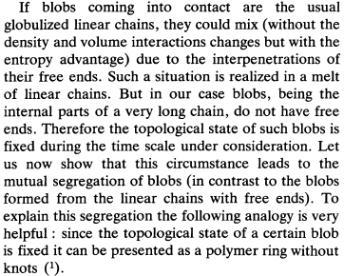
How to model a crumpled globule?

Slide 10
How to model a crumpled globule
3 – Ring polymers

Slide 11
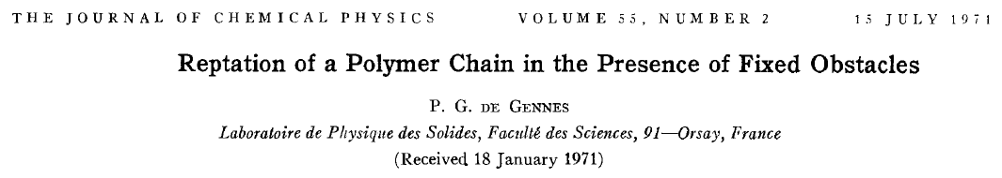
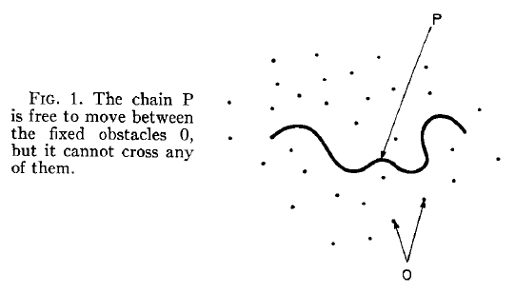
Flory theorem: R~N^{ν}, ν=1/2
Notes:
Flory theorem: screening of excluded volume interactions!

Slide 12
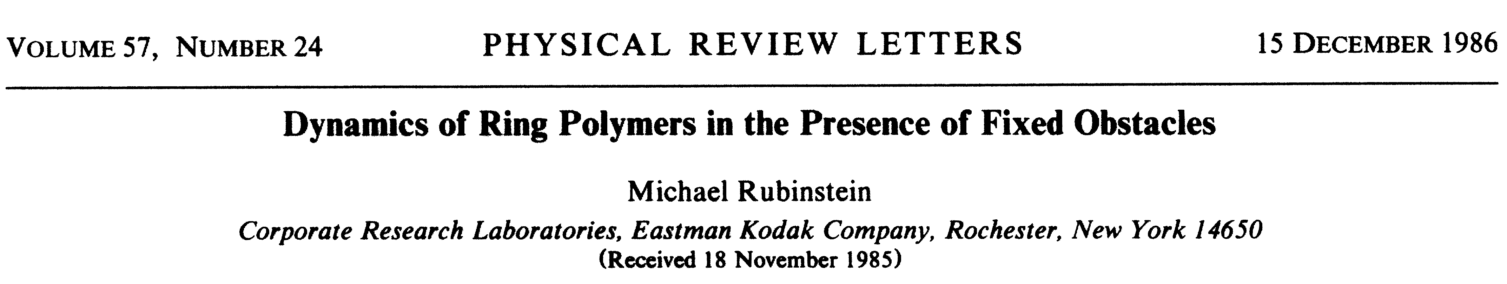
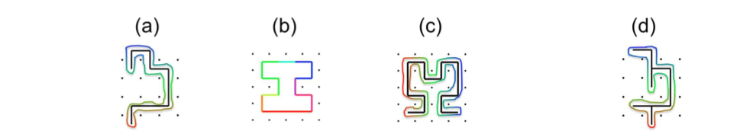


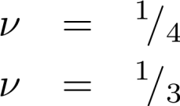

Flory theorem: R~N^{ν}, ν=1/2
Wrapped
randomly-branched tree
Linear random-walk ribbon
Moore ring
Hilbert ribbon
Klein (1986)
Grosberg et al. (1988)
“Crumpled globule”
Khokhlov & Nechaev (1985)
Rubinstein (1986,1995)
Cates & Deutsch (1986): None of the above,
Notes:
Flory theorem: screening of excluded volume interactions!

Slide 13

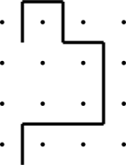
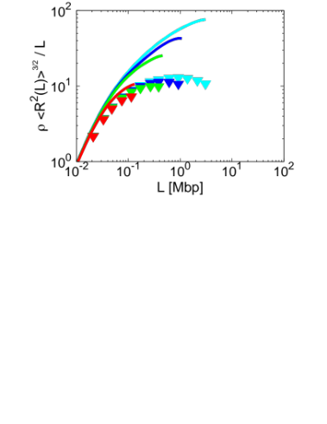
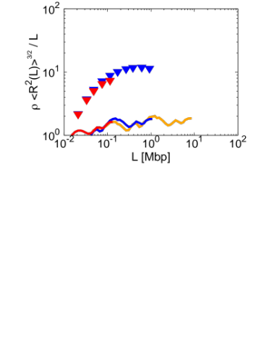
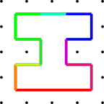
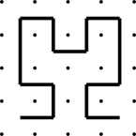
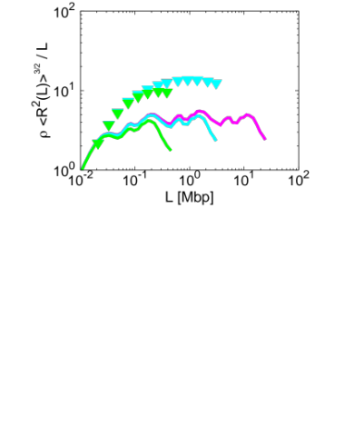
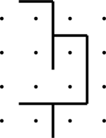
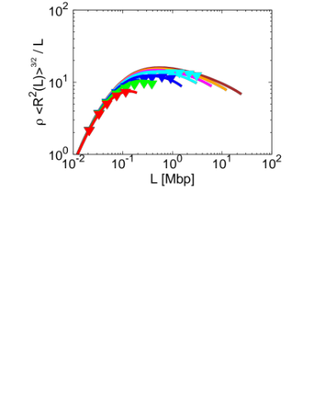
Physics of ring polymers: A “bunch” of theories
( - ) Initial configurations
(▼) Equilibrated configurations
Random-walk ribbons
Klein, Macromolecules (1986)
Space-filling curves
Lieberman-Aiden et al., Science (2009)
Ideal lattice trees
Obukhov et al., PRL (1994)
AR & Everaers, PRL (2014)
Notes:
Initial conformations constructed using iterative algorithms or simple MC approaches.

Slide 14
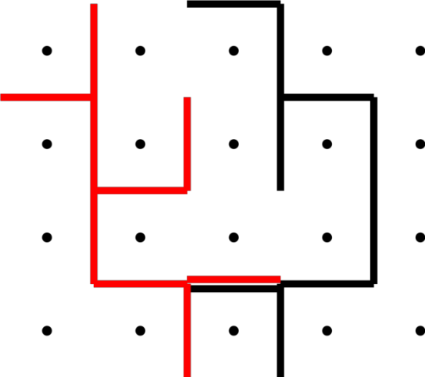
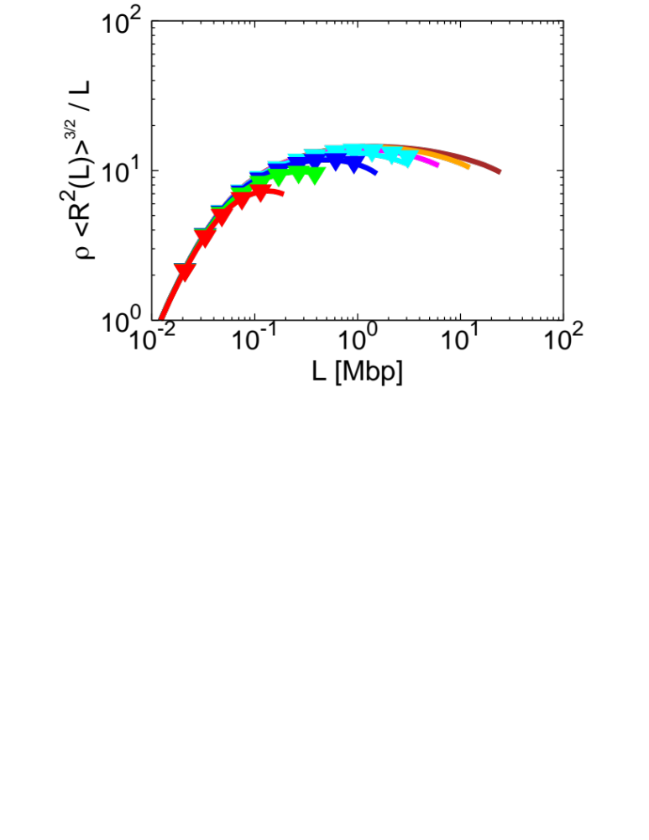
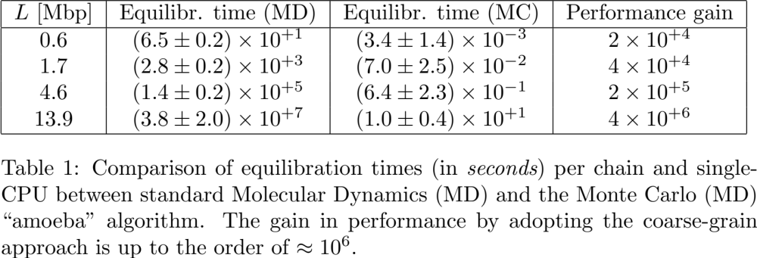
The model: Interacting Lattice Trees
Excluded volume interactions
Benchmarking the protocol
Comparison to MD results up to ~10Mbp
Successful construction of equilibrated configurations
Equilibration time (MD) [secs] | Equilibration time (MC) [secs] | Performance gain
6.5 x 10⁺¹ | 3.4 x 10⁻³ | 2 x 10⁺⁴
2.8 x 10⁺³ | 7.0 x 10⁻² | 4 x 10⁺⁴
1.4 x 10⁺⁵ | 6.4 x 10⁻¹ | 2 x 10⁺⁵
3.8 x 10⁺⁷ | 1.0 x 10⁺¹ | 4 x 10⁺⁶
AR & Everaers, PRL (2014)

Slide 15
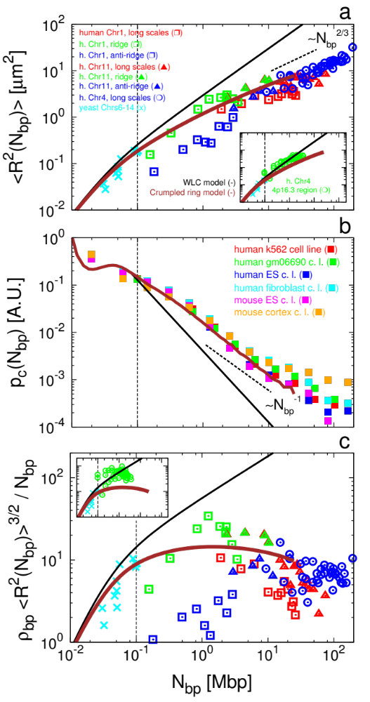
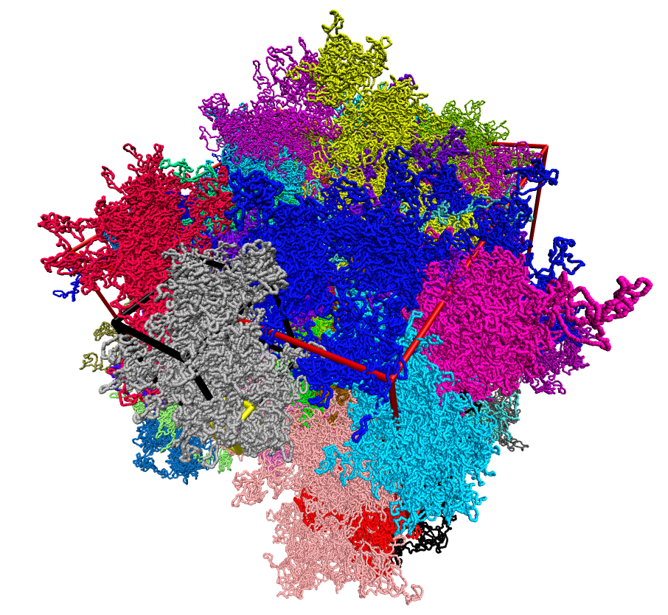
Well-equilibrated samples of BIG rings
AR & Everaers, PRL (2014)
Jost, AR, Vaillant & Everaers (2017)
Notes:
Crumpled, compact-like, but highly protruding!

Slide 16
Connections to the Statistical Physics of randomly branched / branching polymers
N+1 nodes, N bonds

Slide 17

Structure of rbp’s: critical exponents
L
R(L)
N+1 nodes, N bonds

Slide 18

Generalized Flory Theory
Isaacson & Lubensky, J Physique Lettres (1980)
Gutin, Grosberg & Shakhnovic, Macromolecules (1993)
Everaers, Grosberg, Rubinstein & AR, Soft Matter (2017)
L
R(L)
N+1 nodes, N bonds

Slide 19

Comparison to simulations
Not the same universality class
(Gutin, Grosberg & Shakhnovich, Macromolecules (1993))
AR & Everaers, J Phys A: Math Theor (2016)
AR & Everaers, J Chem Phys (2016)

Slide 20
Comparison to simulations
AR & Everaers, J Phys A: Math Theor (2016)
AR & Everaers, J Chem Phys (2016)

Slide 21
Comparison to simulations
Different factors affect imperfect agreement:
Finite-size effects of trees: N up to O(10³) => L up to O(10²)
Flory theory is not exact: already known for the simple self-avoiding walk in 3d
AR & Everaers, J Phys A: Math Theor (2016)
AR & Everaers, J Chem Phys (2016)

Slide 22



Comparison to simulations
Interacting trees show pronounced deviations from mean-field behavior.
In self-avoiding walks:
AR & Everaers, Phys Rev E (2017)
Notes:
Pair-distances and contact freqs. between nodes as a function of their path distance!!

Slide 23

Beyond Flory: distribution functions
AR & Everaers, Phys Rev E (2017)

Slide 24
Beyond Flory: distribution functions
AR & Everaers, Phys Rev E (2017)

Slide 25


Beyond Flory: distribution functions
AR & Everaers, Phys Rev E (2017)

Slide 26





Crumpled globule dynamics

Slide 27




Ring dynamics

Slide 28







Ring dynamics
Smrek & Grosberg, JPCM (2015)

Slide 29




Chromosome dynamics

Slide 30
What’s next?
The role of active mechanisms (ex., looping extrusion mechanisms)
Other non-equilibrium effects (Jan’s talk)

Slide 31

Acknowledgements
Ralf Everaers (ENS-Lyon, France)
Alexander Y. Grosberg
Michael Rubinstein
Cédric Vaillant, Daniel Jost, Christophe Zimmer, Kerstin Bystricky
Manon Valet, Ana-Maria Florescu

Slide 32



A couple of announcements - I

Slide 33


A couple of announcements - II

