Slide 1
Lecture 4
Restricted Boltzmann Machine
Ji-Woo Lee

Slide 2
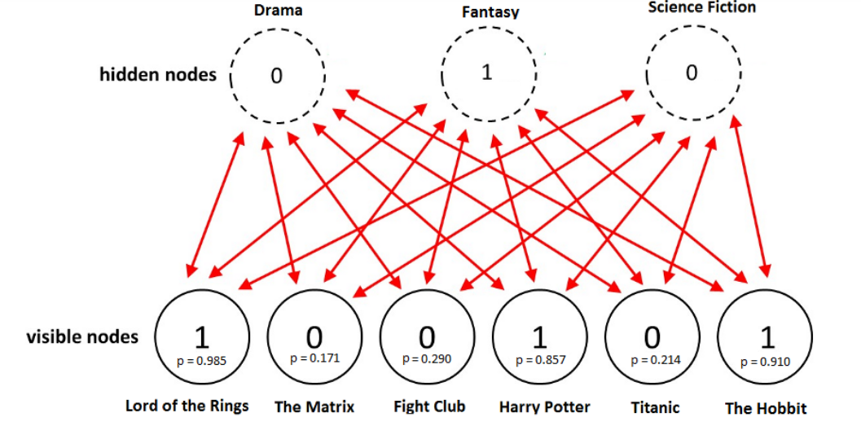
Restricted Boltzmann Machine
Represent a probability distribution with neural network

Slide 3
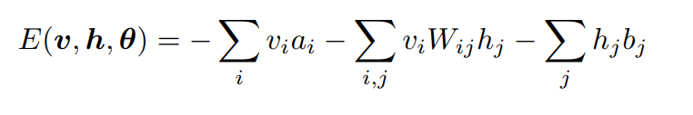
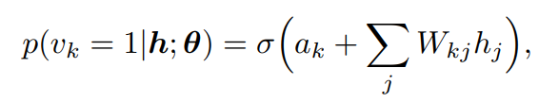
Theory

Slide 4
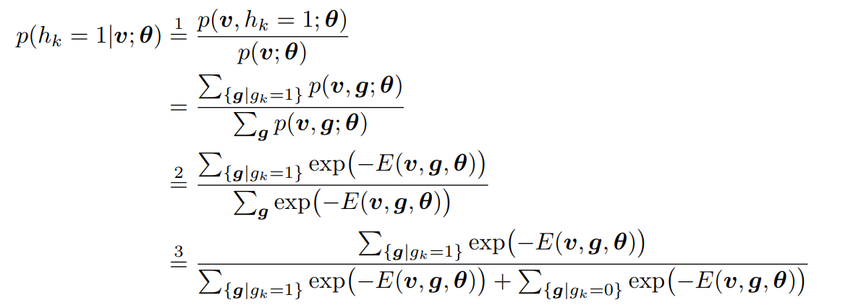
Conditional Prob.

Slide 5
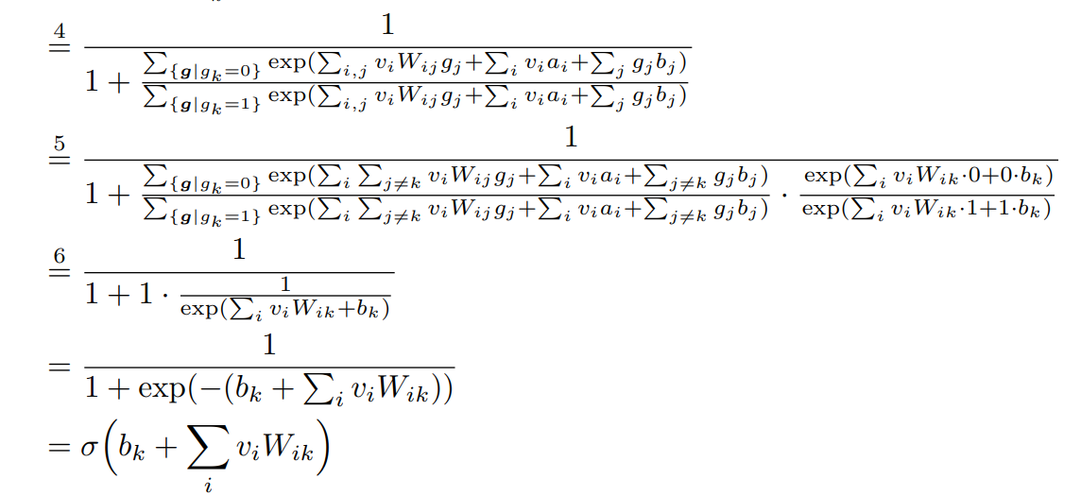
Conditional Prob.

Slide 6
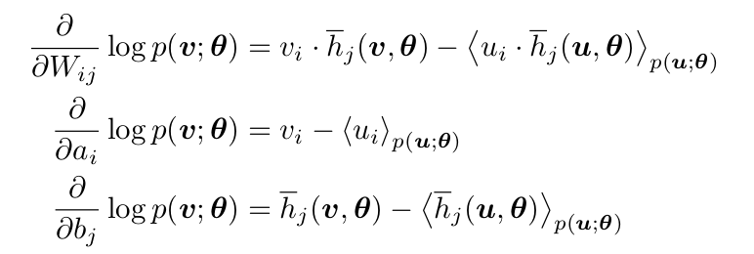
Update rule

Slide 7
Movie data run : rbm_model.py
dw_=tf.subtract(tf.multiply(ph0_, v0_),tf.multiply(phk_, vk_))
dbh_=tf.subtract(ph0_,phk_)
dbv_=tf.subtract(v0_,vk_)

Slide 8
Analysis of code
... practice!

Slide 9
Project 2
Write down your own code for RBM

