Slide 1
Lecture 5
RBM and Phase Transition
Ji-Woo Lee

Slide 2
Idea: Probability distribution is Boltzmann dist.
Regenerating the Boltzmann distribution with RBM
For each temperature, we use the MC Ising data to obtain
W, a, b

Slide 3
Update rule
pos_associations = np.dot(data1.T, pos_hidden_probs)
# Update weights.
self.weights += learning_rate * ((pos_associations0 - neg_associations) / num_examples)

Slide 4
Day dreaming
Once, W, a, b is fixed
We use Gibbs sampling method to generate RBM samples
It is called "Day dreaming"
We compare RBM generated data with Monte Carlo data

Slide 5
Code : rbm-cd.py
Code explanation ....

Slide 6
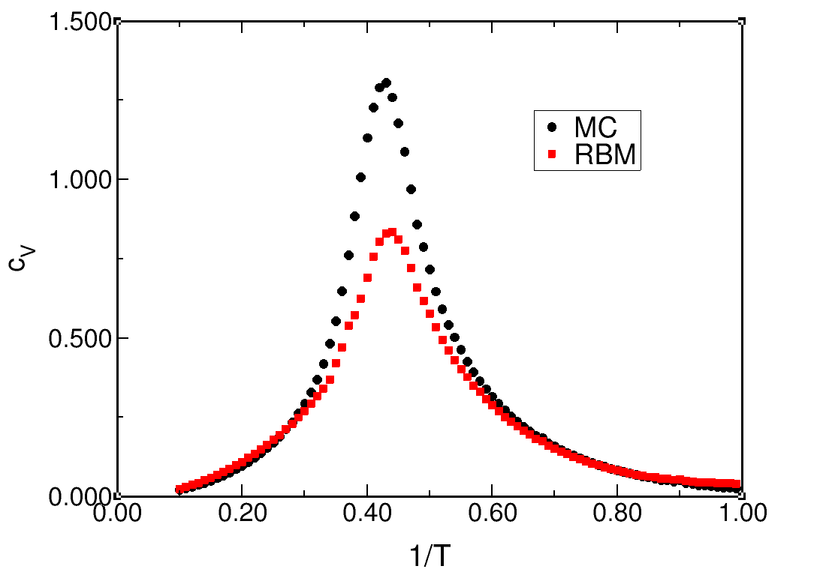
Results

Slide 7
Project 2
Obtain RBM results for Ising model (our final object)

