Slide 1
Some Extremes in Nuclear and Nuclear Astrophysics II
High Momentum Distribution and Nucleon Pairs Beyond Mean Field
Disappearance of Magic Numbers and New Magic Number around Drip Line
Dineutron and Intruder in Halo Nuclei
Cosmological Origin of p-Nuclei
Dense Nuclear Matter
Nuclear Astrophysics in Plasma
Strong Magnetic Field Physics …
Myung-Ki Cheoun, OMEG Inst., Soongsil Univ.

Slide 2

Dense Nuclear Matter
(Two Rabbits with One Shot)

Slide 3

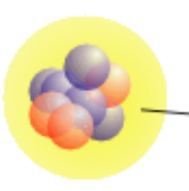
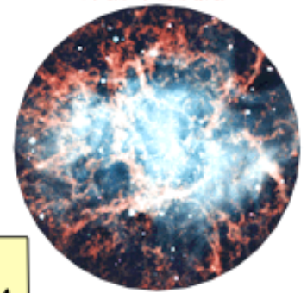

RMF, (C)QMC, (D)BHF, Skyrme, Chiral PT …. QCD

Slide 4





Introduction (GW170817)
PRL 119, 161101 (2017)
Mass
$$m_{1}=1.36−1.60M_{⊙}$$
$$m_{2}=1.17−1.36M_{⊙}$$
Distance
$${40}_{−14}^{+8}\text{Mpc}$$
Combined dimensionless
tidal deformability
$$\tilde{Λ}≤800$$
Dimensionless
tidal deformability
NSF/LIGO/Sonoma State University/A. Simonnet
https://www.ligo.caltech.edu/image/ligo20171016d
$$Λ(1.4M_{⊙})≤800$$
PRL 119 161101 (2017)

Slide 5


Introduction (GW170817)
Mass
$$m_{1}=1.36−1.60M_{⊙}$$
$$m_{2}=1.17−1.36M_{⊙}$$
Distance
$${40}_{−14}^{+8}\text{Mpc}$$
Combined dimensionless
tidal deformability
$$\tilde{Λ}≤800$$
Dimensionless
tidal deformability
NSF/LIGO/Sonoma State University/A. Simonnet
https://www.ligo.caltech.edu/image/ligo20171016d
$$Λ(1.4M_{⊙})≤800$$
PRL 119 161101 (2017)

Slide 6






Introduction
$$Q=−λℰ$$
$$Q$$
: Quadrupole moment of neutron star
$$ℰ$$
: External quadrupole tidal field
$$λ$$
: a constant which is related to the tidal deformability
$$Λ=\frac{5}{2}λ\frac{1}{M}(\frac{c^{2}}{G})^{5}$$
$$\tilde{Λ}=\frac{16}{13}\frac{(m_{1}+12m_{2})m_{1}^{4}Λ_{1}+(m_{2}+12m_{1})m_{2}^{4}Λ_{2}}{(m_{1}+m_{2})^{5}}$$
PRD 81 123016 (2010)

Slide 7
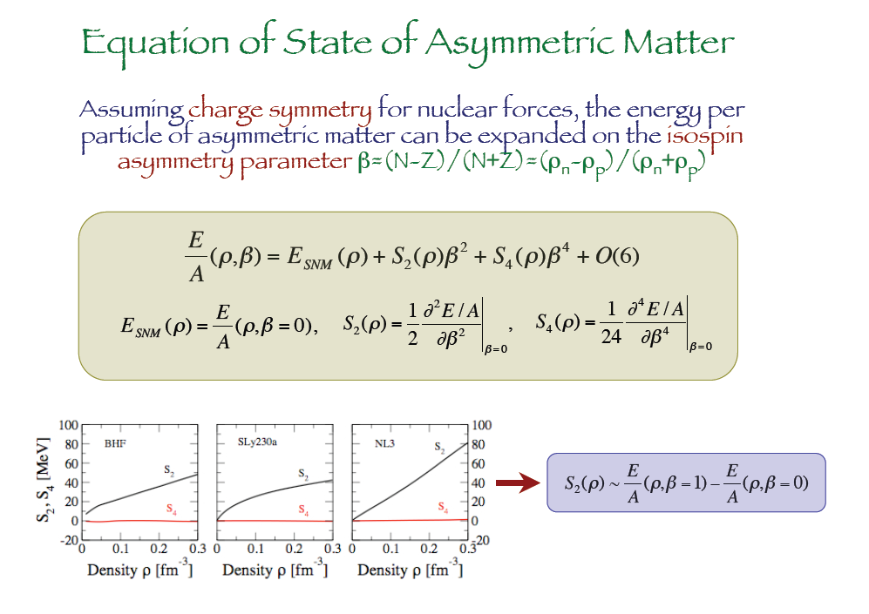
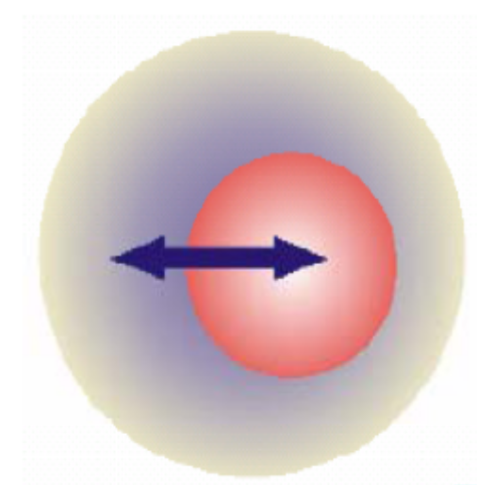
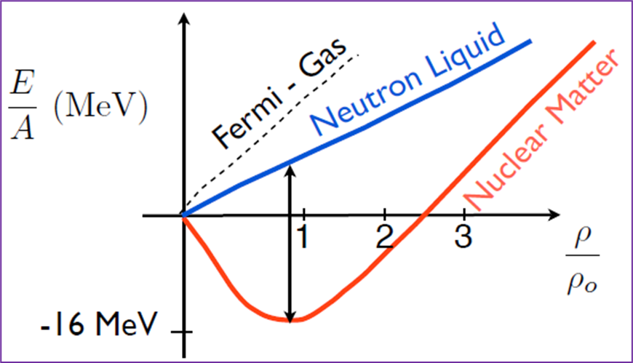
7

Slide 8
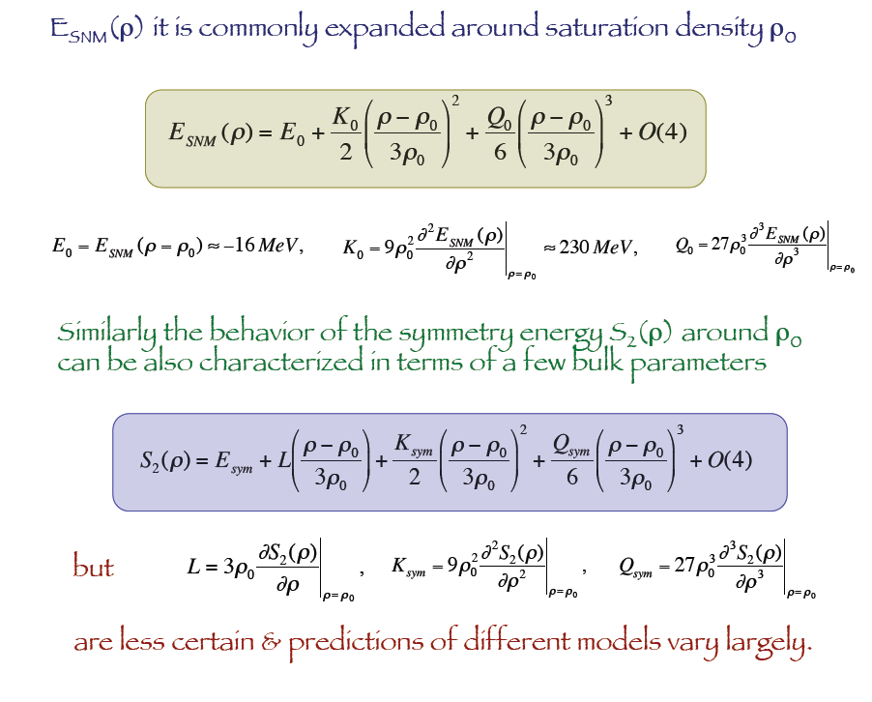
Sym. Energy is given by the difference of the SNM and PNM energy !!

Slide 9
Why not \alpha*S_1(\rho) ?
because of Isospin Symmetry of N-N force.
But if we include the ISBreaking including Coulomb interaction, we may consider the term.
Why not the 1st derivative term of density in E_{SNM} ?
because the derivative should be zero at rho = rho_0 in SNM.
Why the 1st term of density in the symmetry energy,
which is just the symmetry pressure L term ?
because the derivative does not need to be zero at rho = rho_0 in Asymmetric NM.
Is it really true ????
1) E_{PNM} – E_{SNM}
= S_(\rho)
= S_1(\rho) + S_2(\rho) + S_3(\rho) + S_4(\rho) … ~ S_2(\rho) for alpha = 1
= a*S_1(\rho) + a^2*S_2(\rho) + a^3*S_3(\rho) … for alpha .ne. 1
2) Therefore, L term in the S_{\rho) includes terms neglected in the standard definition. And for asymmetric matter we have to also the asymmetry coefficients.
3) How is the relation of the saturation density(\rho_0) and asymmetry (\alpha) ?

Slide 10
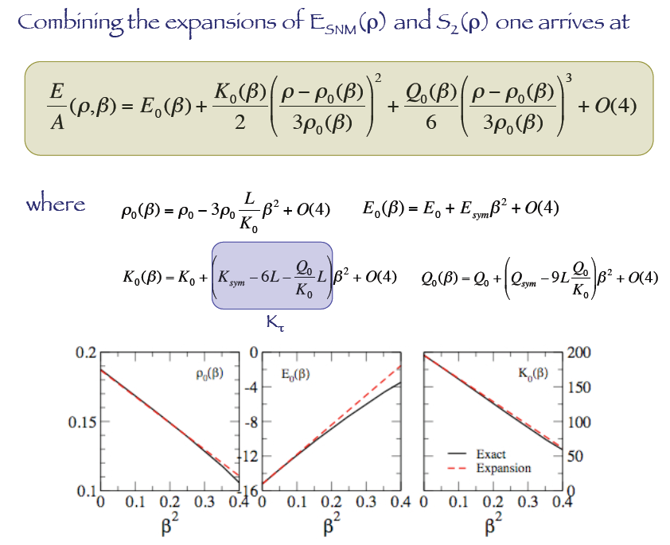

Slide 11
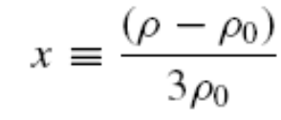
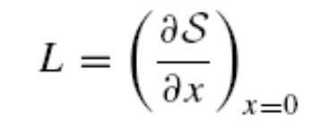
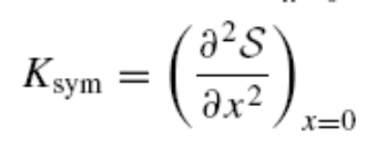

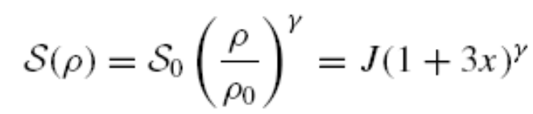


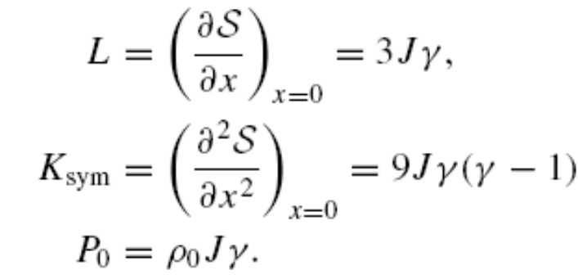



Symmetry Energy
S. Energy, Pressure and Incompressbility
Sym. Energy at sat. density
Sym. (in)compressbility
Sym. Pressure
Sym. Energy has still some ambiguities !!
More refined values may be obtained from the Low Energy Reactions ? !!

Slide 12
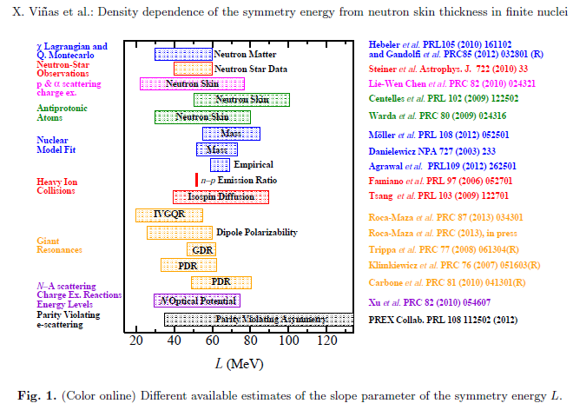
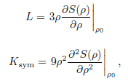




Symmetry Energy
Low Density from N. Phys. (GDR and PDR)
How to determine L from static properties of finite nuclei and neutron
Star observation, simultaneously ?
= 30 ~ 35 MeV

Slide 13


Relativistic mean field model
Lagrangian density for static uniform nuclear matter :
The effective baryon mass in matter :
      The following non-linear term is also introduced in order to reproduce the saturation properties of nuclear matter :
$$B=N,Λ,Σ^{−,0,+},Ξ^{−,0}$$
$$ℒ=\overset{}{\underset{B}{∑}}{\overline{ψ}}_{B}^{}[iγ_{μ}^{}∂_{}^{μ}−M_{B}^{∗}(σ_{0},σ_{0}^{∗})−g_{ωB}γ_{0}^{}ω_{0}^{}−g_{φB}γ_{}^{0}φ_{}^{0}−g_{ρB}^{}γ_{}^{0}ρ_{0}^{}I_{3B}]ψ_{B}^{}$$
$$−\frac{1}{2}m_{σ}^{2}σ_{0}^{2}−\frac{1}{2}m_{σ^{∗}}^{}σ_{0}^{∗2}+\frac{1}{2}m_{ω}^{2}ω_{0}^{2}+\frac{1}{2}m_{φ}^{2}φ_{0}^{2}+\frac{1}{2}m_{ρ}^{2}ρ_{0}^{2}−U_{NL}(σ_{0},ω_{0}^{},ρ_{0}^{})$$
$$M_{B}^{∗}(σ,σ_{}^{∗})=M_{B}−g_{σB}^{}σ−g_{σ^{∗}B}σ_{}^{∗}$$
$$U_{NL}(σ,ω_{}^{μ}ρ_{}^{μ})=\frac{1}{3}g_{2}σ_{}^{3}+\frac{1}{4}g_{3}σ^{4}−Λ_{v}^{}g_{ωB}^{2}g_{ρB}^{2}(ω_{0}^{2}ρ_{0}^{2})$$
Notes:
From now on, I’m going to talk what model we used. The relativistic-mean-field model is employed for the calculation of properties of the neutron star. We consider octet baryons in the neutron star. To describe the interaction between each particle, we include sigma, sigma*, omega, phi, and rho meson. In addition, the mass in matter can be expressed as M*. It can be saturation property. We add the non-linear potential to the lagrangian density. I’m going to explain in detail later. Now we need to fix the coupling constants

Slide 14









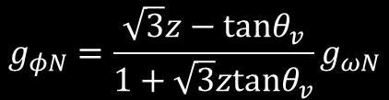
Coupling constants
Coupling constants, gσN, g𝜔N, and g𝜌N are determined so as to reproduce
the binding energy per nucleon, and symmetry energy at saturation density.
The SU(3) symmetry in the vector-meson gives the relations of the coupling constants as
$$B/A=−16.0MeV$$
$$ρ_{0}=0.16{fm}^{−3}$$
$$S_{0}(ρ_{0})=32.5MeV$$
$$g_{ωΛ}=g_{ωΣ}=\frac{1}{1+\sqrt{3}ztanθ_{v}}g_{ωN}$$
$$g_{ρΣ}=2g_{ρN},g_{ρΞ}=g_{ρN}g_{ρΛ}=0$$
$$g_{ωΞ}=\frac{1−\sqrt{3}ztanθ_{v}}{1+\sqrt{3}ztanθ_{v}}g_{ωN}$$
$$g_{φΛ}=g_{φΣ}=\frac{−tanθ_{v}}{1+\sqrt{3}ztanθ_{v}}g_{ωN}$$
$$g_{φΞ}=−\frac{\sqrt{3}z+tanθ_{v}}{1+\sqrt{3}tanθ_{v}}g_{ωN}$$
In the present calculation, we refer to
the Nijmegen extended-soft-core (ESC) model [1]
to fix the mixing angle (𝜃v) and z as
$$g_{φN}=\frac{\sqrt{3}z−tanθ_{v}}{1+\sqrt{3}ztanθ_{v}}g_{ωN}$$
$$θ={37.50}^{∘},z=0.1949$$
^{[1]}Prog. Theor. Phys. Suppl. 185 14 (2010)
Notes:
First, the coupling of sigma-nucleon, omega-nucleon, and rho-nucleon is fitted to reproduce the well determined saturation properties which are binding energy and symmetry energy. These couplings are used to determine hyperon couplings. The SU(3) symmetry in the vector-meson gives the relations of the coupling constants. there are two-unknown parameters theta and z. In the present calculation, we refer to the Nijmegen extended-soft-core model to fix the theta and z. This model may be most complete model for the baryon-baryon interaction. It can well describe the experimental data.

Slide 15






Coupling constants
We need to consider the hyperon coupling. The σ-Y and σ*-Y are determined as follows. The potential for hyperon Y in symmetric nuclear matter is calculated as
The potential for Y in Y-hyperon matter is written as :
$$U_{Y}^{(N)}=−g_{σY}σ_{0}+g_{ωY}ω_{0}$$
$$U_{Λ}^{(N)}=−28MeV$$
[1]
$$U_{Σ}^{(N)}=30MeV$$
[2]
$$U_{Ξ}^{(N)}=−18MeV$$
[3]
$$U_{Y}^{(Y)}=−g_{σY}σ_{0}^{(Y)}−g_{σ^{∗}Y}σ_{0}^{∗(Y)}+g_{ωY}ω^{(Y)}+g_{φY}φ_{0}^{(Y)}$$
$$U_{Ξ}^{(Ξ)}≃U_{Λ}^{(Ξ)}≃2U_{Ξ}^{(Λ)}≃2U_{Λ}^{(Λ)}$$
[3]
$$U_{Λ}^{(Λ)}=−5MeV$$
Nagara event
^{[1]}PRC 54 1416 (1996), ^{[2]}PRC 88 015802 (2013),
^{[3]}PRC 77 025801 (2008)
Notes:
Now we consider the sigma-hyperon and sigma*-hyperon. The potential for hyperon in symmetric nuclear matter is expressed as U_Y N. If the Lambda particle is in symmetric nuclear matter, then the depth of potential is about -28 MeV. Since we determined the omega-hyperon coupling, we can fix the sigma-hyperon coupling by using these values. The final step to fix the coupling constant is sigma*-hyperon coupling. the method is similar to the sigma-hyperon coupling. the potential for hyperon in hyperon matter is written as U Y Y. We already know the coupling constants except sigma* coupling. If we have the depth of potential, then we can get the sigma*-hyperon coupling. To do this we use the nagara event which suggest that the depth of potential between two Lambda particles is about -5 MeV. By using this relation we can fix the all of coupling constants.

Slide 16
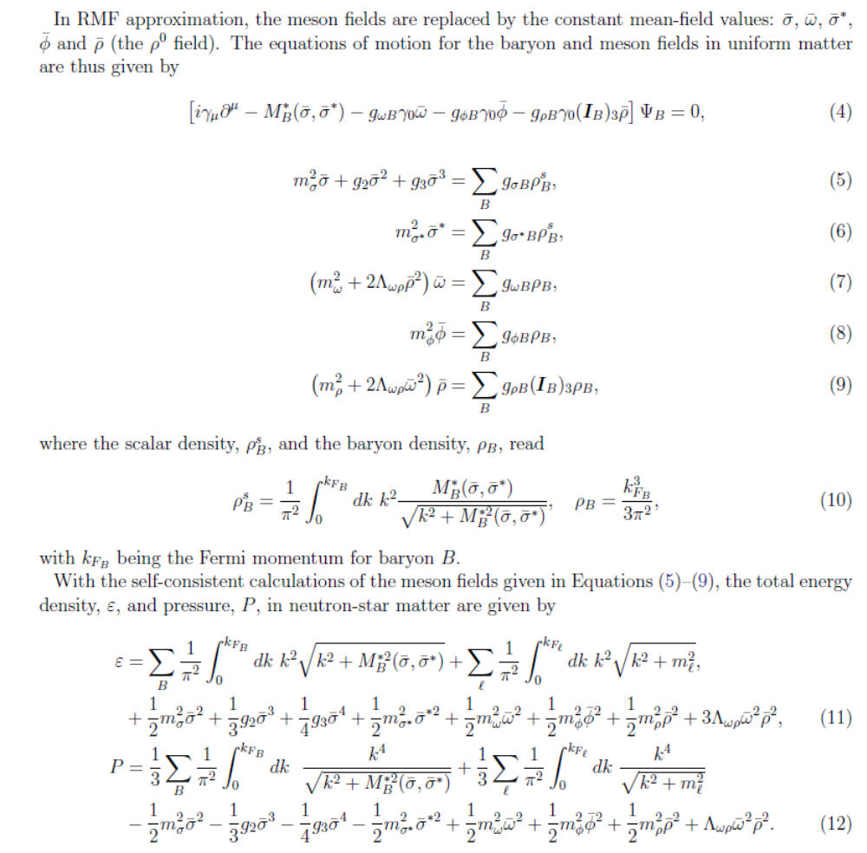
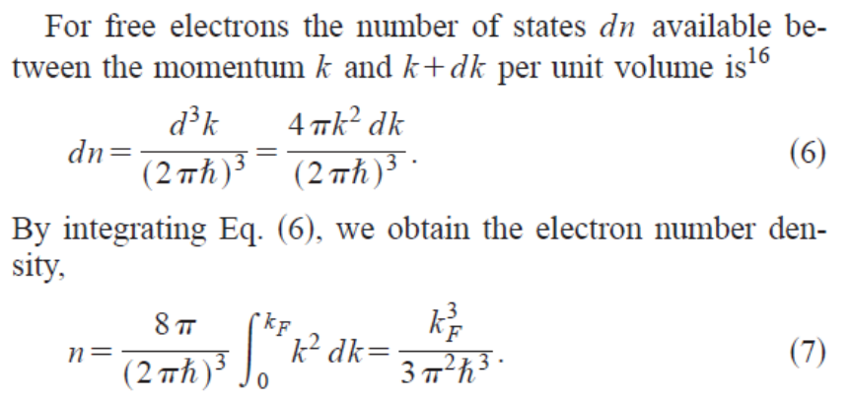
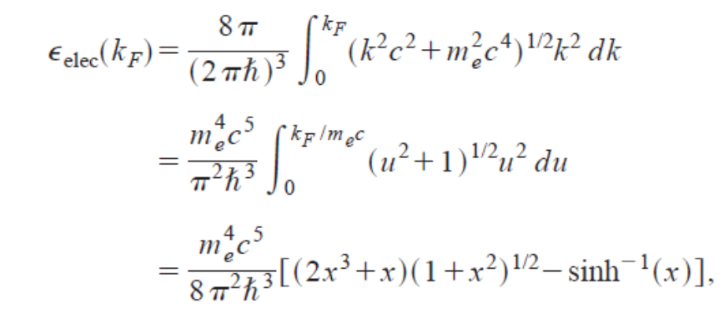
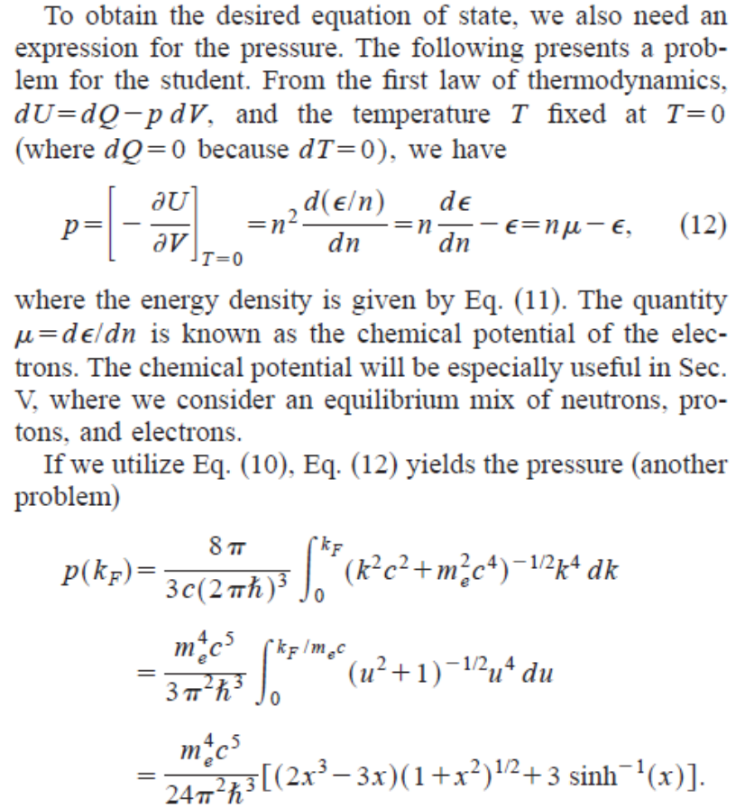

Slide 17
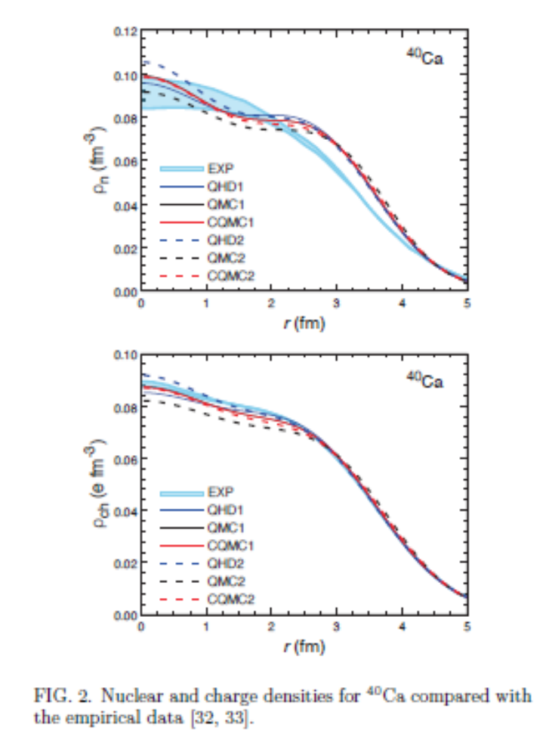
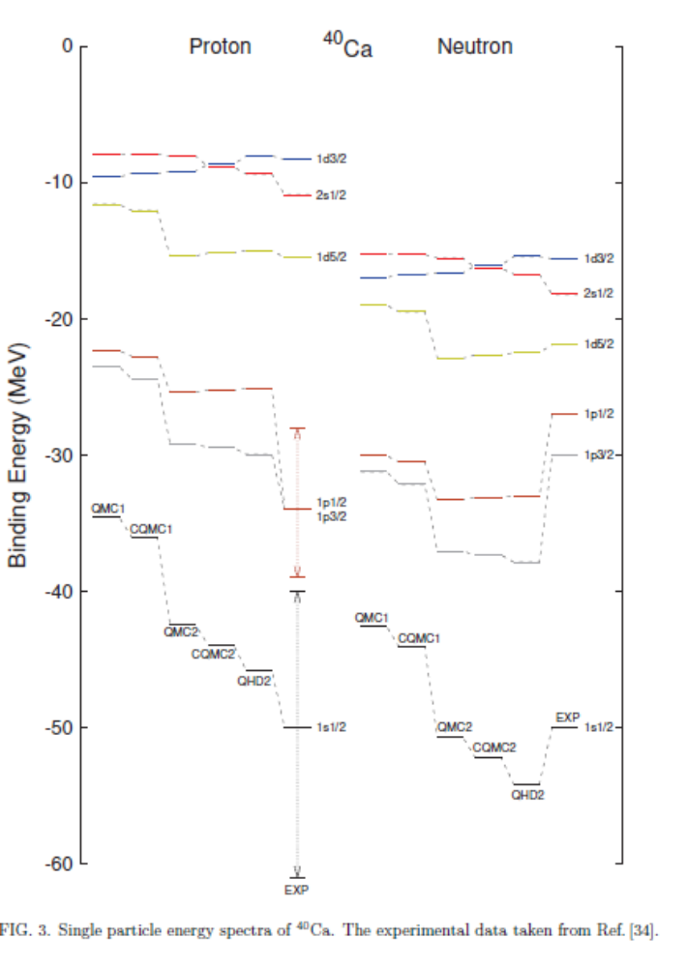
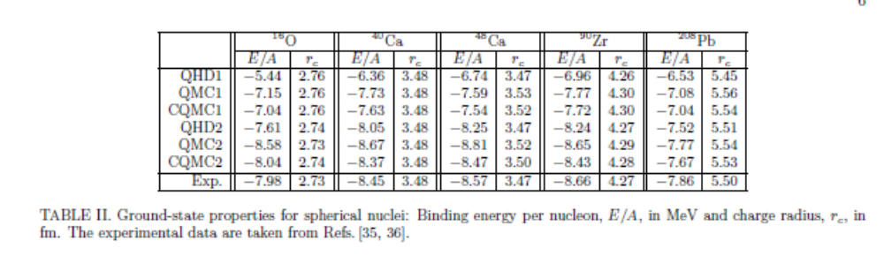

Slide 18
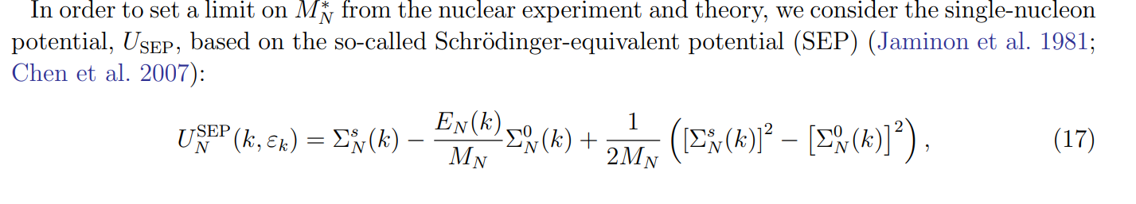
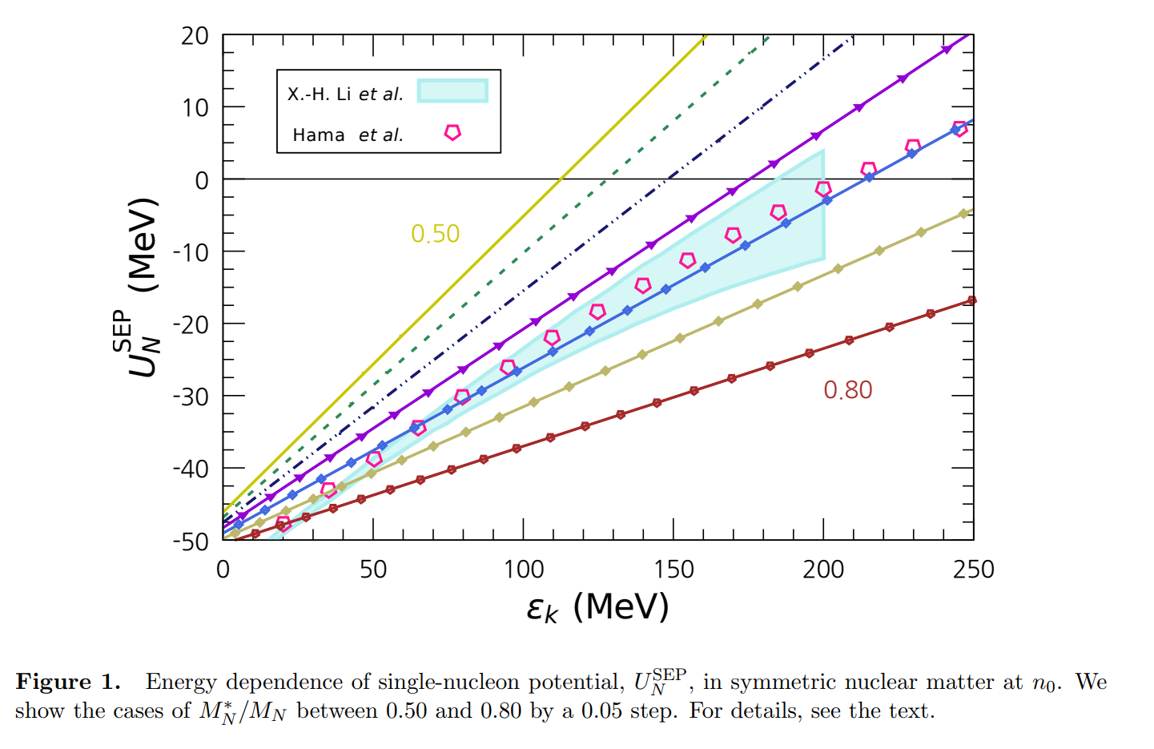

Slide 19
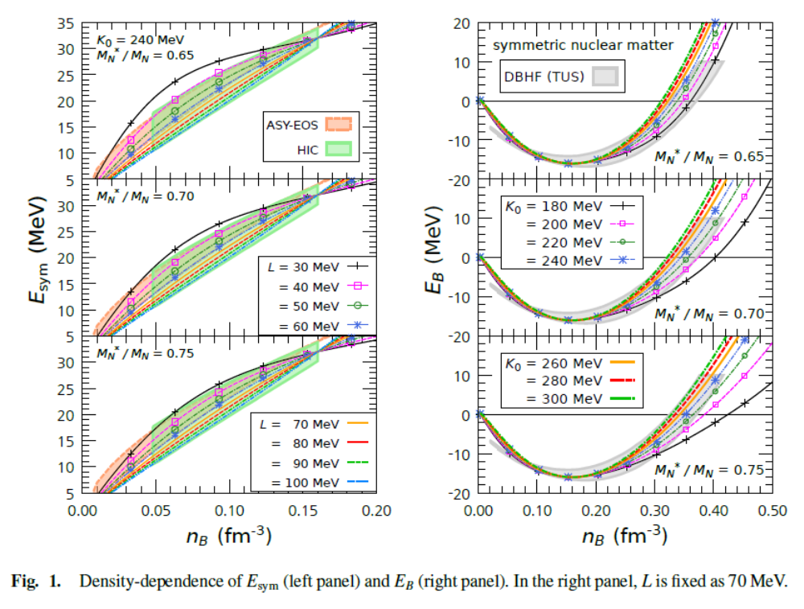
Results ( Dependence on L,K₀, and M*)

Slide 20
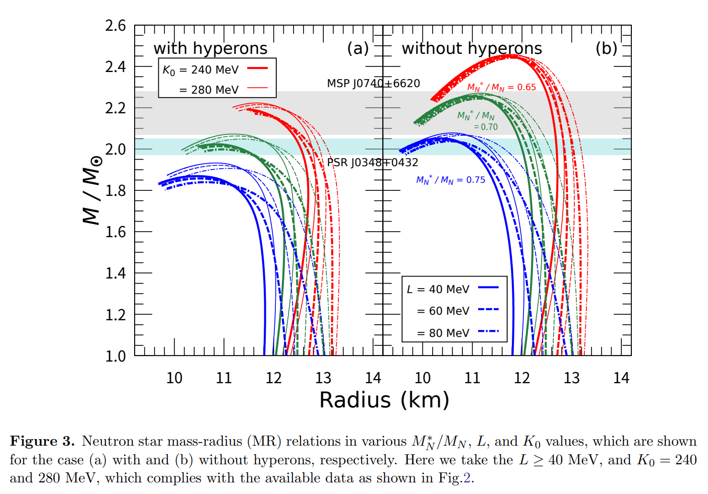

Slide 21
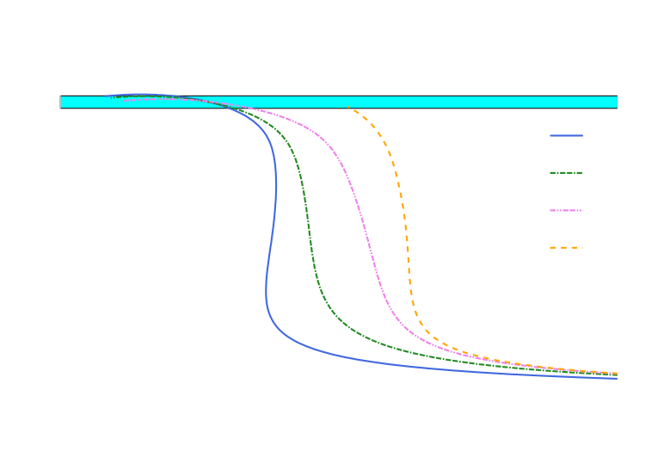
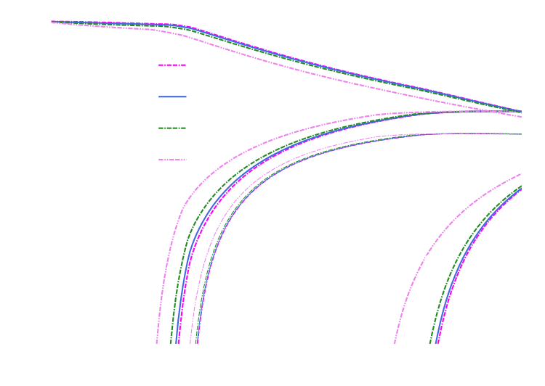

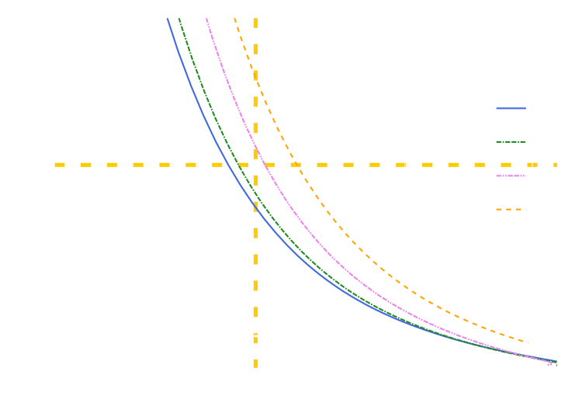
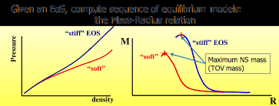
Result (dependence on slope parameter L)
The slope parameter does not affect the maximum mass of neutron star.
Around the 1.3 solar mass neutron star
In the tidal deformability case, the large slope parameter gives the high tidal deformability.
Large slope parameter
Large radius of neutron star
Notes:
I’m going to show the result. This slide shows the effect of slope parameter for the neutron star. In this slide we fix the incompressibility and change the slope parameter. In the upper figure, the horizontal axis is radius. The vertical axis is mass divided by solar mass. The lower figure shows the tidal deformability and mass. These light blue and yellow dotted line are two-solar-mass neutron star and upper limit of tidal deformability respectively. Let’s see the upper figure. The interesting point is that the maximum mass of neutron stars does not depend on the slope parameter. In the high-density region, hyperonuclear matter dominates. Furthermore, the fraction of each particle is almost same, In this situation, since the interaction between each hyperon or between hyperon and nucleon is same, the maximum mass of neutron star is almost same. On the other hands, the radius and tidal deformability can be change by the slope parameter. In this result, we can rule out the combination of L =100 and K =240. If we use this combination, then the tidal deformability is over 800.

Slide 22
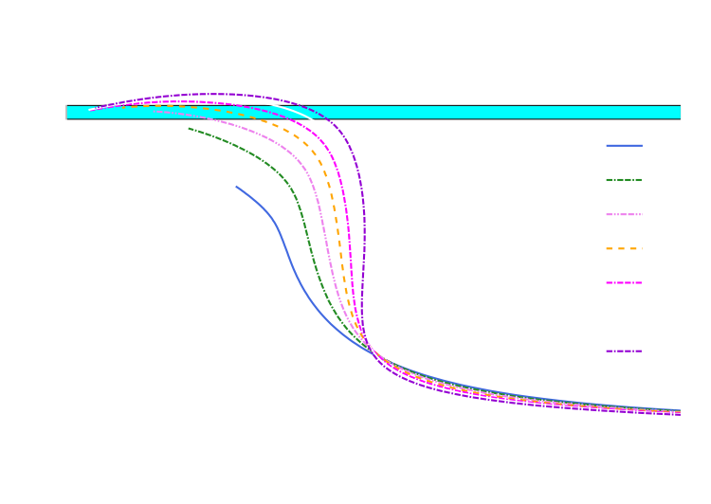
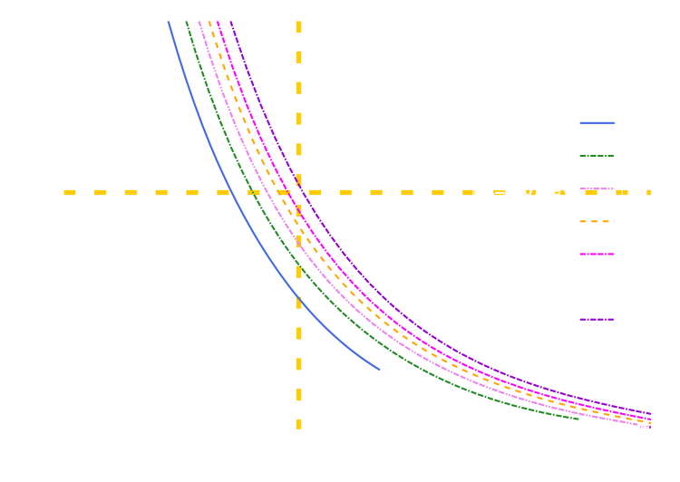
Result (dependence on incompressibility K)
The incompressibility affect both maximum mass and radius.
The effect of incompressibility is around maximum mass of neutron star.
The two-solar mass neutron star
cannot be described
in K = 180 and 200 MeV cases.
Large incompressibility
Large maximum mass
Notes:
Differently from the slope parameter case, incompressibility can affect both maximum mass and radius. K = 180 and 200 MeV cases cannot explain the two-solar-mass neutron star. From this result, we don’t need to consider these two values. In the tidal deformability case, the effect of incompressibility is not so large. All of these lines can be under upper limit of tidal deformability. Now I’m going to show the investigated region.

Slide 23
Result (dependence on incompressibility)
The incompressibility affect both maximum mass and radius.
The effect of incompressibility is around maximum mass of neutron star.
The two-solar mass neutron star
cannot be described
in K = 180 and 200 MeV cases.
Large incompressibility
Large maximum mass
Notes:
Differently from the slope parameter case, incompressibility can affect both maximum mass and radius. K = 180 and 200 MeV cases cannot explain the two-solar-mass neutron star. From this result, we don’t need to consider these two values. In the tidal deformability case, the effect of incompressibility is not so large. All of these lines can be under upper limit of tidal deformability. Now I’m going to show the investigated region.

Slide 24
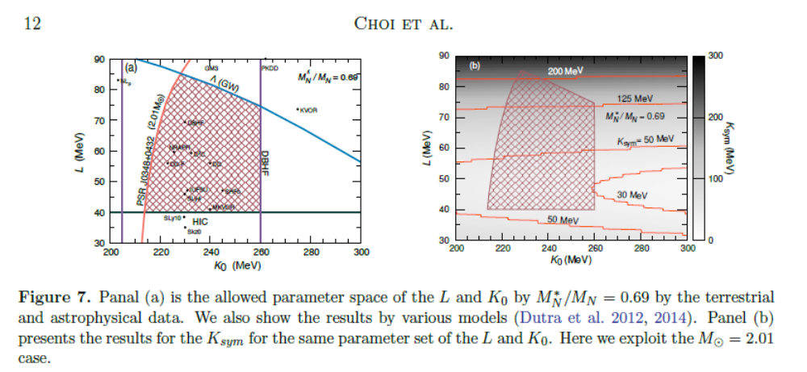
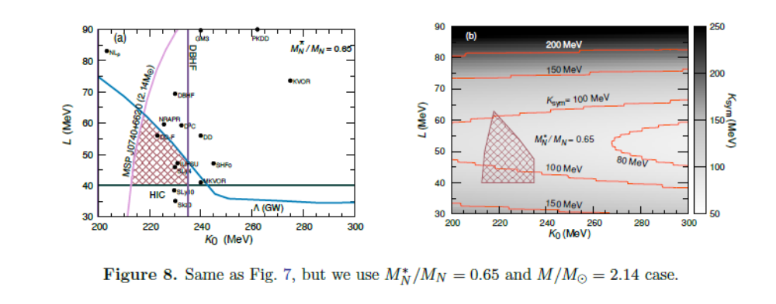

Slide 25
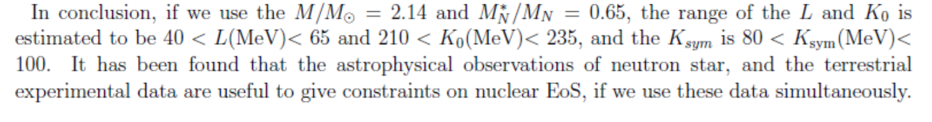
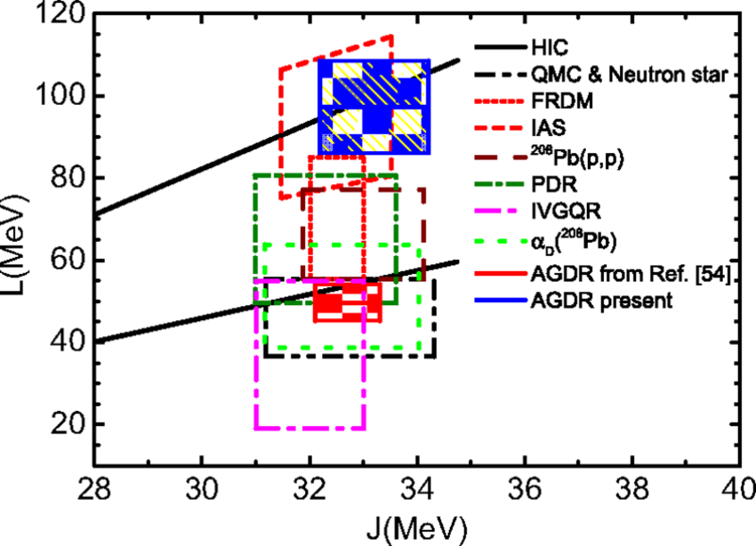
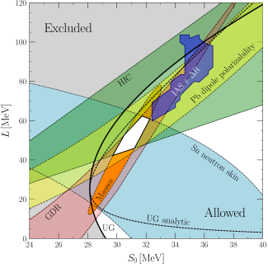

Slide 26
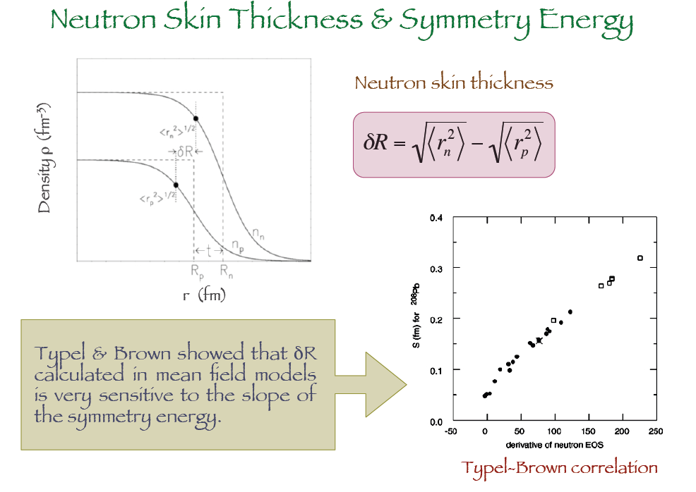
Neutron Skin Thickness (NST)
and Symmetry Energy

Slide 27
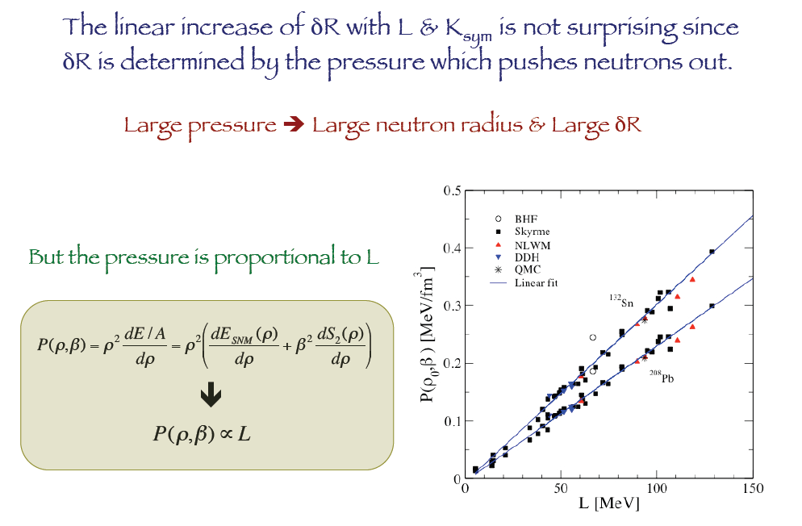
Linear increase of NST with L is not surprising
because the NST is determined by the pressure
which pushes neutron out.
Moreover, the pressure is given as

Slide 28
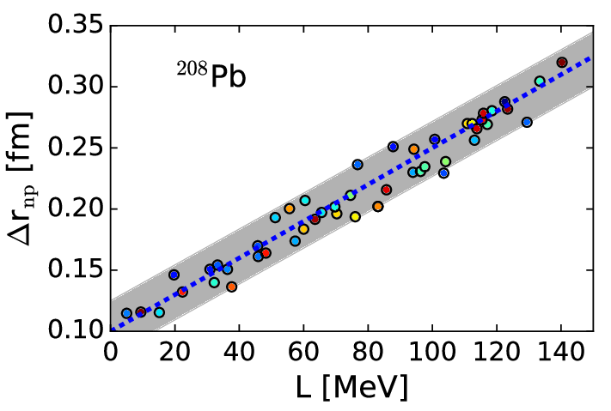

Slide 29
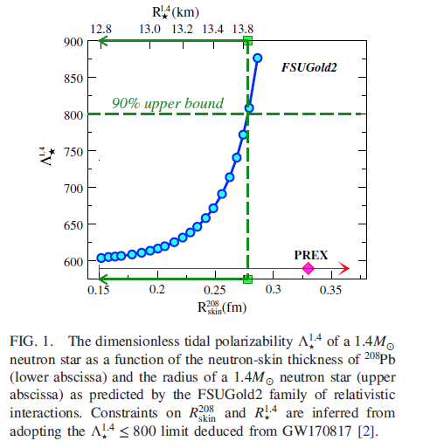
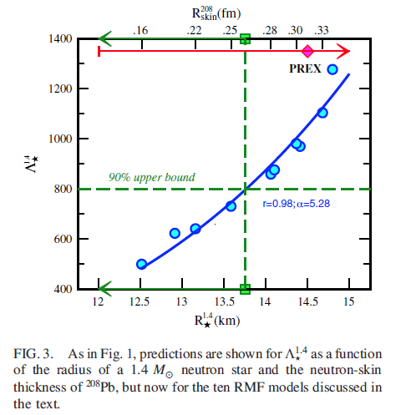
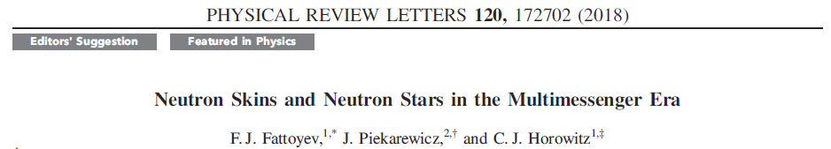
Eq. of State
Results by the Hybrid Model (SHF+TB)

Slide 30
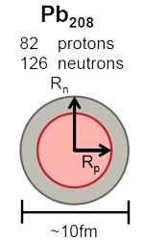
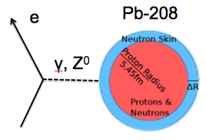
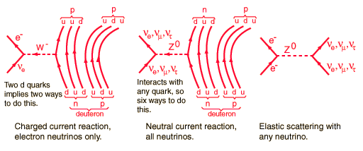
Outlook III : Neutron skin thickness by the neutrino beam
PREX I and II
Neutrino scattering could be the alternative of the NST measurement !!!

Slide 31

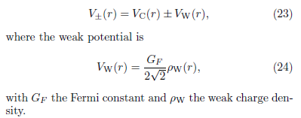
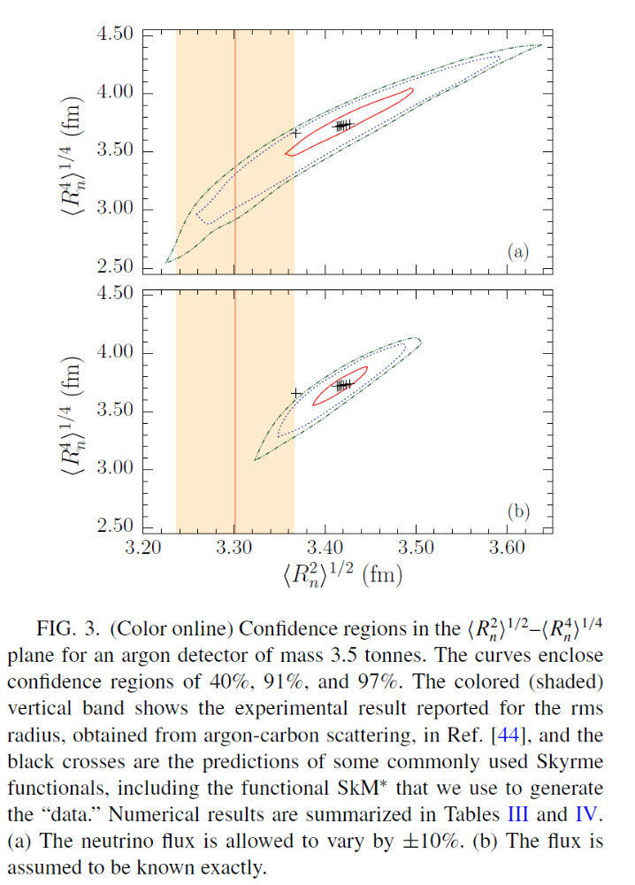




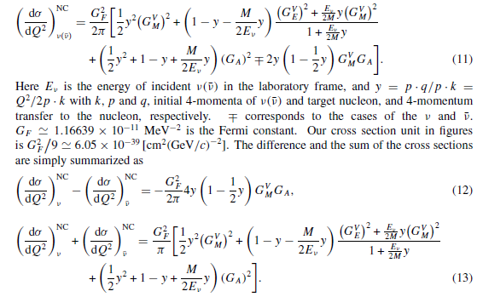
3. NST by Neutrino Scattering (Nu-N and Nu-A)
M.-K. Cheoun, J. Phys. G35 (2008) 065107
How about Nu-A scattering ?

Slide 32
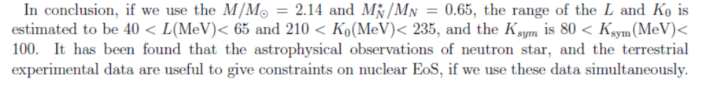
Dense Nuclear Matter
(Two Rabbits with One Shot)

Slide 33
Backup Files
Dense Nuclear Matter
(Two Rabbits with One Shot)

Slide 34
Nuclear Astrophysics In Plasma
(Nuclear Reactions in Lab. and Plasma)

Slide 36
Strong Magnetic Field Physics
(Physics in 10¹⁴⁻¹⁶ Gauss)

